Slide 1

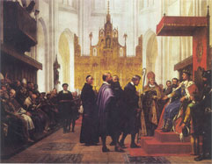
Search for NCG in hadronic Z decays
Julie Hougaard
Bachelor Project in Physics

Slide 2
Outline
Introduction
Theory
Methods
Results

Slide 3
Theory

Slide 4
Methods

Slide 5
Results

Slide 6
Conclusion

Slide 12


