Slide 1
Real Time Twitter Master by Joseph Fang Github: sherlockjjj/capstone

Slide 2

Motivation
Real Time Data Product
Machine Learning at Scale
Streaming Data
Horizontally Scalable
Low Cost for Iterative Development Cycles

Slide 3
Product Features
Real Time Web App Dashboard:
Sentiment Analysis
Tweets Search
Summary Statistics and Graphs
Message Alert
Daily Email Report
Weekly Model Updates
Airflow Monitoring

Slide 4






Real Time Data Flow
Events
Events Collector
Stream
Processing
Distributed
Store
Web Application
Bulk Storage

Slide 5
Real Time Web Application

Slide 6
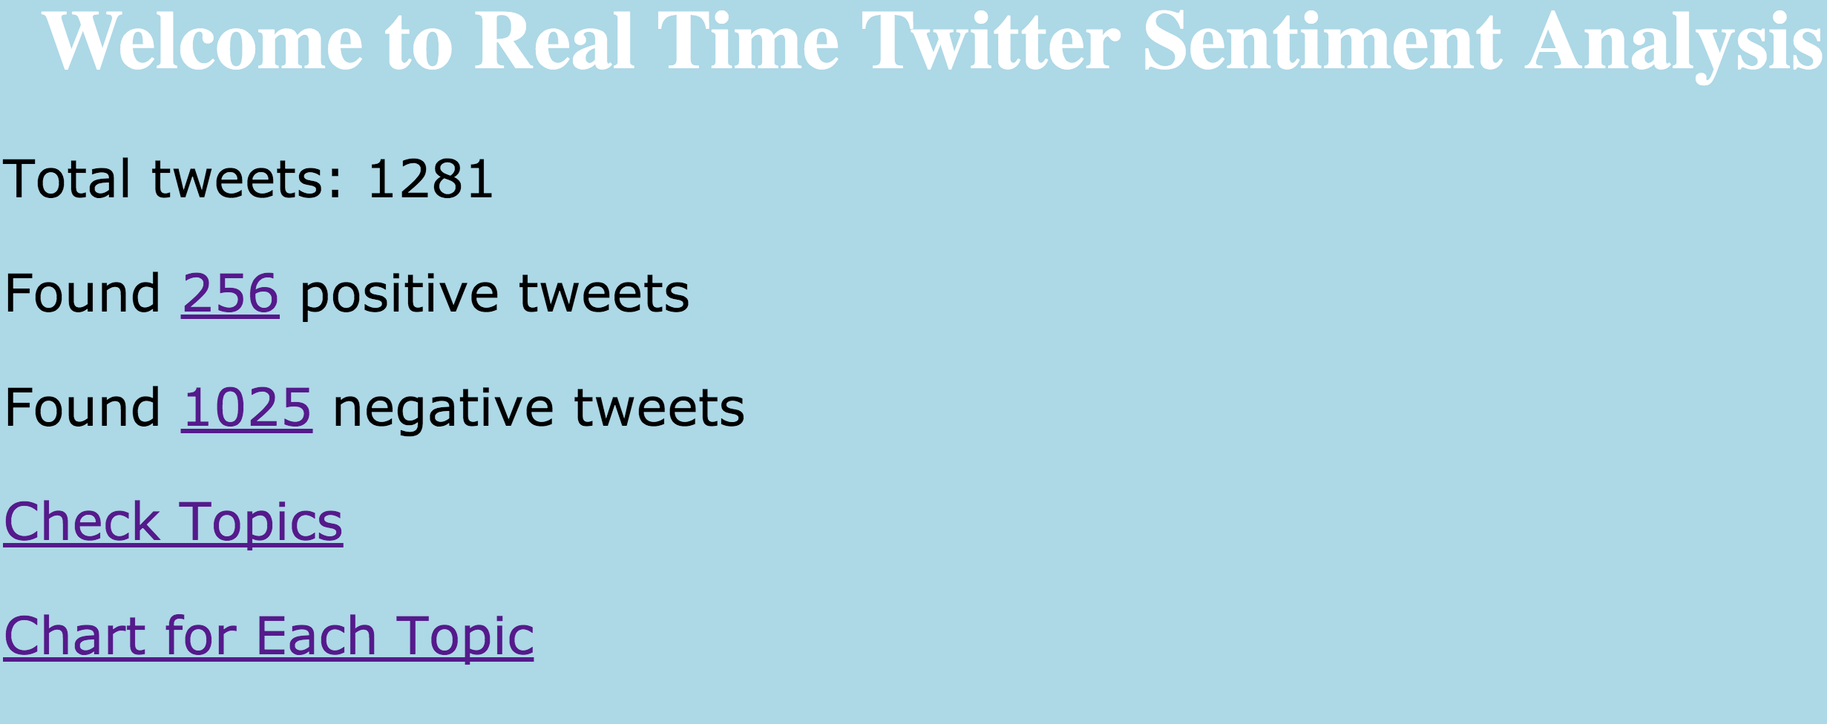
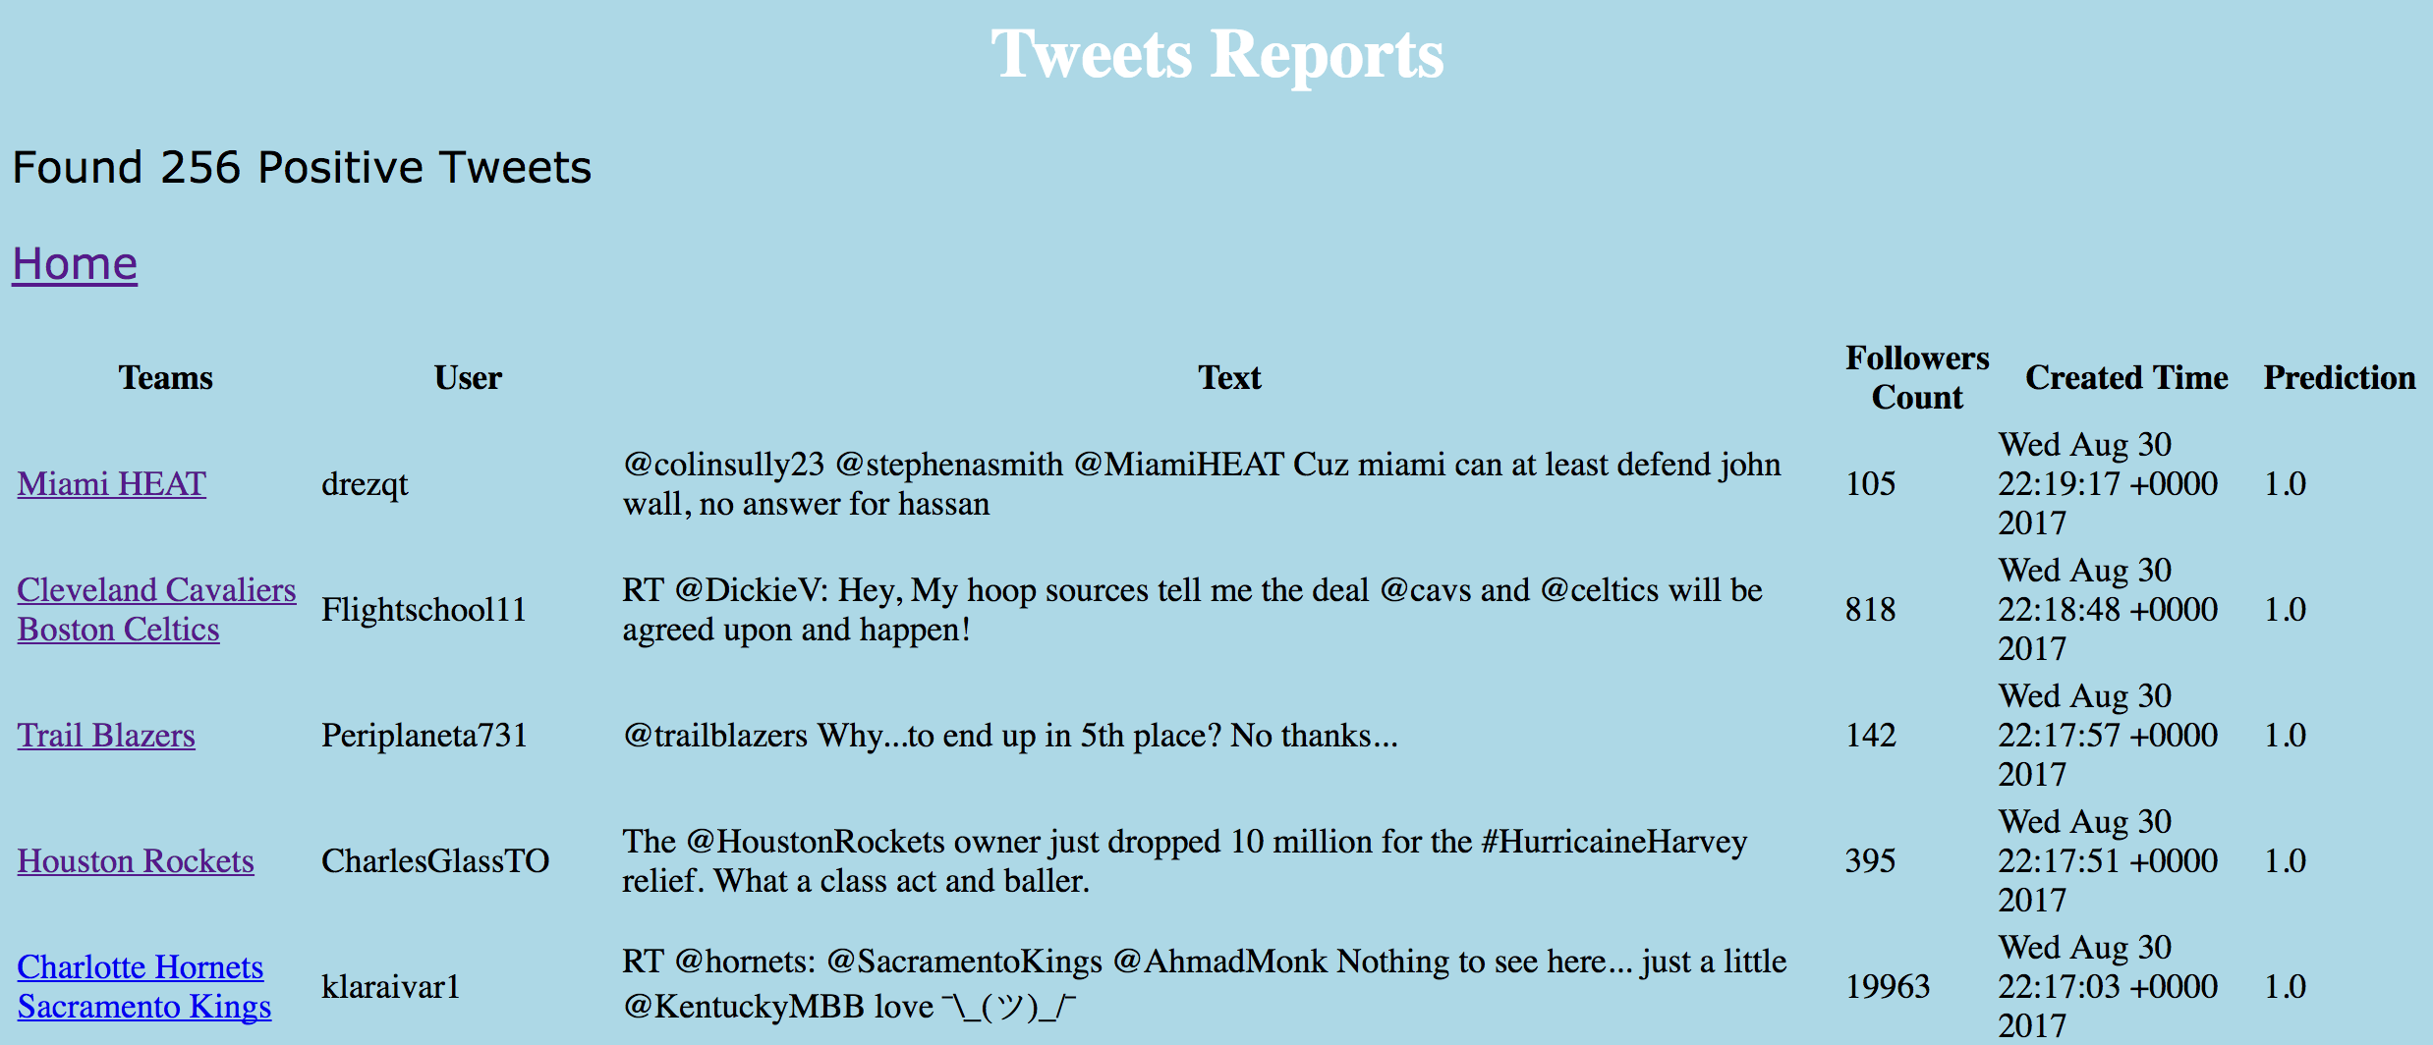
Home Page
Tweets Report

Slide 7
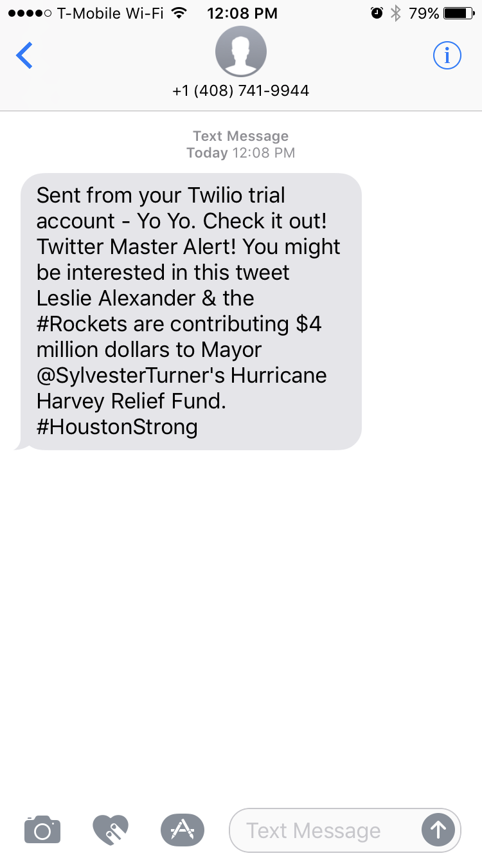
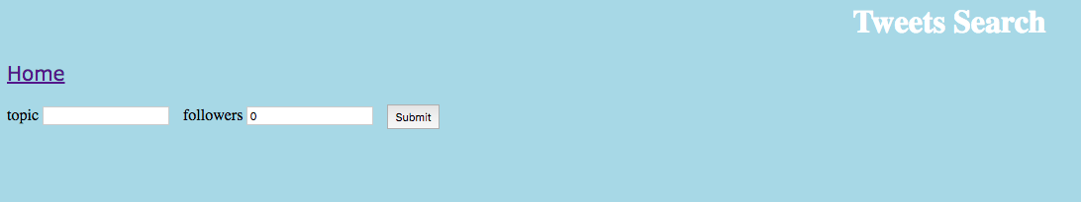
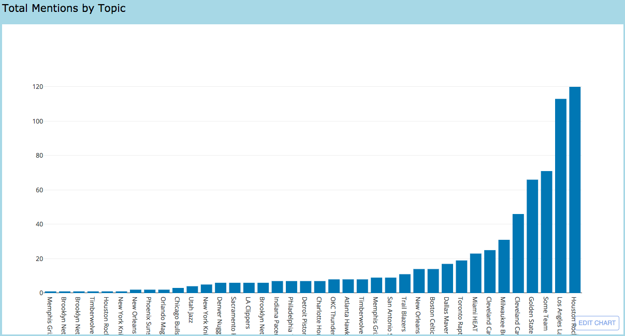
Tweets Search
Real Time Graphs
Message Alert

Slide 8
Model Training and Updates

Slide 9

Model Training and Updates
First Model Training
Hashing TF
IDF
Random Forest
Save Model
1 M+ tweets with label
Fetch Initial Dataset

Slide 10
Model Training and Updates
Weekly Updates
Save New Model
Fetch Updated Data

Slide 11
Daily Email Report

Slide 12
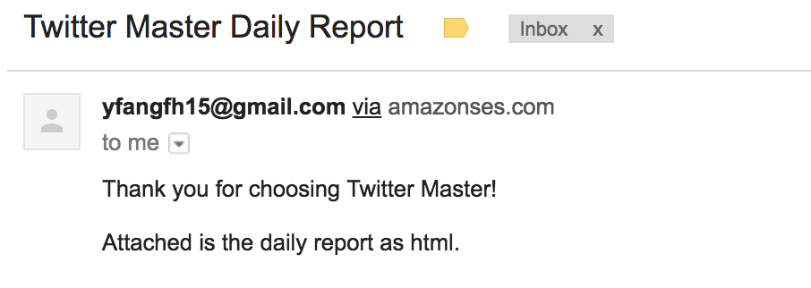
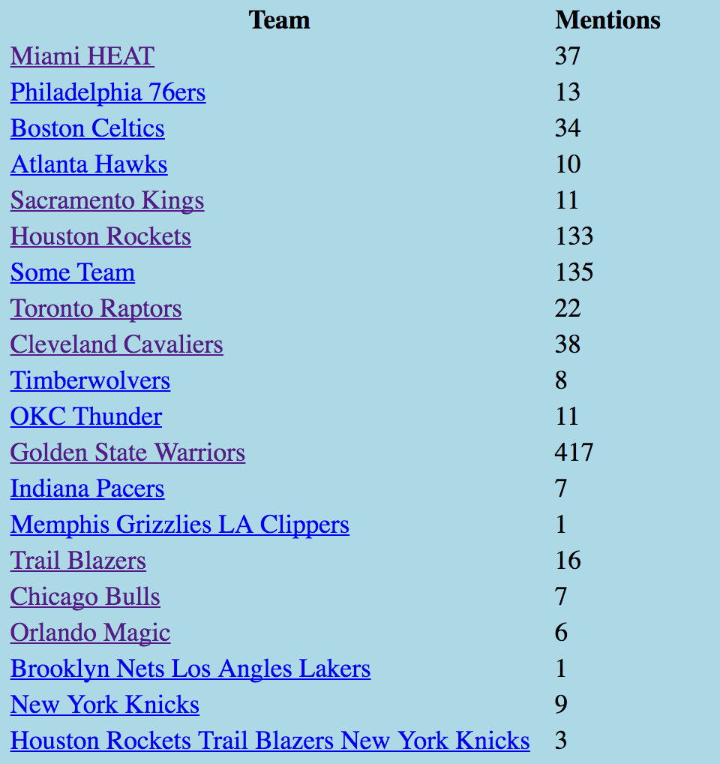
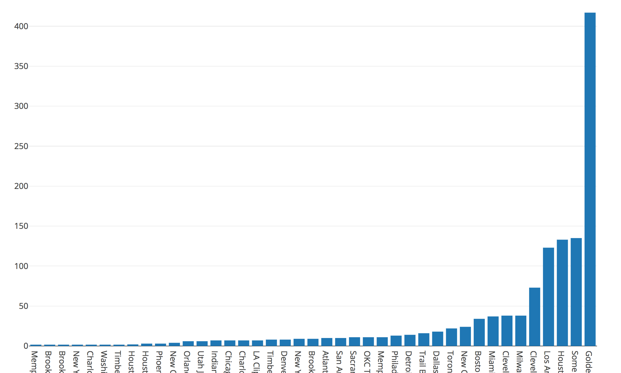
Current Version:
An email will be sent to the user via Amazon SES
The attachment is html format containing one graph and one table of the aggregate statistics

Slide 13
Tools
Spark Streaming, SQL, ML lib
Kafka
Flask
Airflow
MongoDB
AWS: EC2, EMR, S3, SES
Twilio
Plotly

Slide 14
Future Works
Integrate RNN for training model with tensorflow and spark
Better Data Preprocessing and Feature Extractions for Twitter Feeds
Apache Cassandra as more robust database
Elasticsearch
Multiple Data Sources
Mobile App

Slide 15
THANKS!
Any questions?
You can find me at
yfangfh15@gmail.com
Github: sherlockjjj/capstone

