Slide 1




NextHello: AI-Powered WhatsApp Outreach
Real-time multi-agent orchestration powered by OpenClaw reasoning and content generation — built for teams managing follow-ups who need consistency and scale.
Multi-Agent Swarm
OpenClaw Intelligence
WhatsApp-Native

Slide 2
Executive Summary
What the Platform Does
Business Outcomes
Ingests live WhatsApp conversations in real time
Orchestrates specialized AI agents across the full follow-up workflow
Uses OpenClaw for model inference and response generation
Persists every interaction for auditability and relationship sync
⚡ Faster Interaction Handling
🎯 Personalization at Scale
Automated first response in under 10 seconds
Context-aware messaging for every contact
🕐 Shorter Follow-Up Time
Contact prioritization to outreach without manual handoffs

Slide 3


The Problem with Today's Follow-Up Workflows
Slow Manual Response Cycles
Teams manually track follow-ups across WhatsApp, losing engagement to faster, automated interactions.
Inconsistent Contact Prioritization
Relationship quality depends on manual effort — not on a reliable, repeatable process.
Fragmented Tooling
Personalization, media delivery, and relationship data updates live in separate, disconnected tools.
Zero Automation Visibility
No clear audit trail of which follow-up action occurred, when, and why.
The need: One orchestrated system that reacts in real time, handles every follow-up workflow step, and logs everything for traceability.

Slide 4

Solution Architecture at a Glance
WhatsApp Ingest
API Router
CrewAI Swarm
OpenClaw LLM
Each layer has a single, well-defined responsibility — keeping the follow-up management system modular, observable, and easy to extend as requirements for relationship maintenance evolve.

Slide 5

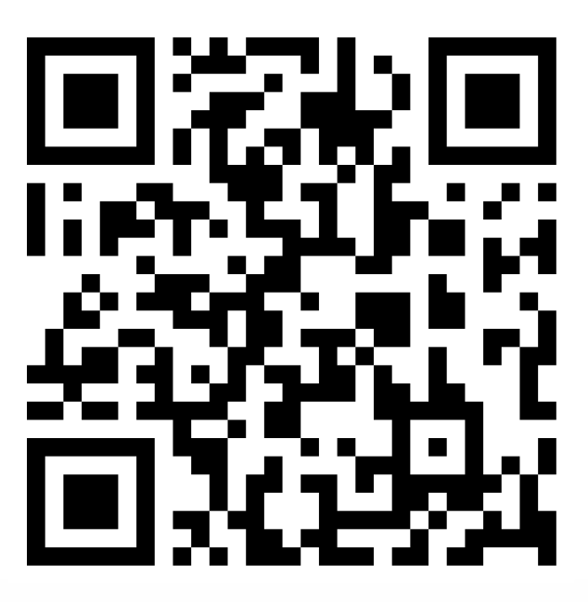
Live Demo !
305 427 7457
Please send a WhatsApp message to start.
Scan the QR code or add us on WhatsApp to experience NextHello live and revolutionize your follow-up workflows.

Slide 6




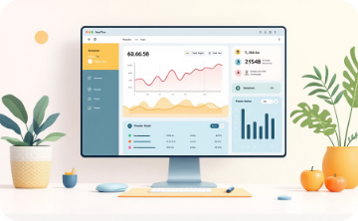
Core Components
WhatsApp Bridge
FastAPI Service
CrewAI Swarm
Data Layer
Message ingress and outbound delivery — the entry and exit point for every conversation.
Orchestration endpoints and admin APIs that normalize, validate, and route all events.
Autonomous agent lifecycle management — research, prioritize, personalize, and relationship-update in parallel.
PostgreSQL for durable history. Redis for low-latency swarm state. Both always in sync.
Admin UI
React + ReactFlow + SSE live stream for real-time orchestration visualization.

Slide 7
KEY SLIDE
How NextHello Talks to OpenClaw
Inference Request Flow
What OpenClaw Powers
01
🧠 Contact Prioritization
✍️ Personalized Messaging
Message Arrives
Contact message received from WhatsApp; coordinator emits event to relevant agent.
Engagement scoring and routing logic generated per conversation
Dynamic message copy tailored to contact context
02
Context Assembly
📋 Content & Script Generation
Agent builds prompt from conversation state + contact enrichment fields.
Agent-authored follow-up scripts and interaction sequences
03
OpenClaw Inference
Request routed via CrewAI LLM(model=...) using shared LLM_PROVIDER config.
04
Parse + Emit
Structured or free-form output drives contact prioritization, messaging, or relationship updates — then propagates downstream.

Slide 8
End-to-End Inference Loop with OpenClaw
/https://youtu.be/qtVW4goCNnk
Every inference call is traceable end-to-end — from the raw WhatsApp message to the final database update — enabling complete auditability across the automation loop for relationship management.

Slide 9

Real-Time Observability Built In
What You Can See
Why It Matters
Live SSE stream feeds dashboard updates as events occur
ReactFlow graph shows coordinator, agents, and active contacts
Agent activity log captures status, action, timing, and correlation IDs
Swarm state snapshots support replay and troubleshooting
🔍 Faster Debugging
Pinpoint failures in the event chain instantly
🤝 Better Trust
Teams can verify follow-up automation behavior without reading logs
🔄 Easier Handoff
Engineering and ops share a single source of truth for relationship management

Slide 10


KPIs, Roadmap & Next Steps
Target KPIs
Roadmap
First-Response Latency
0–30 Days
1
Target: under 10 seconds from inbound message to automated action
Harden OpenClaw retry/fallback · Improve SSE stream granularity · Richer ReactFlow drill-down
2
30–90 Days
Prioritization Completion Rate
Multi-provider routing policy · Automated prompt QA · Advanced follow-up workflow automation
Percentage of contacts categorized without human intervention
Engagement-to-Resolution Rate
Managed contacts advancing to successful resolution
Impact goal: Increase follow-up completion rate while reducing manual effort per contact.

Slide 11

Why NextHello Wins
Real-Time Orchestration
Multi-agent swarm reacts in seconds, not minutes
Full Observability
Every action logged, visualized, and replayable
OpenClaw Intelligence
Centralized LLM layer — swap models without rewriting logic
Measurable Outcomes
Follow-up completion rate up, manual effort per contact down
✅ Approve Pilot Scope
📊 Define KPI Baseline
🚀 Launch Phased Rollout

Slide 12
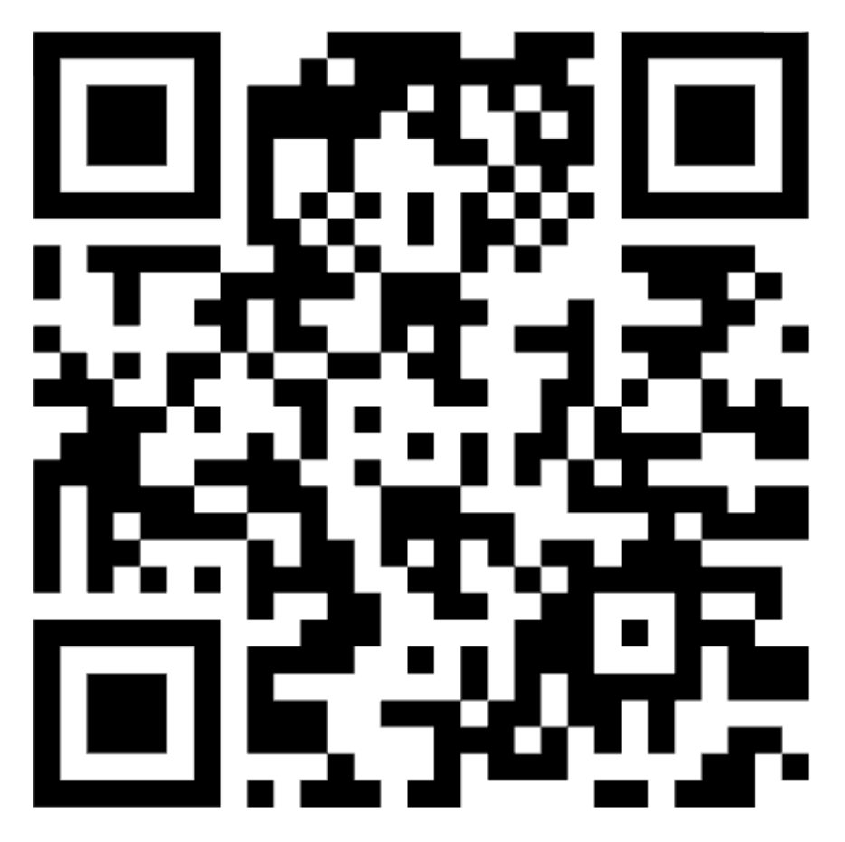
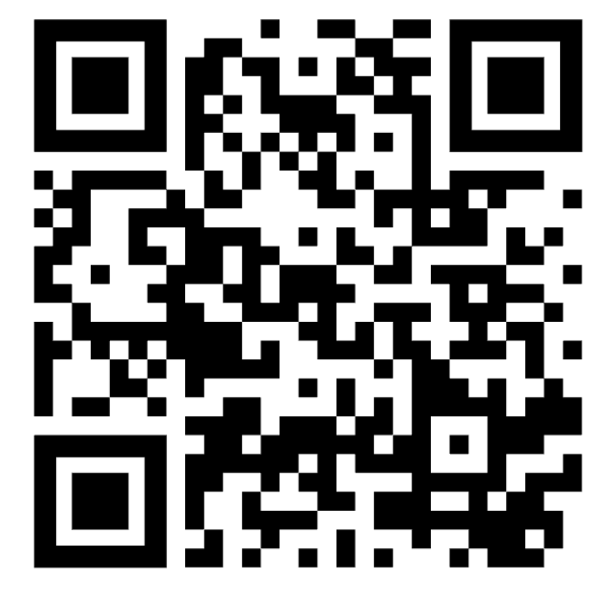

Explore the architecture, contribute, or deploy your own instance of NextHello.
https://github.com/askmikeai/next-hello
Stay in Touch
Phone
Email
305 427 7457
askmikeai@gmail.com
X (Twitter)
Instagram
@askmikeai
@askmikeai
TikTok
@askmikeai

