Slide 1
Eternal Tec
Assignment 4
Web Technologies
Group 6

Slide 2
Collections
Cart
Comments
Product
Sales
User

Slide 3
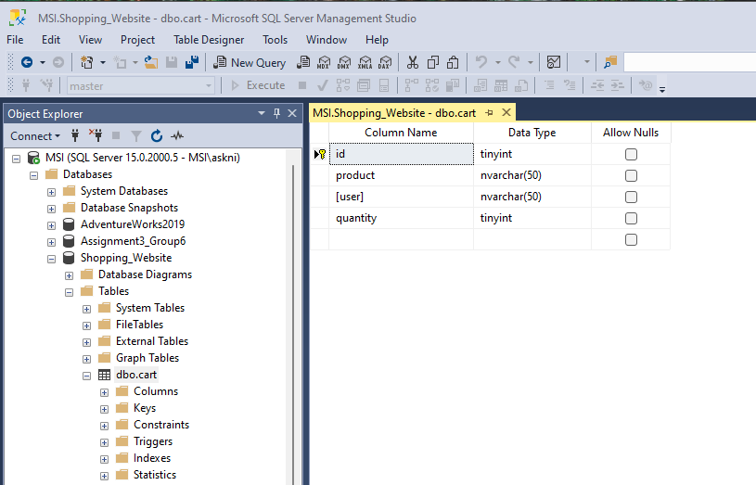
CART

Slide 4
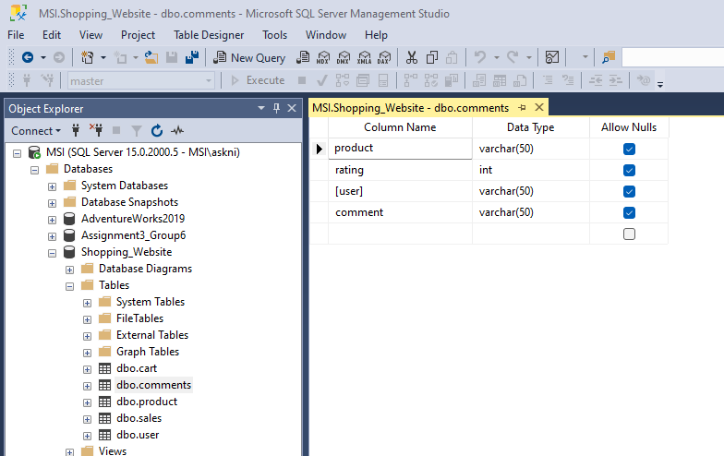
comments

Slide 5
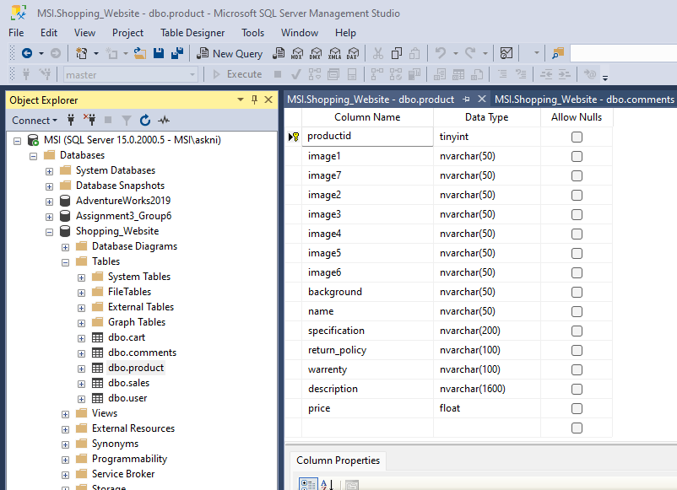
Products

Slide 6
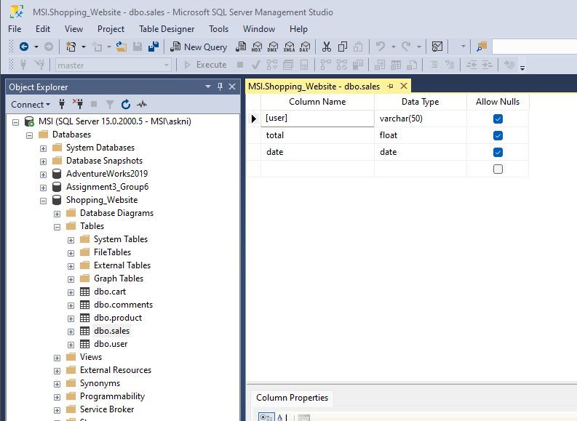
Sales

Slide 7
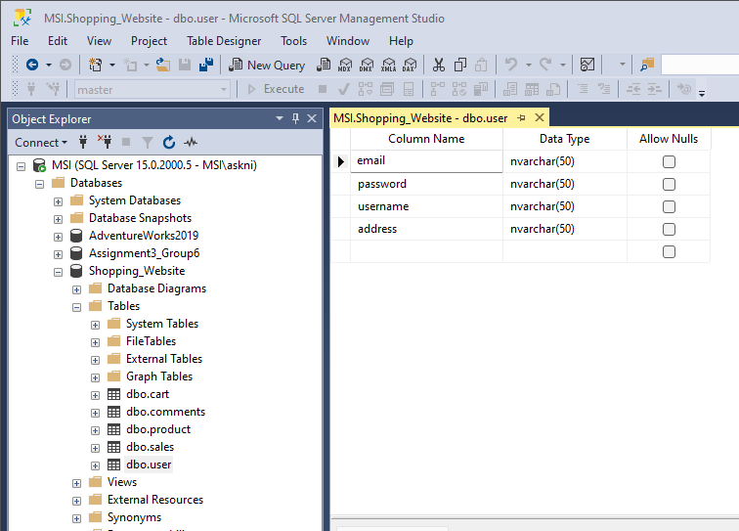
User

Slide 8
API Design
API | Input | Output | Function
addComment | user, comment, rating, product | Comment added to table | Add users comment into comment table
fetchComment | product | comments | To fetch comments on a product
product | - | products | To fetch all the product details
user | name, password | Boolean | To check the login credentials

Slide 9
POSTMAN

Slide 10
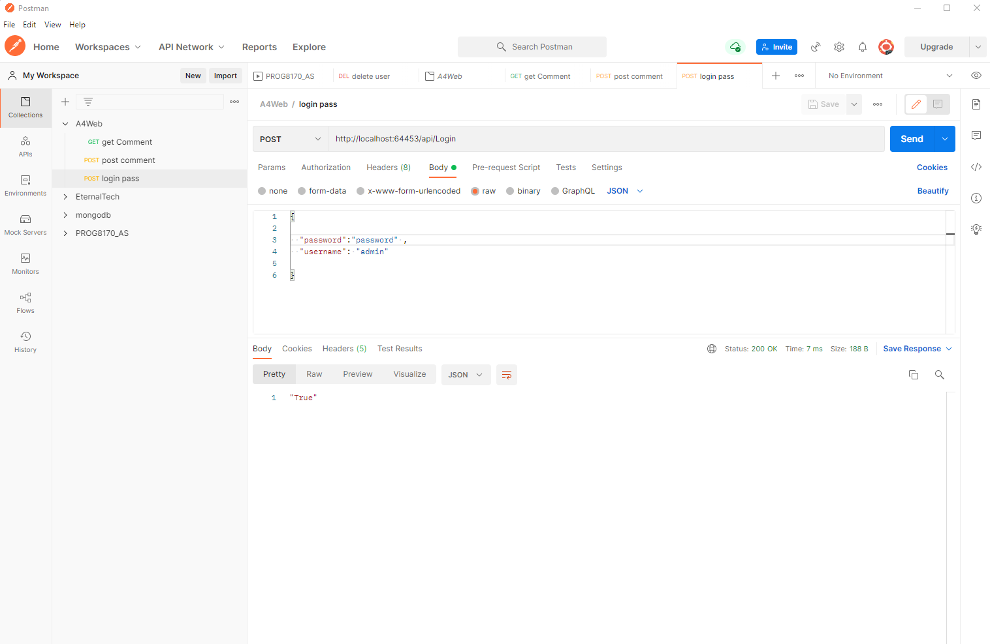
login - pass

Slide 11
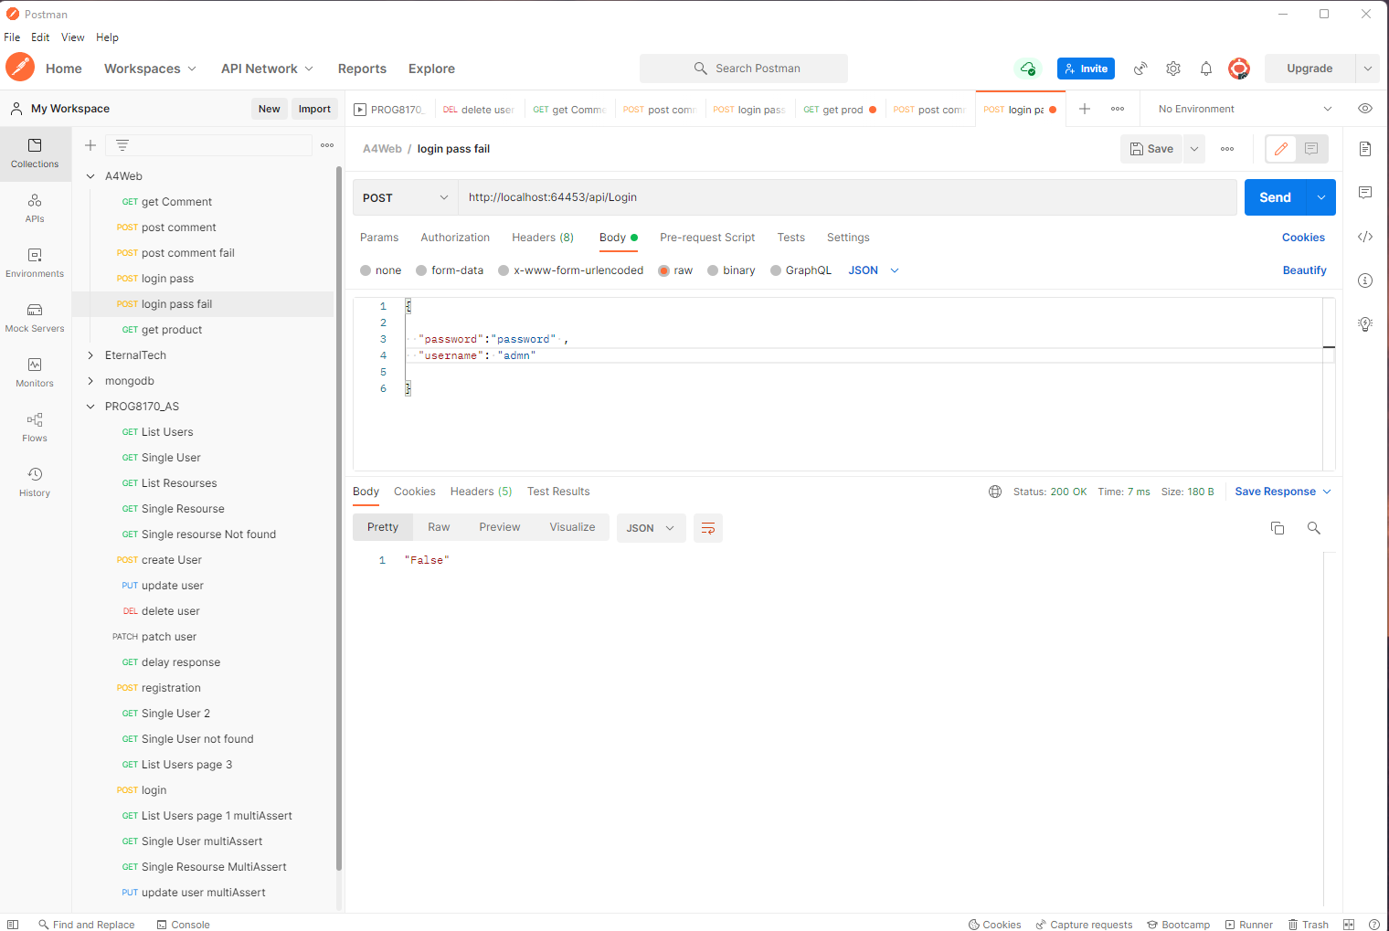
login - fail

Slide 12
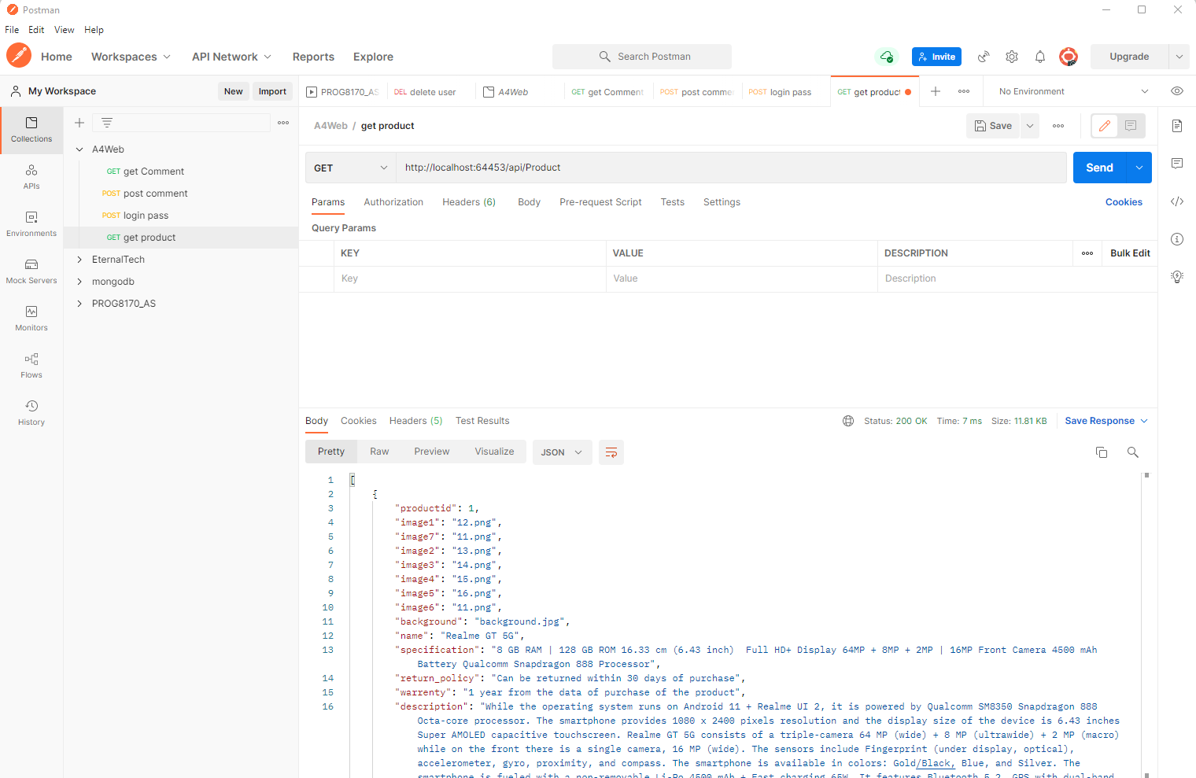
VIEW PRODUCT

Slide 13
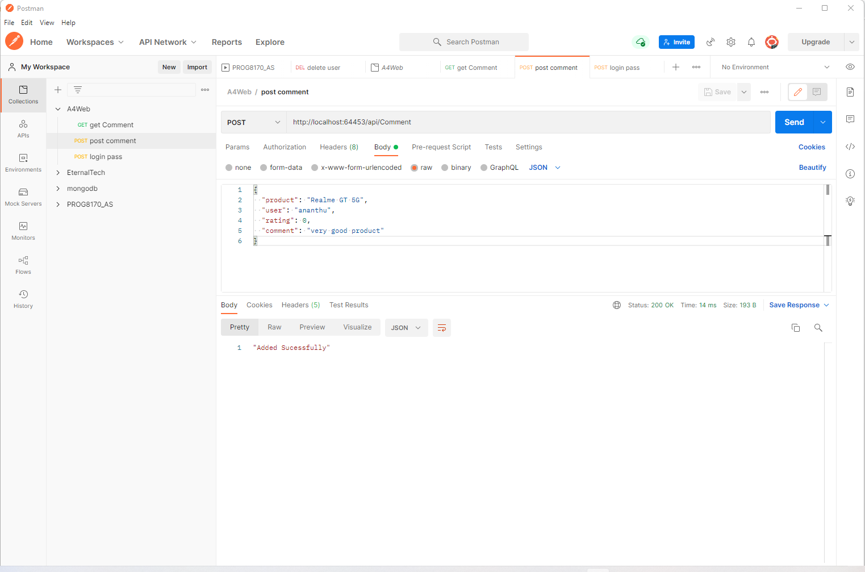
POST COMMENT - pass

Slide 14
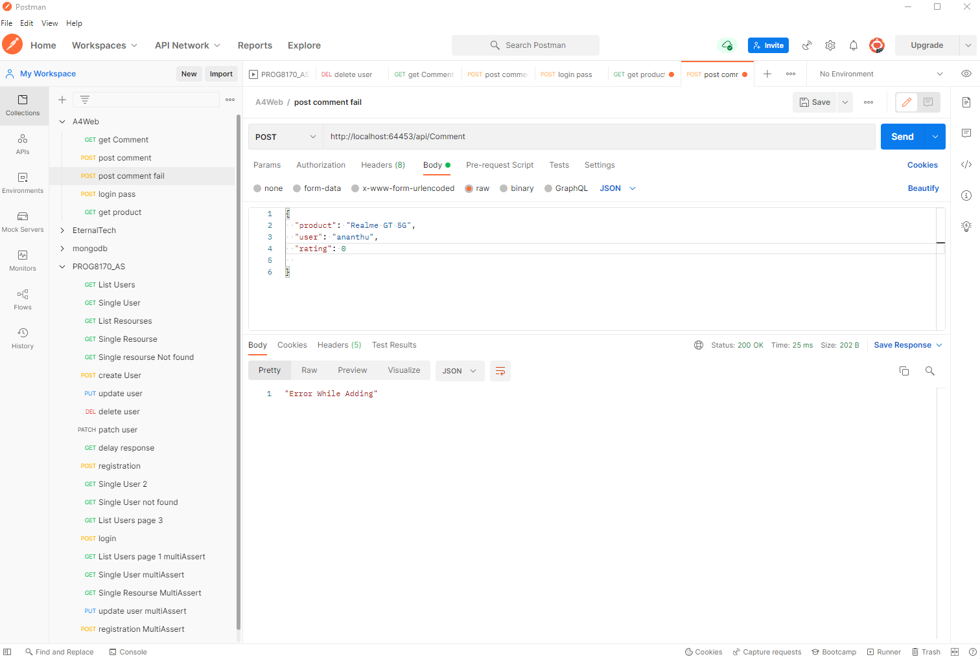
POST COMMENT - FAIL

Slide 15
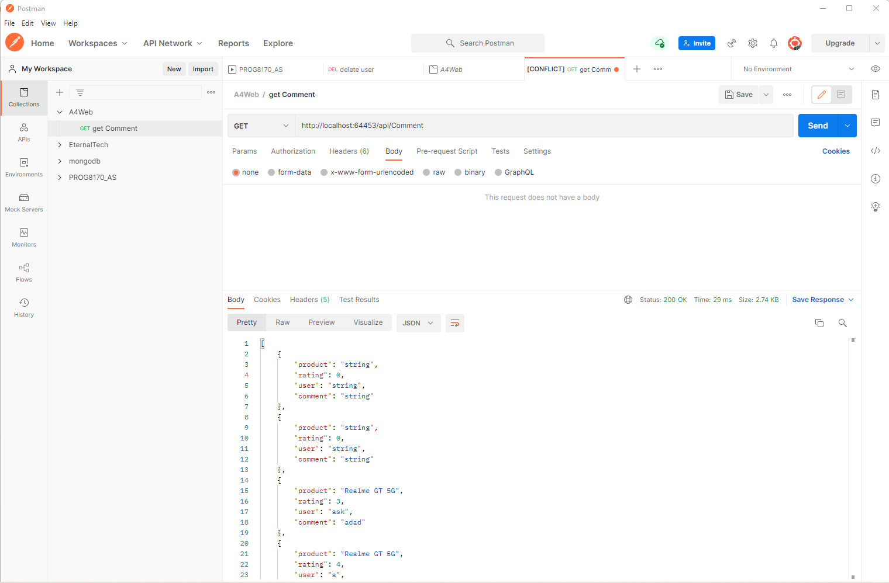
View Comment

Slide 16
DEMO

Slide 17
Thank You

