Slide 1
Windows Azure IaaS Virtual Machines ,Virtual Networks & Application Gateway
Raju Kumar
Embee Software Pvt Ltd.

Slide 2
Microsoft Azure
Microsoft Azure is a cloud Platform that Developers and IT Professionals use to build, deploy and manage the Applications on the Global network of Microsoft.

Slide 3
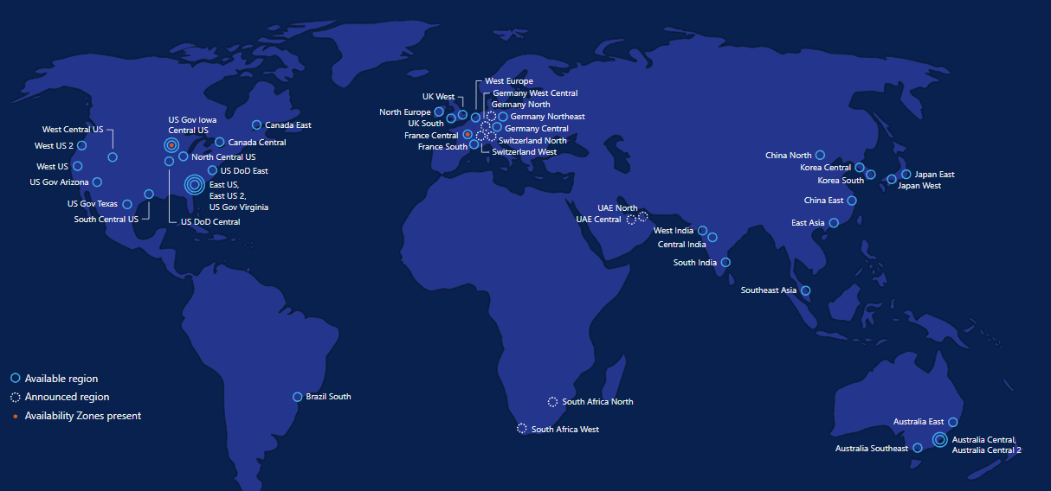
Azure Datacenter’s 50 Regions Worldwide
Notes:
Azure Regions
Azure has more global regions than any other cloud provider—offering the scale needed to bring applications closer to users around the world, preserving data residency and offering comprehensive compliance and resiliency options for customers.
Total 50 regions world wide.

Slide 4
Azure Benefit's
Flexibility: Use the scalability of the Microsoft cloud to grow your business on-demand and only pay for what you consume
Security: Microsoft uses the security development lifecycle, ensuring the Azure cloud platform and your data is secure. Even if company laptops and computers are lost or stolen
Competitiveness: By using the most up to date cloud technology you will have the ability to build, test and deploy infrastructure and applications faster
Disaster Recovery: Create a DR strategy that will allow you to safe guard data and applications and ensure that your users and customers will never be off-line.
Automatic Software Updates: Using the Azure cloud means your updates are deployed in real-time with 100% uptake.
Work from Anywhere: Using the cloud enables your workforce to access documents and applications from around the globe.
Reduce Capital Expenditure: Cut costs and create a predictable ongoing Op-Ex by using the Azure cloud.

Slide 5
Windows Azure Virtual Machines
Support for key server applications
Easy storage manageability
High availability features
Advanced networking
Integration with compute PaaS
If it requires a developer, it’s not IaaS
Notes:
Windows Azure Virtual Machines and Virtual Networks support adds the capability to run key server applications and workloads such as Active Directory, SharePoint, SQL Server and most applications that run on a Virtual Machine today.
Adding storage capacity is simple. Either through the portal or PowerShell add up to 64TBs of storage on an X-Large VM.
Virtual machines allows you to the option of splitting virtual machine loads across multiple racks in the data center using availability sets.
Virtual Networks provide the capability of connecting the Virtual machines securely to your on-premises network
Application migration is much simpler. In most cases the app will just run without changes on a virtual machine.

Slide 6
Images
OS Images
Microsoft
Partner
User
Base OS image for new Virtual Machines
Sys-Prepped/Generalized/Read Only
Created by uploading or by capture
Disks
OS Disks
Data Disks
Writable Disks for Virtual Machines
Created during VM creation or during upload of existing VHDs.

Slide 7
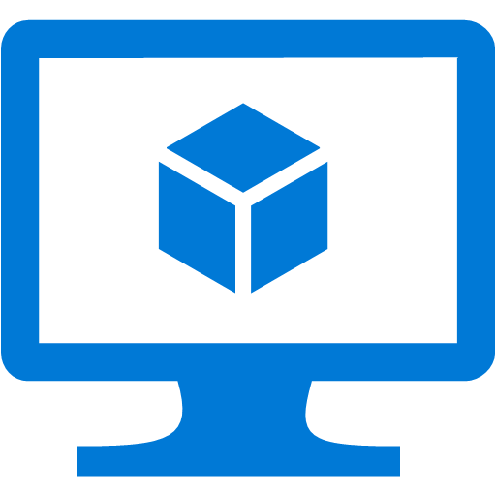

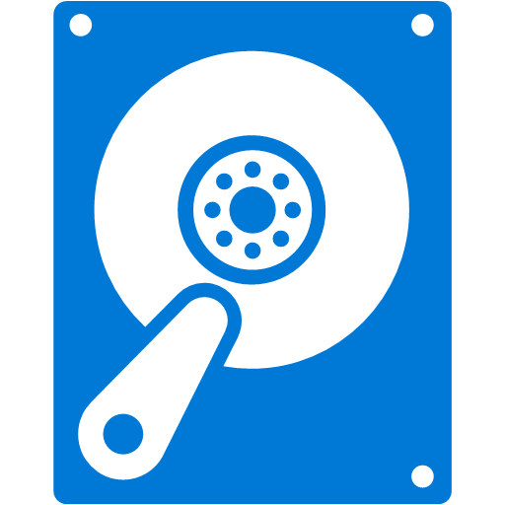
Azure Disks
Performance Tiers
Management Options
Resource Group
Resource Group
Standard Storage Account
Premium Storage Account
Premium Disks (SSD)
Standard Disks (HDD)
Managed Disks
Unmanaged Disks
/Page Blob
Premium Disks: SSD based, provisioned performance
Standard Disks: HDD based, cost effective
Managed Disks: highly available & manageable
Unmanaged Disks: legacy with Storage Account

Slide 8
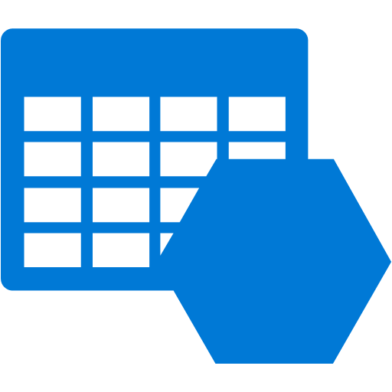
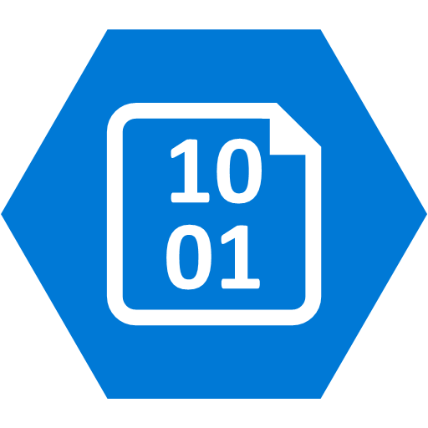

Managed Disk Overview
Managed by Azure
Unmanaged Disks with Storage Accounts
Storage Account 0
OS Disk
Storage Account 1
Azure VMs
Data Disk
Managed Disks

Slide 9
Availability/Scalability
Availability
Managed Disk GA
Azure Site Recovery(ASR) supports Managed Disks
Single VM SLA for VMs using Premium Disks
Scalability
Larger Premium and Standard Disks 2TB & 4TB
Smaller Premium Disks 32GB & 64GB
Security
Encryption at Rest with Microsoft Keys

Slide 10
Standard Disk /Premium Disk
Standard Disk Type | S4 | S6 | S10 | S20 | S30 | S40 | S50
Disk size | 32 GB | 64 GB | 128 GB | 512 GB | 1024 GB (1 TB) | 2048 GB (2TB) | 4095 GB (4 TB)
IOPS per disk | 500 | 500 | 500 | 500 | 500 | 500 | 500
Throughput per disk | 60 MB/sec | 60 MB/sec | 60 MB/sec | 60 MB/sec | 60 MB/sec | 60 MB/sec | 60 MB/sec
Premium Disks Type | P4 | P6 | P10 | P20 | P30 | P40 | P50
Disk size | 32 GB | 64 GB | 128 GB | 512 GB | 1024 GB (1 TB) | 2048 GB (2 TB) | 4095 GB (4 TB)
IOPS per disk | 120 | 240 | 500 | 2300 | 5000 | 7500 | 7500
Throughput per disk | 25 MB/sec | 50 MB/sec | 100 MB/sec | 150 MB/sec | 200 MB/sec | 250 MB/sec | 250 MB/sec

Slide 11
Virtual Machine Availability

Slide 12

Service Level Agreements
99.95% for multiple role instances
4.38 hours of downtime per year
99.9% for single role instances
8.75 hours of downtime per year
What’s included
Compute Hardware failure (disk, cpu, memory)
Datacenter failures - Network failure, power failure
Hardware upgrades, Software maintenance – Host OS Updates
What is not included
VM Container crashes, Guest OS Updates

Slide 13

How Does this Relate to SLA?
Availability set
Virtual Machine
Virtual Machine
Virtual Machine
SQL Server
SQL Server
Primary
SQL Server
Secondary
No SLA
SLA 99.95

Slide 14
Fault and Update Domains
Fault Domains
Represent groups of resources anticipated to fail together
i.e. Same rack, same server
Fabric spreads instances across fault at least 2 fault domains
Update Domains
Represents groups of resources that will be updated together
Host OS updates honour service update domains
Specified in service definition
Default of 5 (up to 20)
Fabric spreads role instances across Update Domains and Fault Domains

Slide 15
Getting Started with Virtual Machines

Slide 16



Cloud First Provisioning
Getting Started
Select Image and VM Size
New Disk Persisted in Storage
Windows Server
Management Portal
Boot VM from New Disk
Linux
>_
Blob Storage
Extra Small
Small
Medium
Large
X-Large
Scripting
(Windows, Linux and Mac)
Cloud
REST API
Notes:
Slide Objective:
Explain workflow for provisioning VMs in the cloud
Notes:
Cloud First Provisioning means exactly what is says. Building a VM in the cloud first.
You have three methods of starting this process: Build a VM from the portal, from the command line OR programmatically calling the REST API.
Once your choice of provisioning is made you will need to select the image and instance size to start from.
The newly created disk will be stored in blob storage and your machine will boot.

Slide 17
Bring Your Own Server/VHD
On-Premises
Cloud
MyApp.vhd
On Premises Virtual Server
Provision VM from Image or Disk using portal, script or API
Use Case
.Migration of VMs
.Sys Prepped Images
VHD Must Be Fixed Disk
* Converted by PowerShell
Blob Storage
Upload VHD
Create Disk or
Image
Notes:
Slide Objective:
Explain workflow for bringing your own VHD
Notes:
This use case is when you already have a “golden image(s)” your company uses for server provisioning or you have a VM running on premises that you would just like to run in our data center. You take the vhd – and use storage explorer or PowerShell to upload as a page blob to a storage account. From there use the portal to add as an image (sysprepped) or disk (configured VM) and there you can create a VM based off of the vhd.

Slide 18
Imaging VMs in the Cloud
Cloud
Blob Storage
Identical/similar deployment instances using common OS image as start
Base. VHD
Boot
VM
Blob Storage
Customize
VHD
Generalize
VHD
Capture
VM
Capture VM Saves Customized Image to Your Image Library
Notes:
Slide Objective:
Explain workflow for creating a custom image in the cloud
Notes:
This use case is all about using the capture feature of IaaS to create OS images. The first part you start with a base vhd that you then custom with software binaries, registry settings etc.. You run sysprep.exe and generalize/shutdown the OS. You can then upload it if coming from on-premises or just click the capture button if you created the VM in the cloud.
Capture allows you to take a generalized VM and save the underlying VHD as a new image in your image library.

Slide 19
Image Mobility
On-Premises
Cloud
Blob Storage
MyApp.vhd
Notes:
Slide Objective:
Explain the benefits of image mobility
Notes:
One of the key benefits of IaaS is flexibility and control. The Windows Azure solution provides the capability of not only moving VHDs TO the cloud but also allows you to copy the VHD back down and run it locally or on another cloud provider. Great for testing out production issues or any other need where you require a copy of the production server.

Slide 20
DEMO :

Slide 21
Windows Azure Networking
Notes:
Azure Virtual Network enables many types of Azure resources, such as Azure Virtual Machines (VM), to securely communicate with each other, the internet, and on-premises networks. Azure Virtual Network provides the following key capabilities:

Slide 22
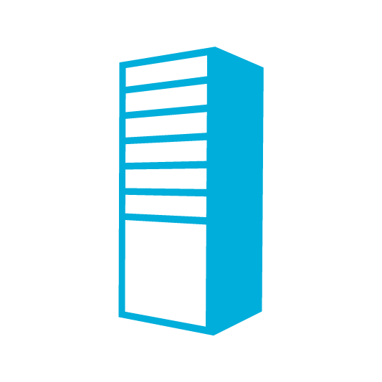

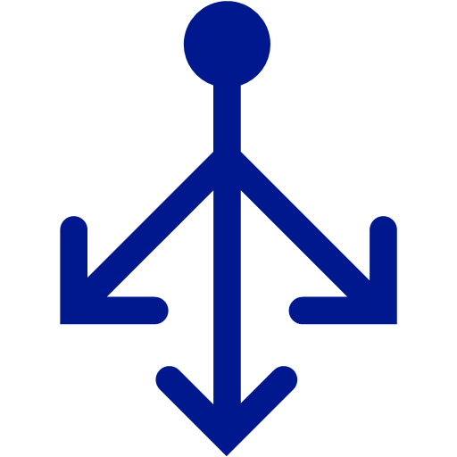
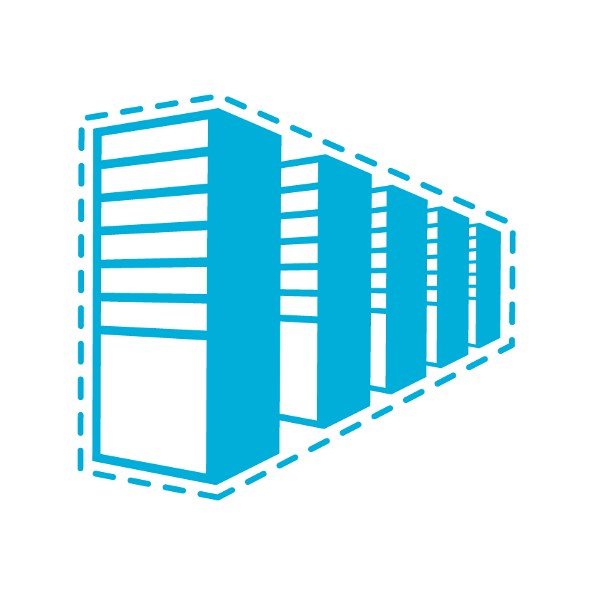

Azure Virtual Network
Internet
Bring your own network
Logical isolation with control over network
Create subnets with your private or public IP address spaces
Bring your own DNS or use Azure-provided DNS
Secure VMs with Network Security Groups
Run highly available internal services behind internal load balancer
Direct Internet
Connectivity
Virtual Network
Azure Infra
Network Security Group
DNS
WEB SERVER
AD
FE Subnet
Azure Internal LB
APP SERVERS
DB SERVERS
BE Subnet
Notes:
Azure Virtual Network enables many types of Azure resources, such as Azure Virtual Machines (VM), to securely communicate with each other, the internet, and on-premises networks.
Isolation and segmentation:- You can implement multiple virtual networks within each Azure subscription and Azure region. Each virtual network is isolated from other virtual networks. For each virtual network you can:
Extend your on-premises AD with using your own DNS.

Slide 23
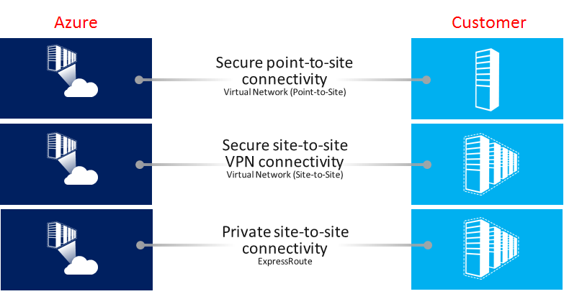
VPN in Azure Introduction
Notes:
Communicate with on-premises resources:-
Site-to-Site – VPN connection over IPsec (IKE v1 and IKE v2). This type of connection requires a VPN device or RRAS.
.
Point-to-Site – VPN connection over SSTP (Secure Socket Tunneling Protocol) or IKE v2. This connection does not require a VPN device.
VNet-to-VNet – This type of connection is the same as a Site-to-Site configuration. VNet to VNet is a VPN connection over IPsec (IKE v1 and IKE v2). It does not require a VPN device..
Multi-Site – This is a variation of a Site-to-Site configuration that allows you to connect multiple on-premises sites to a virtual network.
ExpressRoute – ExpressRoute is a direct connection to Azure from your WAN, not a VPN connection over the public Internet.

Slide 24
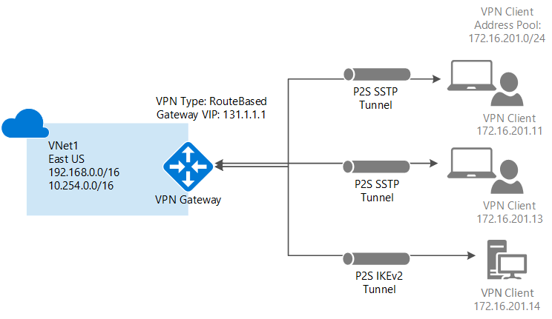
Point to Site VPN in Azure
Notes:
Point-to-site virtual private network (VPN): Established between a virtual network and a single computer in your network. Each computer that wants to establish connectivity with a virtual network must configure its connection. This connection type is great if you're just getting started with Azure, or for developers, because it requires little or no changes to your existing network. The communication between your computer and a virtual network is sent through an encrypted tunnel over the internet.

Slide 25
VPN Gateway Types/Sku’s
1. Static Routing = PolicyBased, Supports Ike,V1 and supports Basic SKU only
2. Dynamic Routing = Route Based, Supports Ike,V2
SKU | S2S/VNet-to-VNet Tunnels | P2S Connections | Aggregate Throughput Benchmark
VpnGw1 | Max. 30 | Max. 128 | 650 Mbps
VpnGw2 | Max. 30 | Max. 128 | 1 Gbps
VpnGw3 | Max. 30 | Max. 128 | 1.25 Gbps
Basic | Max. 10 | Max. 128 | 100 Mbps
Notes:
With Static Routing we can only connect 1 Site whereas with Dynamic Routing we can connect upto 30 Sites.

Slide 26
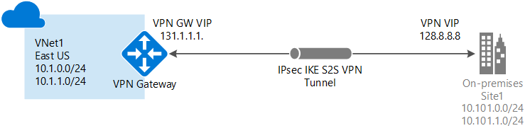
Site To Site VPN.( Cross Premises Network)
Notes:
Site-to-site VPN: Established between your on-premises VPN device and an Azure VPN Gateway that is deployed in a virtual network. This connection type enables any on-premises resource that you authorize to access a virtual network. The communication between your on-premises VPN device and an Azure VPN gateway is sent through an encrypted tunnel over the internet
VPN Gateway:- A VPN gateway is a specific type of virtual network gateway that is used to send encrypted traffic between an Azure virtual network and an on-premises location over the public Internet. You can also use a VPN gateway to send encrypted traffic between Azure virtual networks over the Microsoft network. Each virtual network can have only one VPN gateway. However, you can create multiple connections to the same VPN gateway. When you create multiple connections to the same VPN gateway, all VPN tunnels share the available gateway bandwidth.
Requirements to configure Site to Site VPN:-
1. Make sure you have a compatible VPN device and someone who is able to configure it. For more information about compatible VPN devices and device configuration.
2. If you are unfamiliar with the IP address ranges located in your on-premises network configuration, you need to coordinate with someone who can provide those details for you. When you create this configuration, you must specify the IP address range prefixes that Azure will route to your on-premises location. None of the subnets of your on-premises network can over lap with the virtual network subnets that you want to connect to.

Slide 27
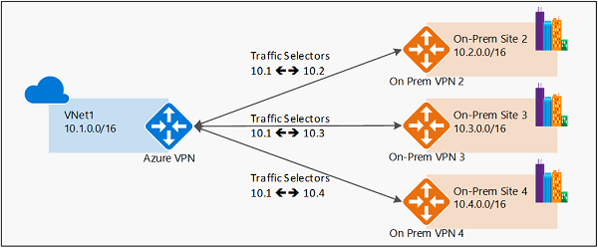
Multi-Site VPN in Azure
Notes:
You Can configure the Multi-Site VPN with Route Based VPN Gateway.

Slide 28
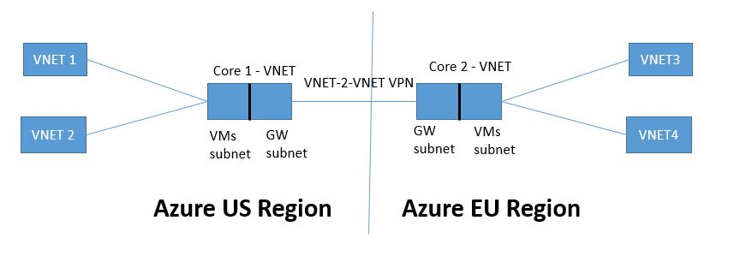
Vnet Peering Across Region
Notes:
You can connect virtual networks to each other, enabling resources in either virtual network to communicate with each other, using virtual network peering. The virtual networks you connect can be in the same, or different,

Slide 29
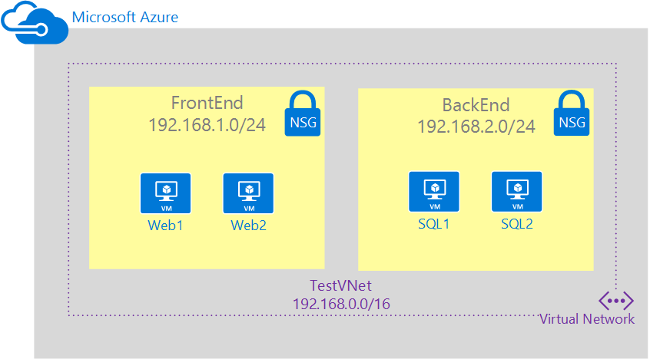
Network Security Group
Notes:
A network security group (NSG) contains a list of security rules that allow or deny network traffic to resources connected to Azure Virtual Networks (VNet). NSGs can be associated to subnets, individual VMs (classic), or individual network interfaces (NIC) attached to VMs (Resource Manager). When an NSG is associated to a subnet, the rules apply to all resources connected to the subnet. Traffic can further be restricted by also associating an NSG to a VM or NIC.
NSG

Slide 30
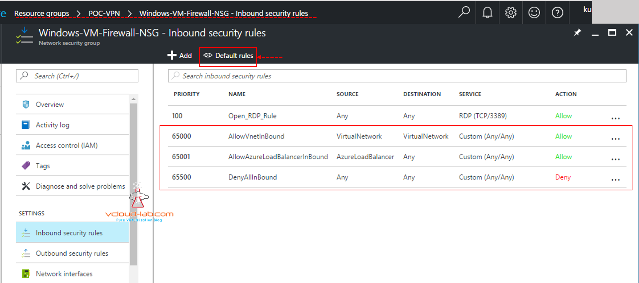
NSG Rules
Notes:
Filter network traffic with network security groups:-
All Inbound traffic is blocked to the Azure VM, we have to manually specified the traffic (Ports) to allowing to the VM.
By Default all Outbound traffic is allow to Azure VM’s

Slide 31
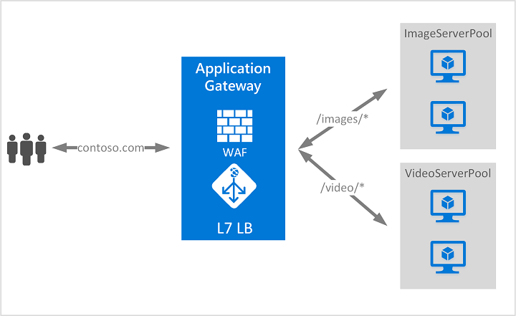
Application Gateway
Notes:
Azure Application Gateway is a web traffic load balancer that enables you to manage traffic to your web applications.
Traditional Load balancer works operate at the transport layer (OSI layer 4 - TCP and UDP) and route traffic based on source IP address and port, to a destination IP address and port. But with the Application Gateway you can be even more specific. For example, you can route traffic based on the incoming URL. So if /images is in the incoming URL, you can route traffic to a specific set of servers (known as a pool) configured for images. If /video is in the URL, that traffic is routed to another pool optimized for videos.

Slide 32
Features Of Application Gateway 1. URL-based routing. 2. Redirection.(Http-https) 3. Multiple-site hosting. 4.cookie-based session affinity. 5.Secure Sockets Layer (SSL) termination 6.End to End SSL 7. Web Application firewall
Notes:
URL Path Based Routing allows you to route traffic to back-end server pools based on URL Paths of the request.
Redirection: A common scenario for many web applications is to support automatic HTTP to HTTPS redirection to ensure all communication between an application and its users occurs over an encrypted path.
Multiple-site hosting: Multiple-site hosting enables you to configure more than one web site on the same application gateway instance. This feature allows you to configure a more efficient topology for your deployments by adding up to 20 web sites to one application gateway.
cookie-based session affinity: The cookie-based session affinity feature is useful when you want to keep a user session on the same server. By using gateway-managed cookies, the Application Gateway can direct subsequent traffic from a user session to the same server for processing. This is important in cases where session state is saved locally on the server for a user session.
Secure Sockets Layer (SSL) termination: Application gateway supports SSL termination at the gateway, after which traffic typically flows unencrypted to the backend servers. This feature allows web servers to be unburdened from costly encryption and decryption overhead. However, sometimes unencrypted communication to the servers is not an acceptable option. This could be due to security requirements, compliance requirements, or the application may only accept a secure connection

Slide 33
Web Application Firewall (WAF)
Web application firewall (WAF) is a feature of Application Gateway that provides centralized protection of your web applications from common exploits and vulnerabilities. WAF is based on rules from the OWASP (Open Web Application Security Project) core rule sets 3.0 or 2.2.9.

Slide 34
Commonly Attacks. 1. SQL injection. 2. Http Header Injection. 3. Http protocol violation 4. X-site Scripting 5. Detection of common Application misconfiguration.

Slide 35
Thank You and Q&A.

