Slide 1



Azure Log Analytics & OMS

Slide 2
Training Contents
Introduction To Log Analytics
How Log Analytics Works
Data Collection
Workflow of Log Analytics
Collect
Analyze
Visualize
Alert
Data and Log Collection from :
Azure VMs ( Windows & Linux)
On Premise VM(Windows, Linux)
AWS VMs
SCOM
Supported OS and Versions
Kusto Query Language
Operation Management Suite
Management Solutions
Reports
QA Session

Slide 3
Introduction to Log Analytics
With Azure Log Analytics, you can gather and search log data from all of your resources, whether they reside on Azure, on another cloud host, or on-premises. Then you can transform the gathered data into rich analytics with AI-enhanced insights into your environment.
Features of Log Analytics :
Data collection from multiple source.
Analyze data with Kusto Query language.
Set different type of condition alerts on the data collected.
Export log data to Excel and Power BI.
Can integrate to other azure services to collect logs.
Visualize logs in the form of table or charts.
Add custom solution to collect logs.
Rich query language support to retrieve, consolidate and analyze collected data.

Slide 4
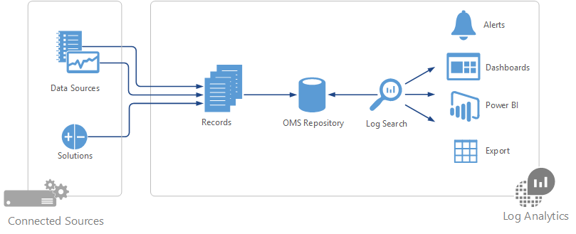
How Log Analytics Works

Slide 5
Data Collection
Different methods for collecting Data
Configure Azure Monitor to copy metrics and logs that it collects from Azure resources.
Agents on Windows and Linux virtual machines send telemetry from the guest operating system and applications to Log Analytics according to Data Sources that you configure.
Connect a System Center Operations Manager management group to Log Analytics to collect data from its agents.
Azure services such as Application Insights and Azure Security Center store their data directly in Log Analytics without any configuration.
Write data from PowerShell command line or Azure Automation runbook using Log Analytics cmdlets.
If you have custom requirements, then you can use the HTTP Data Collector API to write data to Log Analytics from any REST API client.

Slide 6
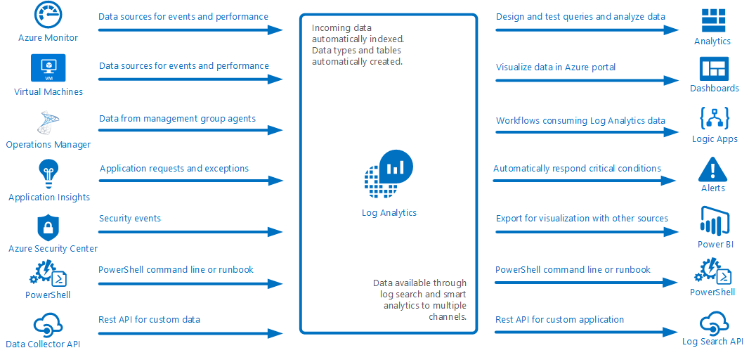
Data Collection

Slide 7
Workflow of Log Analytics
Collect
Analyze
Visualize
Alert

Slide 8
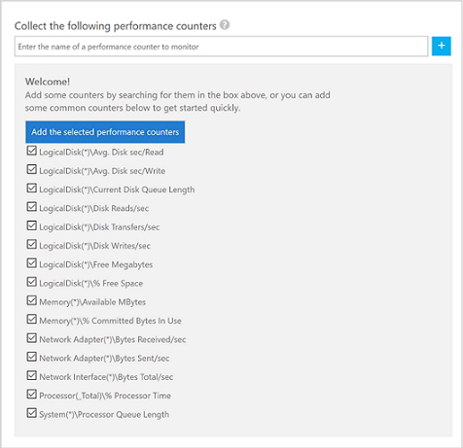
Collect
Collect logs from:
Event Logs
Custom App Logs
IIS Logs
Crash Dumps
Performance Data

Slide 9
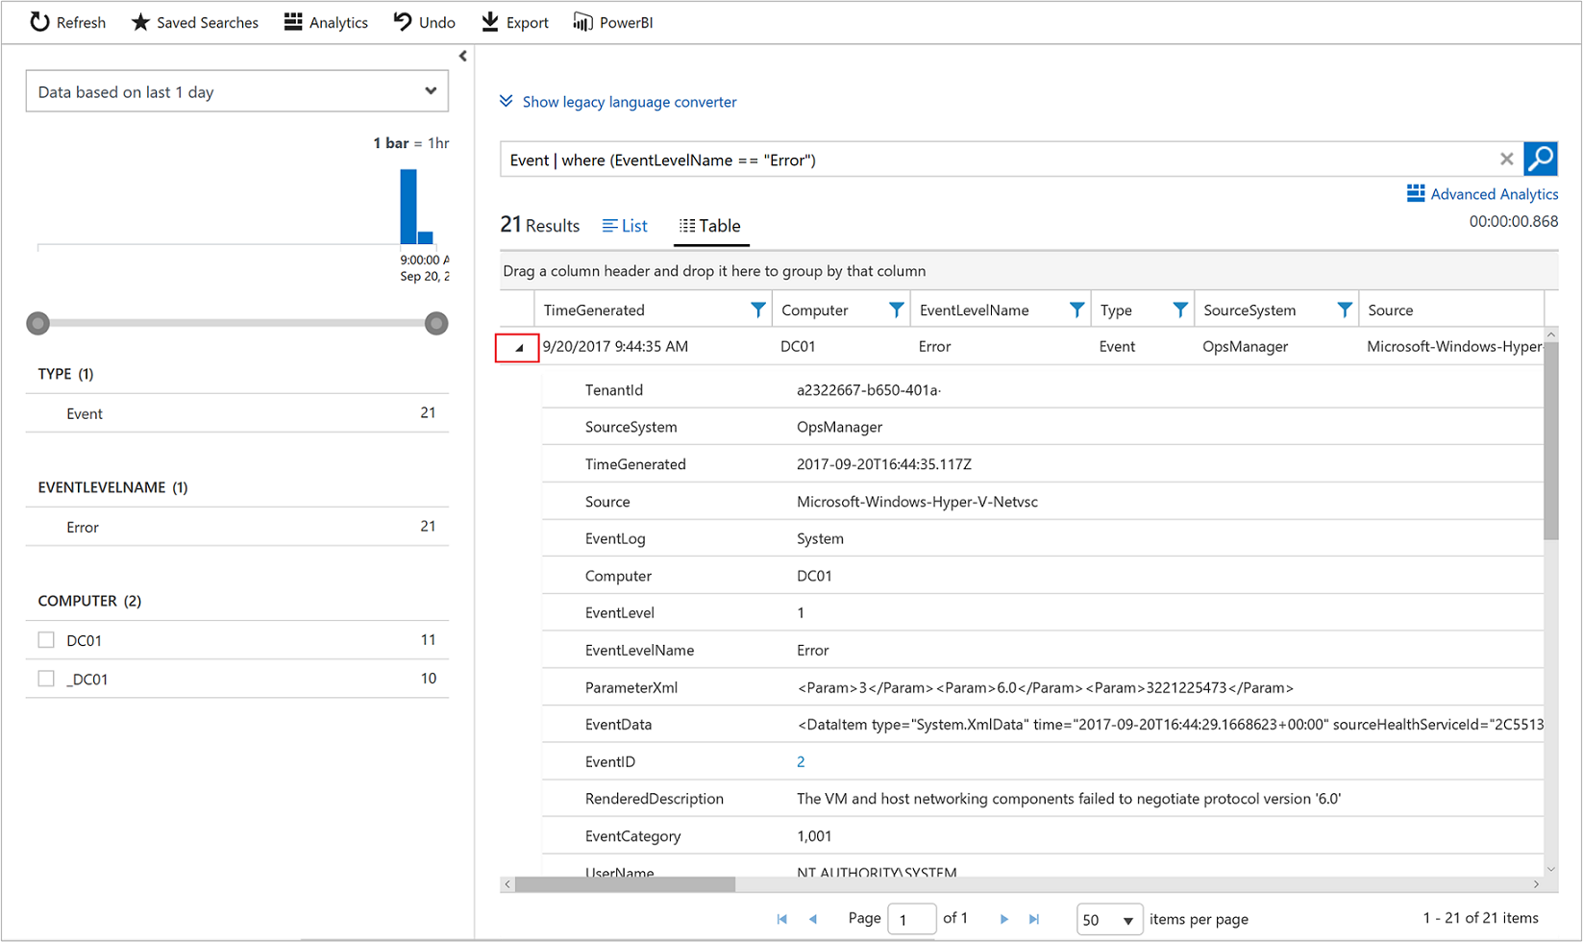
Analyze
Filter based on attributes
Analyze data with Kusto Query language.
Sort data.
Export log data to Excel and Power BI.
Conditional Filtering

Slide 10
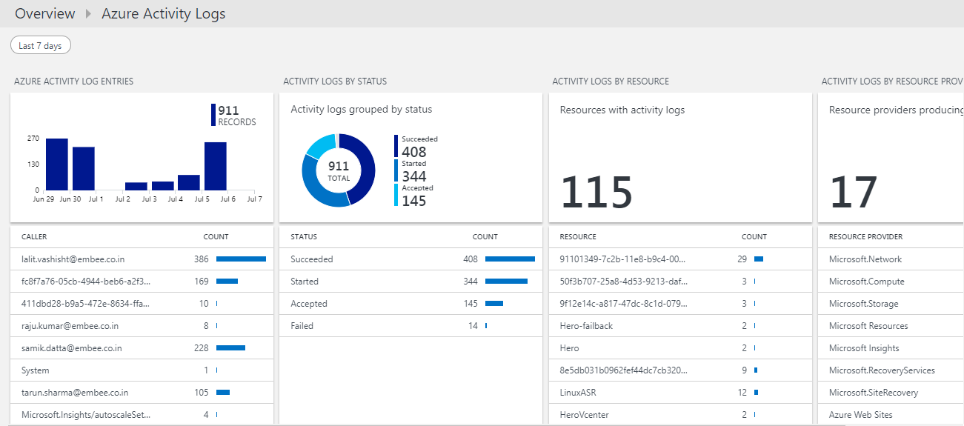
Visualize

Slide 11
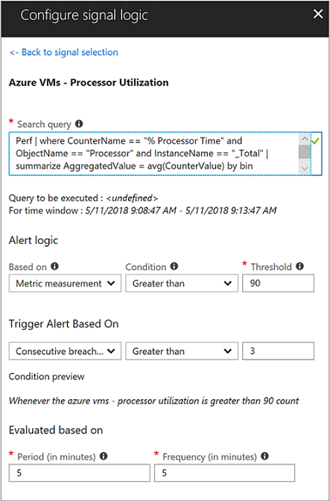
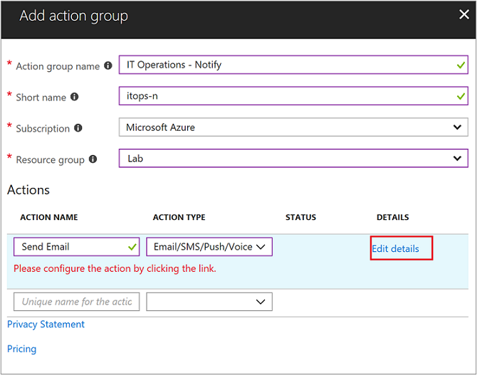
Alert

Slide 12
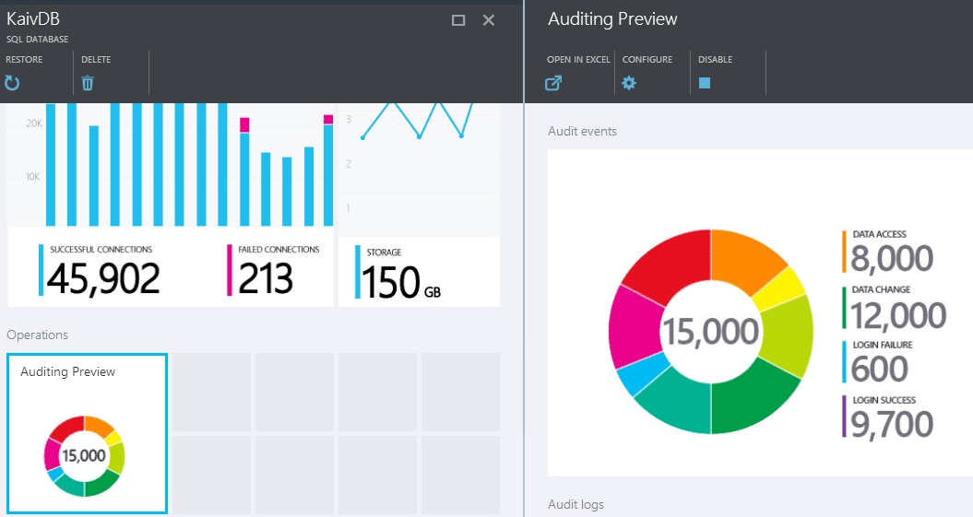
DEMO

Slide 13
Data and Log Collection

Slide 14
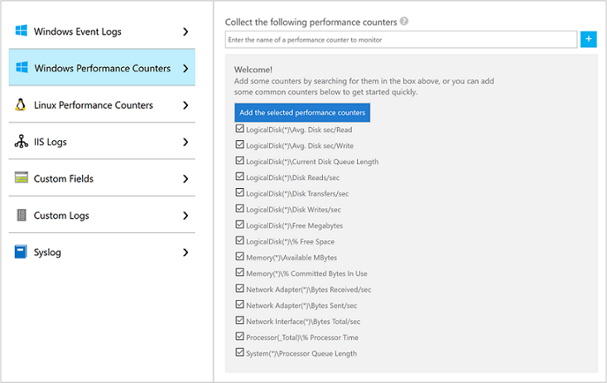
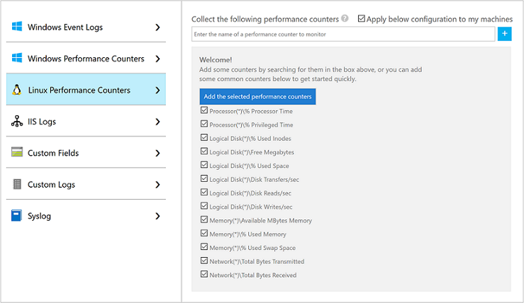
Azure VMs(Windows & Linux)
Create a workspace
Enable Log Analytics VM Extension

Slide 15
On Premise & AWS VMs(Windows ,Linux & SCOM )
Windows
Via Agent Install (Manual)
SCOM
Integrate Operation Manager with Log Analytics
ARM Template with Azure Stack
Linux
Via Agent Install (Manual)
Azure Automation DSC

Slide 16
Supported OS and Versions
Windows
Windows Server 2008 Service Pack 1 (SP1) or later
Linux
Amazon Linux 2012.09 to 2015.09 (x86/x64)
Windows 7 SP1 and later.
CentOS Linux 5, 6, and 7 (x86/x64)
Oracle Linux 5, 6, and 7 (x86/x64)
Red Hat Enterprise Linux Server 5, 6 and 7 (x86/x64)
Debian GNU/Linux 6, 7, and 8 (x86/x64)
Ubuntu 12.04 LTS, 14.04 LTS, 16.04 LTS (x86/x64)
SUSE Linux Enterprise Server 11 and 12 (x86/x64)

Slide 17
Operation Management Suite (OMS)

Slide 18
Introduction to OMS
The Microsoft Operations Management Suite (OMS), previously known as Azure Operational Insights, is a software as a service platform that allows an administrator to manage on-premises and cloud IT assets from one console.
OMS Services :
Log Analytics : Monitor and analyze the availability and performance of different resources including physical and virtual machines.
Automation : Automate manual processes and enforce configurations for physical and virtual machines.
Backup : Backup and restore critical data.
Site Recovery : Provide high availability for critical applications

Slide 19
OMS Capabilities
GOVERN
SECURE
Policy Management
Cost Management
Security Management
Threat Protection
CONFIGURE
Microsoft Azure
PROTECT
Configuration
Update Management
Automation
Scripting
Backup
Disaster Recovery
MONITOR
App, Infra, & Network Monitoring
Log Analytics and Diagnostics

Slide 20
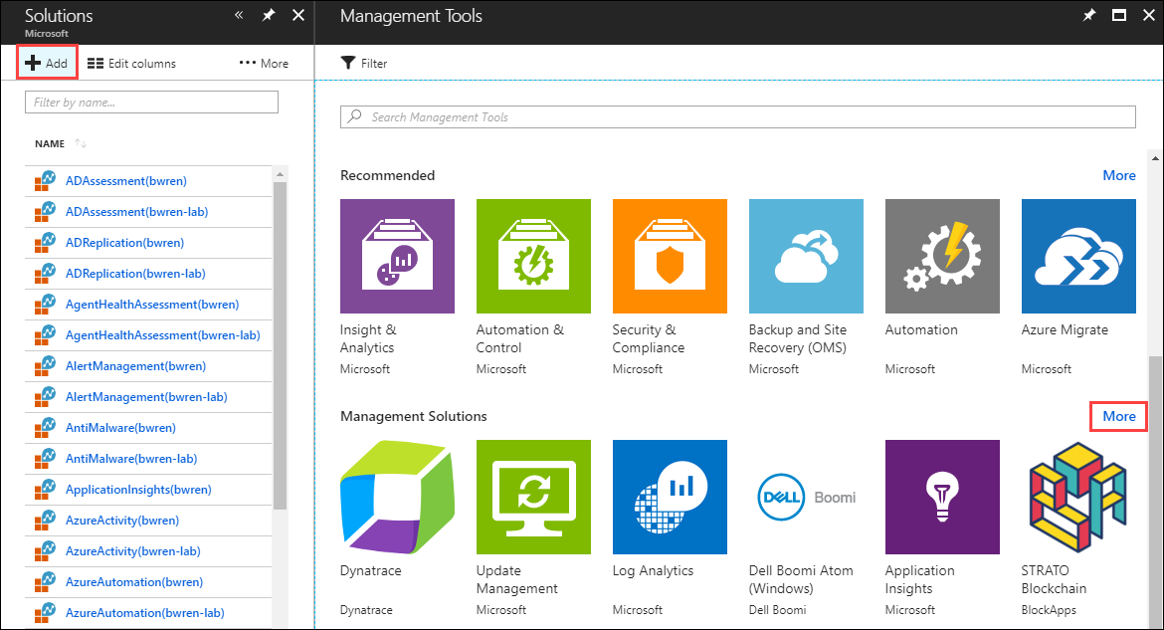
Management Solutions
Management solutions leverage services in Azure to provide additional insight into the operation of a particular application or service.

Slide 21
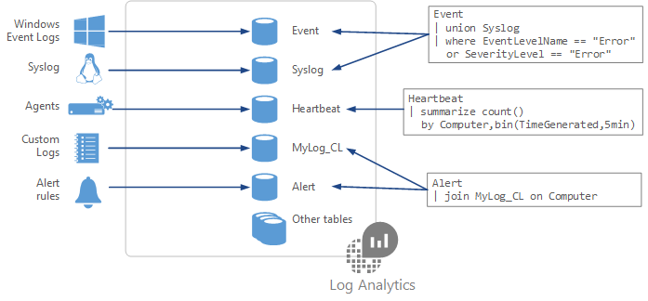
Kusto Query Language
Kusto Query Reference Portal :
https://docs.loganalytics.io

Slide 22
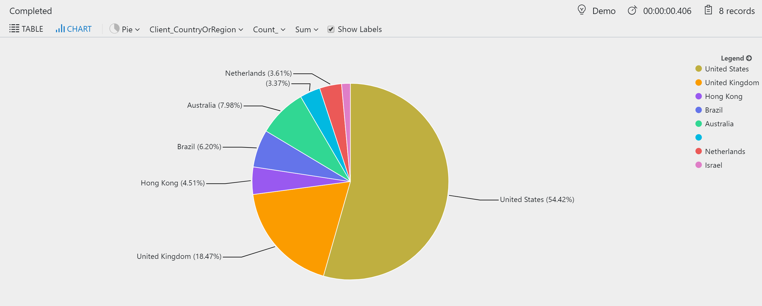
Reports
Export reports to excel and Power BI, Data can be displayed in table and Chart format.

Slide 23
QA Session

Slide 24
Thank You
Raju Kumar
Raju.kumar@embee.co.in
+91 9015081245

