Slide 1



Azure Web App Troubleshooting

Slide 2
Training Contents
Introduction To Web App
Traditional hosting vs. PaaS in Azure Architecture
Troubleshoot using Visual Studio
Availability and Performance
  High CPU Consumption
  High Memory Consumption
  Web App Down
  Web App Slow
  Web App Restarted
  TCP Connections
Azure Web App Logs
  Application logging
  Web server logging
  Detailed error messages
  Failed request tracing
Log file analysis(FTP/Event Logs)
Remote Debugging
KUDU
Application Insights
QA Session

Slide 3
Introduction to Web App
  Web App is a service for hosting Web Applications, REST APIs, and Mobile Backends.
  You can develop in your favorite language, be it .NET, .NET Core, Java, Ruby, Node.js, PHP or Python.
Features of App Service – Web Apps :
  Multiple Languages and frameworks.
  DevOps optimization.
  Global scale with high availability.
  Connections to SaaS platforms and on-premises data
  Security and compliance
  Application templates
  Visual Studio integration
  API and mobile features
  Serverless code

Slide 4
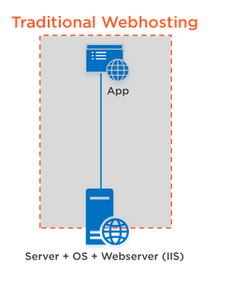
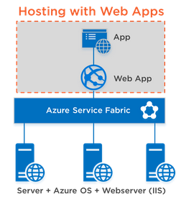
Traditional hosting vs. PaaS in Azure Architecture

Slide 5
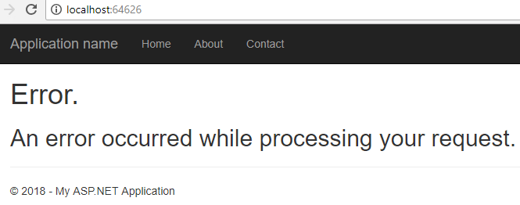
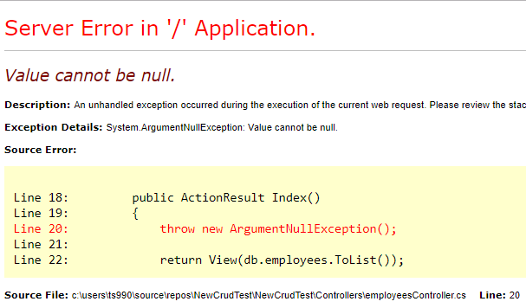
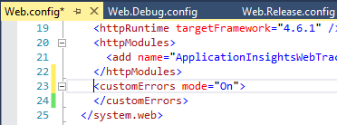
Troubleshoot using Visual Studio
1. Enable Actual Error View
Generic Error Message
Actual Error Message
Enable Actual Error View

Slide 6
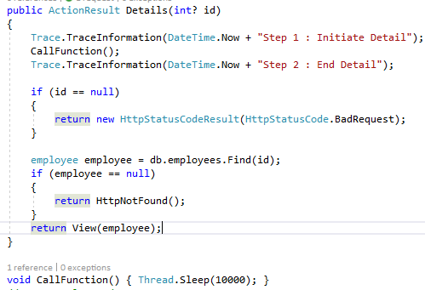
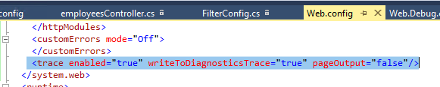
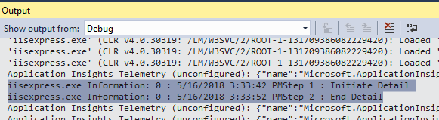
Troubleshoot using Visual Studio
2. Enable Trace

Slide 7
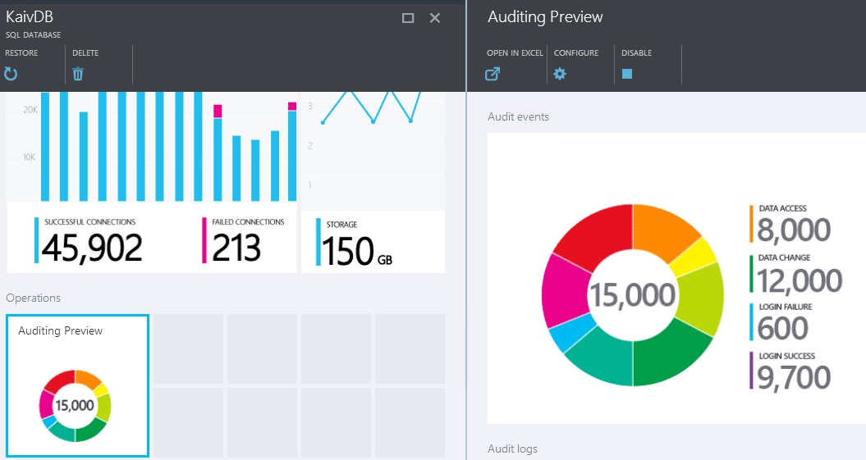
DEMO

Slide 8
Availability and Performance
Web App
Down
Web App
Slow
High CPU
Usage
High Memory
Usage
Web Restarted
TCP
Connections

Slide 9
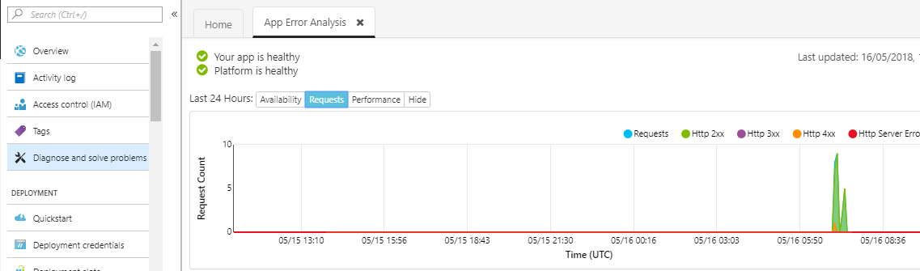
Availability and Performance
1. Web App Down

Slide 10
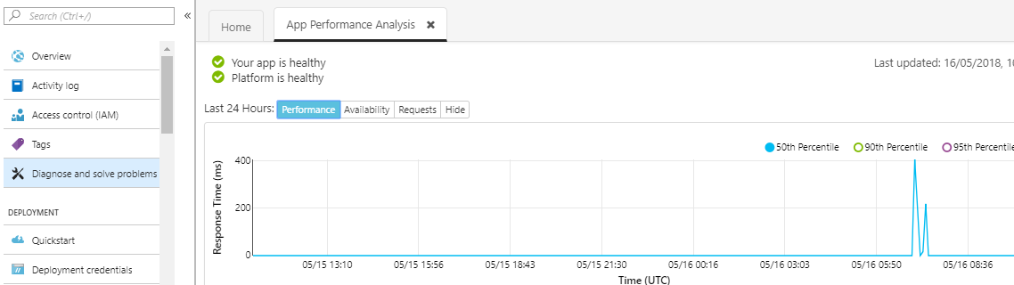
Availability and Performance
2. Web App Slow

Slide 11
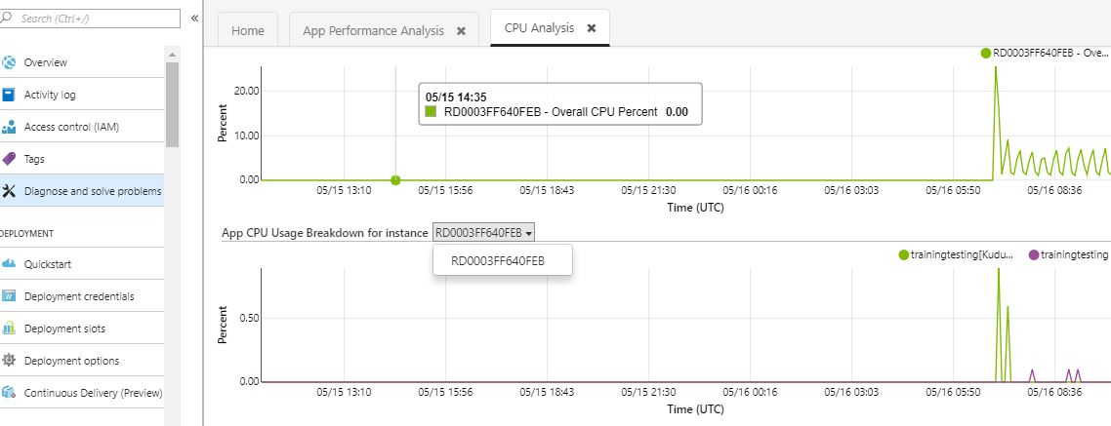
Availability and Performance
3. High CPU Usage

Slide 12
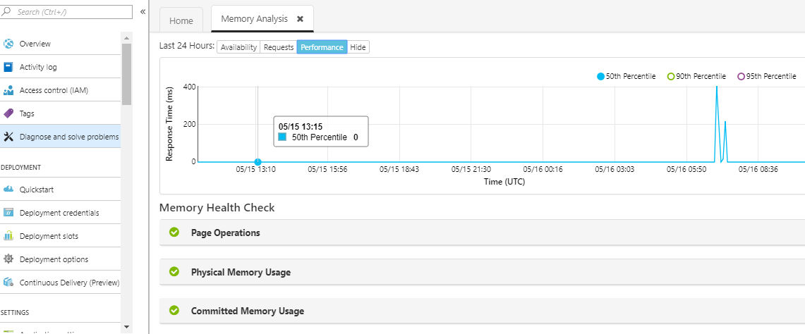
Availability and Performance
4. High Memory Usage

Slide 13
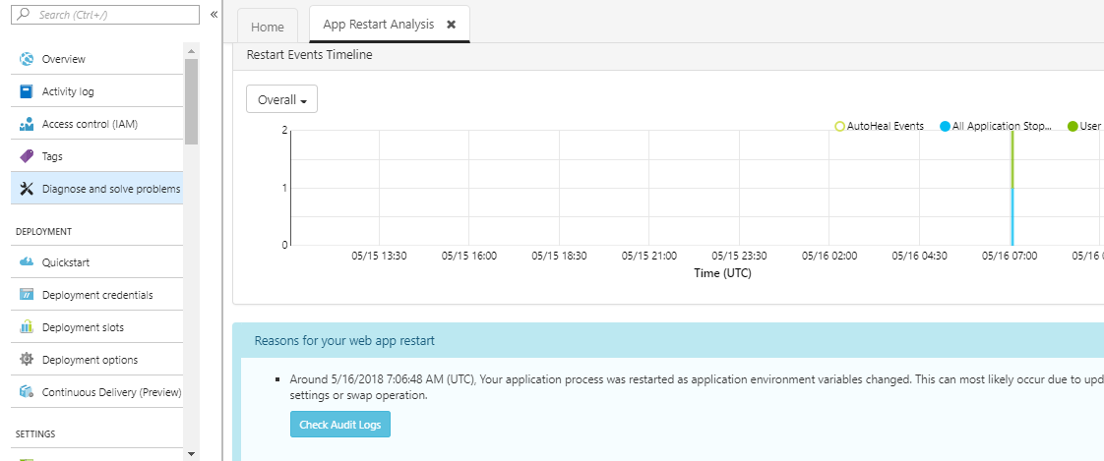
Availability and Performance
5. Web App Restarted

Slide 14
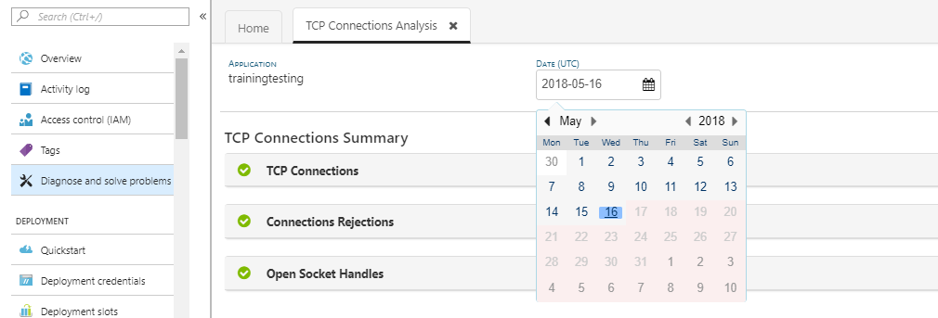
Availability and Performance
6. TCP Connections

Slide 15
Azure Web App Diagnostic Logs
Application Logging
(File System)
Application Logging
(Blob)
Web Server Logging
Detailed Error
Messages
Failed
Request
Tracing

Slide 16
Azure Web App Diagnostic Logs
1. Application Logging (File System) :
  Enable application logging to collect diagnostic traces
  from your web app code.
2. Application Logging (Blob) :
  Logs are collected in the blob container that is specified under Storage
  settings.
3. Web Server Logging :
  Gather diagnostic information for your web server.
4. Detailed Error Logging :
  Gather diagnostic information for your web app.
5. Failed Request Tracing :
  Gather diagnostic information on failed requests.

Slide 17
DEMO

Slide 18
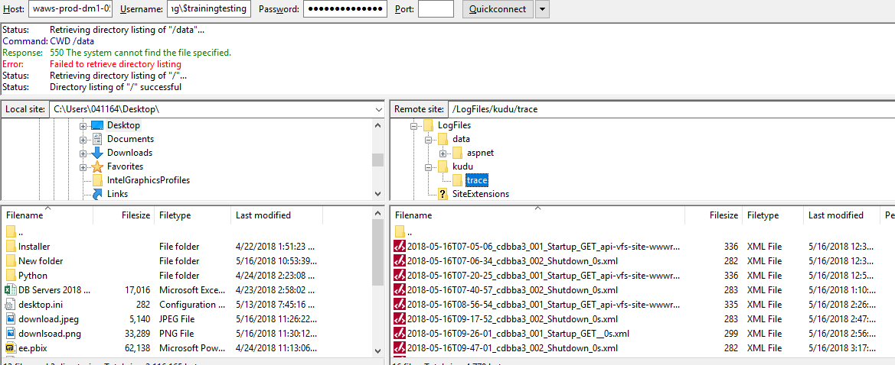
Log File Analysis (FTP/Event Logs)

Slide 19
DEMO

Slide 20
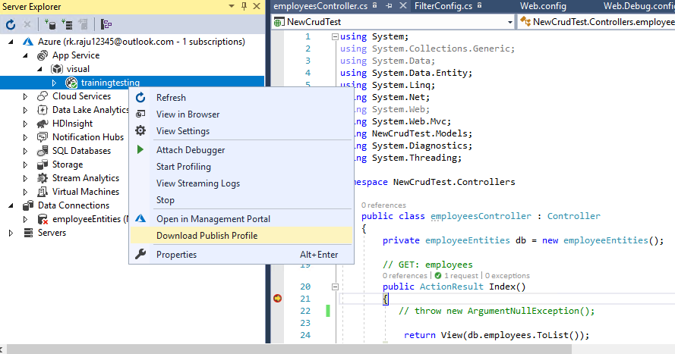
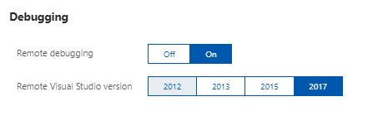
Remote Debugging

Slide 21
DEMO

Slide 22
KUDU

Slide 23

DEMO

Slide 24
Application Insights

Slide 25
Advanced Debugging

Slide 26
Snapshot Debugger

Slide 27
DEMO

Slide 28
Dissambler

Slide 29
DEMO

Slide 30
QA Session

Slide 31
Summary

Slide 32
Thank You
Raju Kumar
Raju.kumar@embee.co.in
+91 9015081245

