Slide 1




Design and Deploy ARM Templates

Slide 2
Training Contents
Implement ARM templates
Control access
Design role-based access control (RBAC)
Hands-on Labs

Slide 3
Implement ARM templates
What is ARM template
A JavaScript Object Notation (JSON) file that defines one or more resources to deploy to a resource group
It also defines the dependencies between the deployed resources.
You can then customize the template and deploy it.
Features of ARM:
You can define the dependencies between resources so they're deployed in the correct order.
Organize Azure resources
Logical Grouping with azure resources
Share same lifecycle
Can use to scope with RBAC (Role Base Access Control)

Slide 4
Methods to Create and Deploy ARM templates
Create template By –
Portal – Just need to sign in to Azure portal (azure.portal.com) and create new template.
VS Code – Install Vs code soft. And create new file and upload to azure to deploy
Visual Studio – Create new project and select Azure Resource Group and publish to deploy
Deploy template By -
Power-shell – you can deploy and create template by open power shell on Local machine.
CLI – Open command prompt on local machine
Azure Portal – Create new resource Template deployment and deploy own template

Slide 5
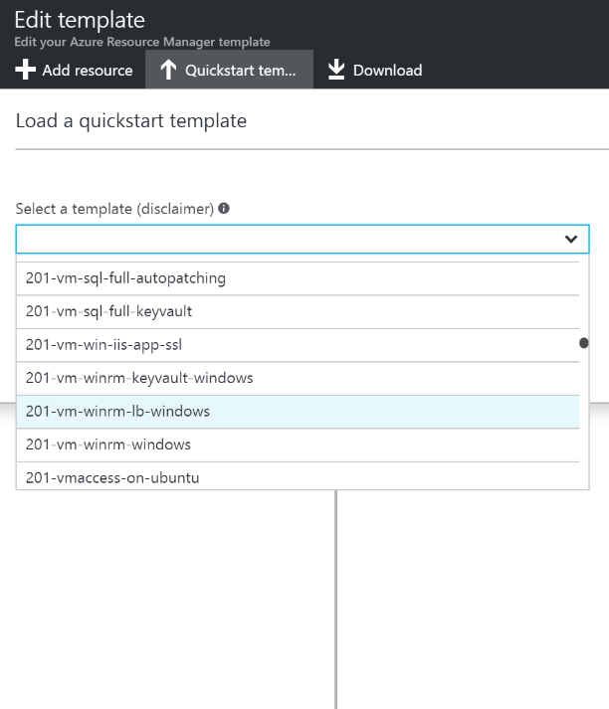
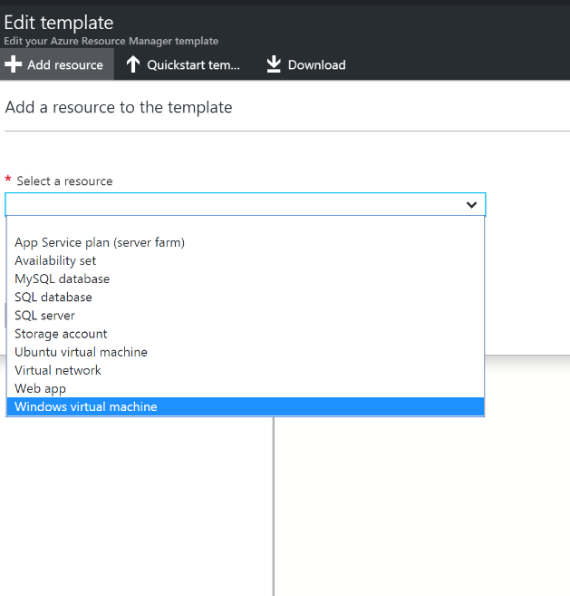
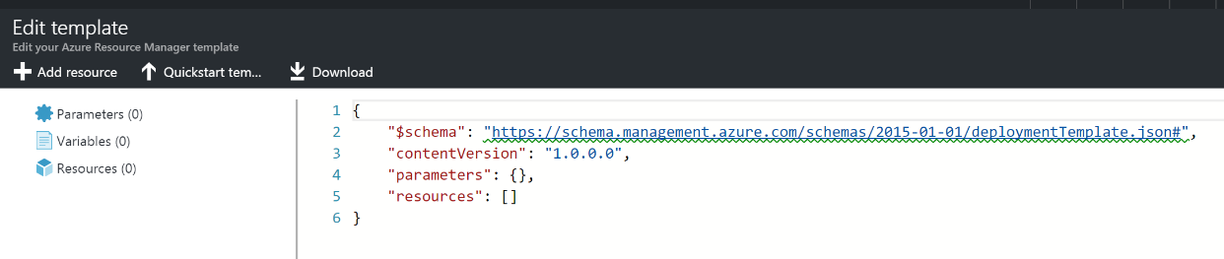
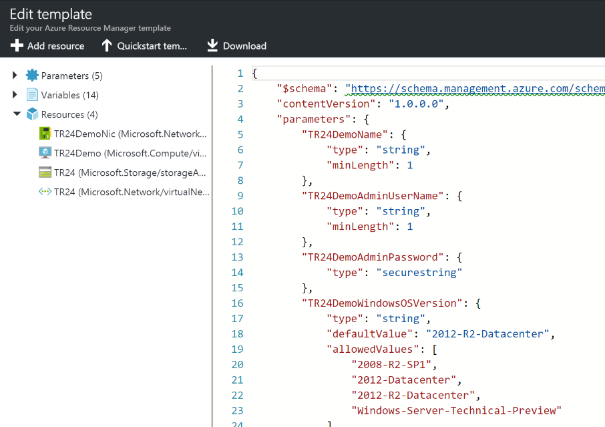
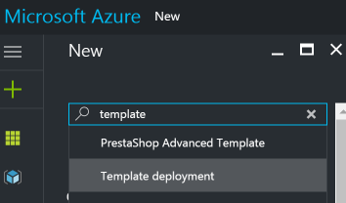
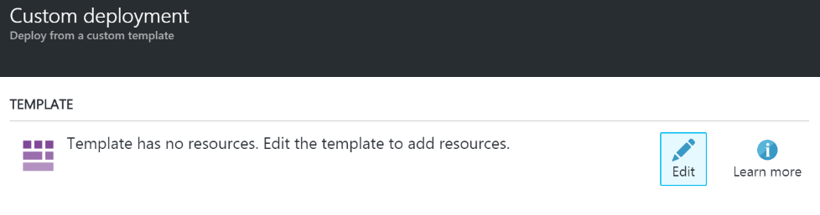
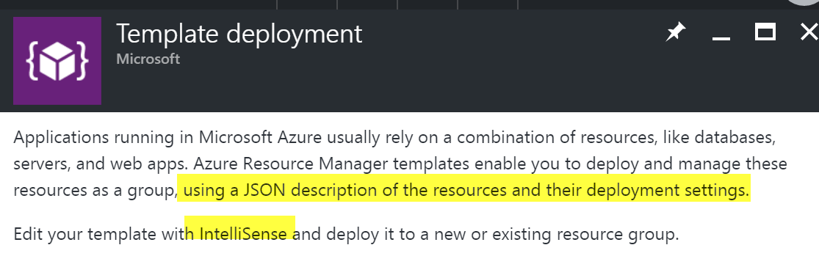
ARM Templates

Slide 6
Control Access To Resource
With Azure Resource Manager
you can control who in your organisation can perform actions on the resources
You manage permissions by defining roles and adding users or groups to the roles
you can apply an explicit lock that prevents users from deleting or modifying the resource.
Azure Resource Manager logs all user actions so you can audit those actions.
You Can Give Control Access
Leverage service principals with ARM authentication.
Use Azure Active Directory Authentication with ARM.
Set management policies.
Configure lock policies; lock resources.

Slide 7
Role-based access control (RBAC)
RBAC is a system that provides fine-grained access management of resources in Azure.
RBAC helps you manage who has access to Azure resources, what they can do with those resources, and what areas they have access to.
What can I do with RBAC
Allow one user to manage virtual machines in a subscription and another user to manage virtual networks.
Allow a DBA group to manage SQL databases in a subscription.
Allow a user to manage all resources in a resource group, such as virtual machines, websites, and subnets.
Allow an application to access all resources in a resource group.

Slide 8
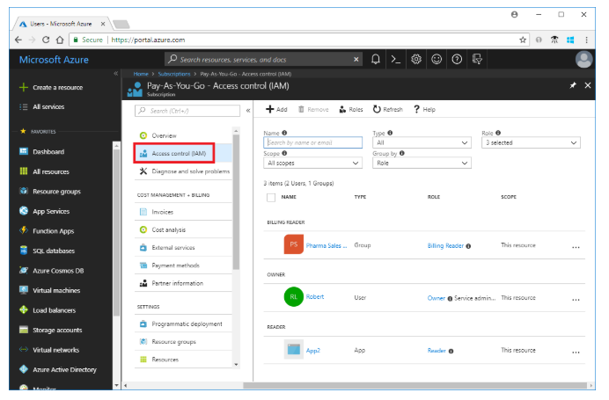
Role-based access control (RBAC)
List roles
A role definition is a collection of permissions that you use for role assignments. Azure has over 70 built-in roles. Follow these steps to list the roles in the portal.
Steps
In the Azure portal, choose All services and then Subscriptions.
Choose your subscription.
Choose Access control (IAM).

Slide 9
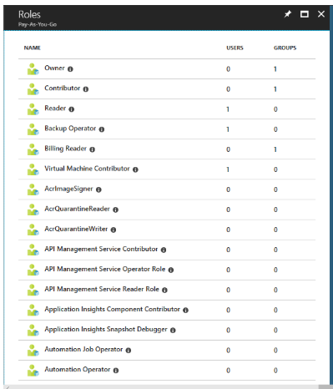
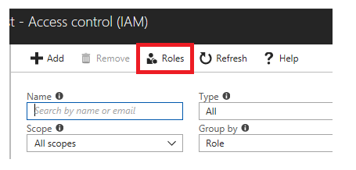
Role-based access control (RBAC)
Steps
Choose Roles to see a list of all the built-in and custom roles.
You can see the number of users and groups that are assigned to each role.

Slide 10
How Role-based access control (RBAC) Works
The way you control access to resources using RBAC is to create role assignments. This is a key concept to understand – it’s how permissions are enforced.
A role assignment consists of three elements : -
Security principal - It is an object that represents a user, group, or service principal that is requesting access to Azure resources.
Role definition - A role definition is a collection of permissions. It's sometimes just called a role. A role definition lists the operations that can be performed, such as read, write, and delete. Roles can be high-level, like owner, or specific, like virtual machine reader.
Scope - Scope is the boundary that the access applies to. When you assign a role, you can further limit the actions allowed by defining a scope. This is helpful if you want to make someone a Website Contributor, but only for one resource group.

Slide 11
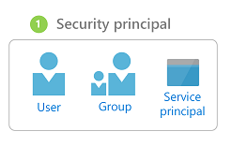
Security Principal
User - An individual who has a profile in Azure Active Directory. You can also assign roles to users in other tenants. For information about users in other organizations, see Azure Active Directory B2B.
Group - A set of users created in Azure Active Directory. When you assign a role to a group, all users within that group have that role.
Service principal - A security identity used by applications or services to access specific Azure resources. You can think of it as a user identity (username and password or certificate) for an application.

Slide 12
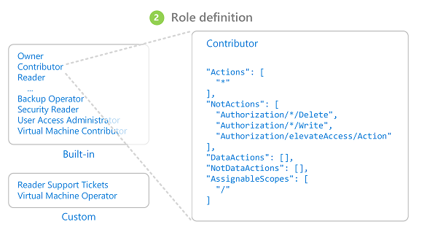
Role definition
Azure includes several built-in roles that you can use. The following lists four fundamental built-in roles. The first three apply to all resource types.
Owner - Has full access to all resources including the right to delegate access to others.
Contributor - Can create and manage all types of Azure resources but can’t grant access to others.
Reader - Can view existing Azure resources.
User Access Administrator - Lets you manage user access to Azure resources.
The rest of the built-in roles allow management of specific Azure resources. For example, the Virtual Machine Contributor role allows a user to create and manage virtual machines. If the built-in roles don't meet the specific needs of your organization, you can create your own custom roles

Slide 13
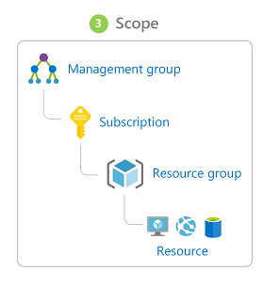
Scope
Scope is the boundary that the access applies to. When you assign a role, you can further limit the actions allowed by defining a scope. This is helpful if you want to make someone a Website Contributor, but only for one resource group.
When you grant access at a parent scope, those permissions are inherited to the child scopes. For example :-
If you assign the Owner role to a user at the management group scope, that user can manage everything in all subscriptions in the management group.
If you assign the Reader role to a group at the subscription scope, the members of that group can view every resource group and resource in the subscription.
If you assign the Contributor role to an application at the resource group scope, it can manage resources of all types in that resource group, but not other resource groups in the subscription.

Slide 14
Hand On Lab
1). Create virtual machine in new resource group by ARM template deployment and deploy it from
Power shell
CLI
azure portal
2). Create a custom role on a resource by
Azure Portal
Power shell

