Slide 1




Manage Azure Security
and Recovery Service

Slide 2
Training Contents
Monitor on-premises identity infrastructure and synchronisation services with Azure AD Connect Health
Manage domains with Azure Active Directory Domain Services
Integrate with Azure Active Directory (Azure AD)
Implement Azure AD B2C and Azure AD B2B
Hands-on Labs

Slide 3
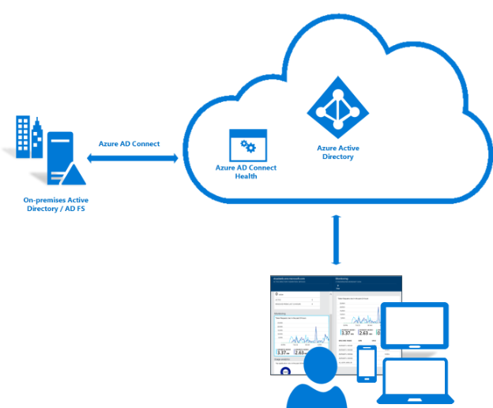
Azure AD Connect Health
Azure Active Directory (Azure AD) Connect Health helps you monitor and gain insights into your on-premises identity infrastructure and the synchronization services
In the Azure AD Connect Health portal, you can view alerts, performance monitoring, usage analytics, and other information.
Why use Azure AD Connect Health?
When you integrate your on-premises directories with Azure AD, your users are more productive because there's a common identity to access both cloud and on-premises resources. However, this integration creates the challenge of ensuring that this environment is healthy so that users can reliably access resources both on premises and in the cloud from any device.

Slide 4
Azure AD Connect Health
Azure AD Connect Health for AD FS
Azure AD Connect Health for AD FS supports AD FS 2.0 on Windows Server 2008 R2, Windows Server 2012, Windows Server 2012 R2 and Windows Server 2016. It also supports monitoring the AD FS proxy or web application proxy servers that provide authentication support for extranet access
key capabilities:
Monitoring with alerts to know when AD FS and AD FS proxy servers are not healthy
Email notifications for critical alerts
Trends in performance data, which are useful for capacity planning of AD FS
Usage analytics for AD FS sign-ins with pivots (apps, users, network location etc.), which are useful to understand how AD FS is getting utilized
Reports for AD FS such as top 50 users who have bad username/password attempts and their last IP address
Risky IP report for failed AD FS sign-ins

Slide 5
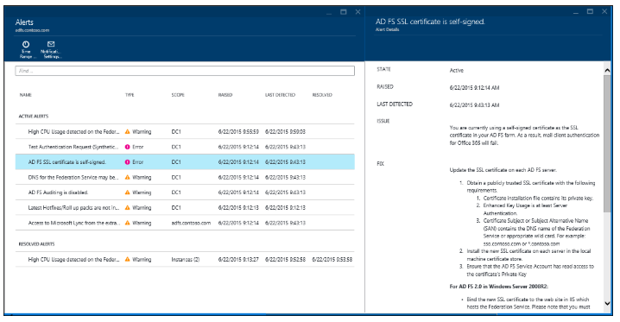
Azure AD Connect Health
Monitor AD FS using Azure AD Connect Health
The Azure AD Connect Health Alerts section provides you the list of active alerts. Each alert includes relevant information, resolution steps, and links to related documentation.
You can double-click an active or resolved alert, to open a new blade with additional information, steps you can take to resolve the alert, and links to relevant documentation. You can also view historical data on alerts that were resolved in the past.

Slide 6
Azure AD Connect Health
Azure AD Connect Health Agent Installation
Requirements :-
Azure AD Premium (Azure AD Connect Health is an Azure AD Premium feature and requires Azure AD Premium).
You must be a global administrator of your Azure AD to get started with Azure AD Connect Health
Azure AD Connect Health Agent is installed on each targeted server
Outbound connectivity to the Azure service endpoints
Outbound connectivity based on IP Addresses
SSL Inspection for outbound traffic is filtered or disabled
Firewall ports on the server running the agent
TCP port 443
TCP port 5671
Allow the following websites if IE Enhanced Security is enabled
Ensure PowerShell v4.0 or newer is installed
Disable FIPS (FIPS is not supported by Azure AD Connect Health agents).

Slide 7
Azure AD Connect Health
Azure AD Connect Health for AD DS
Azure AD Connect Health for Active Directory Domain Services (AD DS) provides monitoring for domain controllers that are installed on Windows Server 2008 R2, Windows Server 2012, Windows Server 2012 R2, and Windows Server 2016.
key capabilities:
Monitoring alerts to detect when domain controllers are unhealthy and email notifications for critical alerts
The Domain Controllers dashboard, which provides a quick view of the health and operational status of your domain controllers
The Replication Status dashboard that has the latest replication information and links to troubleshooting guides when errors are detected
Quick anywhere access to performance data graphs of popular performance counters, which are necessary for troubleshooting and monitoring purposes.

Slide 8
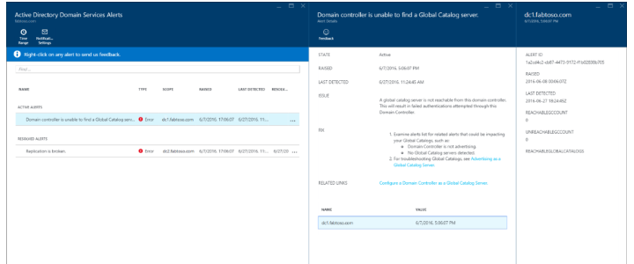
Azure AD Connect Health
Monitor AD DS using Azure AD Connect Health
The Alerts section within Azure AD Connect Health for AD DS, provides you a list of active and resolved alerts, related to your domain controllers. Selecting an active or resolved alert opens a new blade with additional information, along with resolution steps, and links to supporting documentation.

Slide 9
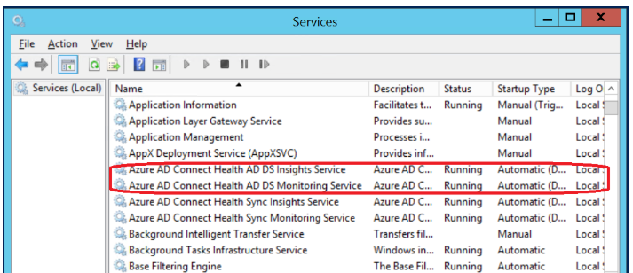
Azure AD Connect Health
Installing the Azure AD Connect Health Agent for AD DS
Steps :-
Download the latest version from http://www.microsoft.com/download/details.aspx?id=47594
To start the agent installation, double-click the .exe file that you downloaded. On the first screen, click Install.
Once the installation is finished, click Configure Now.
A command prompt is launched, followed by some PowerShell that executes Register-AzureADConnectHealthADDSAgent. When
prompted to sign in to Azure, go ahead
and sign in.
To verify the agent has been installed, look for the following services on the domain controller.
Azure AD Connect Health AD DS Insights Service
Azure AD Connect Health AD DS Monitoring Service

Slide 10
Azure AD Domain Services managed domain
Azure Active Directory Domain Services includes a DNS (Domain Name Resolution) server that provides DNS resolution for the managed domain. Occasionally, you may need to configure DNS on the managed domain. You may need to create DNS records for machines that are not joined to the domain, configure virtual IP addresses for load-balancers or setup external DNS forwarders.
How to Manage domains with Azure Active Directory Domain Services
Create a domain-joined virtual machine to remotely administer DNS for the managed domain
Install DNS Server tools on the virtual machine
On the Features page, click to expand the Remote Server Administration Tools node and then click to expand the Role Administration Tools node. Select DNS Server Tools feature from the list of role administration tools.
Launch the DNS management console to administer DNS
In the Connect to DNS Server dialog, click The following computer, and enter the DNS domain name of the managed domain (for example, 'contoso100.com’).
The DNS Console connects to the managed domain.
You can now use the DNS console to add DNS entries for computers within the virtual network in which you've enabled AAD Domain Services.

Slide 11
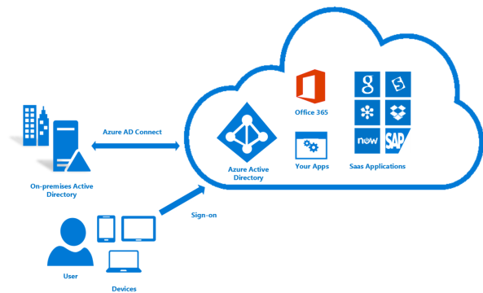
Azure Active Directory (Azure AD)
Azure AD Connect
Azure AD Connect will integrate your on-premises directories with Azure Active Directory. This allows you to provide a common identity for your users for Office 365, Azure, and SaaS applications integrated with Azure AD.
Azure AD Connect is the best way to connect your on-premises directory with Azure AD and Office 365.

Slide 12
Azure Active Directory (Azure AD)
Installation steps for Azure AD Connect
Download Azure AD Connect from http://go.microsoft.com/fwlink/?LinkId=615771
Sign in as a local administrator to the server you wish to install Azure AD Connect on. You should do this on the server you wish to be the sync server.
Navigate to and double-click AzureADConnect.msi.
On the Welcome screen, select the box agreeing to the licensing terms and click Continue.
On the Connect to Azure AD screen, enter the username and password of a global administrator for your Azure AD. Click Next.
On the Connect to AD DS screen, enter the username and password for an enterprise admin account. You can enter the domain part in either NetBios or FQDN format, that is, FABRIKAM\administrator .Click Next.
On the Ready to configure screen, click Install.
When the installation completes, click Exit.
After the installation has completed, sign off and sign in again before you use Synchronization Service Manager or Synchronization Rule Editor.

Slide 13
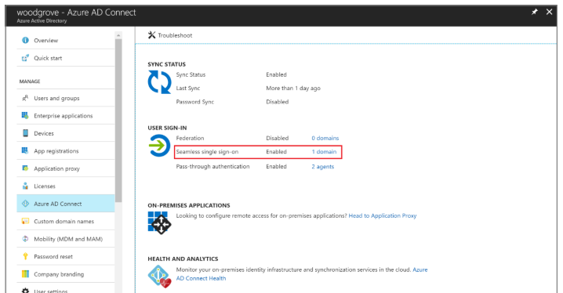
Azure Active Directory (Azure AD)
Single Sign-On
Azure Active Directory (Azure AD) Seamless Single Sign-On (Seamless SSO) automatically signs in users when they are on their corporate desktops that are connected to your corporate network. Seamless SSO provides your users with easy access to your cloud-based applications without needing any additional on-premises components.

Slide 14
Azure Active Directory (Azure AD)
How does sign-in on a web browser with Seamless SSO work
The sign-in flow on a web browser is as follows:
The user tries to access a web application (for example, the Outlook Web App - https://outlook.office365.com/owa/) from a domain-joined corporate device inside your corporate network.
Using JavaScript in the background, Azure AD challenges the browser, via a 401 Unauthorized response, to provide a Kerberos ticket.
The browser, in turn, requests a ticket from Active Directory for the user’s computer account (which represents Azure AD).
Active Directory locates the computer account and returns a Kerberos ticket to the browser encrypted with the computer account's secret.
The browser forwards the Kerberos ticket it acquired from Active Directory to Azure AD.
Azure AD decrypts the Kerberos ticket, which includes the identity of the user signed into the corporate device, using the previously shared key.
After evaluation, Azure AD either returns a token back to the application or asks the user to perform additional proofs, such as Multi-Factor Authentication.

Slide 15
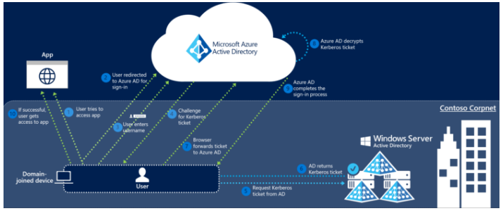
Azure Active Directory (Azure AD)
How does sign-in on a web browser with Seamless SSO work
If the user sign-in is successful, the user is able to access the application.
The following diagram illustrates all the components and the steps involved.

Slide 16
Azure AD B2C and Azure AD B2B
Azure Active Directory (Azure AD) Business-to-Consumer B2C is an identity management service that enables you to customize and control how customers sign up, sign in, and manage their profiles when using your applications. This includes applications developed for iOS, Android, and .NET, among others.
Azure Active Directory (Azure AD) Business-to-Business B2B collaboration capabilities enable any organization using Azure AD to work safely and securely with users from any other organization, small or large.
Some examples are:
Enable a customer to sign up to use your registered application
Enable a signed-up customer to sign in and start using your application
Enable a signed-up customer to edit their profile
Enable multi-factor authentication in your application
Enable the customer to sign up and sign in with specific identity providers
Grant access from your application to APIs that you build
Customize the look and feel of the sign-up and sign-in experience
Manage single sign-on sessions for your application

Slide 17
Azure AD B2C and Azure AD B2B
Key benefits of Azure AD B2B collaboration
Work with any user from any partner
Partners use their own credentials
No requirement for partners to use Azure AD
No external directories or complex set-up required
Simple and secure collaboration
Provide access to any corporate app or data, while applying sophisticated, Azure AD-powered authorization policies
Easy for users
Enterprise-grade security for apps and data
No management overhead
No external account or password management
No sync or manual account lifecycle management
No external administrative overhead

Slide 18
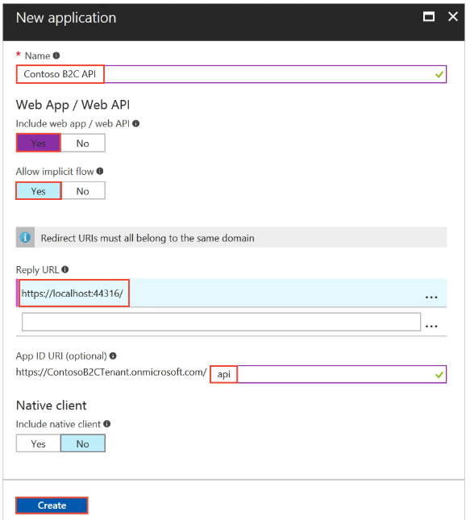
Azure AD B2C and Azure AD B2B
Register a web API
In the B2C settings, click Applications and then click + Add.
To register your web API, use the settings specified in the table.
Click Create to register your application.
Your newly registered application is displayed in the applications list for the B2C tenant. Select your web app from the list. The web application's property pane is displayed.
Make note of the globally unique Application Client ID. You use the ID in your application's code.
To delete the app, go to the Application Registration Portal and delete the application there.

Slide 19
Hand On Lab
1).Install and configure Azure Ad connect health.

