Slide 1




Manage Azure Operations

Slide 2
Training Contents
Enhance cloud management with automation.
Collect and analyze data generated by resources (cloud and on-premises environments )
Hands-on Labs

Slide 3
Azure Automation
Azure Automation delivers a cloud-based automation and configuration service that provides consistent management across your Azure and non-Azure environments. It consists of process automation, update management, and configuration features.
Azure Automation Capabilities
Process automation – Orchestrate processes using graphical , Power shell , And Python runbook
Configuration Management – Collect inventory Track changes configure desired state
Update Management – Assess compliance Schedule update installation
Shared capabilities – Role based access control Secure , global store for variables , credentials , certificates , connections flexible scheduling shared modules source control support Auditing Tags
Heterogenous - It is designed to work across your hybrid cloud environment and also for Windows & Linux.

Slide 4
Common scenarios for Automation
Azure Automation manages across the lifecycle of your infrastructure and applications. Transfer knowledge into the system on how the organization delivers and maintains workloads.
Author in common languages like PowerShell, desired state configuration, Python, and graphical runbooks.
Build / Deploy resources - Deploy VMs across a hybrid environment using Runbooks and Azure Resource Manager templates. Integrate into development tools like Jenkins and Visual Studio Team services.
Configure VMs - Assess and configure Windows and Linux machines with the desired configuration for the infrastructure and application.
Monitor - Identify changes on machines that are causing issues and remediate or escalate to management systems.
Protect - Quarantine VM if security alert is raised. Set in-guest requirements.
Govern - Set up role-based access control for teams. Recover unused resources

Slide 5
Automation using Runbook
You can add a runbook to Azure Automation by either creating a new one or by importing an existing runbook from a file or from the Runbook Gallery
Method to create Runbook
Azure portal - open automation account and select add a runbook and select the type to create runbook
Power shell - You can use the New-AzureRmAutomationRunbook cmdlet to create an empty PowerShell
Workflow runbook. The Type parameter should also be included to specify one of the four runbook types.
The following sample commands show how to create a new empty runbook.
New-AzureRmAutomationRunbook -AutomationAccountName MyAccount `
-Name NewRunbook -ResourceGroupName MyResourceGroup -Type PowerShell

Slide 6
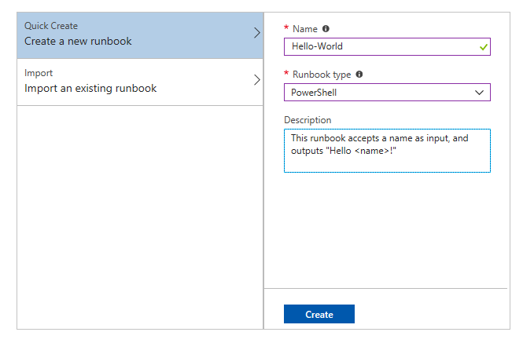
Automation using Runbook
Create Runbook

Slide 7
Publishing a runbook
When you create or import a new runbook, you must publish it before you can run it.
Method to Publish Runbook
Azure portal - open Runbook and click edit and click publish button to publish runbook.
Power shell - You can use the Publish-AzureRmAutomationRunbook cmdlet to publish a runbook with Windows PowerShell. The following sample commands show how to publish a runbook.
The following sample commands show how to create a new empty runbook.
$automationAccountName = "AutomationAccount"
$runbookName = "Sample_TestRunbook"
$RGName = "ResourceGroup"
Publish-AzureRmAutomationRunbook -AutomationAccountName $automationAccountName `
-Name $runbookName -ResourceGroupName $RGName

Slide 8
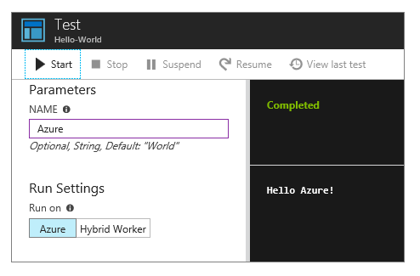
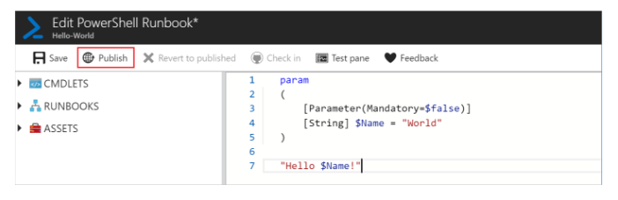
Publishing a runbook
Test Runbook
Publish

Slide 9
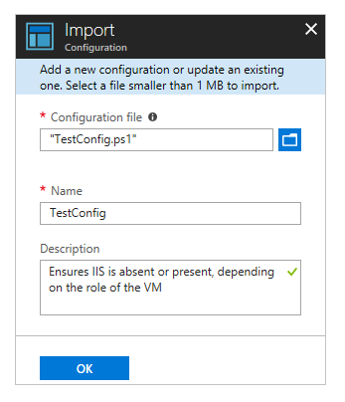
DSC – Desired State Configuration
By enabling Desired State Configuration (DSC), you can manage and monitor the configurations of your Windows and Linux servers. Configurations that drift from the desired configuration can be identified or auto-corrected.
Method to Create DSC script
Create a DSC script in power shell and save name with extension (.ps1) for ex – newDsc.ps1
Import configuration into Azure Automation by select State configuration (DSC) under Configuration Management on the State configuration (DSC) page, click the Configurations tab, then click + Add and browse the file

Slide 10
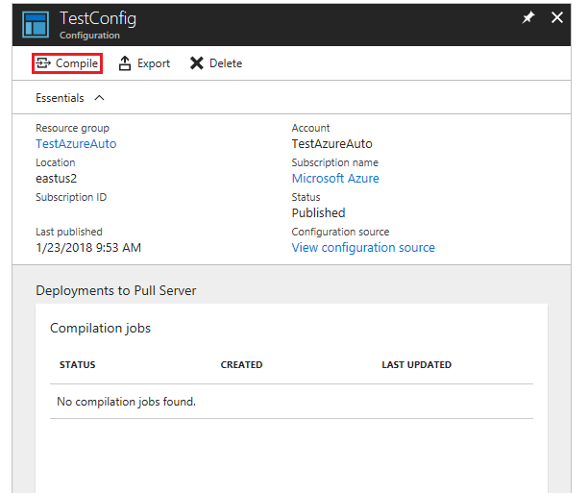
DSC – Desired State Configuration
Compile configuration by click the Configurations tab, then click the name of the previously imported configuration , On the Configuration page, click Compile, and then click Yes. This starts a compilation job.

Slide 11








What is Serverless computing
Serverless computing is the abstraction of servers, infrastructure and operating systems. When you build serverless apps you do not need to provision and manage any servers, so you can take your mind off infrastructure concerns.

Slide 12






Benefits Of Serverless

Slide 13




















Serverless application platform components

Slide 14







Introducing Azure Function
Easily build the apps you need using simple, serverless functions that scale to meet demand. Use the programming language of your choice and do not worry about servers or infrastructure.

Slide 15
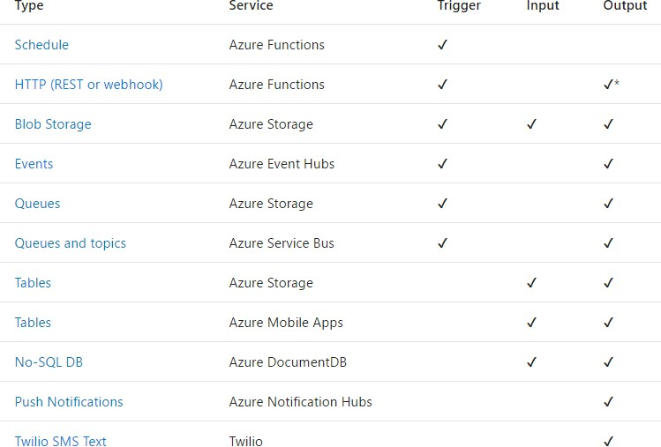
Triggers and bindings

Slide 16
Collect and search across data sources from multiple systems
With Azure Log Analytics, you can gather and search log data from all of your resources, whether they reside on Azure, on another cloud host, or on-premises. Then you can transform the gathered data into rich analytics with AI-enhanced insights into your environment.
Features of Log Analytics :
Data collection from multiple source.
Analyze data with Kusto Query language.
Set different type of condition alerts on the data collected.
Export log data to Excel and Power BI.
Can integrate to other azure services to collect logs.
Visualize logs in the form of table or charts.
Add custom solution to collect logs.
Rich query language support to retrieve, consolidate and analyze collected data.

Slide 17
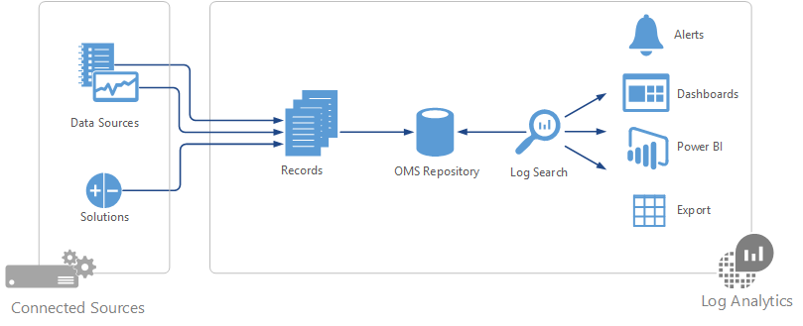
How Log Analytics Works

Slide 18
Data Collection
Different methods for collecting Data
Configure Azure Monitor to copy metrics and logs that it collects from Azure resources.
Agents on Windows and Linux virtual machines send telemetry from the guest operating system and applications to Log Analytics according to Data Sources that you configure.
Connect a System Center Operations Manager management group to Log Analytics to collect data from its agents.
Azure services such as Application Insights and Azure Security Center store their data directly in Log Analytics without any configuration.
Write data from PowerShell command line or Azure Automation runbook using Log Analytics cmdlets.
If you have custom requirements, then you can use the HTTP Data Collector API to write data to Log Analytics from any REST API client.

Slide 19
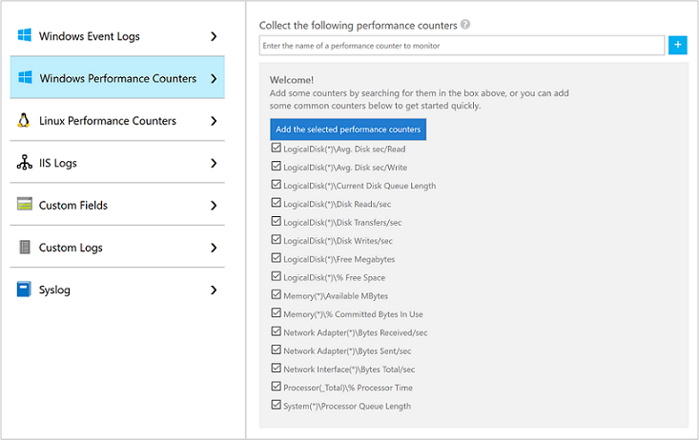
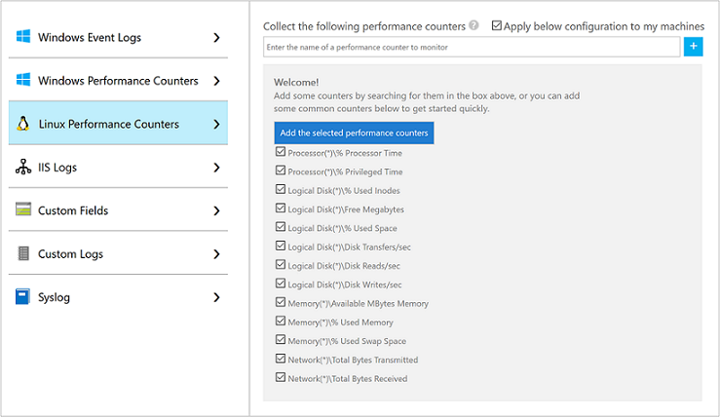
Azure VMs(Windows & Linux)
Create a workspace
Enable Log Analytics VM Extension

Slide 20
On Premise & AWS VMs(Windows ,Linux & SCOM )
Windows
Via Agent Install (Manual)
SCOM
Integrate Operation Manager with Log Analytics
ARM Template with Azure Stack
Linux
Via Agent Install (Manual)
Azure Automation DSC

Slide 21
Hand On Lab
1). create a runbook that give outputs Hello World by default and run that runbook on azure
2). Create a azure function with http-trigger.

