Slide 1




Manage Azure Security
and Recovery Service

Slide 2
Training Contents
Manage data protection and security compliance
Implement recovery services
Hands-on Labs

Slide 3
Azure Key Vault?
Azure Key Vault is a tool for securely storing and accessing secrets. A secret is anything that you want to tightly control access to, such as API keys, passwords, or certificates
Azure Key Vault helps solve the following problems :-
Azure Key Vault can be used to Securely store and tightly control access to tokens, passwords, certificates, API keys, and other secrets
Azure Key Vault can also be used as a Key Management solution. Azure Key Vault makes it easy to create and control the encryption keys used to encrypt your data.
The secrets and keys can be protected either by software or FIPS 140-2 Level 2 validates HSMs

Slide 4
Basic concepts
Here are some key terms
Tenant: A tenant is the organization that owns and manages a specific instance of Microsoft cloud services. It’s most often used in an exact manner to refer to the set of Azure and Office 365 services for an organization.
Vault owner: A vault owner can create a key vault and gain full access and control over it.
Resource: A resource is a manageable item that's available through Azure. Some common resources are a virtual machine, storage account, web app, database, and virtual network, but there are many more.
Resource group: A resource group is a container that holds related resources for an Azure solution.
Vault consumer: A vault consumer can perform actions on the assets inside the key vault when the vault owner grants the consumer access.
Azure Active Directory (Azure AD): Azure AD is the Active Directory service for a tenant. Each directory has one or more domains.
Azure tenant ID: A tenant ID is a unique way to identify an Azure AD instance within an Azure subscription.

Slide 5
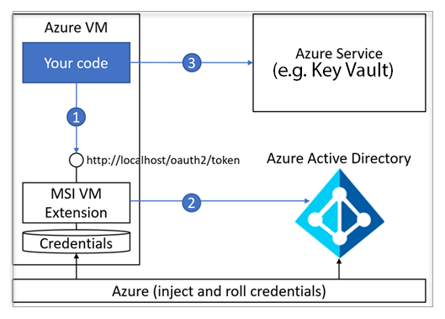
Basic concepts
Here are some key terms
Managed Service Identity: Azure Key Vault provides a way to securely store credentials and other keys and secrets, but your code needs to authenticate to Key Vault to retrieve them. Managed Service Identity makes solving this problem simpler by giving Azure services an automatically managed identity in Azure AD.

Slide 6
Azure Security Center
Azure Security Center provides unified security management and advanced threat protection across hybrid cloud workloads. With Security Center, you can apply security policies across your workloads, limit your exposure to threats, and detect and respond to attacks.
Why use Security Center?
Centralized policy management – Ensure compliance with company or regulatory security requirements by centrally managing security policies across all your hybrid cloud workloads.
Continuous security assessment – Monitor the security posture of machines, networks, storage and data services, and applications to discover potential security issues.
Actionable recommendations – Remediate security vulnerabilities before they can be exploited by attackers with prioritized and actionable security recommendations.
Prioritized alerts and incidents - Focus on the most critical threats first with prioritized security alerts and incidents.
Advanced cloud defenses – Reduce threats with just in time access to management ports and adaptive application controls running on your VMs.
Integrated security solutions - Collect, search, and analyze security data from a variety of sources, including connected partner solutions.

Slide 7
Azure Security Center
Health monitoring
Selecting a resource type under Resource health monitoring provides a list of resources and any vulnerabilities that have been identified. Resource types are compute & applications, networking, data & storage, and identity & access.
Under Compute, there are four tabs
Overview: monitoring and recommendations identified by Security Center.
VMs and computers: list of your VMs, computers, and current security state of each.
Cloud Services: list of your web and worker roles monitored by Security Center.
App services (Preview): list of your web applications and App service environments and current security state of each.

Slide 8
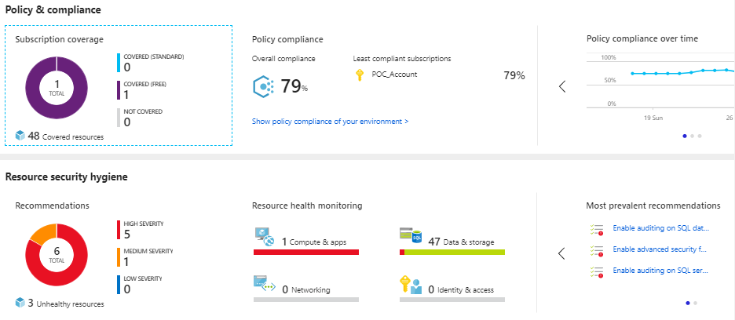
Azure Security Center
Health monitoring

Slide 9
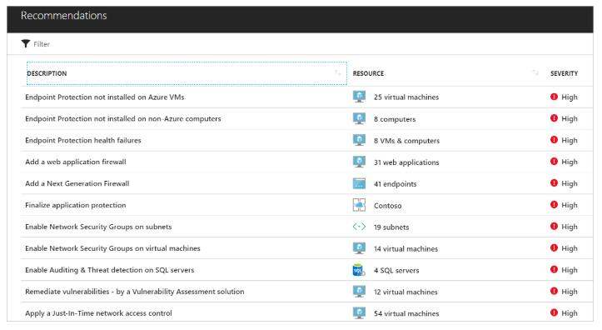
Azure Security Center
Actionable recommendations
Security Center analyzes the security state of your Azure and non-Azure resources to identify potential security vulnerabilities. Selecting Recommendations under Resources provides a list of prioritized security recommendations that guides you through the process of addressing security issues.

Slide 10
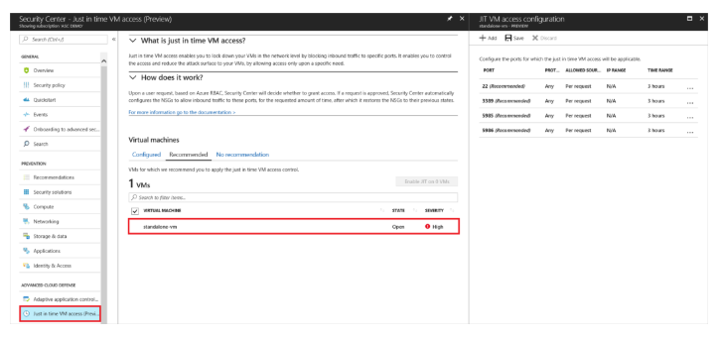
Azure Security Center
Just in time VM access
Reduce the network attack surface with just in time, controlled access to management ports on Azure VMs, drastically reducing exposure to brute force and other network attacks.
Notes:
Specify rules for how users can connect to virtual machines. When needed, access can be requested from Security Center or via PowerShell. As long as the request complies with the rules, access is automatically granted for the requested time.

Slide 11
Azure single sign-on
Single sign-on means being able to access all of the applications and resources that you need to do business, by signing in only once using a single user account. Once signed in, you can access all of the applications you need without being required to authenticate (for example, type a password) a second time.
Main building blocks single sign-on
Single sign-on enables users to access their SaaS applications based on their organizational account in Azure AD. Single sign-on is what enables users to authenticate to an application using their single organizational account.
User provisioning enables user provisioning and de-provisioning into target SaaS based on changes made in Windows Server Active Directory and/or Azure AD. A provisioned account is what enables a user to be authorized to use an application, after they have authenticated through single sign-on.
Centralized application access management in the Azure portal enables single point of SaaS application access and management, with the ability to delegate application access decision making and approvals to anyone in the organization

Slide 12
Azure single sign-on
When users sign in to an application, they go through an authentication process where they are required to prove that they are who they say they are. Without single sign-on, this authentication process is typically done by entering a password that is stored at the application, and users are required to know this password.
Three different ways to sign in to applications:
Federated single sign-on enables applications to redirect to Azure AD for user authentication instead of prompting for its own password. Federated single sign-on is supported for applications that support protocols such as SAML 2.0, WS-Federation, or OpenID Connect, and is the richest mode of single sign-on.
Password-based single sign-on enables secure application password storage and replay using a web browser extension or mobile app. Password-based single sign-on uses the existing process provided by the application, but enables an administrator to manage the passwords and does not require the user to know the password.
Existing single sign-on enables Azure AD to leverage any existing single sign-on that has been set up for the application, but enables these applications to be linked to the Office 365 or Azure AD access panel portals, and also enables additional reporting in Azure AD when the applications are launched there

Slide 13
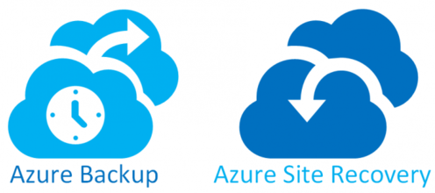
Azure Recovery Services
A Recovery Services vault is a storage entity in Azure that houses data. The data is typically copies of data, or configuration information for virtual machines (VMs), workloads, servers, or workstations. You can use Recovery Services vaults to hold backup data for various Azure services such as IaaS VMs (Linux or Windows) and Azure SQL databases.
Type of Recovery services
1). Azure Backup
2). Azure site recovery

Slide 14
Azure Backup
Azure Backup is the Azure-based service you can use to back up (or protect) and restore your data in the Microsoft cloud. Azure Backup replaces your existing on-premises or off-site backup solution with a cloud-based solution that is reliable, secure, and cost-competitive
key benefits:
Automatic storage management - Hybrid environments often require heterogeneous storage - some on-premises and some in the cloud.
Unlimited scaling - Azure Backup uses the underlying power and unlimited scale of the Azure cloud to deliver high-availability - with no maintenance or monitoring overhead.
Multiple storage options - An aspect of high-availability is storage replication. Azure Backup offers two types of replication: locally redundant storage and geo-redundant storage.
Unlimited data transfer - Azure Backup does not limit the amount of inbound or outbound data you transfer. Azure Backup also does not charge for the data that is transferred.
Data encryption - Data encryption allows for secure transmission and storage of your data in the public cloud.
Long-term retention - You can use Recovery Services vaults for short-term and long-term data retention. Azure doesn't limit the length of time data can remain in a Recovery Services vault.

Slide 15
Azure Backup
Azure Backup is the Azure-based service you can use to back up (or protect) and restore your data in the Microsoft cloud. Azure Backup replaces your existing on-premises or off-site backup solution with a cloud-based solution that is reliable, secure, and cost-competitive
key benefits:
Automatic storage management - Hybrid environments often require heterogeneous storage - some on-premises and some in the cloud.
Unlimited scaling - Azure Backup uses the underlying power and unlimited scale of the Azure cloud to deliver high-availability - with no maintenance or monitoring overhead.
Multiple storage options - An aspect of high-availability is storage replication. Azure Backup offers two types of replication: locally redundant storage and geo-redundant storage.
Unlimited data transfer - Azure Backup does not limit the amount of inbound or outbound data you transfer. Azure Backup also does not charge for the data that is transferred.
Data encryption - Data encryption allows for secure transmission and storage of your data in the public cloud.
Long-term retention - You can use Recovery Services vaults for short-term and long-term data retention. Azure doesn't limit the length of time data can remain in a Recovery Services vault.

Slide 16
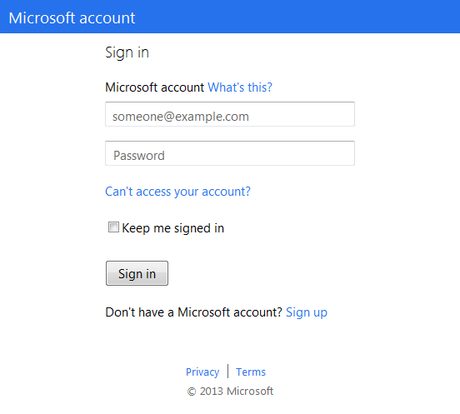
How Windows Azure Backup Works
1. Sign Up
2. Install Agent
3. Register and Configure
4. Backup
Encrypted Data
Window Server 2012
5. Recover - to the same or a different server

Slide 17
Azure Backup
Which applications and workloads can be backed up?
Data or Workload
Azure Backup solution
Files and folders
Hyper-V virtual machine (Windows)
Hyper-V virtual machine (Linux)
VMware virtual machine
Azure IaaS VMs (Windows)
Azure IaaS VMs (Linux)
Azure Backup agent + System Center DPM
Azure Backup agent + System Center DPM
Azure Backup agent + System Center DPM
Azure Backup agent + System Center DPM
Azure Backup (VM extension)
Azure Backup (VM extension)
Window Server 2012

Slide 18
Azure Site Recovery
Site Recovery service: Site Recovery helps ensure business continuity by keeping business apps and workloads running during outages. Site Recovery replicates workloads running on physical and virtual machines (VMs) from a primary site to a secondary location.
Replication scenarios
Replicate Azure VMs from one Azure region to another.
Replicate on-premises
VMware VMs
Hyper-V VMs
physical servers (Windows and Linux) to Azure.
Replicate on-premises
VMware VMs
Hyper-V VMs managed by System Center VMM
and physical servers to a Secondary site.
Window Server 2012

Slide 19


Azure Site Recovery
One solution for multiple infrastructures
Replication
Replication
SAN
SAN
Replication
Hyper-V
Microsoft Azure
Hyper-V
Hyper-V
Hyper-V
Hyper-V
1
Hyper-V to Hyper-V (on-premises)
2
Hyper-V to Hyper-V (on-premises)
3
Hyper-V to Microsoft Azure
Replication
Replication
Microsoft Azure
VMware or Physical
VMware
VMware or Physical
Window Server 2012
5
VMware or Physical to Microsoft Azure
4
VMware or Physical to VMware (on-premises)

Slide 20
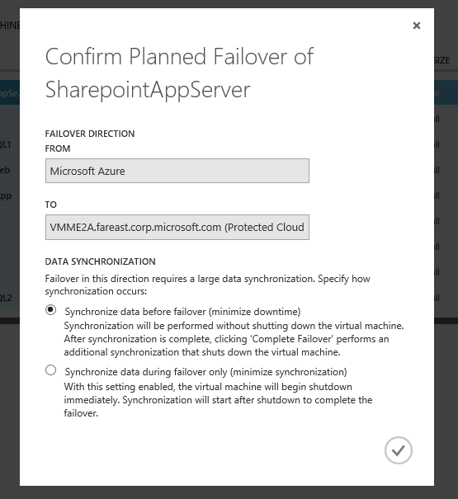
Azure Site Recovery
Executing recovery plans
Test failover: Useful to verify that your recovery plan and virtual machine failover strategy are working as expected.
Simulates your failover and recovery mechanism into an isolated network(s), that you define, or that can be created automatically.
Unplanned failover: Run an unplanned failover when a primary site experiences an unexpected incident, such as a power outage.
Planned failover: Perform a complete failover and recovery in your recovery plans in a proactive, planned manner. Non-replicated changes are applied to the replica virtual machine loss before bringing the VM online ensuring zero data loss
Flexible Failback: Flexible options for failback into on-premises environment.

Slide 21
Hand On Lab
1).Create VM and monitor health and threats by azure security center.
2). Create VM and create backup of vm in recovery service vault.

