Slide 1
SoCal DevOps Users Group Ansible with AWS: From Dev to Production
Apoorva Kulkarni
February 25, 2016

Slide 2
About Me
Sr. DevOps Engineer @ Telecommunication Systems, Inc (formerly Networks in Motion).
Focus on cloud architecture, production infrastructure for high availability and disaster recovery, devops pipeline, development side of operations
Previously Sr. Software Engineer @ 3Tera, Inc. which was acquired by CA Technologies.
Developer for 3Tera’s Xen based AppLogic cloud platform with focus on virtualized resource management

Slide 3
Outline
Ansible Introduction
Basic Usage with AWS
Challenges
Q & A

Slide 4
Ansible Intro
Automation tool for provisioning, configuration management, app deployment, continuous delivery, security & compliance, orchestration
Native integration for AWS, Digital Ocean, Cloudstack, Openstack, Google Cloud, Docker, Vmware and some more
Open source, highly active community on github and IRC
Ansible Tower for a web based solution targeted for enterprises – not free
RBAC
Monitoring of deployments
Job Scheduling
REST API
Recently acquired by RedHat
v2.0 just announced

Slide 5
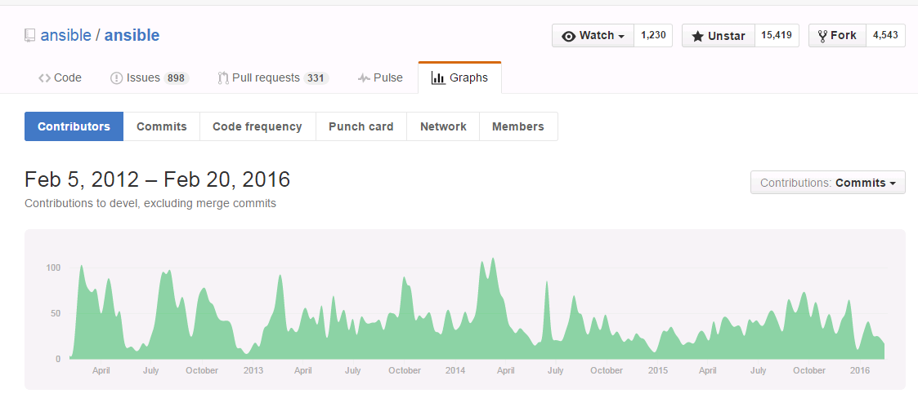
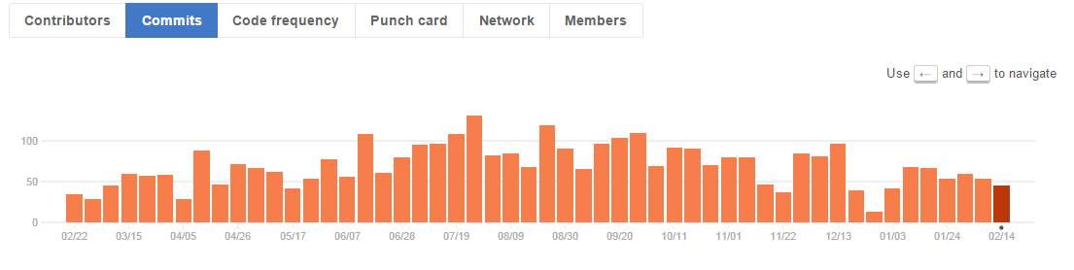
Ansible Intro (contd..)
(source: github.com/ansible/ansible)

Slide 6
Ansible Intro
Written in python, driven by yaml and jinja2 templates.
Agentless (over ssh by default)
no infrastructure to maintain yay!
$pip install ansible …and off you go
Static or dynamic (ec2, openstack) host inventory
BYO Source of Truth
Describe your infrastructure and input variables in group_vars/host_vars to be automatically imported
For each task, use one of the existing modules and plugins or write your own (in any language you want)
DRY – by grouping commonly used tasks through roles
Configure, deploy and orchestrate using playbooks to encapsulate your variables, tasks and roles

Slide 7
Ansible with AWS
Setup:
$pip install boto
export AWS_ACCESS_KEY=…
export AWS_SECRET_ACCESS_KEY=…
AWS Technologies
VPC, Regions, EC2, Launch Configuration, Autoscaling, ELB, KMS, DynamoDb, Route53

Slide 8
Ansible with AWS
$ansible-playbook –i localhost, setup_ec2.yml
# setup_ec2.yml
- hosts: localhost
connection: local
gather_facts: False
tasks:
- name: Provision a set of instances
ec2:
key_name: my_key
group: test
instance_type: t2.micro
image: "{{ ami_id }}"
wait: true
count: 2
instance_tags:
Name: Nginx
register: ec2

Slide 9
Ansible with AWS
$ansible-playbook –i inventory/ec2.py setup_nginx.yml
#setup_nginx.yml
- hosts: tag_Name_Nginx
gather_facts: True
vars:
- nginx_version: 1.6.2
- nginx_port: 8080
roles:
- common
- nginx

Slide 10
Ansible with AWS
Challenges
Same workflow for dev/qa/integ vs staging/production
Multi-region or multi-vpc deployment
Autoscaling
Storing and retrieving secrets
Quick and safe bootstrapping
Deployment patterns
Testing deployments

Slide 11
Ansible with AWS Same workflows and multi-region/vpc
Its all about how you structure the inventory
DRY – Organize variables in a hierarchy and use Ansible’s automatic variable import
Use separate VPCs or even better separate AWS accounts (and link those accounts for common billing)
Multi-region deployment is just another VPC

Slide 12
Ansible with AWS Same workflows and multi-region/vpc
Sample inventory structure
development # inventory file for development
production # inventory file for production
staging # inventory file for staging
group_vars/
webservers # vars for webservers group
databases # vars for databases group
host_vars/
bastion # vars for bastion host
nat # vars for nat host

Slide 13
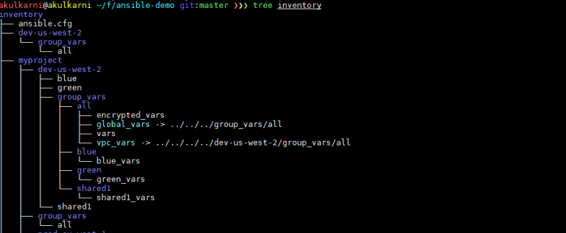
Ansible with AWS Same workflows and multi-region/vpc
VPC Variables such as vpc_id, route_table_ids, vpc_cidr, etc.
Host Files for dev such as ec2_tag_Env_Blue(or green)
Group Vars for dev
Reference to your myproject vars
Reference to your vpc vars
Group vars for blue/green such as source code versions to deploy
Group Vars for myproject such as charge_code tag, port_numbers
$ansible-playbook –i inventory/myproject/dev-us-west-2/blue
Will automatically import all VPC variables for dev-us-west-2 VPC + all group variable for myproject + all group variable for dev-us-west-2 + all blue variables
Notes:
Describe each level

Slide 14

Ansible with AWS
Challenges
Same workflow for dev/qa/integ vs staging/production
Multi-region or multi-vpc deployment
Autoscaling
Storing and retrieving secrets
Quick and safe bootstrapping
Deployment patterns
Testing deployments

Slide 15
Ansible with AWS Autoscaling
Inherently ansible is a push system
$ansible-playbook -i inventory/myproject/dev/hosts playbook.yml
BUT it can also work in a pull mode i.e.
$ansible-pull –o –U git://github.com/myrepo –C devel –d /var/project/myrepo –i inventory/myproject/dev/hosts playbook.yml
Bonus! Ansible-pull can only run when the git repo has changed
Setup a git/github/CodeCommit repository and push your ansible project

Slide 16
Ansible with AWS Autoscaling
Use EC2 user-data to setup a cron job to perform the ansible pull within your Launch Configuration
#user-data.sh
#!/bin/bash
pip install ansible==2.0
cat > /etc/cron.d/ansible-pull << EOF
*/15 * * * * root /usr/local/scripts/ansible_pull.sh
EOF
cat > /usr/local/scripts/ansible_pull.sh << EOF
instance_id=$(curl http://169.254.169.254/latest/meta-data/insance-id)
region=$(curl http://169.254.169.254/latest/meta-data/placement/availability_zone | sed ‘/.$//’)
git_branch=$(aws ec2 describe-tags --filters “Name=resource-id,Values=$instance_id” “Name=key,Value=git” --region=$region --output=text | cut –f5)
ansible-pull –o –U git://github.com/myrepo –C $git_branch –d /var/project/myrepo –i inventory/myproject/dev/blue playbook.yml
EOF

Slide 17
Ansible with AWS Autoscaling
Create Launch configuration and pass in the user-data.sh
ec2_lc:
name: lc-1
image_id: ami-XXX
key_name: default
security_groups: ['group', 'group2' ]
instance_type: t1.micro
user_data: “{{ lookup(‘file’, ‘user-data.sh’) }}”
volumes:
- device_name: /dev/sda1
volume_size: 100
device_type: io1
iops: 3000
delete_on_termination: true

Slide 18
Ansible with AWS Autoscaling
Create autoscaling group - Set a “git” ec2 tag
ec2_asg:
name: special
load_balancers: [ 'lb1' ]
launch_config_name: 'lc-1'
min_size: 1
max_size: 10
desired_capacity: 5
vpc_zone_identifier: [ 'subnet-abcd1234', 'subnet-1a2b3c4d' ]
tags:
- environment: production
- git: v1.0

Slide 19
Ansible with AWS
Challenges
Same workflow for dev/qa/integ vs staging/production
Multi-region or multi-vpc deployment
Autoscaling
Storing and retrieving secrets
Quick and safe bootstrapping
Deployment patterns
Testing deployments

Slide 20
Ansible with AWS Storing and Retrieving Secrets
Never store secrets as plain texts anywhere in the workflow
$ansible-vault [create|decrypt|edit|encrypt|rekey|view] [--help] [options] file_name
Create a separate vars file containing your secrets and encrypt it using ansible-vault before committing to git
$ansible-vault encrypt
inventory/myproject/dev/group_vars/encrypted_vars
Use credstash for managing secrets using AWS KMS and DynamoDB https://github.com/LuminalOSS/credstash
Installation
$pip install credstash

Slide 21
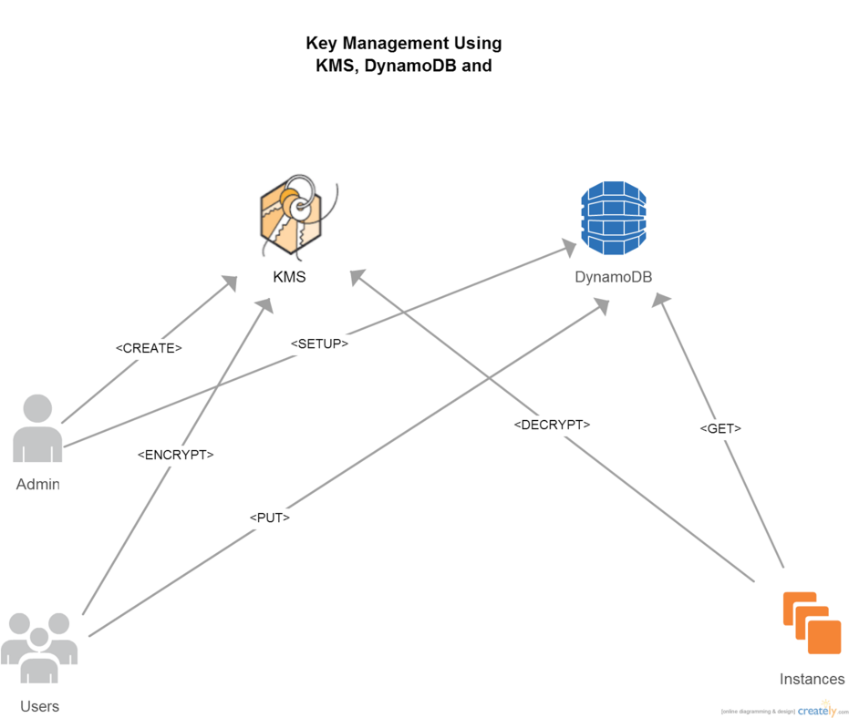
Ansible with AWS Storing and retreiving secrets

Slide 22
Ansible with AWS Storing and Retrieving Secrets
Storing
Create a KMS store and a key called “credstash” with auto-key rotation
Set the “Key Usage Permissions” to allow your IAM users/role
Create a DynamoDB table using credstash
$credstash –t production setup
Store an encrypted value of the ansible-vault password using “credstash” key from KMS
$credstash –t production vault-password <password>

Slide 23
Ansible with AWS Storing and Retrieving Secrets
Retrieving
Create a script that prints the vault-password to STDOUT (do this in user-data)
$cat > /var/project/.vault.sh << EOF
credstash -t tablename get vault-password
EOF
$chmod 600 /var/project/.vault.sh
Use --vault-password-file /var/project/.vault.sh in your ansible-pull command
$ansible-pull –o –U git://github.com/myrepo –C $git_branch –d /var/project/myrepo –i inventory/myproject/dev/hosts playbook.yml
--vault-password-file /var/project/.vault.sh
Ansible now has a credstash plugin
tasks:
- name: "Test credstash lookup plugin -- get the company's github password"
debug: msg="Credstash lookup! {{ lookup('credstash', 'company-github- password', table='company-passwords') }}"

Slide 24
Ansible with AWS
Challenges
Same workflow for dev/qa/integ vs staging/production
Multi-region or multi-vpc deployment
Autoscaling
Storing and retrieving secrets
Quick and safe bootstrapping
Deployment patterns
Testing deployments

Slide 25
Ansible with AWS Quick and Safe Bootstrapping
Create EC2 AMIs after the instance class has been thoroughly tested in development or staging
Avoid waiting for ansible-pull runs to complete thus reducing bootstrap times
Implement immutable systems
Avoid unintentional OS updates
Reduce risk of an unavailable web resource such as a 3rd party git branch that doesn’t exist anymore
What you tested is what you deploy
Ops/devs/qa can be certain that the environments that were tested match production so issues can be diagnosed outside of production

Slide 26
Ansible with AWS Quick and Safe Bootstrapping
Some work is needed to make this happen
Automate the workflow to create images based on your test result
Write a “find_ami” plugin to automatically set the AMI Id in the EC2 launch configuration
Ansible provides ec2_ami
But other tools such as Netflix’s aminator and HashiCorp’s packer also can be used

Slide 27
Ansible with AWS
Challenges
Same workflow for dev/qa/integ vs staging/production
Multi-region or multi-vpc deployment
Autoscaling
Storing and retrieving secrets
Quick and safe bootstrapping
Deployment patterns
Testing deployments

Slide 28
Ansible with AWS Deployment Patterns
Rolling Updates
First create a new LC using ansible
- ec2_lc:
name: my_new_lc
image_id: ami-XXX
name: default security_groups: ['group', 'group2' ]
instance_type: t1.micro
Replace all instances within an autoscaling group one-by-one
- ec2_asg:
name: myasg launch_config_name: my_new_lc
load_balancer: [‘my-elb’]
replace_all_instances: yes
replace_batch_size: 1
wait_for_instances: yes
wait_timeout: 300

Slide 29
Ansible with AWS Deployment Patterns
Blue - Green
Assuming “blue” environment exists bring “green” up
Bring up new ASG + ELB for each blue or green
Change DNS entry to point the traffic to the “green” environment
Hint: use Route53’s weighted DNS to change the weights between “blue” or “green” ELB
First bring blue up
$ansible-playbook –i inventory/myproject/prod-us-east-1/blue blue.yml –e “state=present”
Sets DNS weight for blue=1 and green=0
Then bring green up during next deployment cycle
$ansible-playbook –i inventory/myproject/prod-us-east-1/green green.yml -e “state=present”
Sets DNS weight for green=0 and blue=1
Terminate the old blue since its no longer needed
$ansible-playbook –i inventory/myproject/prod-us-east-1/blue blue.yml –e “state=absent”

Slide 30
Ansible with AWS Deployment Patterns
Blue – Violet
Similar to blue – green except the keep the ELB the same and just bring up new ASG side-by-side and then terminate the old once new is up
Old code needs to be able run side-by-side with new code
Bring up blue intially
$ansible-playbook
–i inventory/myproject/blue blue.yml
For new deployment, bring up violet and terminate old blue asg
$ansible-playbook
–i inventory/myproject/violet violet.yml
–e “terminate_other=yes”

Slide 31
Ansible with AWS
Challenges
Same workflow for dev/qa/integ vs staging/production
Multi-region or multi-vpc deployment
Autoscaling
Storing and retrieving secrets
Quick and safe bootstrapping
Deployment patterns
Testing deployments

Slide 32
Ansible with AWS Testing Deployments
Create a philosophy for Test Driven Deployment within the team
Roles should execute unit tests for your code
Playbooks should execute integration tests
Integrate end-to-end testing or loadtest at the end of the workflow
- post_tasks:
- name: run load test
command: /my/test/loadtest.py
delegate_to: “{{ locust_farm }}”
Report success/failures and summaries to chatrooms (if using hipchat, slack, etc.) for feedback

Slide 33
Ansible with AWS Testing Deployments
Ansible will ensure that things are declaratively true
E.g. no need to if yum install of a package is successful
Additional testing can be performed within roles
E.g. assert:
that:
- “’my_config_value=1’ in /etc/myproject.conf”
Evalute if you can use something like ansible_spec which is based on Rspec

Slide 34
Ansible with AWS
Challenges
Same workflow for dev/qa/integ vs staging/production
Multi-region or multi-vpc deployment
Autoscaling
Storing and retrieving secrets
Quick and safe bootstrapping
Deployment patterns
Testing deployments

Slide 35
References
https://docs.ansible.com/ansible/
http://jinja.pocoo.org/docs/dev/
https://github.com/fugue/credstash
https://www.ansible.com/blog/immutable-systems
https://github.com/Netflix/aminator
https://www.packer.io/
https://github.com/volanja/ansible_spec
http://martinfowler.com/bliki/ImmutableServer.html

Slide 36
Thank you!!
Sample project and presentation available at https://github.com/askulkarni2/ansible-demo
Email Me: askulkarni84@gmail.com
Questions?

