Slide 1
USARSim Tutorial
Controller Session

Slide 2
Outline
The mechanism
Communication protocol
Pyro with USARSim plug-in
Player with USARSim drivers
Video feedback
Notes:
We will at first talk about the robot control mechanism and the communication protocol. Then we introduce pyro with usarsim plig-in and player with usarsim drivers. At last we talk about video feedback.

Slide 3
The mechanism
Gamebots and TCP socket
  Every robot possesses one TCP socket
  Exchange data through the TCP socket
  Unreal Client(s) can connect to the server at anytime
Virtual robot
Unreal
Server
(response to
the command;
send out
sensor data)
Command
Gamebots
Command
Robot Controller
Sensor data
Sensor data
……
……
TCP Socket
Command
Command
Robot Controller
Sensor data
Sensor data
Unreal Client(s)
Notes:
The mechanism.
The controller controls the robot through Gamebots. It connects with Gamebots to get the TCP socket. Then it sends out command through the socket. The virtual robot gets the command through Gamebots and make responses. It can also sends out the sensor data to the controller through Gamebots. On the other hand, we can connect Unreal client to the unreal server at anytime.

Slide 4
The mechanism (cont.)
Workflow
Launch
server
Connect to Server
(get the socket)
Spawn
Robot 1
Send commands
Get sensor data
……
Connect to Server
(get the socket)
Spawn
Robot n
Send commands
Get sensor data
Launch Unreal Client(s)
Attach viewpoint(s)
Video feedback
Notes:
The workflow of controlling a robot is that, at first, we launch the server, then connect to the server, it’s actually the Gamebots. Then we spawn the robot, And then sends command and receives the sensor data. At the same time, we can attach the unreal client to unreal server and change the viewpoint to get video feedback.

Slide 5
Communication protocol
Gamebots protocol
  Format: data_type {segment1} {segment2} …
    data_type: the type of the data in upper case characters
      Examples: INIT, STA, SEN, DRIVE etc.
    segment: a list of name-value pairs separated by space
      Examples: {Location 100,200,300}, {Name Left Range 800.0} etc.
  Example
    INIT {ClassName USARBot.ATRVJr} {Location 200,600,-450}
  Two types of data
    Message (from the server)
    Command (from the client)
Notes:
The protocol used in communication is Gamebots protocol. It includes data_type in upper case characters and several segments in braces. Each segment is a serials of name-value pairs. For example, INIT is data type, this is a segment. ClassName is name, USARBot.ATRVJr is value. Location is name, 200 comma 600 comma negative 450 is value. There are two types of communication data, messages and commands.

Slide 6
Communication protocol (cont.)
Messages
  State message: the robot’s current state
    STA {Time t} {Camera pitch,yaw,roll} {Zoom fov} {Attitude pitch,yaw,roll} {Location x,y,z} {Velocity x,y,z} {LightToggle bool} {LightIntensity int} {Battery float}
  Sensor message: the sensor data
    Sonar Sensor
      SEN {Type Range} {Name string Range number} {Name string Range number} …
    Laser Sensor
      SEN {Type RangeScanner} {Name string} {Location x,y,z Rotation pitch,yaw,roll} {Range r1,r2,r3…}
    Human Motion Detection
      SEN {Type HumanMotion} {Name string} {Prob float}
    Sound Sensor
      SEN {Type Sound} {Name string} {Loudness float} {Duration float}
Notes:
Messages include state message, sensor message, geometry message and configuration message. Sate message describes robot’s current state. It include time, camera direction, camera fov, robot’s attitude, location, velocity, headlight and battery states. Sensor message is the sensor data. It starts with SEN and sensor type, sensor name and the actual sensor data.

Slide 7
Communication protocol (cont.)
  Geometry message: sensor’s geometry information
    GEO {Type string} {Name string Position x,y,z Direction pitch,yaw,roll} {Name string Position x,y,z Direction pitch,yaw,roll} …
  Configuration message: sensor’s configuration information
    CONF {Type string} {Name Value} {Name Value} …
Command
  Spawn robot
    INIT {ClassName robot_class} {Name robot_name} {Location x,y,z}
      robot_class: the class name of the robot. Example: USARBot.P2AT, USARBot.P2DX etc.
      robot_name: the robot’s name. Can be any string.
      x,y,z: the start position of the robot. For different arenas, we need different positions.
    Example
      INIT {ClassName USARBot.P2AT} {Location 312,-600,-305}
Notes:
Geometry message is the sensor’s geometry information. For example, the sensor’s position and direction. The configuration message is sensor’s configuration information like maximum, minimum detecting range.
There are four types of command: Robot Spawning command, wheel or joint command, camera command and query command. Spawn command add a robot in the Unreal world. ClassName is the type of the robot. Name is the robot’s name and location is the spawning position. For example, this command add a P2AT robot at location 312,-600,-305. The robot’s name use the system default name.

Slide 8
Communication protocol (cont.)
  Wheels/joint control
    DRIVE {Left float} {Right float} {Light bool} {Flip bool}
      Control the left, right side wheels; the headlight and car flipping.
      {Left float}: spin speed for the left side wheels.
      {Right float}: spin speed for the right side wheels.
      {Light bool}: whether turn on or turn off the headlight
      {Flip bool}: flip the robot when the value is true.
    DRIVE {Name string} {Steer int} {Order int} {Value float}
      Control A JOINT of the robot.
      {Name string}: the joint’s name
      {Steer int}: steer angle of the joint
      {Order int}: control mode. Can be zero-order, first-order or second-order control.
      {Value float}: the control value. According to the control mode, it can be angle, speed or torque.
    Examples:
      DRIVE {Left 1.0} {Right 1.0}
      DRIVE {Name LeftFWheel} {Order 1} {Value 2000}
Notes:
The drive command controls wheels or joint. Left is the spin speed of the left side wheels. Right is the spin speed of the right side wheels. The same left, right values will move the robot forward or backward. Different values will cause the robot turn left or right. Light turns on or turns off the head light and Flip can flip the robot when it roll over. This DRIVE command control a specific joint. Name is the joint’s name. Steer is the joint steering angle and order is the control order. It can be zero-order, first-order and second-order control. Value is the control value. For zero-order control, it’s the angle. For first-order control, it’s speed and for second-order control it’s torque. For example, this command control the robot move forward. And this command control the leftWheel joint spin in speed 2000.

Slide 9
Communication protocol (cont.)
  Camera control
    CAMERA {Rotation pitch,yaw,roll} {Order int} {Zoom int}
      {Rotation pitch,yaw,roll}: the rotation angle/speed of the camera. Can be relative or absolute value which is set on the robot's configuration file.
      {Order int}: control mode. Can be zero-order or first-order control.
      {Zoom int}: the camera’s filed of view in degree. Smaller or bigger FOV can give the zoom in or zoom out effect.
    Examples
      CAMERA {Rotation 1820,0,0} {Order 0}
      CAMERA {Zoom 20}
  Query command
    GETGEO {Type string}
      Queries the geometry information of all the sensors whose type is ‘string’.
      The return message is GEO message.
    GETCONF {Type string}
      Queries the configuration information of a ‘string’ type sensor.
      The return message is CONF message.
Notes:
Camera command rotates the camera. Rotation is the control value. Order is the control mode. It can be zero-order control or first-order control. For zero-order control, rotation is the angle. According to the robot’s configuration, this angle can be relative value or absolute value. Relative value means rotate the angle for example one degree based on the current direction. Absolute value means rotate to the angle. For example, robot the camera until it’s angle is 90 degrees. Zoom is the camera’s filed of view in degree. Changing fov is to a bigger value cause the zoom-out effect and a smaller value gives us the zoom-in effect. For example, this command pan the camera to 1820. Here 1820 is a integer. Except the fov, all the angle value use in messages and commands are integers. 0 means 0 degree and 65535 means 360 degrees. This command set the camera’s fov to 20 degree.
Query command queries the geometry and configuration information of a sensor. GETGEO asks for the geometry information of all the sensors with the specified type. GETCONF queries about a type of sensor’s configuration.

Slide 10
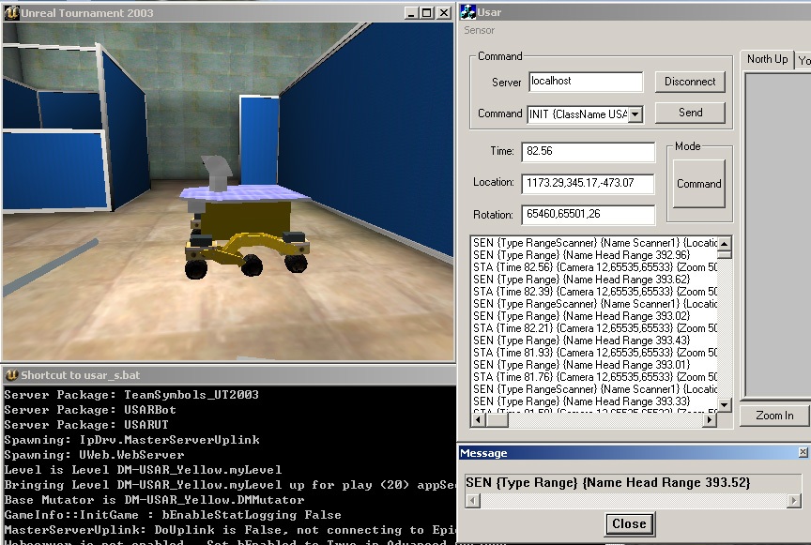
Communication protocol (cont.)
Command
Unreal Client
Sensor data
Unreal Server
Sonar Sensor
message
Notes:
<DEMO>

Slide 11
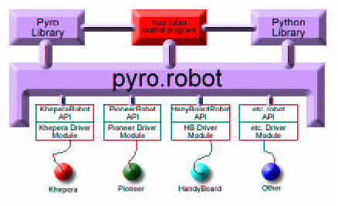
Pyro with USARSim plug-in
Pyro (from Blank et al. SIGCSE 2003.)
  “a Python library, environment, GUI, and low-level drivers used for explore AI and robotics”
Architecture
  Robot control programs (brains): Use a single API to write programs.
  pyro.robot: provides an abstraction layer on top of all the vendor-supplied robot-specific API’s.
  Pyro Library (services etc.): provides other abstractions and services to encapsulate lower-level details.
Notes:
Pyro is “a Python …”
This picture is pyro’s architecture. It includes pyro robot, pyro library and robot control program. Pyro robot provides an abstraction layer on top of all the robot’s specific APIs. Pyro library provides other abstractions and services to encapsulate lower-level details. Robot control program control the robot based on the abstraction robot layer, the pyro robot.

Slide 12
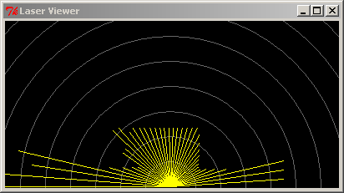
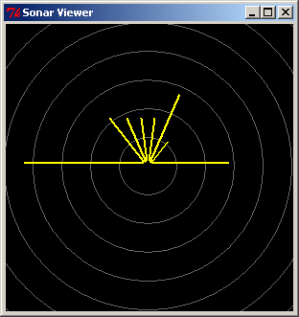
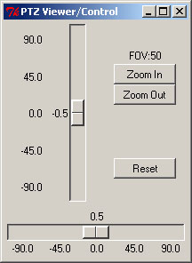
Pyro with USARSim plug-in (cont.)
USARSim plug-in
  Robot driver
    Abstract USARSim robot to pyro.robot
  Services
    New services to visualize sensor data and camera control (based on Python Client for Player/Stage)
  Simulator
    Load USARSim arenas
    Spawn USARSim robots in Unreal world
Pyro modification
    Port Pyro to windows (only the parts involved in USARSim)
Notes:
The USARSim plug-in is a pyro plug-in that integrates USARSim robots into pyro. It includes robot driver that abstracts USARSim robot to pyro robot. Servers that visualizes sensor data can provides camera control. For example, this is the laser sensor and this is the sonar sensor. The PTZ panel displays and controls the ptz camera. Simulator plug-in let pyro load USARSim arenas and spawn robot into unreal world. The pyro is also modified by us to support windows operation system.

Slide 13
Pyro with USARSim plug-in (cont.)
USARSim world file
  Specify
    Where the Unreal Server is
    Which arena will be load
    Where the robot will spawn
  Example
Path:
The installation path of Unreal.
App:
The application name of Unreal Client.
LoadServer:
Whether we need to load Unreal Server.
IP:
IP address of the Gamebots.
Port:
Port number of the Gamebots.
Map:
The arena we will use.
Location:
The initial position of robot.
[Server]
Path=c:\ut2003
App=ut2003.exe
LoadServer=true
IP=127.0.0.1
Port=3000
Map=DM-USAR_yellow
Location=1200,345,-450
Notes:
To use USARSim robot in pyro, we need to define the world file. In the world file, we tell pyro where the unreal server is, which arena we want to use and at which place the robot will be add. This is an example of the world file. Path is …

Slide 14
Pyro with USARSim plug-in (cont.)
Brain (see the Pyro manual http://pyrorobotics.org/pyro/?page=Pyro_20Brains)
#import the appropriate brain superclass
from pyro.brain.<SomeBrainClass> import *
# Define the robot's brain class
class <BrainName>(<SomeBrainClass>):
def setup(self):
# This is the default constructor
# (optional) method
# All code here is run once when the brain
# is loaded
# You can initialize fields, and start devices
# here
def step(self):
# All brains must have a Step method
# This method is executed 10 times/sec
# This is where you define the main control
# 'loop'
def destroy(self):
# This is the default destructor (optional)
# method
# Each time a brain is destroyed, this
# method is executed
# If you start devices in setup, you should
# stop them here (see text below)
# Define other methods of this class as
# appropriate
# end of <Brain Name> class
# Create a brain instance for the robot
def INIT(engine):
brain = <BrainName>('BrainName', engine)
print engine.robot.name + " robot now has " + brain.name + " brain."
return brain
Notes:
Brain is the robot control program. You actually control the robot at here. In the brain class, you need to setup method that initialize the brain, the step method that control the robot step by step and the destroy method that destroy the brain. At last, you need to ass the brain to Pyro.

Slide 15
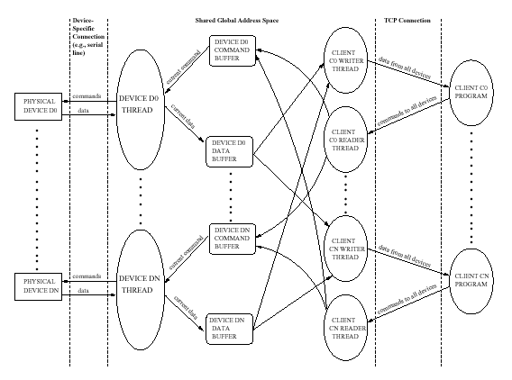
Player with USARSim drivers
Player (Gerkey et al. IROS 2001)
  “a robot device server that gives users simple and complete control over the sensors and actuators on the robot”
Architecture
  Server (Player)
    asynchronously
    communicates between
    the device and the client
  Devices
    Physical devices
    Virtual devices
  Client
    Control programs
Notes:
Player is “a robot …
This picture is the player architecture. The left side is the devices. They can be physical devices or virtual devices. The right side is client that controls the devices. The middle part is the server, player. It asynchronously communicates between the devices and the client.

Slide 16
Player with USARSim drivers (cont.)
USARSim drivers
  Objective
    encapsulates lower-level details
    communicates between USARSim devices and the clients
  The drivers:
    us_bot: bridge between Gamebots and Player devices.
      connect to Unreal server
      spawn robot
      collect and parse USARSim sensor data
      exchange data between other drivers and USARSim devices
    us_positiont/us_positiont3d : control the robot’s movement
Notes:
Our USARSim drivers encapsulate the low-level details and communicate between USARSim devices and the clients. The drivers include us_bot which is a bridge between Gamebots and player devices. It can connect to Unreal server, spawn robot, collect and parse sensor data and exchange data between other drives and USARSim devices. Us_position and us_position3d are the drivers that control UASRSim robot’s movement.

Slide 17
Player with USARSim drivers (cont.)
    us_sonar: access all the sonar sensors
    us_laser: access a laser sensor
    us_ptz: control the ptz camera
USARSim Player Configuration
  Define the USARSim environment
    Where is the Unreal Server (the Gamebots)
    Which Robot is being used
    Where is the Robot’s spawning position
  Define USARSim devices
    Where is the devices
    How to connect to the devices (the driver)
Notes:
Us_sonar and us_laser are the drivers that access the sonar sensors and laser sensor. Us_ptz is the camera control driver. To use Player, we need to edit the configuration file. In the file, we define the USARSim environment and USARSim devices. The USARSim environment includes the location of the unreal server, the type of the robot and the robot’s spawning position. The devices definition define where is the USARSim devices and how to connect to the devices, that is what driver is used to access the devices.

Slide 18
Player with USARSim drivers (cont.)
  Example
simulation:0 (
driver "us_bot"
host "127.0.0.1"
port 3000
pos "1200,345,-450"
bot "USARBot.ATRVJr"
)
position:0 (
driver "us_position"
simulation_index 0
)
laser:0 (
driver "us_laser"
simulation_index 0
)
…
IP address of Gamebots
USARSim environment.
Port number of Gamebots
Robot’s spawning position
The Robot in the world
USARSim device (position)
Specify which robot this device belongs.
USARSim device (laser)
Notes:
This is an example of the Player configuration. The simulation section defines USARSim environment. 0 is the index of the simulation. In the section, host and port specify the unreal server. pos define the USASRim robot’s position and bot define the robot’s type. Position and laser are the USARSim devices. Simulation_index specifies where the device is mounted. 0 means the device uses the USARSim environment with index 0.

Slide 19
Video feedback
The ways to get/use video feedback
  Directly using Unreal Client
    Using Unreal Client as another separate feedback panel. Or.
    Embedding Unreal Client into your application
    Technically easy.
    Can’t simulate frame rate.
  Capturing scenes in Unreal Client
    Locally capture the pictures. Or.
    Receive pictures from the Image Server (capture picture on the remote image server)
    Technically difficult
    Simulate how the real camera works
Notes:
Video feedback.
Video feedback is the main feedback used in robot control. We have two ways to get or use video feedback in USARSim. One is directly using Unreal client. We can use unreal client either as a separate sensor panel or embed unreal client into our application. Another way to get or use video feedback is capturing Unreal client and use the picture in our application. We can locally capture the pictures or receive pictures from an image server. The image server actually
captures unreal client and sends out pictures to our application. The directly using method is easy but can’t simulate video frame rate. The capturing method is complex. But it’s very close to the real camera feedback. I will introduce embedding, locally capturing and image server.

Slide 20
Video feedback (cont.)
Embedding Unreal Client into your application
  under windows
    Get window handle of Unreal Client
      CWnd * m_AppWnd = FindWindow(NULL, “Unreal Tournament 2003”);
    Move and scale Unreal Client to the desired region
      m_AppWnd->SetWindowPos(this, 60, 40, 400, 300, NULL);
      “This” is the pointer of your application.
    Modify Unreal Client’s window style
      m_AppWnd->ModifyStyle(WS_CAPTION, NULL, SWP_DRAWFRAME);
      m_AppWnd->ModifyStyle(WS_THICKFRAME, NULL, SWP_DRAWFRAME);
    Set Unreal Client’s parent window
      m_AppWnd->SetParent(this);
      “This” is the pointer of your application.
Notes:
Under windows, to embed unreal client into an application, we need to 1) get window handle of Unreal client. For example, we can use findwindow() function. 2) move and scale unreal client. We can use SetWindowPos() function to place the Unreal client. 3) Modify unreal client’s window style. So it looks like one part of your application. For example, this line remove the title bar, this line remove the frame border. And at last, we set our application to be Unreal client’s parent.

Slide 21
Video feedback (cont.)
Capturing Unreal Client
  Mechanism
    Hooking DirectX by Detours (instrumenting library built by Microsoft Reasearch)
    Copying back buffer of DirectX into shared memory
  Procedure
    We provide the Hook.dll to capture pictures. To use it:
    Attach Hook.dll to Unreal Client
      Using DetourCreateProcessWithDll() to load Unreal Client
    Get the address of the shared memory
      Get and call the getFrameData() function of Hook.dll
    Access the memory to get the picture
Notes:
Capturing unreal client.
The method is that we hook DirectX by detours and then copy the back buffer of DirextX into shared memory. Then we can directly access the shared memory to get the Unreal Client pictures. Detours is a library that helps you insert your code into a windows function without known the function’s source codes. We provide the dynamic link library Hook.dll to capture unreal client. Basically, we need three steps to use it. 1) is attaching hook.dll to Unreal client. So it can capture the Unreal client. Then we need to get the address of the shared memory. The getFrameData() function of hook.dll can return you the shared memory address. Then we access the memory to get the pictures.

Slide 22
Video feedback (cont.)
  Image data format
    state: The state of the shared memory
      FRAME_PENDING: memory is in using
      FRAME_OK: memory is ready
      FRAME_ERROR: something wrong
    sequence: The sequence of the image data
      Hook.dll only captures picture when it gets a new sequence number
    width: Width of the captured picture
    height: Height of the captured picture
    size: Data length in the ‘data’ array in bytes
    data: The actual image data stored from left to right, from top to bottom in RGB style. Every color occupies 1 byte.
#define FRAME_PENDING 0
#define FRAME_OK 1
#define FRAME_ERROR 2
typedef struct FrameData_t {
BYTE state;
BYTE sequence;
USHORT width;
USHORT height;
UINT size;
BYTE data[640*480*3+1];
} FrameData;
Notes:
The data stored in the shared memory is image data. This is its data structure. State is the memory’s state. It can be frame-pending, frame-ok or frame-error. Frame-pending means memory is in using. Frame-ok means the memory is ok and frame-error means something is wrong. Sequence is the sequence number of the image data. Hook.dll only capture a picture when it gets a new sequence number. Width and height are the picture’s size. And size is the picture’s data length. Data stores the actual picture data. The biggest picture can be stored is the picture with width is 640 and height is 480. Every pixel is represented by one byte red, one byte green and one byte blue.

Slide 23
Video feedback (cont.)
Using Image Server
  The Image Server workflow
    Send out a picture when the client connects with it.
    Wait for the acknowledgement form the client.
    If the current time is the sending time triggered in the specified frame rate, then send out the next picture.
    Go to step 2).
  The procedure
Start Unreal Server
Start Image Server
Connect to Image Server
Receive image
& Send ack.
Adjust viewpoint (we can do it at anytime)
Notes:
Image server simulates the web camera. It sends out the picture when the client connect with it. Then it waits for the acknowledgement from the client and sends out the next picture according to the specified frame rate. The procedure of using image server is that: start unreal server, and image server and then you can adjust the viewpoint. For example attach the viewpoint to a camera. And then on the client side, we connect to the image server. Then we can receive pictures and send back acknowledgement.

Slide 24
Video feedback (cont.)
  Image data
    ImageType (1 byte) + ImageSize (4 bytes) + ImageData (n bytes)
    ImageType: The format of the image.
      0: raw data
      1~5: jpeg with quality from super to bad
    ImageSize: The total length of ImageData in bytes
    ImageData: The actual data of the image
      Raw data:
      width (2 bytes) + height (2 bytes) + RGB (1 byte + 1 byte + 1 byte) data
        from left to right, from top to bottom.
      Jpeg data: the real jpeg data
  Communicate protocol
    send acknowledgement 'OK' (in plain text) after received a picture
Notes:
The format of the transferred data is one byte image type plus 4 bytes image size and the real image data. For the image type, 0 means raw data. 1 to 5 means the jpeg data with different quality. 1 is supper quality and 5 is bad quality. Image size of data length of the real image data. For raw image, the image data is 2 bytes width plus 2 bytes height and the rgb data from left to right, from top to bottom.
The communication protocol of image transfer is very simple. You just send back ‘OK’ in plain text after you got the whole picture.

Slide 25
Summary
Robot control
Communicate Protocol: data_type {segment1} {segment2} …
Pyro
  ❑ Configure the world file  Build your “brain”
Player
  ❑ Configure the configuration file  Build your client program
Video feedback
  Using Unreal Client as a separate panel
  Embedding Unreal Client into your application
  Directly capturing Unreal Client (Hook.dll)
  Receiving pictures from the Image Server (image server)
Unreal Server
Gamebots
commands
Controller (Send commands;
Get sensor data)
messages
Notes:
In summary, we control robot through Gamebots. We send commands to unreal server and unreal server makes responses and sends sensor messages to our control application. The communication protocol is Gamebots protocol. The data include one data type and several segments in braces. Pyro and player is the tools can help us control the robot. To use them, we need to edit the world file or configuration file. And them we can build the control program on the abstract layer which encapsulates the lower level details. We can get and use video feedback in four ways. One is using unreal client as a separate sensor panel. One is embedding unreal client into application. And one is directly capturing unreal client and one is getting pictures through the simulated web camera, the image server.

