Slide 1
Coursera Capstone
IBM Applied Data Science Capstone
opening a new bar in the city of London& looking for a happy place to live. By:Mohammad Aslam
July 2020

Slide 2
Business Problem
1)The objective of this capstone project is to analyse and select the best locations in the city of London to start a family or living or moving in from other places
•
2).The best place in the city of london to start a “Bar”. Using the techniques learnt throughout the course I aim to solve the problem.

Slide 3
Data
Data required
List of neighbourhoods in London
Latitude and longitude coordinates of the neighbourhoods
Venue data, particularly data related to Bar.
□ Data on happiness index.
Sources of data
london data store:burrough profiles.
Geocoder package for latitude and longitude coordinates
Foursquare API for venue data

Slide 4
Methodology
Web scraping Wikipedia page for neighbourhoods list
Get latitude and longitude coordinates using Geocoder
map and clustter the happiness index data
Use Foursquare API to get venue data
Group data by neighbourhood and taking the mean of the frequency of occurrence of each venue category
Filter venue category by Bar
Perform clustering on the data by using k-means clustering
Visualize the clusters in a map using Folium

Slide 5
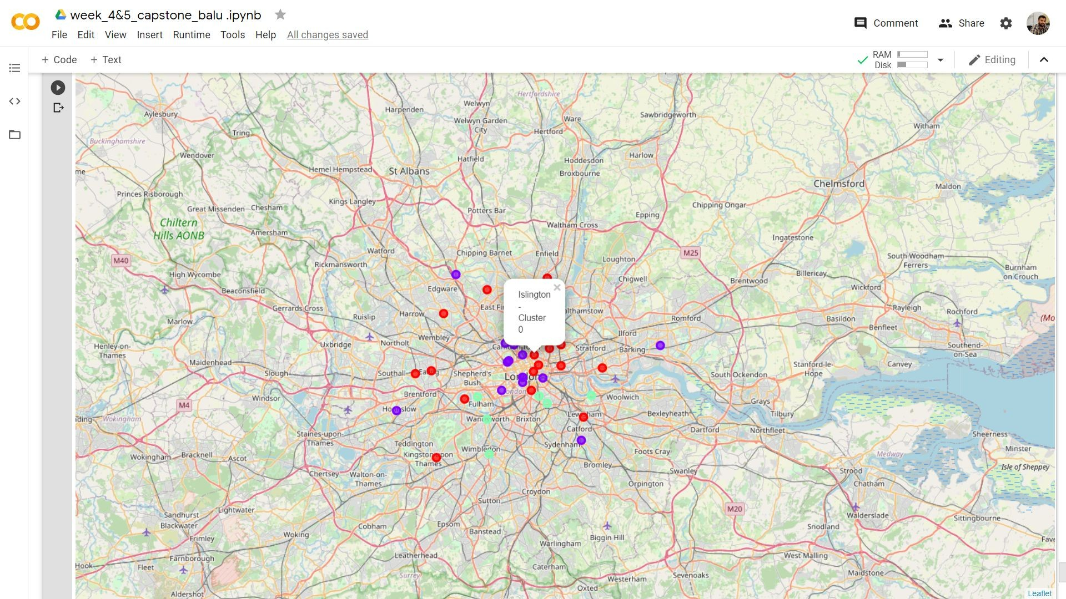
Results
Categorized the neighbourhoods into 3 clusters :
Cluster 0: Neighbourhoods with highno of bars.
Cluster 1: Neighbourhoods with moderate number to no of bars
Cluster 2: Neighbourhoods with low concentration of shopping malls

Slide 6
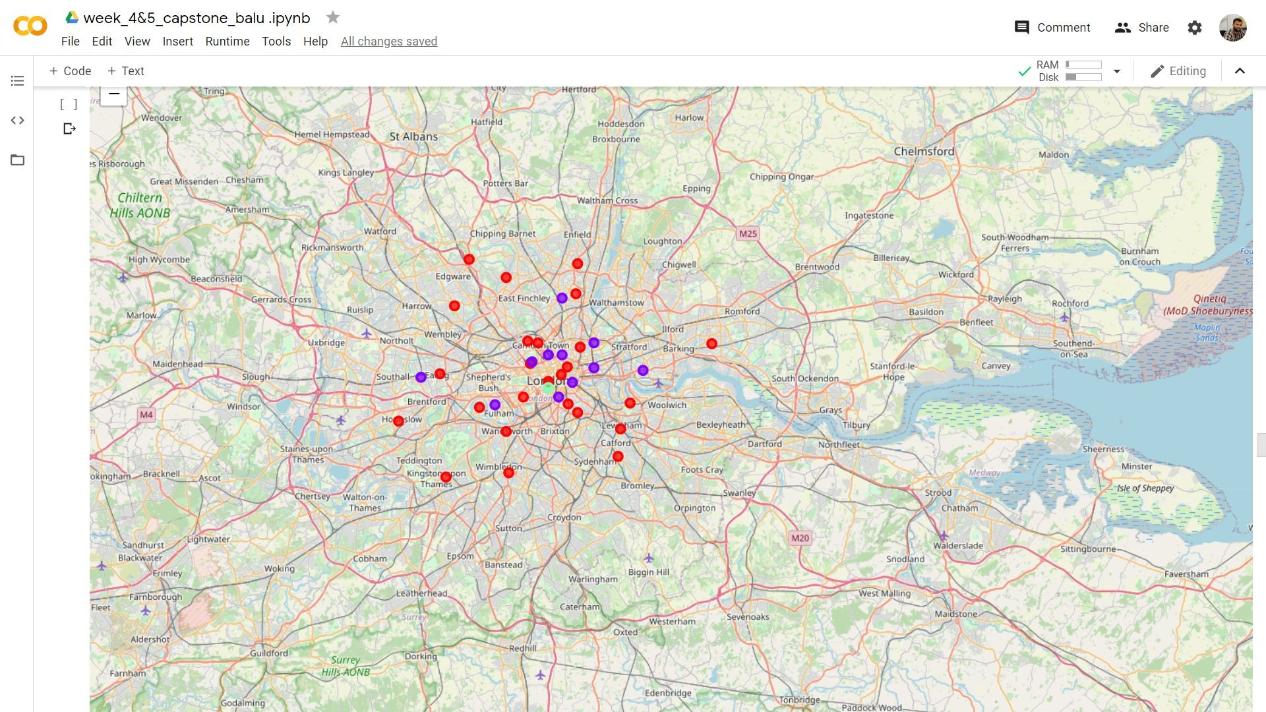
Results
All the areas in the city of London ,England have been clustered into three regions as shown above in the map
.They have been clustered based on the happiness index,worthwhileness index
,life satisfaction indices that give the overall living index of these areas.

Slide 7
Discussion
The results from the k-means clustering of bars show that we can categorize the neighbourhoods into 3 clusters based on the frequency of occurrence for “bars”
Cluster 0: Neighbourhoods with high number of bars
Cluster 1: Neighbourhoods with moderate number to no existence of “bars”
Cluster 2: Neighbourhoods with low concentration of bara

Slide 8
Recommendation
Open new shopping malls in neighbourhoods in cluster 1 with little to no competition
Can also open in neighbourhoods in cluster 0 with moderate competition if have unique selling propositions to stand out from the competition
Avoid neighbourhoods in cluster 2, already high concentration of shopping malls and intense competition

Slide 9
Conclusion
Answer to business question: The neighbourhoods in cluster 1 are the most preferred locations to open a new shopping mall
Findings of this project will help the relevant stakeholders to capitalize
on the opportunities on high potential locations while avoiding overcrowded areas in their decisions to open a new shopping mall

Slide 10

Thank you!

