Slide 1
An AI-Driven Self-Service Tool for Incident Triaging & Prevention
Aslam Mohamed Ehiya

Slide 2
Problem Statement | Proposed Solution
User issues are written in unstructured natural language. Mapping user symptoms to technical issues is difficult. Manual searching of past incidents delays triaging. Recurring incidents are not detected automatically. Resolution steps are inconsistent across L1/L2 teams. High dependency on L1 agents increases MTTR. Large ITSM repositories (ServiceNow/Jira) are underutilized. No automation exists for repeated or known issue types. | Use NLP embeddings to understand user issue descriptions. Implement FAISS-based semantic search to retrieve similar incidents instantly. Detect recurring issues using clustering (KMeans/HDBSCAN). Provide ranked resolution steps from historical fixes. Train XGBoost to recommend or trigger auto-heal actions. Integrate KB + incident retrieval for unified guidance. Provide an AI-assisted interface for L1/L2 teams. Use MLOps (MLflow, Docker, CI/CD) for continuous improvement.

Slide 3
Research Paper references
Each research paper contributes a foundational component:
The FAISS paper supports our semantic retrieval engine
The XGBoost paper guides our model choice for auto-heal decisioning.
The AIOps paper validates our automation approach.
Research Paper | Author(s) | Key Concept Learned
Billion-Scale Similarity Search with GPUs | Jeff Johnson, Matthijs Douze, Hervé Jégou | Demonstrates scalable semantic similarity search; validates using FAISS for fast incident retrieval and future scaling to large ITSM datasets.
AIOps in Cloud-Native DevOps: IT Operations Management with AI | Sumanth Tatineni | Supports automation-driven incident management; reinforces need for intelligent triaging, pattern detection, and automated remediation within IIRAF.
XGBoost: A Scalable Tree Boosting System | Tianqi Chen & Carlos Guestrin | Justifies using XGBoost for auto-heal predictions; highlights performance, scalability, and suitability for tabular incident data.

Slide 4









System Architecture & Data Flow
User / Chat Interface
1. The Entry Point User reports an issue (e.g., "Payment Error") via Chat/Portal. Raw text payload is sent to backend.
App Chat, Portal, Teams
2. The Gateway (API) API Layer authenticates the request and routes traffic to specific engines for processing.
IIRAF API Layer
FastAPI / Flask / Node.js
3. Intelligence Retrieval System converts text to vectors to find similar historical incidents and relevant KB articles simultaneously.
Semantic Search
Knowledge Base Hub
Incident Plugin Layer
FAISS / Pinecone
ElasticSearch / Confluence
ServiceNow / Jira Connectors
4. Decision & Action Pattern Detector flags recurring issues. Validated patterns trigger the Autoheal Executor scripts.
Pattern Detector
Autoheal Executor
Feedback Processor
ML Models + Rule Engine
Agentic Actions / Scripts
Retrain / Refine Models
5. Persistence Incident data and patterns are stored. Audit logs record automated actions. Team is notified.
Storage Layer
Audit Logs
Notification
PostgreSQL / S3
Action History
Email / Slack Queue

Slide 5
Tech Stack Overview
Each tool was selected based on practicality for a PoC and scalability for an enterprise deployment.
SentenceTransformers + FAISS give strong semantic search.
Scikit-learn + XGBoost cover pattern detection and auto-heal decisions.
FastAPI + Docker provide a clean deployment layer.
MLflow and GitHub Actions ensure reproducibility
Airflow/Prefect are planned for future retraining automation.
Tool | Purpose | Why Used in IIRAF (Concise)
Sentence Transformers (MiniLM-L6-V2) | Generate semantic embeddings | Fast, accurate text understanding for incident similarity
FAISS | Vector similarity search | Extremely fast retrieval of similar incidents/KB articles
Scikit-learn (KMeans/HDBSCAN) | Pattern detection | Simple, reliable clustering for recurring issues
XGBoost | Auto-heal prediction | High accuracy on tabular incident data; industry standard
FastAPI | Serve models & APIs | Lightweight, fast, ideal for ML inference
MLflow | Track experiments & models | Ensures reproducibility and organized model versions
GitHub Actions | CI automation | Quick automated checks for stable code builds
Docker | Containerization | Consistent, portable deployment across environments
Docker Compose | Multi-service setup | Easy local orchestration of API + DB + vector store
Airflow / Prefect (Future) | Automated retraining | Scales to periodic retraining & pipeline automation

Slide 6
Performance Measures
Precision@K & Recall@K → measure accuracy of semantic incident retrieval.
Silhouette Score → evaluates clustering quality for pattern detection.
F1 Score & ROC-AUC → assess auto-heal prediction model performance.
MTTR Reduction → measures improvement in incident resolution time.
Repeated Incident Reduction → evaluates effectiveness of pattern detection.
Auto-Heal Success Rate → tracks how often automated fixes resolve issues correctly.
User/Agent Satisfaction Feedback → checks usability and clarity of AI recommendations.
Execution / Roadmap:
Data creation → Semantic search → Retrieval.
Pattern detection → Auto‑heal model.
API + Ticketing integration → Evaluation.

Slide 7
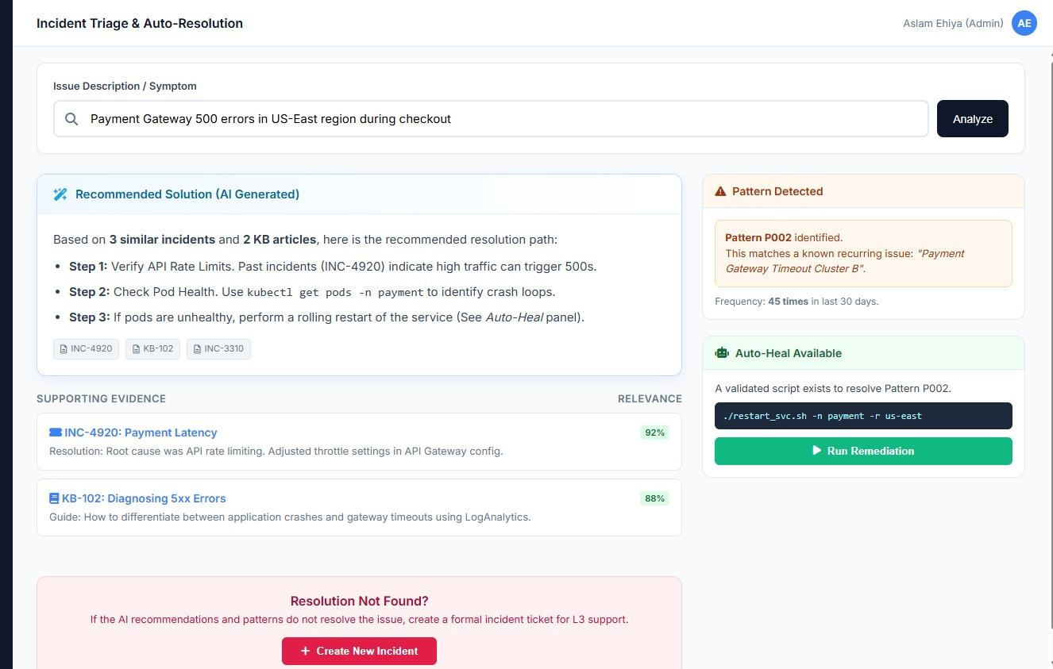
Sample / Mock screen

