Slide 1
DUAL INPUT NON ISOLATED DC DC CONVERTER WITH VEHICLE TO GRID FEATURE
Project batch members:
Abhinand UD - PRN19EE002
Muhammed Aslam A - PRN19EE030
Sreehari T - PRN19EE043
Thanveer Shahal - PRN19EE044
Guided by:
Mrs. Ajisha S

Slide 2
CONTENTS
Introduction
Literature review
Problem identification
Objectives
Existing system
Proposed system
Component design
Simulink model and results
Hardware implementation and results
Estimate
Advantages
Applications
References

Slide 3
INTRODUCTION
Throughout the world, the focus is given for developing suitable technologies to provide clean energy to protect the environment
Conventionally, parallel-connected single input-single output DC-DC converters are used in hybrid energy system
The dedicated reactive elements, semiconductor switches and controller of each parallel-connected systems lead to increase the cost, size and complexity.
To overcome these demerits, the 'Multi-Input single output DC-DC Converters are introduced.

Slide 4
LITERATURE REVIEW
Paper Title | Objectives
S. K. Haghighian, S. Tohidi, M. R. Feyzi, and M. Sabahi, “Design and analysis of a novel SEPIC-based multi-input DC/DC converter,” IET Power Electron., vol. 10, no. 12, pp. 1393–1402, 2017. | A novel single-ended primary-inductor converter (SEPIC)-based multi-input DC/DC converter is presented. The structure inherits all the advantages of the SEPIC converter such as step-up/down capability without inverting the polarity of the regulated output voltage. It is suitable to charge–discharge the ESS and to extract maximum power from the photovoltaic panels.
M. Zandi, A. Payman, J. P. Martin, S. Pierfederici, B. Davat, and F.Meibody Tabar, “Energymanagementof a fuel cell/supercapacitor/battery power source for electric vehicular applications,” IEEE Trans. Veh. Technol., vol. 60, no. 2, pp. 433–443, 2011 | An energy management method in an electrical hybrid power source (EHPS) for electric vehicular applications. The method is based on the flatness control technique (FCT) and fuzzy logic control (FLC).The main property of this strategy is that the energy management in the power source is carried out with a single general control algorithm in different operating modes, consequently avoiding any algorithm commutation

Slide 5
LITERATURE REVIEW
Paper Title | Objectives
T. K. Santhosh and C. Govindaraju, “Dual input dual output power converter with one-step-ahead control for hybrid electric vehicle applications,” IET Electr. Syst. Transp., vol. 7, no. 3, pp. 190–200, 2017. | A simplified structure of dual input dual output (DIDO) with single-stage power conversion for hybrid electric vehicle accessory applications.The generic switch model-based DIDO is realised with power switches based on switch realisation technique.A one-step-ahead controller is used for inductor current control in conjunction with a mode selection logic to utilise its operating modes based on the availability of the sources and its protection
D. Yang, M. Yang, and X. Ruan, “One-cycle control for a double-input DC/DC converter,” IEEE Trans. Power Electron., vol. 27, no. 11, pp. 4646–4655, 2012. | An one-cycle control (OCC) for double-input buck converter (DIBC) to eliminate the interactions of the control loops and, thus, to simplify the design of the controllers. The mode transition circuit is further proposed to realize seamless mode transition, according to the available renewable energy and the output power.

Slide 6
OBJECTIVIES
In conventional system, more number of DC-DC converters are needed for different modes of operation when connecting more than one source.
During braking in the case of EV’s, kinetic energy can be recoverd and can be converted into an immediately usable form or be stored until required by regenration. In this existing system, this energy is not being recovered efficiently.
By implementing regneration braking through motor vehicle’s kinetic energy is converted back to electrical energy during braking. The converted electrical energy is stored in energy storage devices such as batteries, ultracapacitors or ultrahigh speed flywheels to extent the driving range by upto some extent.
Also BLDC motor is used in the proposed project, so a 3 phase BLDC drive circuit is also designed

Slide 7
EXISTING SYSTEM
PV CELL
DC-DC CONVERTER
BLDC
MOTOR
DC-DC CONVERTER
BATTERY

Slide 8
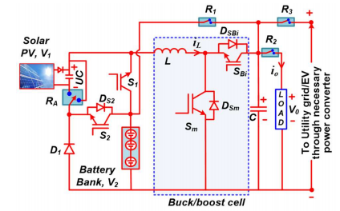
PROPOSED SYSTEM

Slide 9
PROPOSED SYSTEM
Types of operation:
Type i - C-boost operation
Type ii. Solar PV-powered operation
Type iii. Battery-powered operation
Type iv. Battery charging from solar PV in parking mode
Type v. Power flow from V2V or V2G in parking mode
Type vi. Bidirectional rear-buck operation

Slide 10
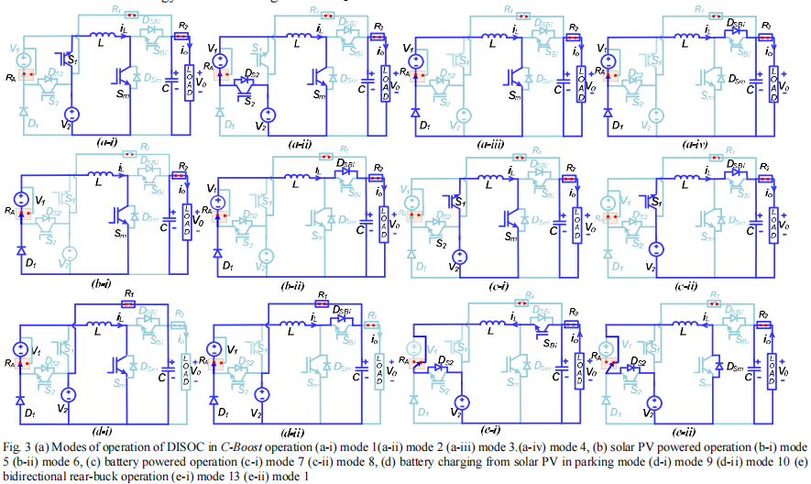
EXISTING SYSTEM

Slide 11
PROPOSED SYSTEM
10w
12v
Pv
Panel
Dual input
superboost
DC-DC Converter
Ext.
source
DC
Loads
+
Battery
-
12v
1.3Ah
3 pulses
15v
15V
power supply
TLP250 driver
3 pulse
5v
R1
5V
power supply
Arduino
Mega controller
Relay 5V
R2
R3
S1
S2
S3
SELECTION SWITCHES

Slide 12


COMPONENT DESIGN
Inductors selection: During on state of the switch, the value of current ripple of the inductor over a cycle is expressed as,
From the above equation, the inductor L is selected as,
The inductor is chosen by assuming the current ripple of <10% in CCM operation.

Slide 13


COMPONENT DESIGN
Capacitors selection: The capacitor C is charged during on state of the switch, and the stored energy in the capacitor is written as,
After simplifying, the capacitance is expressed as,

Slide 14
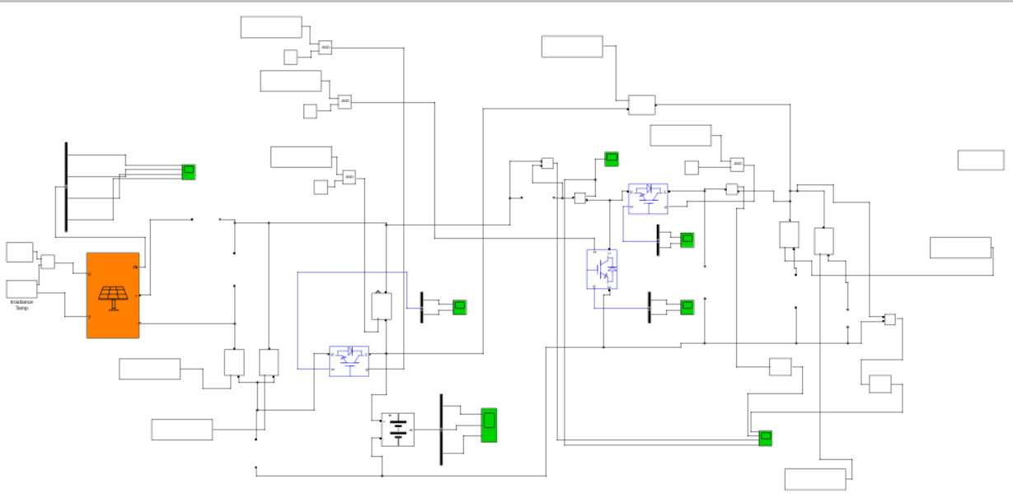
SIMULINK MODEL

Slide 15
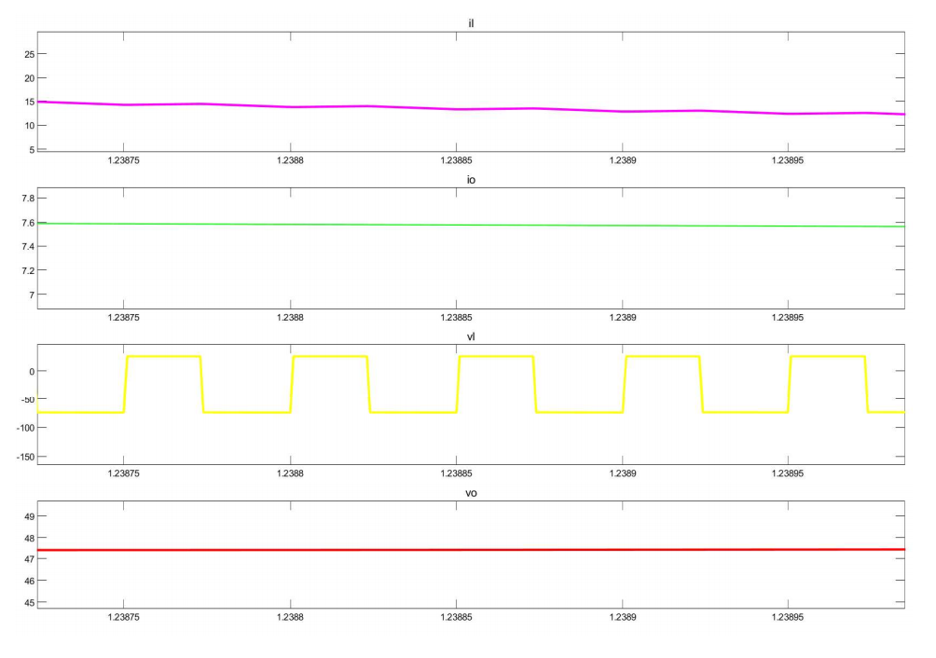
SIMULATION RESULTS
MODE 2

Slide 16
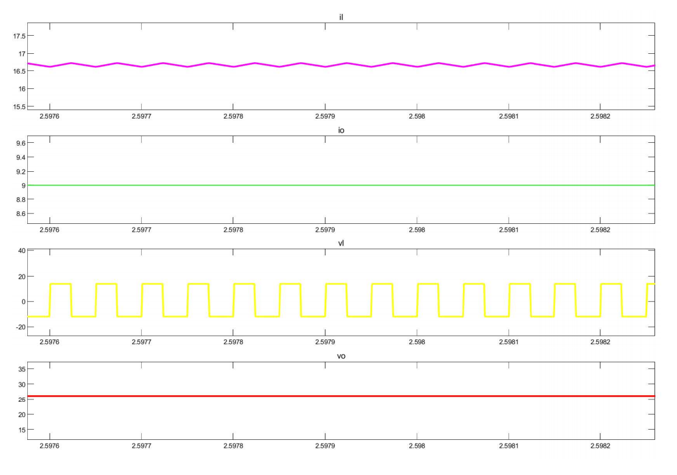
SIMULATION RESULTS
MODE 3

Slide 17
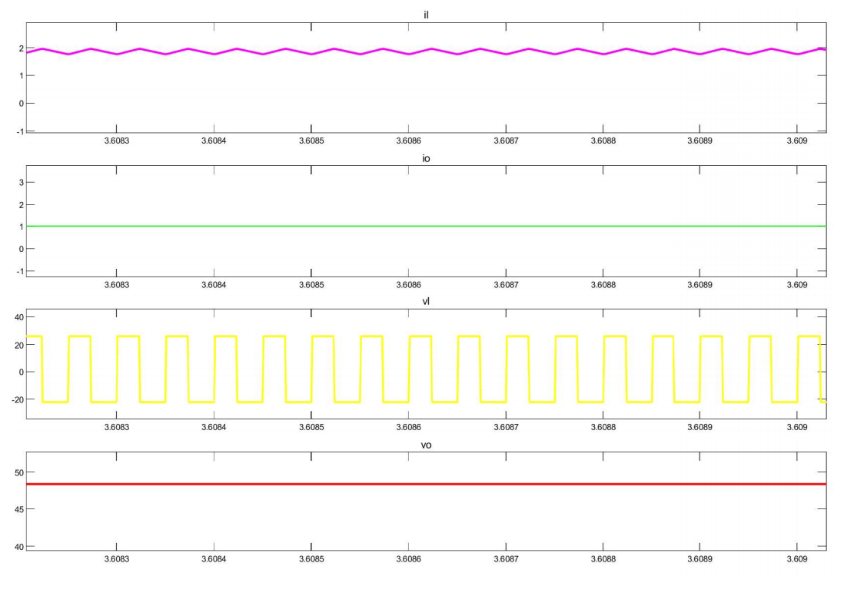
SIMULATION RESULTS
MODE 4

Slide 18
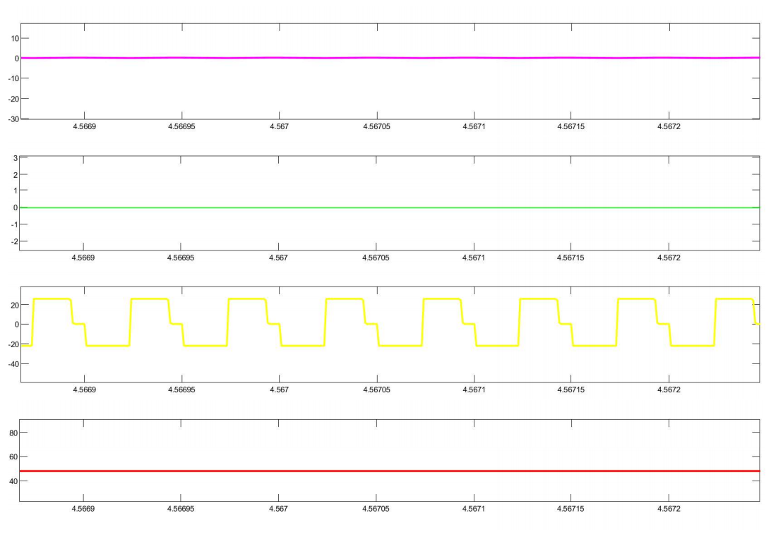
SIMULATION RESULTS
MODE 5

Slide 19
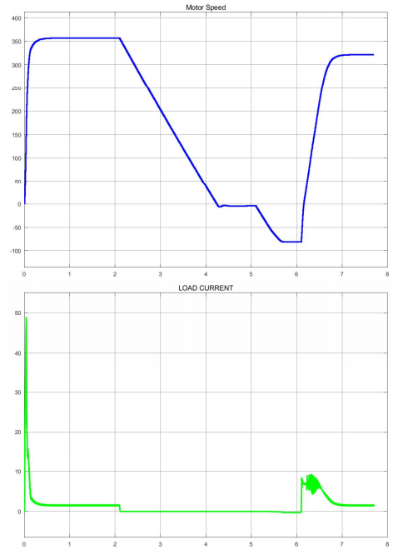
SIMULATION RESULTS
MOTOR CHARA.

Slide 20
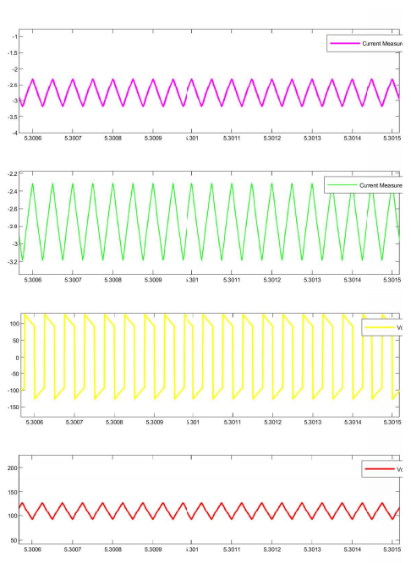
SIMULATION RESULTS
REGENRATION

Slide 21
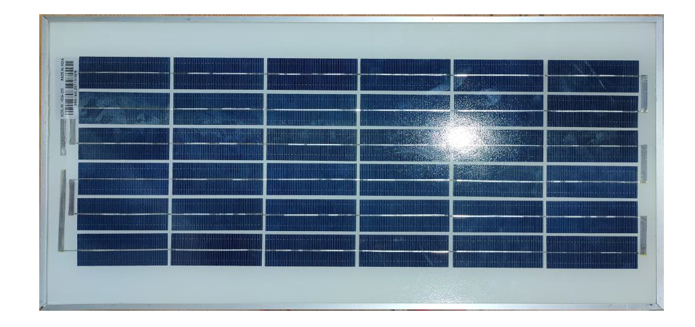
HARDWARE IMPLIMENTATION
1) SOLAR PANEL
we are using a solar panel of the below mentioned specification:
Rated power : 15 W
Open Circuit Voltage : 22 V
Short Circuit Current : 0.870A
Voltage at Maximum Power : 18 V
Current at Maximum Power : 0.84 A

Slide 22
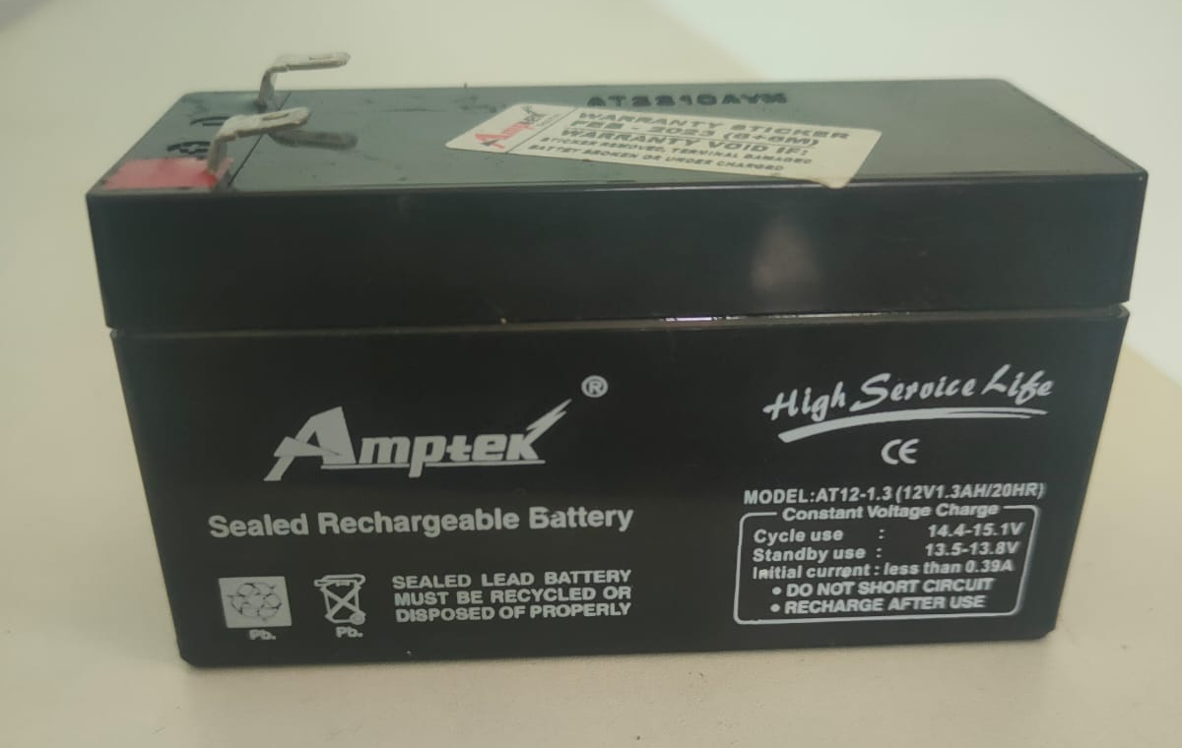
HARDWARE IMPLIMENTATION
2) BATTERY
Rated voltage : 12V
Rated Amp-hr : 1.3Ah
Type : Lead Acid

Slide 23
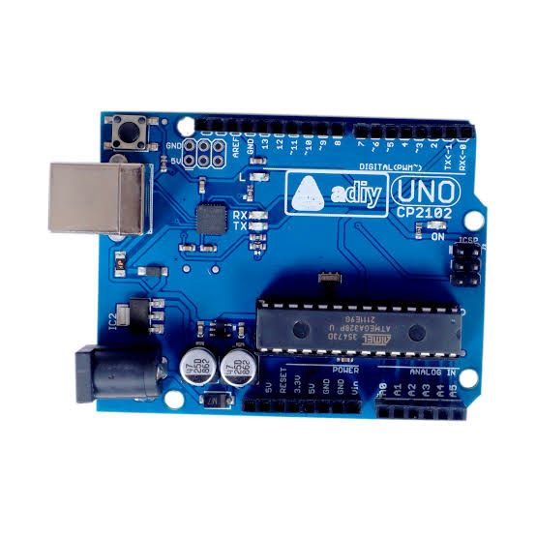
HARDWARE IMPLIMENTATION
3)ARDUINO UNO CP2102
Specifications • CPU Architecture : 8-bit RISC Architecture • Operating Voltage : 4.5-5.5V • CPU Frequency - 16MHz • ADC - 8 channel • EEPROM 512 bytes • SRAM 1Kb • It has low power CMOS 8-bit controller
with AVR RISC

Slide 24
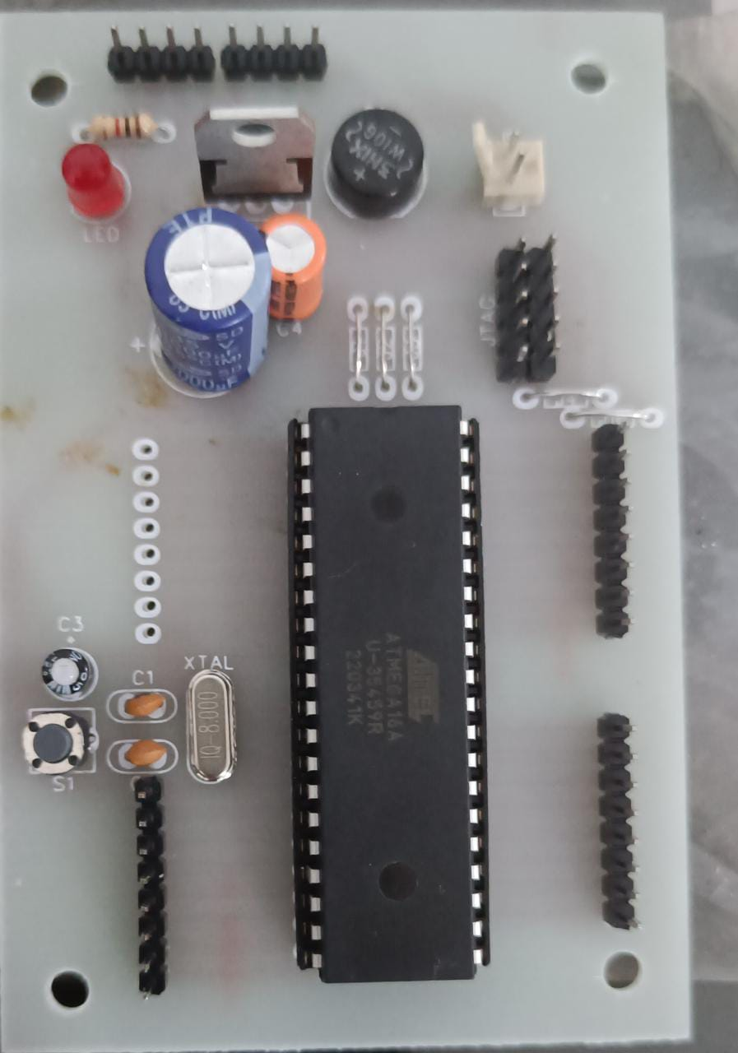
HARDWARE IMPLIMENTATION
4) ATMEGA 16
We used Atmega16 because of the following features:
It has low power CMOS 8-bit controller with AVR RISC
Its throughput is up to 16MIPS per
512 bytes of EEPROM, 1k byte SRAM, JTAG
Serial programmable USART+I2C protocol
CPU frequency - 16MHz
Operating Voltage - (4.5-5.5V)
ADC - 8 Channel

Slide 25
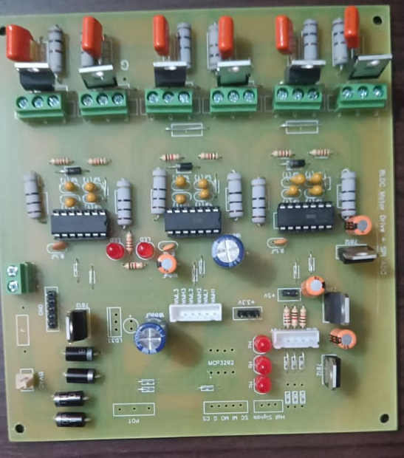
HARDWARE IMPLIMENTATION
5) THREE PHASE BLDC DRIVE CIRCUIT
Hall sensors are set inside the motor to determine the rotor position.
The control system senses the rotor position and the proper voltage pattern is applied to the motor by BLDC drive circuit.
The main components of the driver circuit are:
IR2110
IRFB4110
LM7812

Slide 26
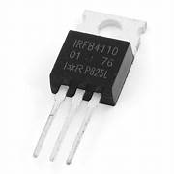
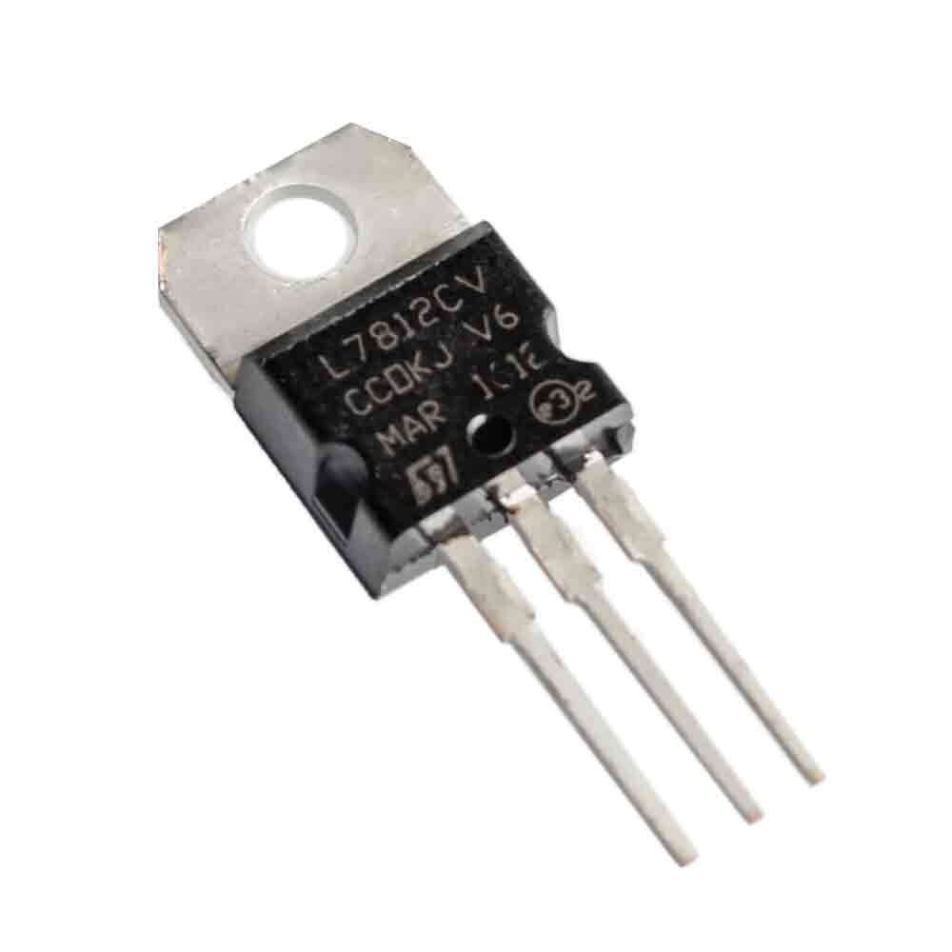
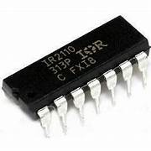
HARDWARE IMPLIMENTATION
6) THREE PHASE BLDC DRIVE CIRCUIT
1) Voltage Regulator (LM7812)
Input voltage – 14V-35V
Output voltage - 12V
4)MOSFET IRFB4110
Drain-Source Voltage (Vds) - 100V
Gate-Source Voltage (Vgs)- ±20V
5) IRF2110 Driver IC
IR2110 is a high voltage, high speed power MOSFET and IGBT driver with independent high and low side referenced output channels.
2)Capacitor
1000 μF,35V
3)Resistor
22Ω
11Ω
IRFB4110
LM7812
IRF2110

Slide 27
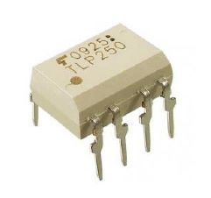
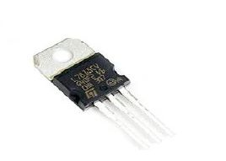
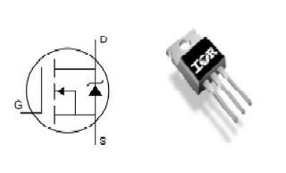
HARDWARE IMPLIMENTATION
7) DUAL INPUT NON ISOLATED DC-DC CONVERTER
1) MOSFET (IRFP250N) Metal Oxide Semiconductor Field Effect Transistor
• Drain-Source Voltage (Vds) - 20V
• Gate-Source Voltage (Vgs)- ±20V
2) TLP 250 Driver IC
• Supply Voltage Vcc - 15V-30V
• Input Current If ON- 7-10mA
• Input Voltage Vf off - 0-0.8V
3) Voltage Regulator (LM7815)
4) Inductor
• Inductor - 2mH ,90 turns,EE42 ferrite core
5) Capacitor
• 220 μF,250V
TLP250 Driver IC
LM7815
IRFP250

Slide 28
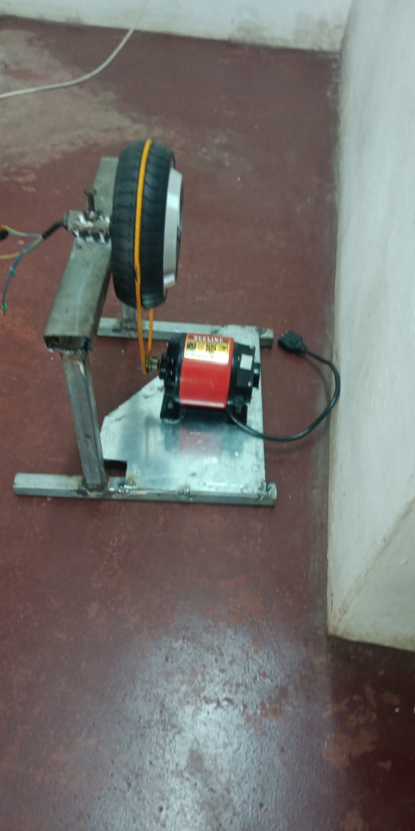
HARDWARE IMPLIMENTATION
8) TRANSFORMER
In this experimental setup we are using three transformers, which are as follows:
1) 240/15V Transformer
This transformer is used to power the driver circuit of the MOSFET,
power up the power supply unit from where the conditioned signal is fed to the Arduino,
switch circuit.
9) BLDC MOTOR
320W,24V

Slide 29
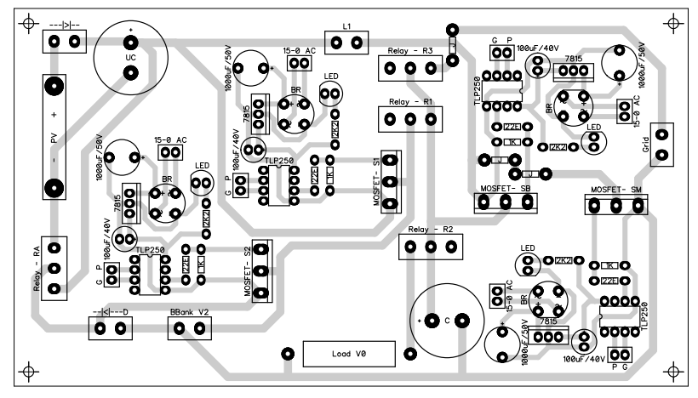
PCB LAYOUT
PCB LAYOUT OF CONVERTER

Slide 30
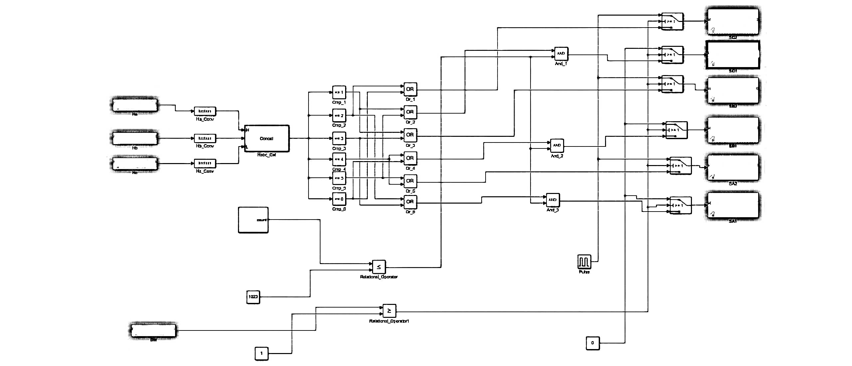
CONTROL DIAGRAM

Slide 31
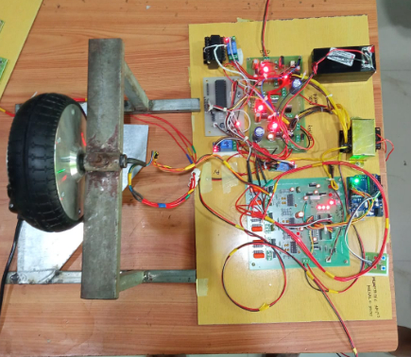
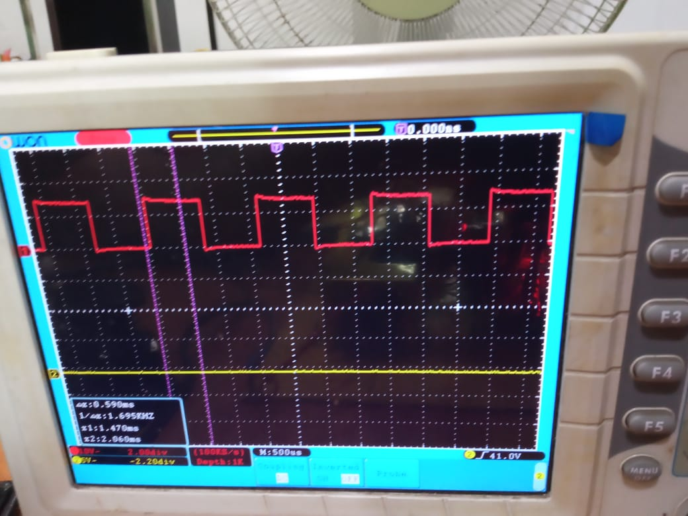
HARDWARE OUTPUT
switch pulse

Slide 32
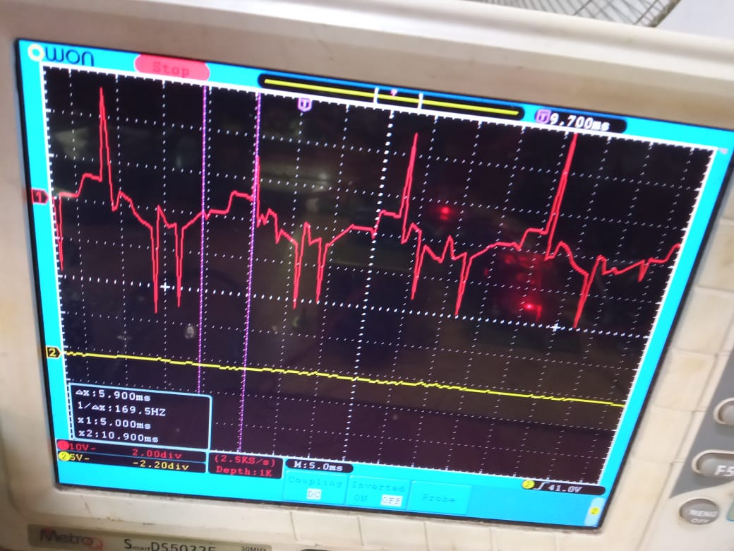
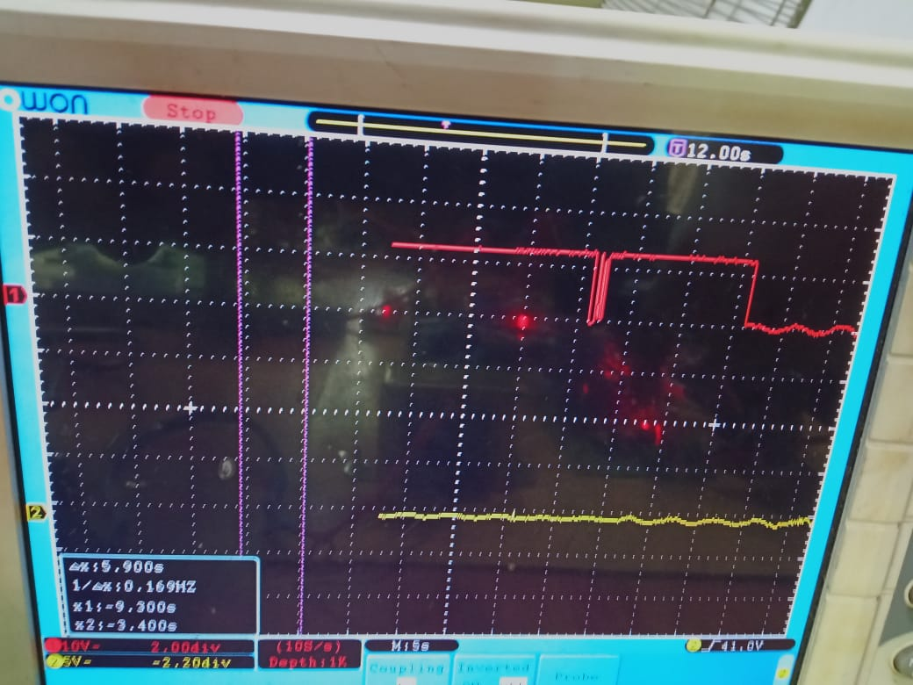
HARDWARE OUTPUT
Output voltage (to bldc motor)
regeneration current

Slide 33
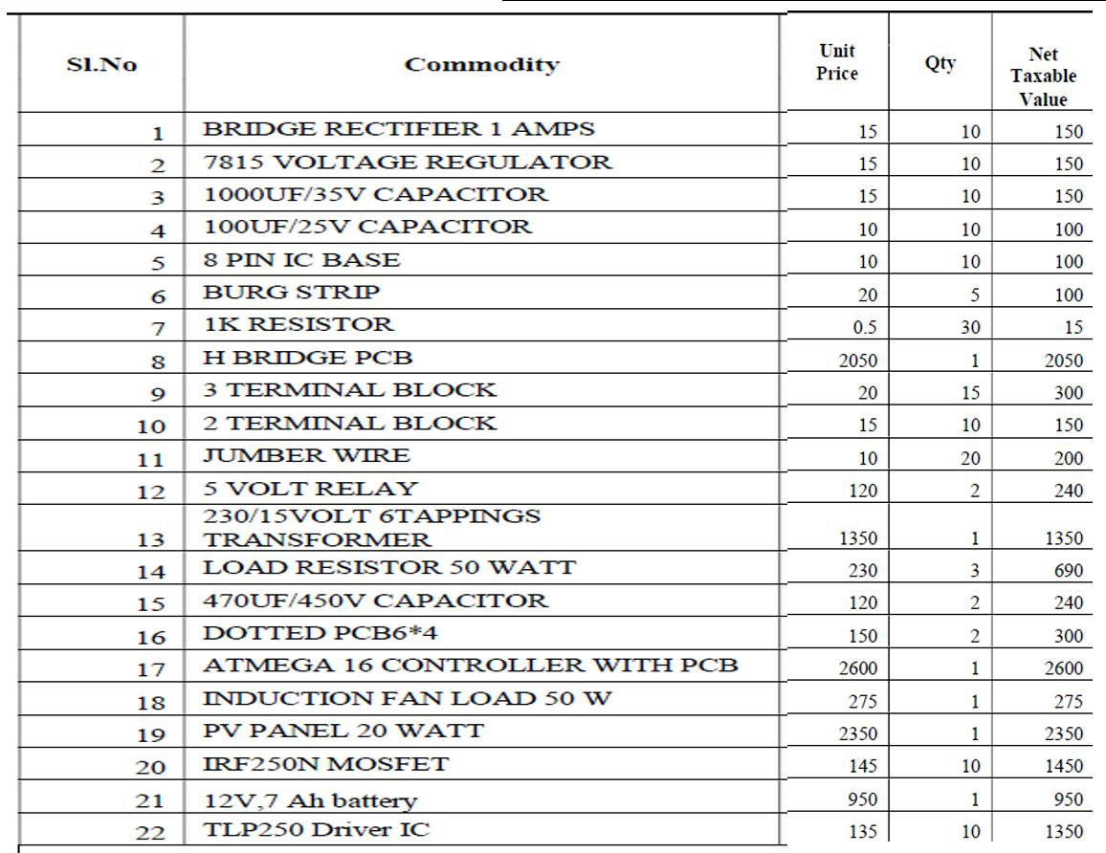
ESTIMATE
Total estimated cost is around Rs. 30,000/-

Slide 34
ADVANTAGES
Extends range
Reduction of Pollution
Improves the efficiency of braking
It reduces wear

Slide 35
APPLICATIONS
This mechanism retrieves some of the energy that’s lost during braking and in return uses the energy as a mechanism to recharge the battery and thereby improve not just the efficiency but also increases the range as battery regeneration and storage gives a pathway for introducing larger batteries for greater range without increasing the time required for charging.

Slide 36
REFERNCES
S. K. Haghighian, S. Tohidi, M. R. Feyzi, and M. Sabahi, “Design and analysis of a novel SEPIC-based multi-input DC/DC converter,” IET Power Electron., vol. 10, no. 12, pp. 1393–1402, 2017.
M. Zandi, A. Payman, J. P. Martin, S. Pierfederici, B. Davat, and F.Meibody Tabar, “Energymanagementof a fuel cell/supercapacitor/battery power source for electric vehicular applications,” IEEE Trans. Veh. Technol., vol. 60, no. 2, pp. 433–443, 2011
T. K. Santhosh and C. Govindaraju, “Dual input dual output power converter with one-step-ahead control for hybrid electric vehicle applications,” IET Electr. Syst. Transp., vol. 7, no. 3, pp. 190–200, 2017.
D. Yang, M. Yang, and X. Ruan, “One-cycle control for a double-input DC/DC converter,” IEEE Trans. Power Electron., vol. 27, no. 11, pp. 4646–4655, 2012.

