Slide 1
JOINS
What is SQL Joins?
An SQL JOIN clause combines rows from two or more tables. It creates a set of rows in a temporary table.
How to Join two tables in SQL?
A JOIN works on two or more tables if they have at least one common field and have a relationship between them.
JOIN keeps the base tables (structure and data) unchanged.

Slide 2
Join vs. Subquery
JOINs are faster than a subquery and it is very rare that the opposite.
In JOINs the RDBMS calculates an execution plan, that can predict, what data should be loaded and how much it will take to processed and as a result this process save some times, unlike the subquery there is no pre-process calculation and run all the queries and load all their data to do the processing.
A JOIN is checked conditions first and then put it into table and displays; where as a subquery take separate temp table internally and checking condition.
When joins are using, there should be connection between two or more than two tables and each table has a relation with other while subquery means query inside another query, has no need to relation, it works on columns and conditions.

Slide 3
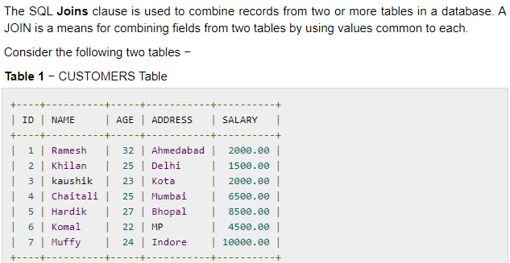
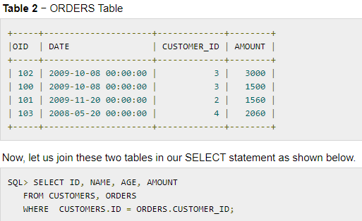
JOIN OPERATORS:

Slide 4
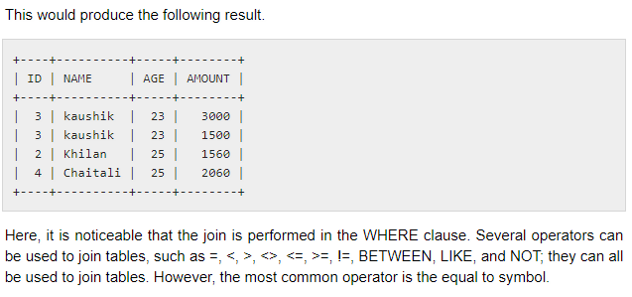

Slide 5
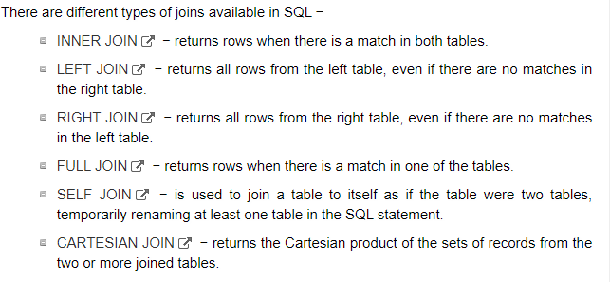

Slide 6
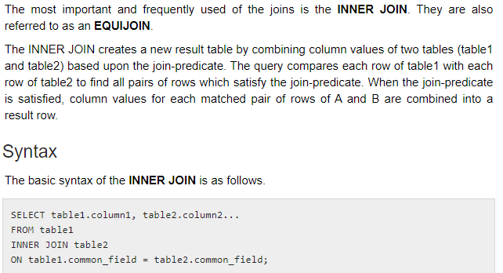
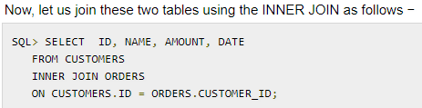
INNER JOIN:

Slide 7
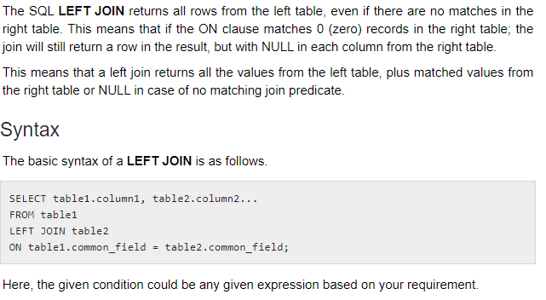
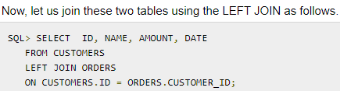
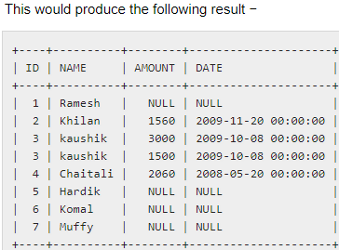
LEFT JOINS

Slide 8
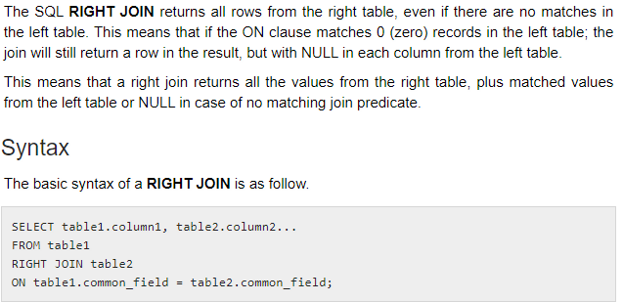
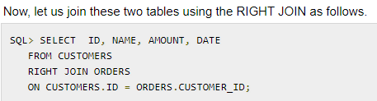
RIGHT JOIN

Slide 9
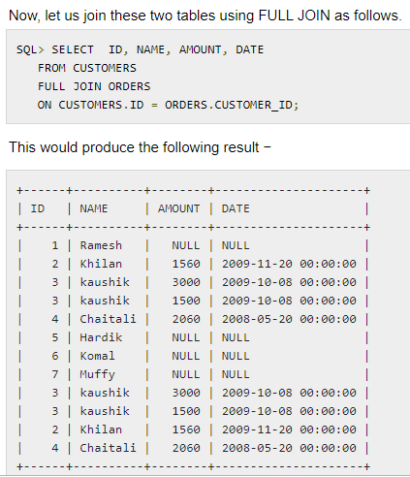
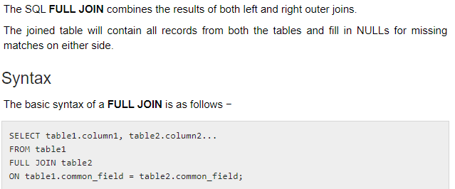
FULL JOIN

Slide 10
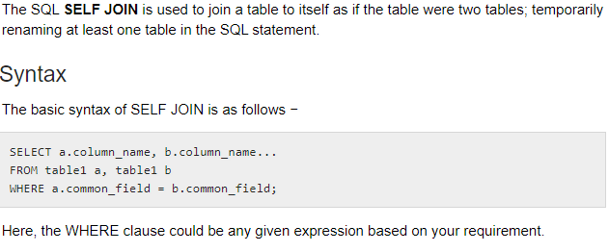
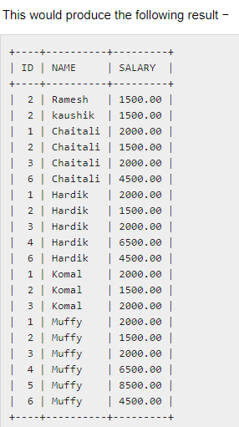
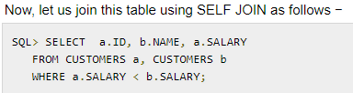
SELF JOIN

Slide 11
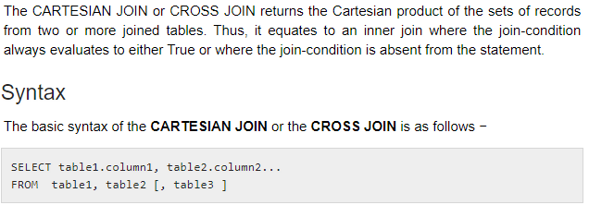

CROSS PRODUCT

Slide 12
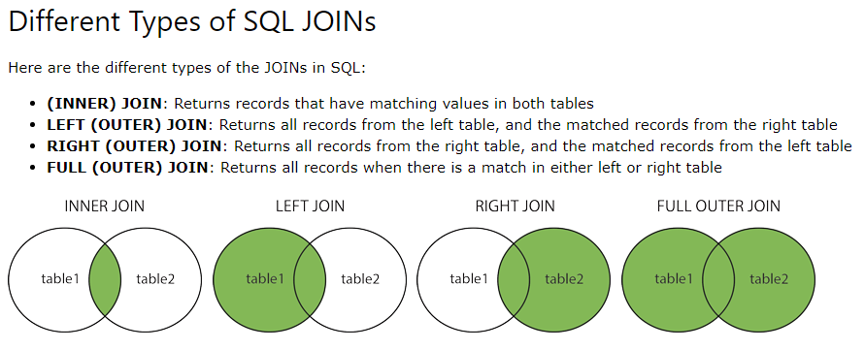

Slide 13
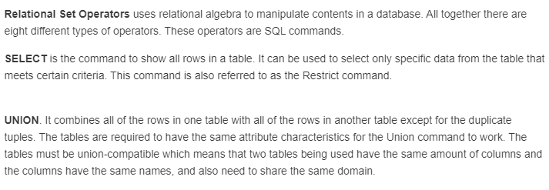

Slide 14
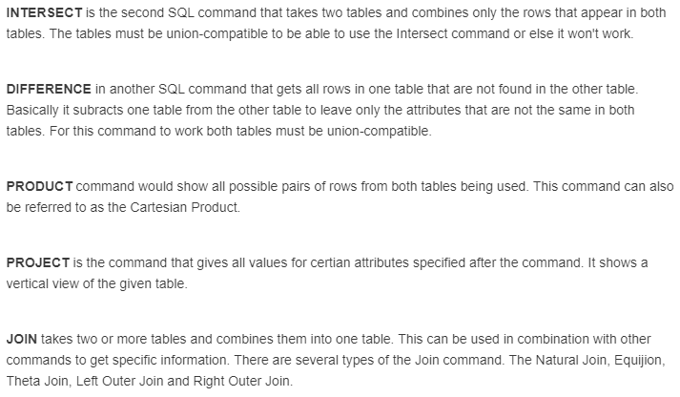

Slide 15
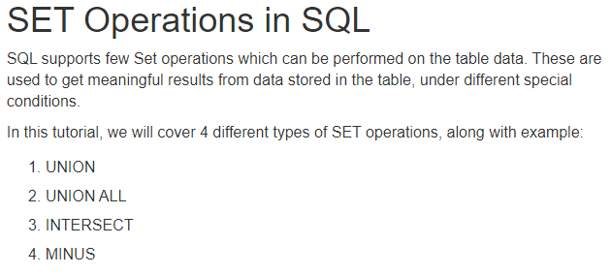
RELATIONAL SET OPERATORS

Slide 16
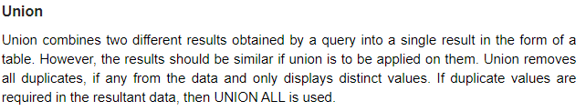
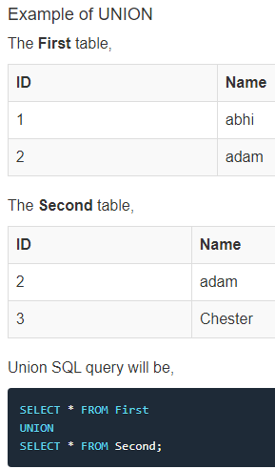

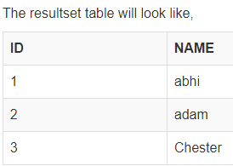

Slide 17
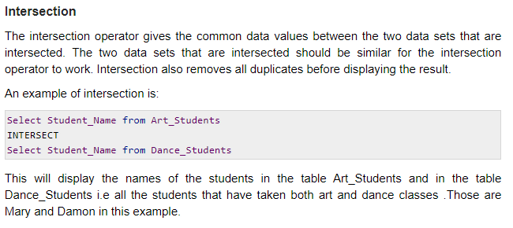
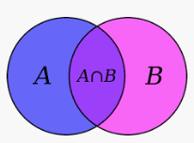

Slide 18
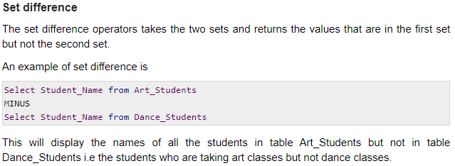
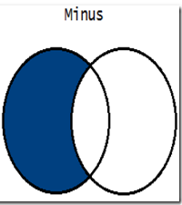

Slide 19
