Slide 1






VOLTI
PROJECT

Slide 2


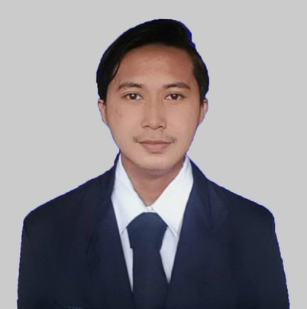

HELLO GUYS
AND WELCOME
WELCOME MESSAGE
Presentations are communication tools that can be used as demonstrations, lectures, speeches, reports, and more. It is mostly presented before an audience.
LETS GET STARTED

Slide 3



Slide 4
THANKS FOR
WATCHING
Presentations are communication tools that can be used as demonstrations.

