Slide 1

Inventory Management System for Anemos Energies
Prepared By:
Abdullah Shaikh 191106001
Aslan Shaikh 191106009
Joseph Roy Thayil 191106023

Slide 2

Introduction:
Founded in 2016
Cumilation of over 12 years of development in wind energy.
Focuses on production of vertical axis wind turbines.

Slide 3
Problem statement
Develop smart Inventory Management System for anemos energies.
Cross platform.

Slide 4
Problems with traditional inventory management system ??
Poor communication.
Lot of manual work.
Overheads of maintaining records.
Poor execution.
Poor decision-making.
Overstocking of products which are not sold for years.

Slide 5
Inventory management system
A complete app and web based application.
It will contain all information regarding stock.
Application will contain organization profile, sales, purchase details.
Application will provide information regarding operator activity (login, logout, changes made at what time and when).
Updation to stock items will happen at real time.
Vendor payables and receivables at ease.
Stock prediction using ML algorithm.

Slide 6
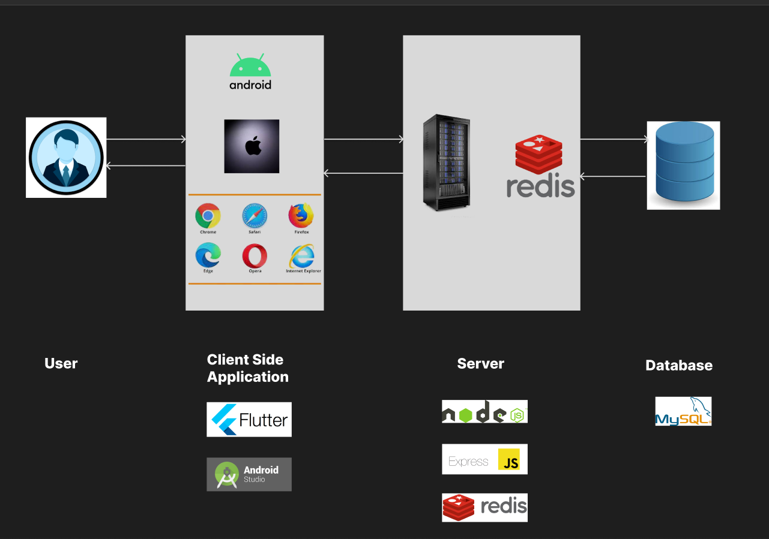
Architecture

Slide 7
Literature SURVEY
The concept of inventory management includes a vast set of areas to be dealt with.
With rapid expansion of e-commerce industry, the demand for efficient inventory management is the need of the hour.
Forecasting usually includes two different methodologies: Time series methodology and Machine learning methods.
AI proves to be beneficial in handling the inventory data and forecasting the stock requirements.
Notify or recommend company to re-order stock.

Slide 8
Algorithm:
XGBoost :
ML algorithm using decision trees.
Decision tree algorithms are considered best for structured data.
Hence, we decided to go with the XGBoost algorithm for demand forecasting.
Image Processing:

Slide 9
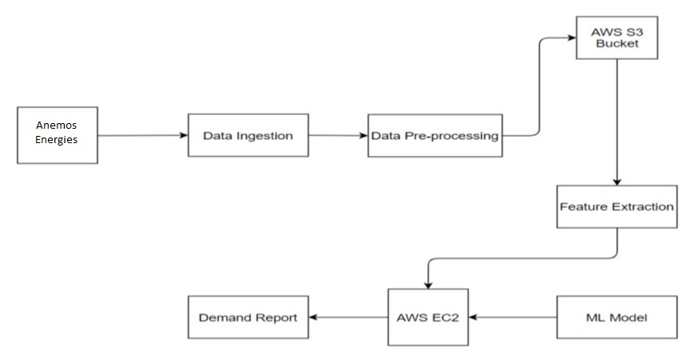
Ml architecture
The proposed architecture is collectively obtained from five components: Data Ingestion, Data Pre-Processing, Storage, Feature Extraction, ML model.

Slide 10
. Data Ingestion:
Initially, operators login to the system and add their product details which is stored in a database.
Historical sales data is recorded in the database.
Data Pre-processing:
Data pre-processing is a data mining technique which is used to transform the raw data in a useful and efficient format.
The data ingested is cleaned before it is used for training the model.
Storage:
The pre-processed data is stored in the S3 Bucket.

Slide 11
Feature Extraction:
With the help of proper feature extraction, the accuracy of model can be increased.
Hence only certain fields of the dataset were extracted for training.
ML Model:
An algorithm called XGBoost is used as the machine learning model.
XGBoost is an ensemble algorithm which is based on decision-trees and uses gradient boosting framework.
Report:
The demand values for the next 2 weeks are predicted by the XGBoost model. .
The predicted values are output as a report to the operators aiding for an efficient inventory management.

Slide 12
BLOCK DIAGRAM FOR IMAGE CLASSIFICATION
Process QR Code
Yes
QR Code
Capture Image
Process Image
Get Item ID
Image
Send Image to ML Model
No
Display Item Details
Fetch Data from database using Item ID

Slide 13
TILL PROJECT REVIEW 1
Brainstorming of Technologies to be used and installation of technologies
Designing of screens using Figma
WEEK 1
WEEK 3
WEEK 5
WEEK 2
WEEK 4
Meeting with client
Brainstorming of customer Requirement
Implementation of screens
Client meeting for app review
Learning Flutter, Node Js.
Writing Project synopsis

Slide 14
PROJECT REVIEW 1 – PROJECT REVIEW 2
Deciding the source of dataset
WEEK 3
WEEK 1
WEEK 2
Adding Object detection module
Referring research papers
Deciding the algorithm to be used for object detection

Slide 15
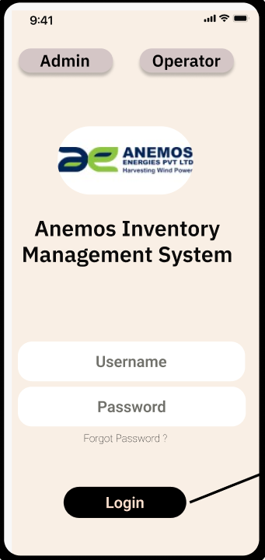
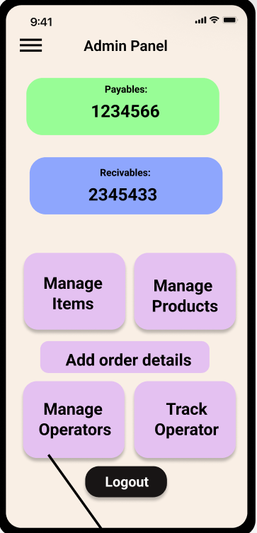
USER INTERFACE

Slide 16
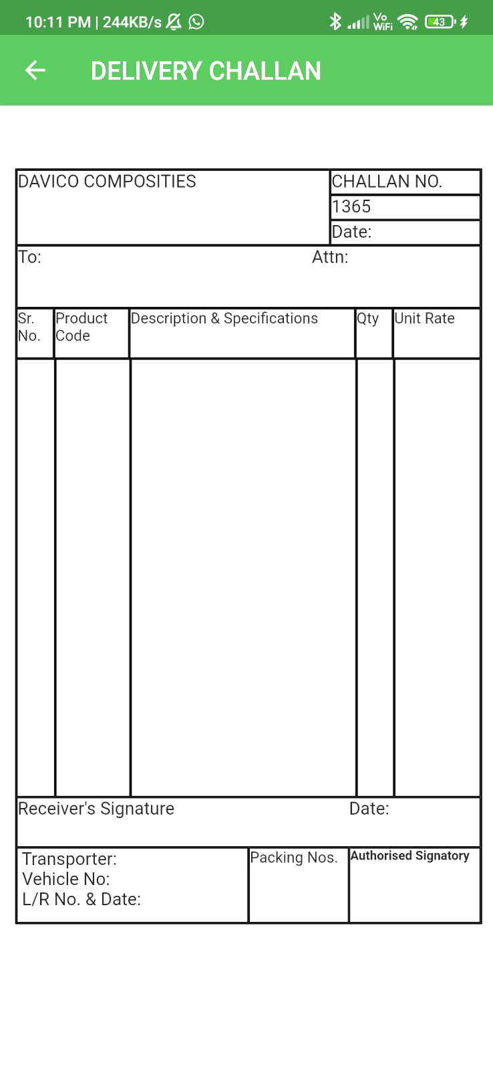
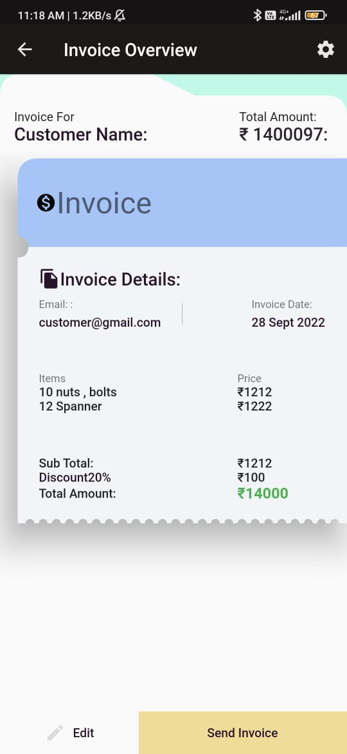

Slide 17
THANK YOU

