Slide 1
Spring Ecosystem
Spring Framework is one of the most popular application development frameworks for Java.
It all started in 2002 by Rod Johnson as part of his book Expert One-on-One J2EE Design and Development.
In February 2003, Juergen Hoeller and Yann Caroff began working with Rod Johnson in an open source project based on the book code.
In June 2003, spring 0.9 was released under Apache 2.0 license. Version 1.0 was released in Mach 2004.
Now is a full ecosystem with more than 20 main projects and tons of subprojects and community initiatives.

Slide 2
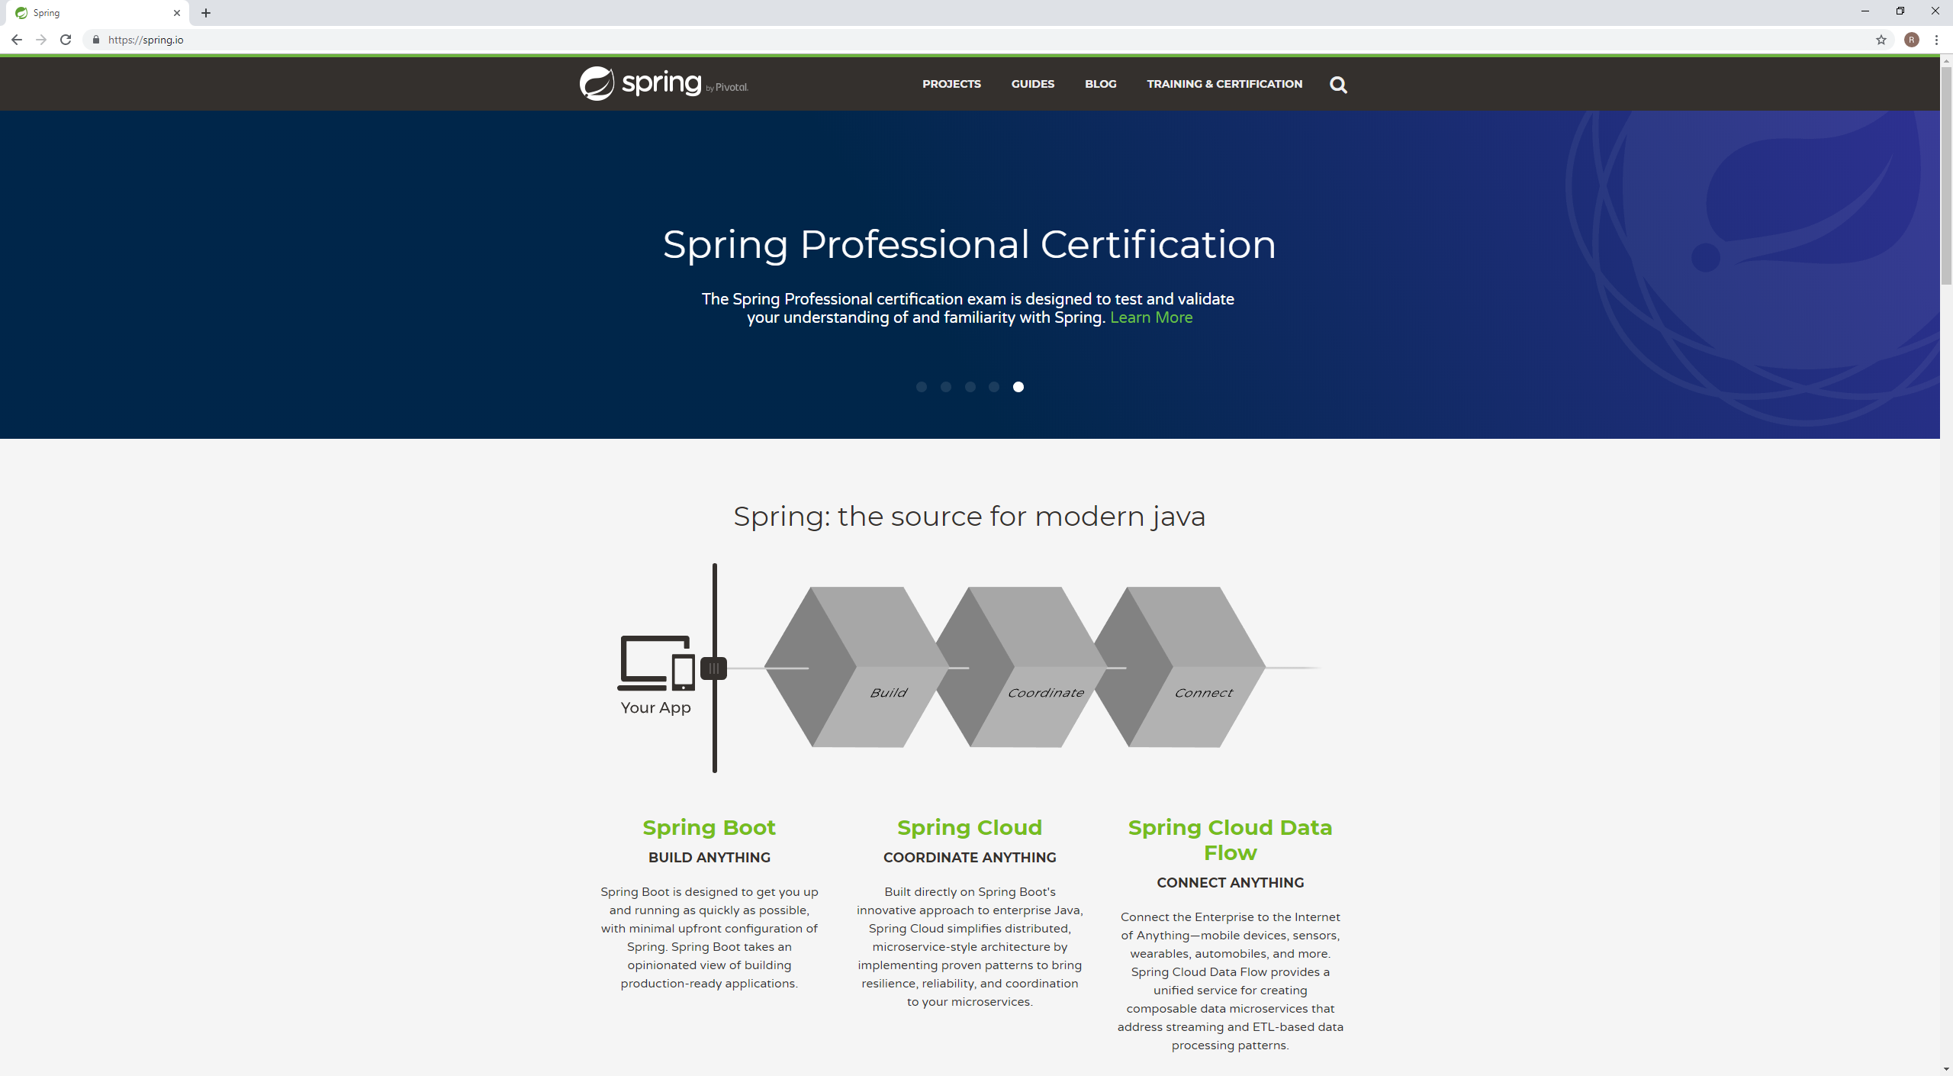
Spring Ecosystem
Spring by Pivotal https://spring.io

Slide 3
Spring Framework
Inversion of Control
Flexible Configuration
Aspect Oriented Programming
Data Access
Transaction Management
WebMVC and WebFlux
Testing

Slide 4
Spring Framework
Inversion of Control
Inversion of Control is a principle in software engineering by which the control of objects or portions of a program is transferred to a container or framework.
Inversion of Control can be achieved through various mechanisms such as Strategy design pattern, Service Locator pattern, Factory pattern or Dependency Injection (DI).
Spring Framework provides an IoC container, represented by the ApplicationContext interface, responsible for instantiating, configuring and assembling objects known as beans, as well as managing their lifecycle.
Configuration can be done through XML files or through Java annotations and code.
Dependency Injection can be done through constructors, setters or fields.

Slide 5
Spring Framework
IoC Container XML Configuration
ApplicationContext context = new ClassPathXmlApplicationContext(“context.xml");
<?xml version="1.0" encoding="UTF-8"?>
<beans xmlns="http://www.springframework.org/schema/beans" xmlns:xsi=http://www.w3.org/2001/XMLSchema-instance ...>
<bean id="bean1" class="com.telefonica.cdo.samples.beans.BeanA">
. . .
</bean>
<bean id=“bean2" class="com.telefonica.cdo.samples.beans.BeanB“>
. . .
</bean>
</beans>

Slide 6
Spring Framework
IoC Container Java Configuration

Slide 7
Spring Framework
Aspect Oriented Programming
AOP is a programming paradigm that aims to increase modularity by allowing the separation of cross-cutting concerns. It does so by adding additional behavior to existing code without modification of the code itself.

Slide 8
Spring Data
From spring.io web site:
Provide a familiar and consistent, Spring-based programming model for data access while still retaining the special traits of the underlying data store.
Umbrella project with modules for specific databases:
Apache Cassandra
JDBC
JPA
MongoDB
Redis
REST

Slide 9
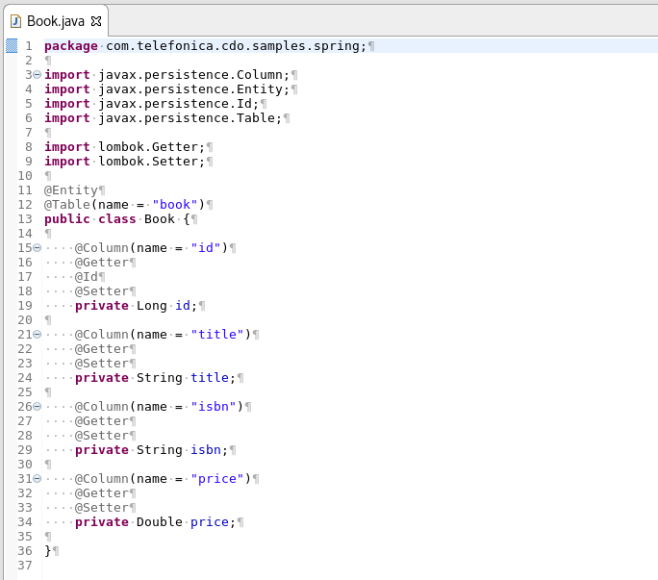
Spring Data

Slide 10
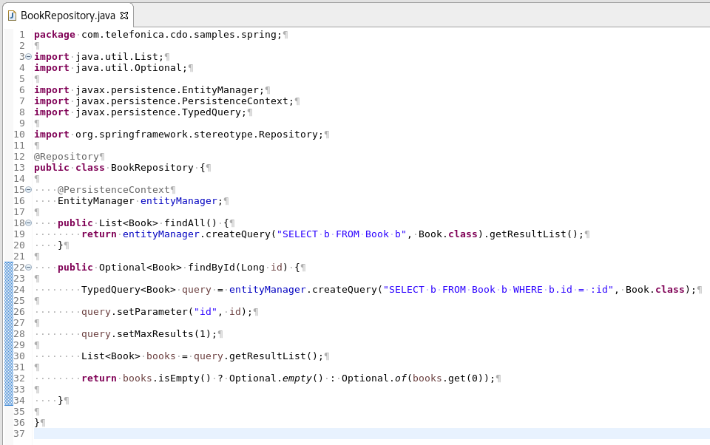
Spring Data

Slide 11
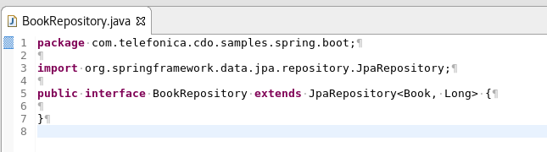
Spring Data

Slide 12
Spring Cloud
From spring.io web site:
Spring Cloud provides tools for developers to quickly build some of the common patterns in distributed systems. [ . . . ]. They will work well in any distributed environment, including the developer’s own laptop, bare metal data centers, and managed platforms such as Cloud Foundry.
Common patterns for distributed systems
API Gateway
Circuit Breakers
Configuration Management
Distributed Tracing
Service Discovery
…

Slide 13
Spring Boot
From spring.io web site:
Spring Boot is the starting point for building all Spring-based applications. Spring Boot is designed to get you up and running as quickly as possible, with minimal upfront configuration of Spring.
Spring Boot is an opinionated, convention-over-configuration focused addition to the Spring platform.
Introduced by David Heinemeier Hansson in Ruby on Rails web framework.
A developer only needs to specify unconventional aspects of the application.

Slide 14
Spring Boot
package com.telefonica.cdo.samples.spring.boot;
import org.springframework.boot.SpringApplication;
import org.springframework.boot.autoconfigure.EnableAutoConfiguration;
import org.springframework.context.annotation.ComponentScan;
import org.springframework.context.annotation.Configuration;
@ComponentScan(
basePackages = {
“com.telefonica.cdo.samples.spring.boot”
}
)
@Configuration
@EnableAutoConfiguration
public class Application {
public static void main(String[] args) {
SpringApplication.run(Application.class, args);
}
}

Slide 15
Spring Boot
package com.telefonica.cdo.samples.spring.boot;
import org.springframework.boot.SpringApplication;
import org.springframework.boot.autoconfigure.SpringBootApplication;
@SpringBootApplication
public class Application {
public static void main(String[] args) {
SpringApplication.run(Application.class, args);
}
}

Slide 16
Spring Boot
Example

