Slide 1
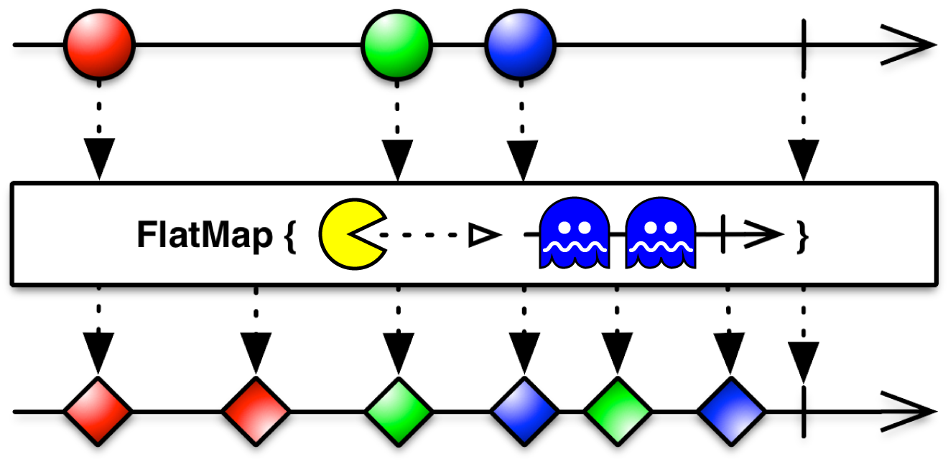
Spring Cloud Stream - Reactive
Apache Kafka Integration
21/05/2019

Slide 2
Index (1/3)
Introducing Spring Cloud Stream
Main Concepts
2.1 Application Model
2.2 Binder Abstraction
2.3 Persistent Publish-Subscribe , Consumer Group, Partitioning
Binders
3.1 Consumers / Producers
Declaring and Binding Channels
4. 1 Programming Modeling
4.2 @EnableBinding / @StreamListener
4.3 @Input, @Output, Sink, Source, Processor

Slide 3
Index (2/3)
Configuration Options
5.1 Binding Service Properties
5.2 Binding Properties
5.2.1 Common Binding Properties
5.2.2 Consumer Binding Properties
5.2.3 Producer Binding Properties
Error handling
6.1 Application Error Handling
6.2 System Error Handling
Reactive Programming Support
7.1 Introduction
7.2 Reactor-Based Handler
7.3 Reactive Sources

Slide 4
Index (3/3)
Apache Kafka Binder
Example
9.1 Guided Example
Exercise
10.1 Hints / Recommendations
Integration With-Non Reactive Systems

Slide 5
01
Introducing Spring Cloud Stream

Slide 6
01 Introducing Spring Cloud Stream
1.1 Concepts
Spring Cloud Stream:
Framework for building message-driven microservice applications.
Builds upon Spring Boot to create Spring applications
Uses Spring Integration to provide connectivity to message brokers.
Provides configuration of middleware from several vendors, introducing the concepts of persistent publish-subscribe semantics, consumer groups, and partitions.

Slide 7
02
Main Concepts

Slide 8
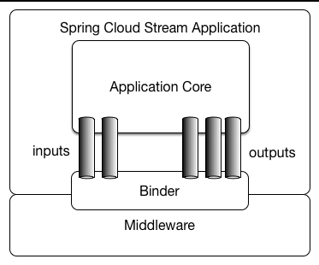
02 Main Concepts
2.1 Application Model
A Spring Cloud Stream application consists of a middleware-neutral core.
The application communicates with the outside world through input and output channels injected into it by Spring Cloud Stream.
Channels are connected to external brokers through middleware-specific Binder implementations.

Slide 9
02 Main Concepts
2.2 Binder Abstraction
Spring Cloud Stream uses Spring Boot for configuration, and the Binder abstraction makes it possible for a Spring Cloud Stream application to be flexible in how it connects to middleware.
For example, deployers can dynamically choose, at runtime, the destinations (such as the Kafka topics or RabbitMQ exchanges) to which channels connect.
Such configuration can be provided through external configuration properties and in any form supported by Spring Boot:
Application arguments
Environment variables
Application.yml or application.properties files

Slide 10
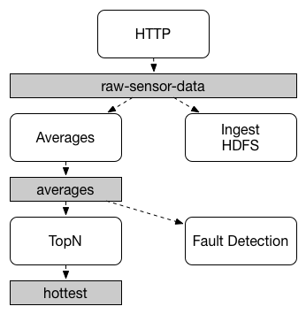
02 Main Concepts
2.3 Persistent Publish-Subscriber
The publish-subscribe communication model:
reduces the complexity of both the producer and the consumer
lets new applications be added to the topology without disruption of the existing flow.
While the concept of publish-subscribe messaging is not new, Spring Cloud Stream takes the extra step of making it an opinionated choice for its application model.
By using native middleware support, italso simplifies use of the publish-subscribe model across different platforms.

Slide 11
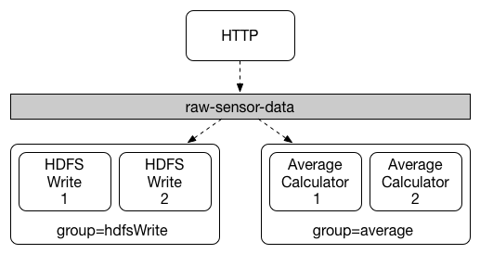
02 Main Concepts
2.3 Consumer Group
While the publish-subscribe model makes it easy to connect applications through shared topics, the ability to scale up by creating multiple instances of a given application is equally important. When doing so, different instances of an application are placed in a competing consumer relationship, where only one of the instances is expected to handle a given message.
Spring Cloud Stream models this behavior through the concept of a consumer group (Kafka inherited).
All groups that subscribe to a given destination receive a copy of published data, but only one member of each group receives a given message from that destination.

Slide 12
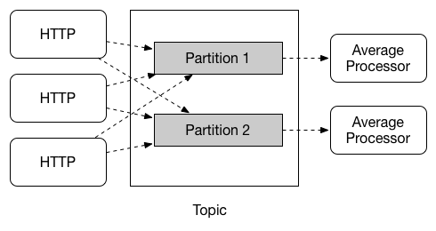
02 Main Concepts
2.3 Partitioning
In a partitioned scenario, the physical communication medium (such as the broker topic) is viewed as being structured into multiple partitions. One or more producer application instances send data to multiple consumer application instances and ensure that data identified by common characteristics are processed by the same consumer instance.
Spring Cloud Stream provides a common abstraction for implementing partitioned processing use cases in a uniform fashion. Partitioning can thus be used whether the broker itself is naturally partitioned (for example, Kafka) or not (for example, RabbitMQ).

Slide 13
03
Binders

Slide 14
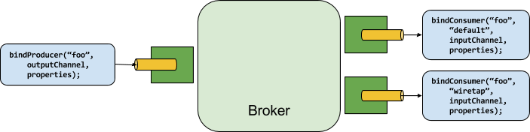
03 Binders
3.1 Producers and Consumers
Spring Cloud Stream provides a Binder abstraction for use in connecting to physical destinations at the external middleware.
A producer is any component that sends messages to a channel. The channel can be bound to an external message broker with a Binder implementation for that broker.
A consumer is any component that receives messages from a channel. As with a producer, the consumer’s channel can be bound to an external message broker.

Slide 15
04
Declaring and Binding Channels

Slide 16
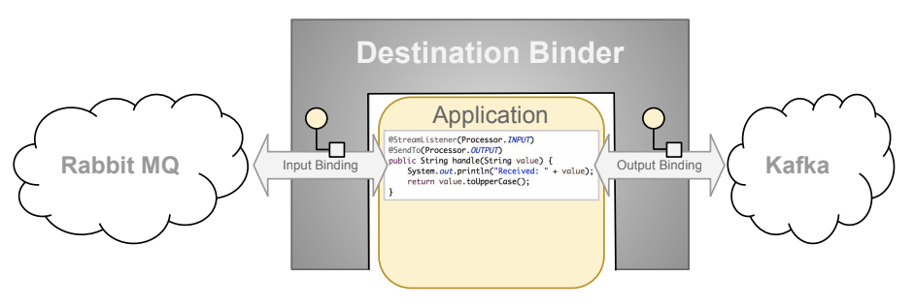
04 Declaring and Binding Channels
4.1 Programming Model
To understand the programming model, you should be familiar with the following core concepts:
Destination Binders: Components responsible to provide integration with the external messaging systems (Kafka binder, Rabbit MQ binder, etc.)
Destination Bindings: Bridge between the external messaging systems and application provided Producers (Source) and Consumers (Sink) of messages (created by the Destination Binders).
Message: The canonical data structure used by producers and consumers to communicate with Destination Binders (and thus other applications via external messaging systems).

Slide 17
04 Declaring and Binding Channels
4.2 Triggering Binding Via @EnableBinding / @StreamListener
You can turn a Spring application into a Spring Cloud Stream application by applying the @EnableBinding annotation to one of the application’s configuration classes. Once added you get immediate connectivity to a message broker, and you can add @StreamListener to a method to cause it to receive events for stream processing. The following example shows an application that receives and process external messages:
@SpringBootApplication
@EnableBinding(Processor.class)
public class MyApplication {
public static void main(String[] args) {
SpringApplication.run(MyApplication.class, args);
}
@StreamListener(Processor.INPUT)
@SendTo(Processor.OUTPUT)
public String handle(String value) {
System.out.println("Received: " + value);
return value.toUpperCase();
}
}

Slide 18
04 Declaring and Binding Channels
4.3 @Input / @Output
A Spring Cloud Stream application can have an arbitrary number of input and output channels defined in an interface as @Input and @Output methods:
public interface Barista {
@Input
SubscribableChannel orders();
@Output
MessageChannel hotDrinks();
@Output
MessageChannel coldDrinks();
}
Using the @Input and @Output annotations, you can specify a customized channel name for the channel, as shown in the following example:
public interface Barista {
...
@Input("inboundOrders")
SubscribableChannel orders();
}

Slide 19
05 Declaring and Binding Channels
4.4 Sink / Source / Processor
For easy addressing of the most common use cases, which involve either an input channel, an output channel, or both, Spring Cloud Stream provides three predefined interfaces out of the box:
Sink: Identifies the contract for the message consumer by providing the destination from which the message is consumed.
Source: Identifies the contract for the message producer by providing the destination to which the produced message is sent.
Processor: Encapsulates both the sink and the source contracts by exposing two destinations that allow consumption and production of messages.
By default, Spring Cloud Stream relies on Spring Boot’s auto-configuration to configure the binding process. When multiple binders are present on the classpath, the application must indicate which binder is to be used for each channel binding.
Binder selection can either be performed globally, using the spring.cloud.stream.defaultBinder property or individually, by configuring the binder on each channel binding. For instance, a processor application (that has channels named input and output for read and write respectively) that reads from Kafka and writes to RabbitMQ can specify the following configuration:
spring.cloud.stream.bindings.input.binder=kafka
spring.cloud.stream.bindings.output.binder=rabbit

Slide 20
05
Configuration Options

Slide 21
05 Configuration Options
5.1 Binding Service Properties
Spring Cloud Stream supports general configuration options as well as configuration for bindings and binders. Some binders let additional binding properties support middleware-specific features.
Configuration options can be provided to Spring Cloud Stream applications through any mechanism supported by Spring Boot. This includes application arguments, environment variables, and YAML or .properties files.
Main binding service properties:
spring.cloud.stream.instanceCount
The number of deployed instances of an application. Must be set for partitioning on the producer side. Must be set on the consumer side when using RabbitMQ and with Kafka if autoRebalanceEnabled=false.
Default: 1
spring.cloud.stream.instanceIndex
The instance index of the application: A number from 0 to instanceCount - 1. Used for partitioning with RabbitMQ and with Kafka if autoRebalanceEnabled=false.
spring.cloud.stream.bindingRetryInterval
The interval (in seconds) between retrying binding creation when, for example, the binder does not support late binding and the broker (for example, Apache Kafka) is down. Set it to zero to treat such conditions as fatal, preventing the application from starting.
Default: 30

Slide 22
05 Configuration Options
5.2 Binding Properties
Binding properties are supplied by using the format of spring.cloud.stream.bindings.<channelName>.<property>=<value>.
The <channelName> represents the name of the channel being configured (for example, output for a Source).
To avoid repetition, Spring Cloud Stream supports setting values for all channels, in the format of spring.cloud.stream.default.<property>=<value>
Let’s divide them into three types:
Common
Producer
Consumer

Slide 23
05 Configuration Options
5.2.1 Common Binding Properties
Binding properties available for both input and output bindings. They must be prefixed with spring.cloud.stream.bindings.<channelName>.
(for example, spring.cloud.stream.bindings.input.destination=ticktock).
binder
The binder used by this binding.
Default: null (the default binder is used, if it exists).
destination
The target destination of a channel on the bound middleware (for example, the RabbitMQ exchange or Kafka topic). If the channel is bound as a consumer, it could be bound to multiple destinations, and the destination names can be specified as comma-separated String values. If not set, the channel name is used instead. The default value of this property cannot be overridden.

Slide 24
05 Configuration Options
5.2.2 Producer Binding Properties
The following binding properties are available for output bindings only and must be prefixed with spring.cloud.stream.bindings.<channelName>.producer.
(for example, spring.cloud.stream.bindings.input.producer.partitionKeyExpression=payload.id).
partitionCount
The number of target partitions for the data, if partitioning is enabled. Must be set to a value greater than 1 if the producer is partitioned. On Kafka, it is interpreted as a hint. The larger of this and the partition count of the target topic is used instead.
Default: 1.
requiredGroups
A comma-separated list of groups to which the producer must ensure message delivery even if they start after it has been created (for example, by pre-creating durable queues in RabbitMQ).
errorChannelEnabled
When set to true, if the binder supports asynchroous send results, send failures are sent to an error channel for the destination.
Default: false.

Slide 25
05 Configuration Options
5.2.3 Consumer Binding Properties
The following binding properties are available for input bindings only and must be prefixed with spring.cloud.stream.bindings.<channelName>.consumer.
(for example, spring.cloud.stream.bindings.input.consumer.concurrency=3).
maxAttempts
If processing fails, the number of attempts to process the message (including the first). Set to 1 to disable retry.
Default: 3.
backOffInitialInterval
The backoff initial interval on retry.
Default: 1000.
backOffMaxInterval
The maximum backoff interval.
Default: 10000.
backOffMultiplier
The backoff multiplier.
Default: 2.0.

Slide 26
06
Error Handling

Slide 27
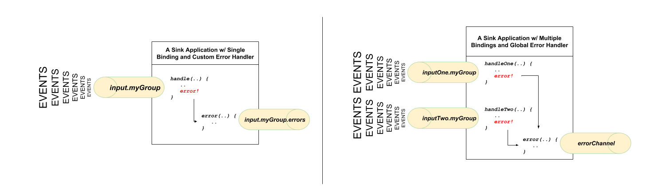
06 Error Handling
6.1 Application Error Handling
For each input binding, Spring Cloud Stream creates a dedicated error channel with the following semantics <destinationName>.errors.
@StreamListener(Sink.INPUT) // destination name 'input.myGroup'
public void handle(Person value) {
throw new RuntimeException("BOOM!");
}
@ServiceActivator(inputChannel = Processor.INPUT + ".myGroup.errors") //channel name 'input.myGroup.errors'
public void error(Message<?> message) {
System.out.println("Handling ERROR: " + message);
}

Slide 28
06 Error Handling
6.2 System Error Handling
System-level error handling implies that the errors are communicated back to the messaging system and, given that not every messaging system is the same, the capabilities may differ from binder to binder.
If no internal error handlers are configured, the errors propagate to the binders, and the binders subsequently propagate those errors back to the messaging system.
Drop Failed Messages
By default, if no additional system-level configuration is provided, the messaging system drops the failed message. While acceptable in some cases, for most cases, it is not, and we need some recovery mechanism to avoid message loss.
DLQ - Dead Letter Queue
DLQ allows failed messages to be sent to a special destination: - Dead Letter Queue.
When configured, failed messages are sent to this destination for subsequent re-processing or auditing and reconciliation.
Re-queue Failed Messages
the currently supported binders (Rabbit and Kafka) rely on RetryTemplate to facilitate successful message processing, guided through properties described at: 5.2.3

Slide 29
07
Reactive Programming Support

Slide 30
07 Reactive Programming Support
7.1 Introduction
Spring Cloud Stream also supports the use of reactive APIs (via Reactor API) where incoming and outgoing data is handled as continuous data flows. Support for reactive APIs is available through spring-cloud-stream-reactive, which needs to be added explicitly to the project.
The programming model with reactive APIs is declarative. Instead of specifying how each individual message should be handled, you can use operators that describe functional transformations from inbound to outbound data flows.
The reactive programming model also uses the @StreamListener annotation for setting up reactive handlers. The differences are that:
The @StreamListener annotation must not specify an input or output, as they are provided as arguments and return values from the method.
The arguments of the method must be annotated with @Input and @Output, indicating which input or output the incoming and outgoing data flows connect to, respectively.
The return value of the method, if any, is annotated with @Output, indicating the input where data should be sent.

Slide 31
07 Reactive Programming Suport
7.2 Reactor-Based Handlers
A Reactor-based handler can have the following argument types:
For arguments annotated with @Input, it supports the Reactor Flux type. The parameterization of the inbound Flux follows the same rules as in the case of individual message handling: It can be the entire Message, a POJO that can be the Message payload, or a POJO that is the result of a transformation based on the Message content-type header. Multiple inputs are provided.
For arguments annotated with Output, it supports the FluxSender type, which connects a Flux produced by the method with an output. Generally speaking, specifying outputs as arguments is only recommended when the method can have multiple outputs.

Slide 32
07 Reactive Programming Suport
7.3 Reactive Sources
Spring Cloud Stream reactive support also provides the ability for creating reactive sources through the @StreamEmitter annotation. By using the @StreamEmitter annotation, a regular source may be converted to a reactive one.
@StreamEmitter is a method level annotation that marks a method to be an emitter to outputs declared with @EnableBinding.
You cannot use the @Input annotation along with @StreamEmitter, as the methods marked with this annotation are not listening for any input. Rather, methods marked with @StreamEmitter generate output.
Following the same programming model used in @StreamListener, @StreamEmitter also allows flexible ways of using the @Output annotation, depending on whether the method has any arguments, a return type, and other considerations.

Slide 33
08
Apache Kafka Binder Reference

Slide 34
08 Apache Kafka Binder Reference
8.1 Usage and Properties Reference
To use Apache Kafka binder, you need to add spring-cloud-stream-binder-kafka as a dependency to your Spring Cloud Stream application, as shown in the following example for Maven:
<dependency>
<groupId>org.springframework.cloud</groupId>
<artifactId>spring-cloud-stream-binder-kafka</artifactId>
</dependency>
Reference:
https://docs.spring.io/spring-cloud-stream/docs/current/reference/htmlsingle/#_apache_kafka_binder_overview
Example:
https://raw.githubusercontent.com/Telefonica/sandas-authorization/master/src/consumers/deleter/src/main/resources/application.yml?token=ABEAXIYZGHGOP3NKHONVVIS44LWRW

Slide 35
09
Examples

Slide 36
09 Examples
9.1 Guided Example
Following:
https://github.com/Telefonica/cto-spring-webflux-training/tree/master/examples/spring-cloud-stream-kafka
Steps:
Create Project from Spring Initializr
Difference between 2.1.4.RELEASE and 2.2.0.M3 (Jackson dependency included in 2.1.4.RELEASE)
Choosing the right dependencies
spring-cloud-stream-reactive + spring-cloud-stream-binder-kafka
Lombok (optional)
Adding Jackson dependencies
SecretMessage Class / KafkaApplicationException Class
@ConditionalOnExpression / application.yml
Coding the Producer / Executing alone (Block) / Kafka Tool to inspect messages (kafkatool.com)
Coding the Consumer / Executing alone / Both simultaneously
Talking about testing

Slide 37
10
Exercises

Slide 38
10 Exercise
10.1 Hints / Recommendations
Following:
https://github.com/Telefonica/sandas-authorization
Steps (Eclipse):
Generic Notification model
Common Interface for both Producer and Consumer
Producer (hint to be explained: Creating an emitter Flux)
Consumer
Take it easy!!

Slide 39
11
Integration With Non-Reactive Systems

Slide 40
11 Integration With Non-Reactive Systems
11.1 Launch your block ops in an independent Pool of Threads (Schedulers)
protected Mono<ApplicationAssertion> parseApplicationAssertion(String jwt) {
// jjwt does not work with observables. As a result, the callback needs to get blocked and to avoid blocking
// the working thread, it is scheduled to a pool of threads with Mono.fromCallable and Schedulers.elastic().
return Mono.fromCallable(() -> {
try {
ApplicationAssertion applicationAssertion = new ApplicationAssertion();
Assertion assertion = jwtManager.parseWithCallback(jwt, asrt -> {
validateAssertion(asrt);
Application application;
try {
application = applicationsService.getApplication(asrt.getIssuer()).block();
} catch (NotFoundException e) {
throw new InvalidGrantException("invalid issuer");
}
applicationAssertion.setApplication(application);
return application.getSecret();
});
….
}
}).subscribeOn(Schedulers.elastic());
}
https://www.mera.ru/media/attachments/2019/04/25/spring_reactor_basic_mera-meetup.pdf (slide 15)

Slide 41
Thanks
Folks

