Slide 1
Spring Data
20.05.2019

Slide 2

Index
01. Spring Data
Introduction
02. Reactive Modules
Introduction
Reactive Mongo
Model
Repository
Advanced Repository
Advanced Queries

Slide 3
Spring Data

Slide 4
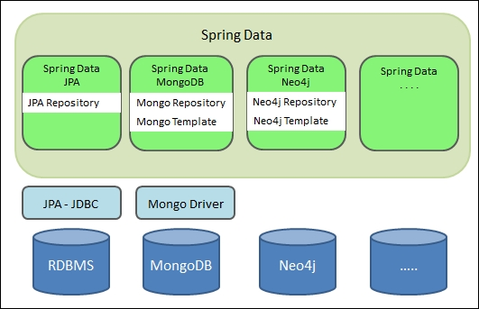
Spring Data
Provides a Spring-based flavour for data access and allowing the special features of the underlying data store.
Easy to use
Relational and non-relational databases
This is an umbrella project that contains many subprojects:
Spring Data JDBC
Spring Data JPA
Spring Data MongoDb
Spring Data Cassandra
Spring Data Redis
Spring Data Neo4j
Ability to create repositories automatically

Slide 5




Links
https://github.com/Telefonica/cto-spring-webflux-training
https://codeshare.io/5zkwNj
https://github.com/Telefonica/cto-spring-webflux-training/blob/master/docker-compose.yml
https://spring.io/projects/spring-data

Slide 6
Reactive Modules

Slide 7
Introduction
Reactive modules for the most popular NoSql Databases are available:
MongoDb
Cassandra
Redis
Couchbase
Project R2DBC brings a reactive programming API to SQL databases and Spring Data R2DBC makes easier to use and the Project Reactor Compliance.

Slide 8
Spring Data Reactive Mongo
Reactive Module
Project Reactor compliant. Repository methods return Mono/Flux objects.
It handles collection creation/index.
Very easy to use at the beggining.

Slide 9
Spring Data Reactive Mongo
Initial Steps
Add reactive dependency to the pom.xml
Add a basic configuration for mongoDb
<dependency>
<groupId>org.springframework.boot</groupId>
<artifactId>spring-boot-starter-data-mongodb-reactive</artifactId>
</dependency>
<dependency>
Properties Config File
YAML config File
spring.data.mongodb.uri = ${MONGO_URI:mongodb://127.0.0.1/webflux}
spring:
data:
mongodb:
uri: ${MONGO_URI:mongodb://127.0.0.1/webflux}

Slide 10
Spring Data Reactive Mongo Model
You need to add some annotations in order to map Pojo instances with database data.
Depending on the type of database, some annotations may vary. Ex. Mongo @Document vs Cassandra @Table
Mongo annotations:
@Document -> Identifies a domain object to be persisted to MongoDB. CollectionName could be configured.
@Id: Applied at the field level to mark the field used for identity purpose.
@Indexed: Applied at the field level to describe how to index the field.
@CompoundIndex: Applied at the type level to declare Compound Indexes.
@Transient: Excludes the field where it is applied from being stored in the database.
@Field: Allows to use other name in the Mongo BSON document.

Slide 11
Spring Data Reactive Mongo Repositories
You will have a basic repository by creating an interface extending ReactiveMongoRepository<T, ID> where
T is the Pojo Type
ID is the type of the @Id property in the Pojo.
You need to annotate the interface with the Spring’s @Repository.
@Repository
public interface SocsRepository extends ReactiveMongoRepository<SOC, Long> {
}

Slide 12
Spring Data Reactive Mongo Repositories
ReactiveMongoRepository offers the typical query methods: findById, deleteById, count, save, etc…
You can add new queries adding new methods to the interface.
@Repository
public interface ClientsRepository extends ReactiveMongoRepository<Client, Long> {
@Query(value="{}", fields="{tenantId: 1, socId: 1, name: 1, acronym: 1}")
Flux<Client> findClientsForContext();
Flux<Client> findByTenantIdAndSocId(Long tenantId, Long socId);
}

Slide 13
Spring Data Reactive Mongo Query Creation
You can create queries using the following methods:
Using a method name convention. Link
findByLastnameAndFirstName
findByAgeOrderByLastnameDesc
Using annotations such as:
@Query
@DeleteQuery
@ExistsQuery
@CountQuery
Building the query programmatically. (Advanced Queries)
@Repository
public interface DefaultProfilesRepository extends ReactiveMongoRepository<DefaultProfile, String> {
@DeleteQuery(value="{contextId : ?0, profileId: ?1}")
Mono<Long> deleteByContextIdAndProfileId(String contextId, Long profileId);
@Query("{'$or':[ {'contextId':?0}, {'contextId':?1}, {'contextId':?2}] }")
Flux<DefaultProfile> findByContextId(String contextIdNoParent, String contextParent, String contextId);
}

Slide 14
Spring Data Reactive Mongo Advanced Repositories
You may need to extend the options of ReactiveMongoRepository because you need to create a complex query or special method.
Sequence problem. Interface + Implementation
@Repository
public class SequenceRepositoryImpl<T> implements SequenceRepository<T> {
private final ReactiveMongoTemplate mongoTemplate;
public SequenceRepository(ReactiveMongoTemplate mongoTemplate) {
this.mongoTemplate = mongoTemplate;
}
@Override
public Mono<Long> next(Class<T> entityType) {
…………….
}
}
public interface SequenceRepository<T> {
Mono<Long> next(Class<T> entityType);
}

Slide 15
Spring Data Reactive Mongo Advanced Queries
ReactiveMongoTemplate + Spring Data Mongo query Classes + Spring data domain classes
Query query = new Query(Criteria.where("_id").is(key));
Update update = new Update().inc("counter", 1);
FindAndModifyOptions options = new FindAndModifyOptions().upsert(true).returnNew(true);
return mongoTemplate.findAndModify(query, update, options, Sequence.class)
.map(Sequence::getCounter);

