Slide 1
D3.js Force Graphs
© 2019 Daniel “Code Whisperer” Stern

Slide 2

Roadmap
Learn about D3.js
Learn about Force graphs
Make a D3.js force graph with HTML, JavaScript an

Slide 3

Scenario – Competitor Relationships
One day, your boss comes into your office with a industry trade report
The report contains all the buying and selling activity of all your competitors
Your boss tells you that the competition has been buying and selling to each other
He wants to know which competitor has the most relationships with other companies, as well as the 2nd most, etc.

Slide 4
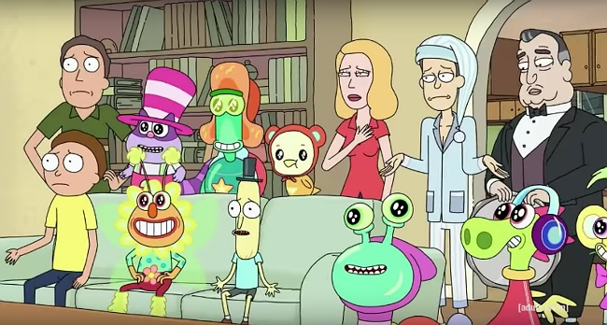
What is D3.js?
Stands for “data driven documents”
Simple to think of it as a graphing library
Does do a lot of graphing
More accurately, a data library
Used to visualize various forms of data

Slide 5

What’s a force graph?
Data visualization
Contains “Nodes” representing the different data points (Competitor A, Competitor B, etc.)
Nodes are connected with lines
Uses “gravity” to arrange the nodes
Most connected nodes are in the center

Slide 6
Activity : Build a Force Graph
Use D3.js to make force graph of character relationships on a popular TV show
Code along using your laptop
Required: Node.js
Nodes will move when they are dragged
Graph will reveal the most important character on the show

Slide 7
Thank you!
© 2019 Code Whisperer
@danieljackstern

