Slide 1
Team KICA Kaoutar, Iris, Cristiana, Ana
The CODATA-RDA Research Data Science Summer School
RDM LAB
Trieste, 9. 8. 2019

Slide 2

Decadal oxygen change in the eastern tropical North Atlantic Johannes Hahn, Peter Brandt, Sunke Schmidtko, and Gerd Krahmann 2017 Ocean Science, 13, 551–576 https://doi.org/10.5194/os-13-551-2017
© Author(s) 2017. This work is distributed under the Creative Commons Attribution 3.0 License.

Slide 3
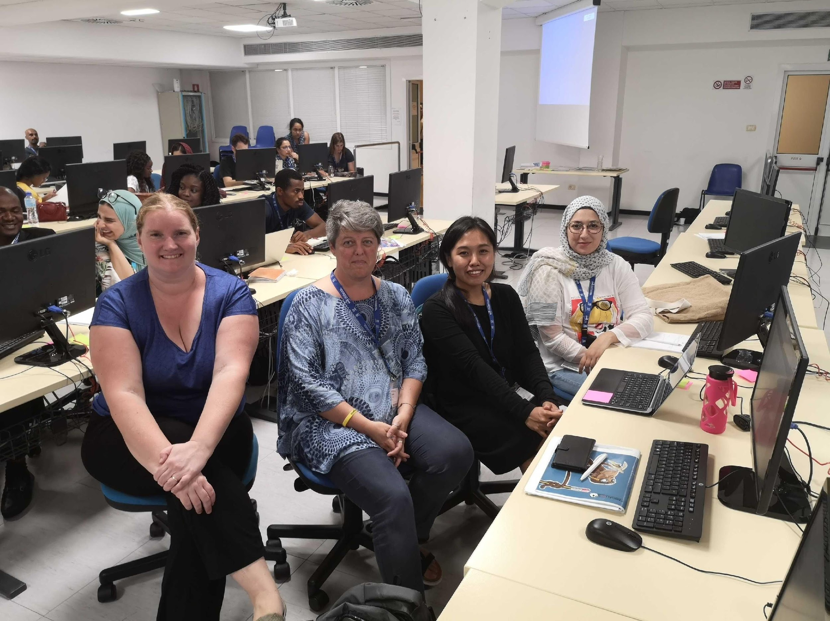
The team Answer the question, “Why are we the ones to solve the problem we identified?”
The Team “Why are we the ones to solve the problem we identified?”
Iris Diana Uy (Philippines) Technician Kaoutar El Khattabi (Morocco) Scientist Cristiana Pisoni (Italy) Reader/Investigator Ana Slavec (Slovenia) Science Communicator

Slide 4
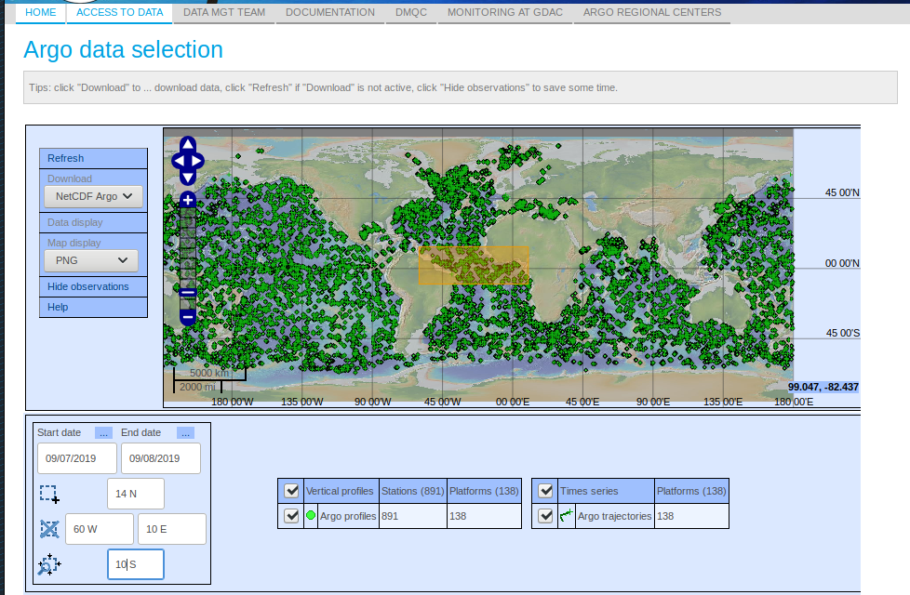
Context
Location: Eastern tropical North Atlantic (Along 23W between 6 and 14 N)
Duration: 2006 - 2015

Slide 5
Aim
The aim of the paper we reviewed was to contribute to a more comprehensive understanding of the oxygen changes during the last decade and of the dynamical processes that drive this variability. This encompasses three major goals:
(i) description of the regional pattern of the decadal oxygen trend;
(ii) determination of associated trends in salinity and circulation;
(iii) discussion of implications of the decadal oxygen trend for the oxygen budget of the ETNA.

Slide 6
Data and methodology
Monthly, isopycnal and mixed-layer ocean climatology - MIMOC (http)
used as a reference mean state to perform a water mass analysis
and quantify the temporal evolution of salinity anomalies in the tropical Atlantic
ARGO float data (DOI)
to quantify the temporal evolution of salinity anomalies in the tropical Atlantic on two characteristic density surfaces (26.8 and 27.2 kg m−3)
Aviso altimetry products of surface geostrophic velocity (http)
to quantify the temporal evolution of salinity anomalies in the tropical Atlantic on two characteristic density surfaces (26.8 and 27.2 kg m−3)
Pangea shipboard and mooring data (DOI)

Slide 7
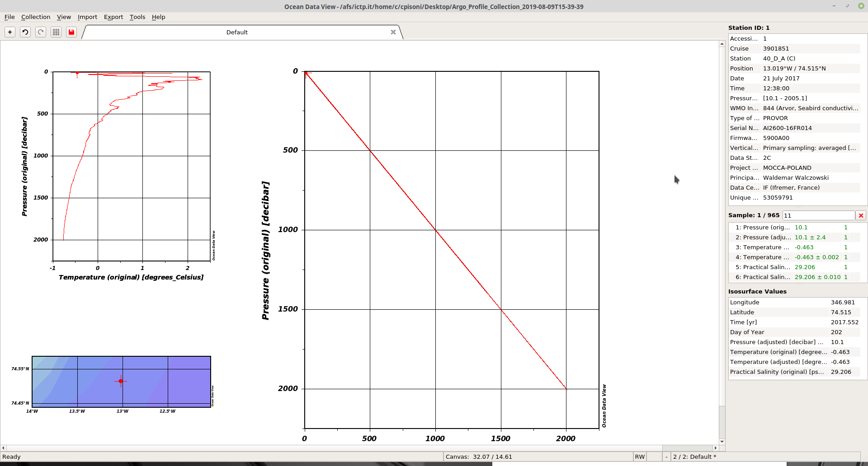
Trying to sample ARGO data
Full data set is huge
Available in binary format that needs other tools to convert to text

Slide 8
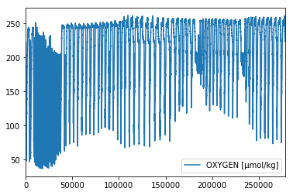
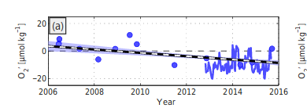
Their result
Our result
Note: the data is only for Pangea data (limited to 2015)

Slide 9
We were not able to replicate data because it is too large and it would need to be sampled (i.e. we cannot replicate the same sample that the original researchers did)
We tried to sample but the data is in binary format so we would need to have other tools.
Finally, we decided to focus on the easiest to access the data which is Pangea but we have that for only for one year and we couldn’t calculate anomalies.
Summary

Slide 10
It is not enough to describe the data but the authors should also explain the methodology in more details and provide instructions on how to download the data in an open source format.
Recommendation for authors

