Slide 1

STICKING TO THE RECIPE

Slide 2
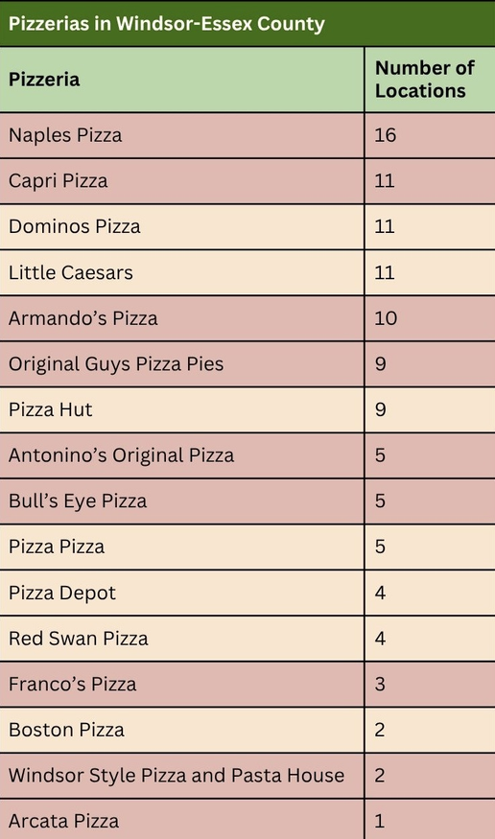

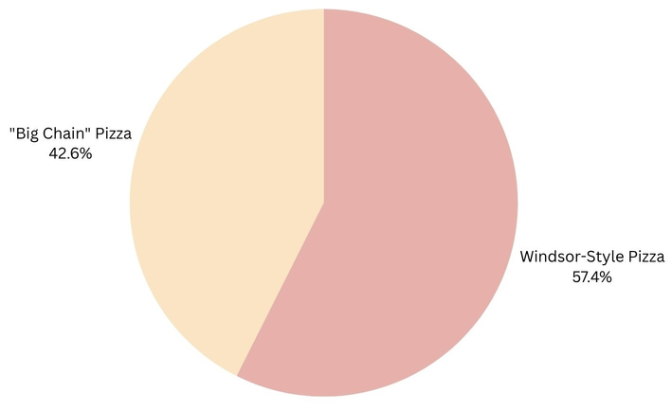
Comparison Between Local and Chain Pizza
Windsor has at least 62 locally owned and operated pizzerias that all follow Windsor-style pizza.
In comparison, there are only 46 big chain pizzerias.

Slide 3
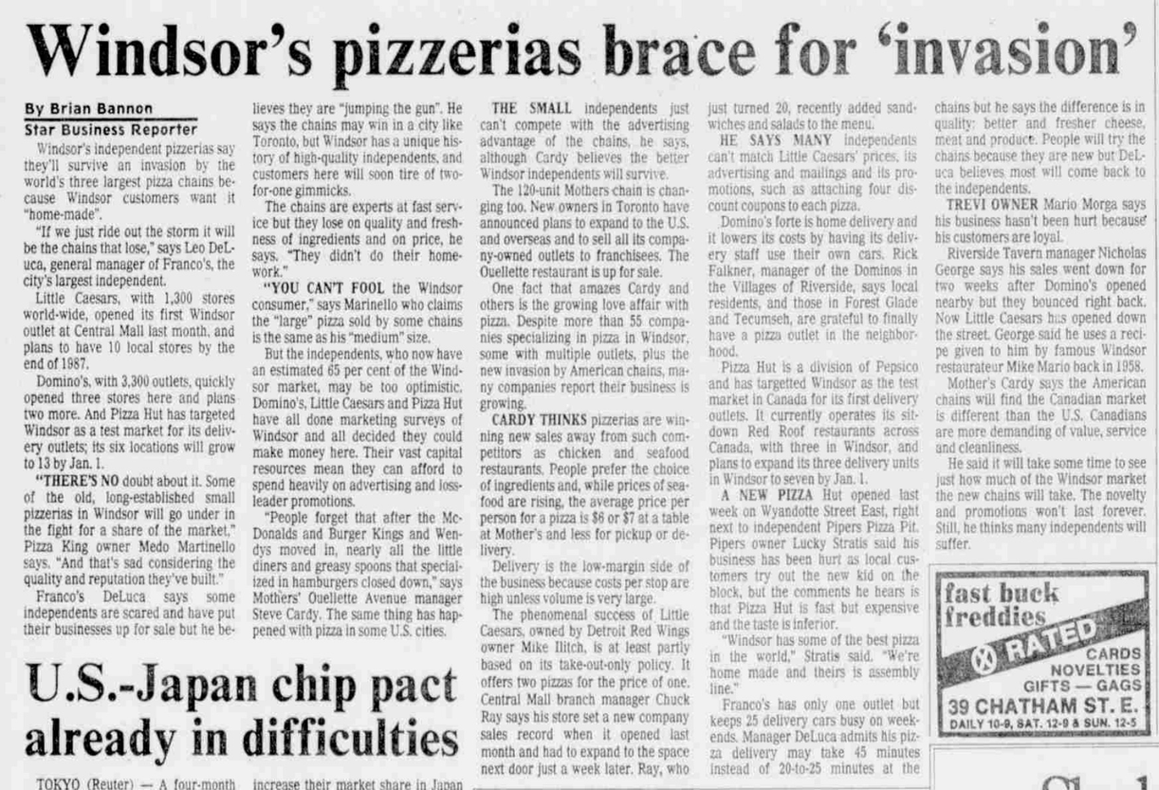
The Pizza War
In the early 1970s, activists warned about the “McDonaldization of America.”
Many of those concerns have now become a reality as independent stores have moved out and large chains have moved in.
In Windsor, local pizzerias believed they would survive the arrival of the chains because their customers preferred “home-made.”
Windsor pizzerias have held strong. Although some have closed, many have expanded
AN ARTICLE ABOUT THE INVASION OF BIG CHAINS IN WINDSOR'S PIZZA INDUSTRY. RETRIEVED FROM THE WINDSOR STAR, DECEMBER 2, 1986.

