Slide 1



Pizza
THE CREATION OF WINDSOR

Slide 2

WHAT MAKES FOOD UNIQUE TO A PLACE?

Slide 3
WHAT STYLE OF PIZZA?

Slide 4
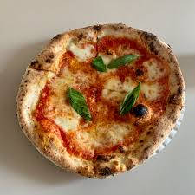

Slide 5
Neapolitan pizza

Slide 6
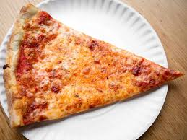

Slide 7
New York Pizza

Slide 8
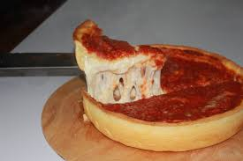

Slide 9
Chicago Pizza

Slide 10
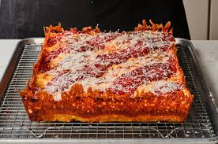

Slide 11
Detroit Pizza

Slide 12
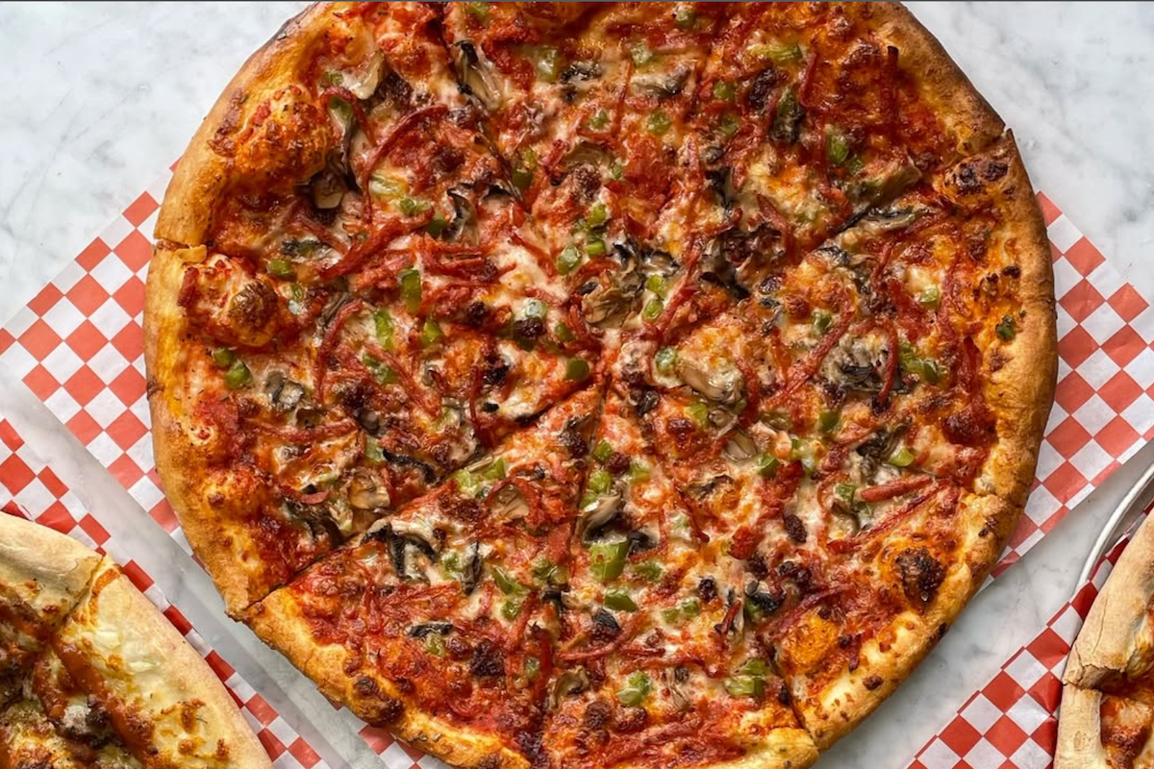

Slide 13
Windsor Pizza

Slide 14
THE SECOND WAVE OF ITALIAN IMMIGRATION
During World War II, concerns of fascism halted immigration.
Following World War II, economic opportunities encouraged immigration to Canada.

Slide 15
GROWTH OF INDEPENDEDNT BUISNESSES
Many immigrants created community spaces to build bonds in a new community.
Immigrants also opened their own buisnesses.
These buisnesses became spaces for families and communities to connect.

Slide 16
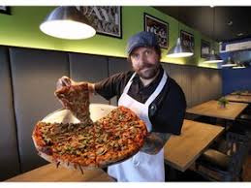
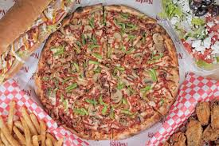
WINDSOR
Pizza
Windsor-style pizza emerged during this period.
Windsor-style pizza became an industry recognized not just for its pizza but also for the experience it created.
Volcano’s Pizzeria was the first pizzeria to make the tradtional Windsor style.
Many of Windsor's pizza makers came from Volcanos and adapted their recipes from there.

Slide 17




WHAT MAKES
Shredded Pepperoni, Canned Mushrooms, Galati Cheese, Zesty Sauce, Corn Meal, Thin Crust
A Windsor Pizza

Slide 18
PIZZA INDUSTRY TIMELINE
In small groups, you will create a timeline showing the development of Windsor-style pizza.
Use the Early Immigration and the Creation of Windsor Pizza tabs on the “A Slice of Windsor” website.
Create your timeline using Prezi
Your timeline should include:
The event and corresponding date
Why are the events important
A connection to immigration, business, or food culture.

Slide 19
Thank
YOU

