Slide 1

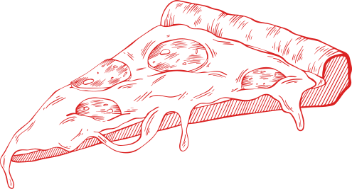
MAINTAINING A LEGACY

Slide 2
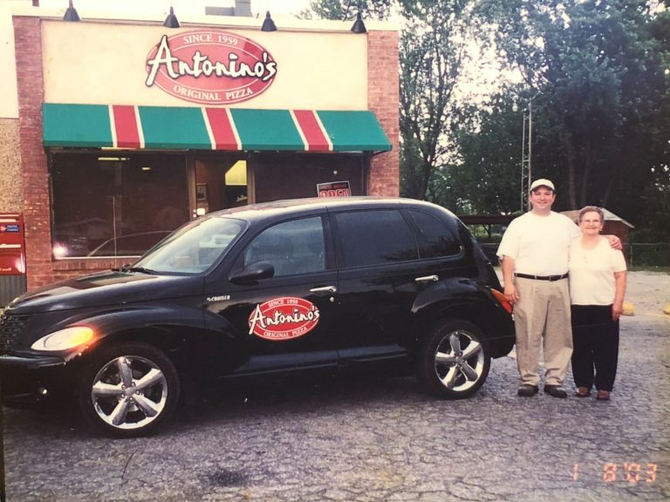
WINDSOR PIZZA
Today
Windsor-style pizza represents more than food. It symbolizes family labour, cultural memory, and resistance to American commercial dominance in a border city.
Antonino’s Original Pizza owner Joe Ciaravino and his mother Vita stand proudly in front of the first Antonino’s Original Pizza location in South Windsor, Ontario (2003). Retrieved from Antonino's Original Pizza.

Slide 3
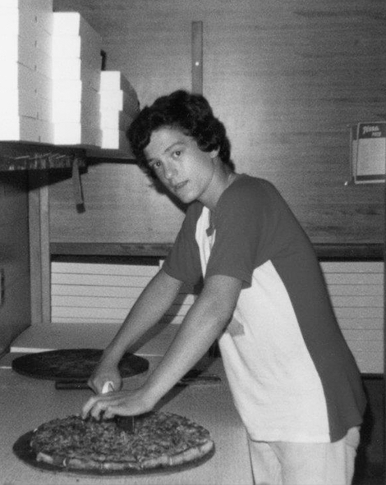
ANTONINO'S ORIGINAL PIZZA
Joe Ciaravino grew up watching his parents work in the Windsor pizza business.
As Joe got older, he attended the University of Windsor and earned a Master of Business Administration.
In 1999, with his mom's help, Joe opened the first Antoninos Original Pizza location on the corner of North Talbot Rd.
Antonino’s Original Pizza owner Joe Ciaravino was working in the family pizzeria at age 13 (1978). Retrieved from Antonino’s Original Pizza.

Slide 4
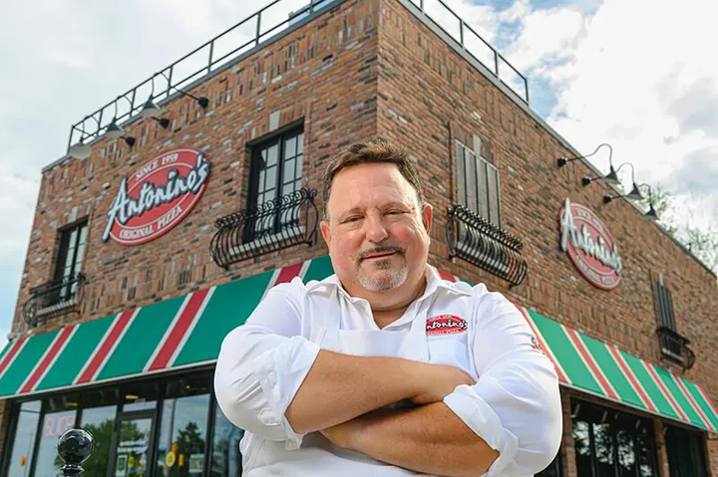
ANTONINO'S ORIGINAL PIZZA
Joe named the locations after his father as a tribute.
Antoninos has now expanded to 5 locations across Windsor-Essex County, including the original location in South Windsor.
Antoninos honour the tradition of past Windsor Pizza makers and maintains a legacy focused on quality and creating a family environment.
Antonino’s Original Pizza owner Joe Ciaravino outside his new South Windsor location. Retrieved from Antonino's Original Pizza.

Slide 5

RECOGNTION
Windsor Pizza has expanded beyond its southernmost city in Canada and gained local, national, and international recognition.
At the 2014 Las Vegas Pizza Expo, Armando’s Pizza won 1st International and 3rd overall.
2021 documentary “The Pizza City You’ve Never Heard Of”
Long Distance Windsor Pizza Orders
Official poster for "The Pizza City You’ve Never Heard Of" by George Kalivas and Tristan Laughton. Retrieved from Windsorlife.

Slide 6
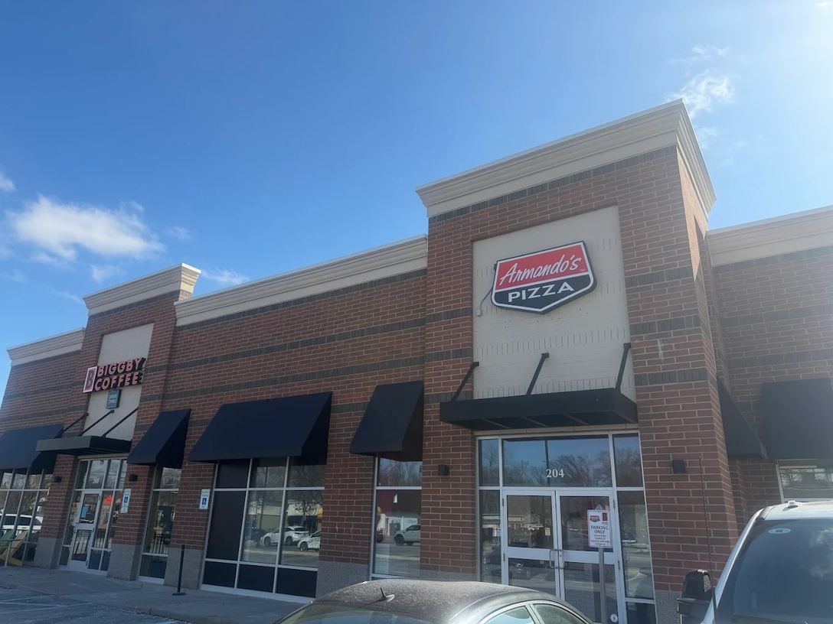
INFLUENCE
Concerns about American influence have risen sharply over recent decades,
Armando's Pizza recently opened in Clawson, Michigan
Official poster for "The Pizza City You’ve Never Heard Of" by George Kalivas and Tristan Laughton. Retrieved from Windsorlife.Official poster for "The Pizza City You’ve Never Heard Of" by George Kalivas and Tristan Laughton. Retrieved from Windsorlife.

