Slide 1
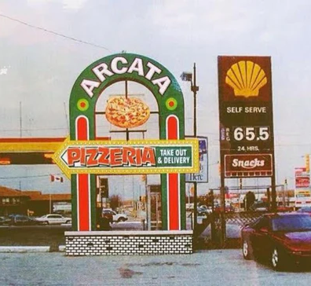

Windsor Pizzerias

Slide 2
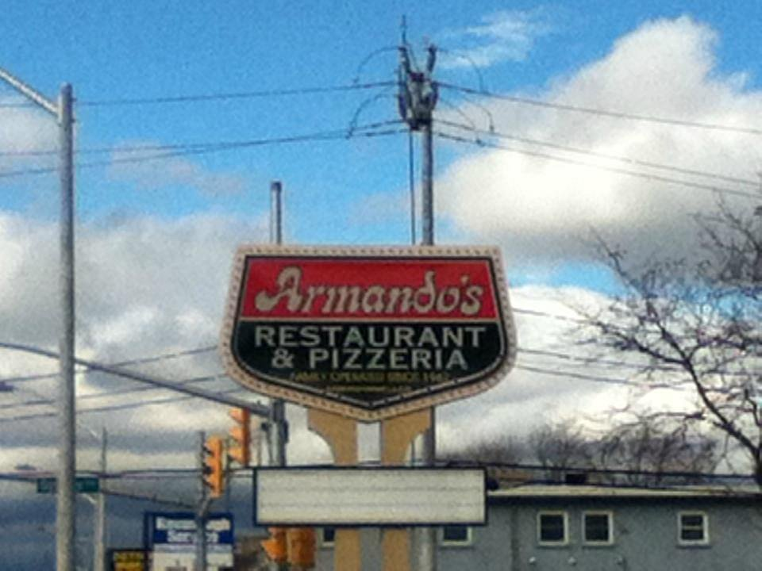
Growth of Windsor Pizzerias
Following the success of Volcanos Pizzeria, many pizzerias appeared in Windsor.
Historic Pizzaerias in Windsor include Capri, Armando, Arcata, Naples, and Francos.
Many of these pizzerias had different generations of owners.

Slide 3
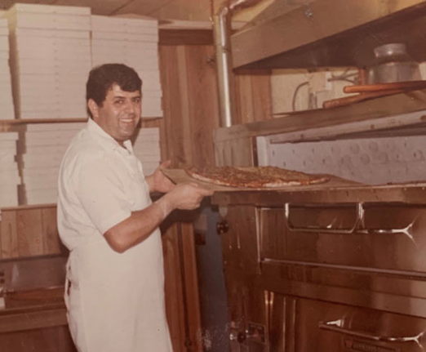
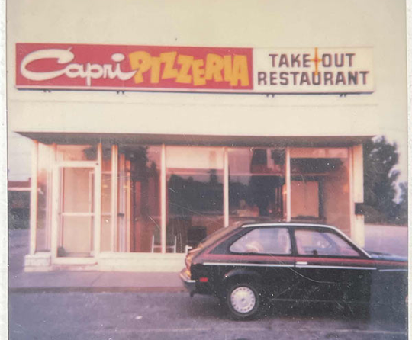
Capri Pizzeria
In 1959, Tony and Vita Ciaravino opened Capri, the first pizzeria in South Windsor.
At this time, pizza was not the main focus
In 1967, Capri was sold to Dominique Vigneri
In 1976, Bob and Dorothy Kalaydjian became the official owners of Capri
By 1997, Kevin (Bob's son) and Jim managed all Capri locations.

Slide 4
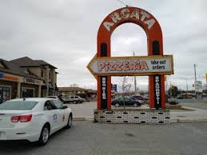
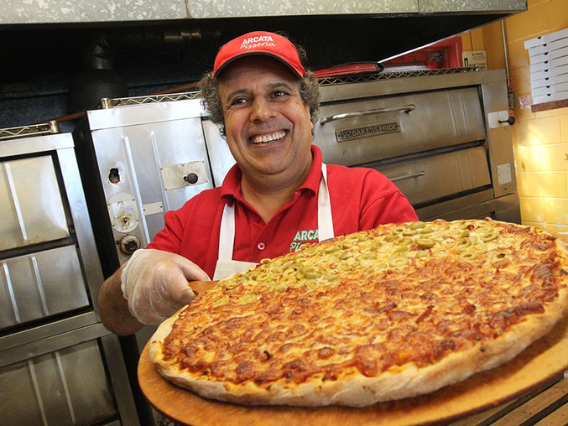
Arcata Pizzeria
Opened in 1972 by Antonino (Tony) and Vita Ciaravino
Sold to Dimitrios (Jim) and Asimina Roupas.
Bob Abumeeiz took over the business in 1996

Slide 5
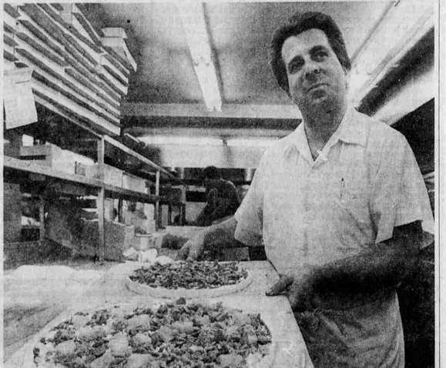
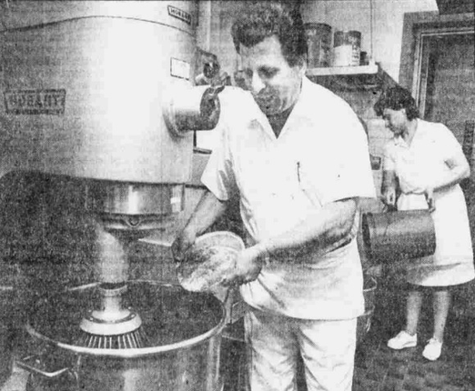
Francos Pizza
In 1973, Frank Tedesco opened Franco’s Spaghetti Factory and Pizza House as a family-friendly establishment.
By the 1980s, Franco’s had become a pizza giant in Windsor, reportedly selling as many as 900 pizzas a day.
After 33 years of ownership, Frank sold Franco’s to the Donato family

Slide 6
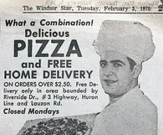
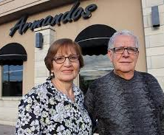
Armando’s Pizza
In 1967, Armando and Antonia Gerardi opened Armando's Pizza.
In 1996, John Pizzo began working at Armando’s, later married the Gerardis' daughter, and opened the Cabana Rd location.
By 2,006, Armando and Antonia retired, passing the businesses to John and their son Andre.

Slide 7
Naples Pizza
In 1984, Tony Bahceli opened the first Naples Pizza location.
By 1995, Naples Pizza had grown to nine locations.
Continued expansion brought the company to 17 locations by 2006 and 19 by 2010.
Today, Naples Pizza operates 12 locations.

