Slide 1


Taxi-v3: Reinforcement Learning
Exploring Dynamic Programming and Monte Carlo methods in the Taxi-v3 environment. This presentation covers problem definition, MDP modeling, and comparative analysis of solutions.

Slide 2
Problem Description & Objective
Environment
Rewards
Objective
Taxi-v3 is a 5x5 grid world. A taxi picks up a passenger and drops them off.
-1 for each time step (encourages speed)
Learn an efficient policy. Minimize steps and avoid penalties.
Each episode starts with random taxi, passenger, and destination positions.
+20 for successful drop-off
-10 for illegal actions

Slide 3





Why Taxi-v3 is Suitable
Discrete Spaces
Finite states (500) and actions (6) are ideal for tabular methods.
Known Dynamics
Transition probabilities are known, enabling Dynamic Programming.
Episodic Nature
Clear start and end points suit Monte Carlo methods.
Model-Based & Model-Free
Supports both DP (model-based) and MC (model-free) learning.

Slide 4
Markov Decision Process (MDP) Definition
States (S): The MDP models the Taxi-v3 environment. Each state captures the taxi, passenger, and destination locations.
Actions (A): Possible actions include moving (North, South, East, West) and interacting (pickup, dropoff).
Transition Probabilities (P): Actions deterministically lead to new states in Taxi-v3. The next state is certain given the current state and action.
Reward Function (R): Rewards guide the agent toward efficient passenger drop-offs and penalize illegal moves.

Slide 5
Q-learning Algorithm
Model-Free Approach: Q-learning directly optimizes policy without needing a model of the environment's transitions.
Q-Value Estimation: It learns an action-value function, Q(s,a), representing expected cumulative rewards.
Off-Policy Learning: The algorithm learns the optimal policy regardless of the agent's exploration strategy.
Iterative Updates: Q-values are refined through experience, converging to the optimal action for each state.

Slide 6
Epsilon-Greedy Exploration
Explore
Exploit
Take random actions with probability epsilon. This discovers new states and potential rewards.
Choose the action with the highest Q-value. This maximizes immediate returns based on current knowledge.

Slide 7
Markov Decision Process (MDP) Definition
States (S)
Actions (A)
Transition Probabilities (P)
500 discrete states: taxi position, passenger location, destination.
6 actions: Move (North, South, East, West), Pickup, Dropoff.
Deterministic environment: actions lead to predictable outcomes.
Rewards (R)
Discount Factor (γ)
-1 per step, +20 for dropoff, -10 for illegal actions.
γ = 0.9, balancing immediate and future rewards.

Slide 8





Dynamic Programming: Value Iteration
Optimal Value Function V*(s)
Optimal Policy π*(s)
Higher V*(s) Values
How good it is to be in state 's' optimally.
Best action to take in each state for maximum rewards.
Closer to goal, more advantageous states.
Convergence
Typically 100-200 iterations, max change < 1e-6.

Slide 9
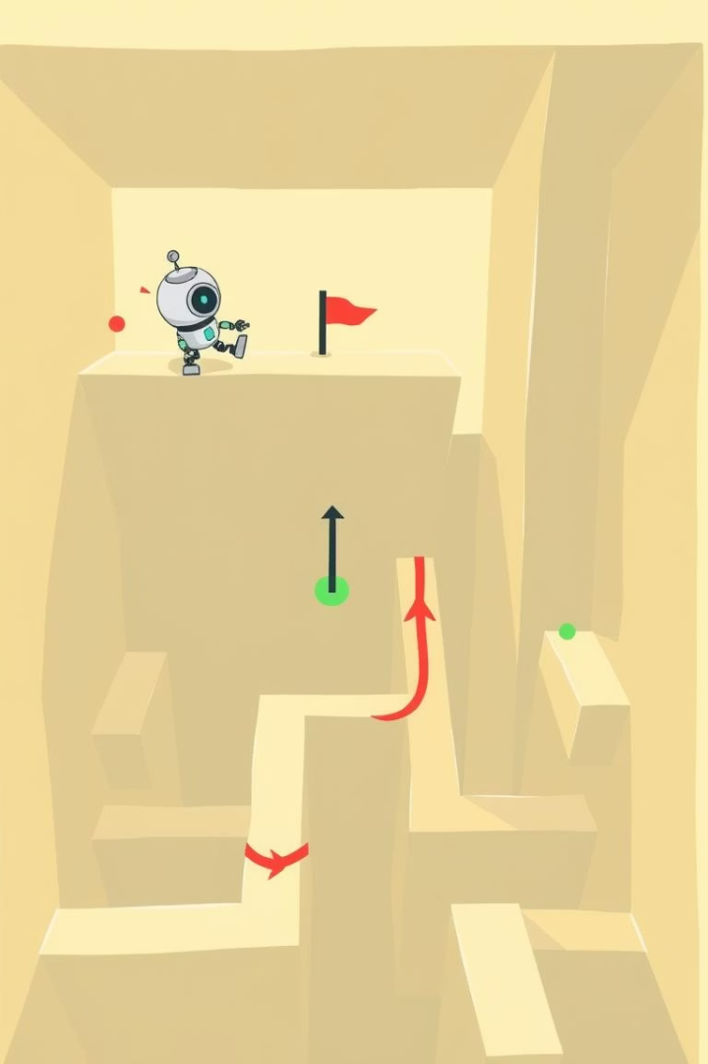




Monte Carlo Method: Control Loop
Setup & Initialization
Import libraries, initialize Q-table, returns, and policy.
Epsilon-Greedy Policy
Balances exploration (random) and exploitation (best Q-value).
Episode Generation
Simulate interactions, record states, actions, and rewards.
Control Loop
Process episodes backward, update Q-values, and improve policy.

Slide 10
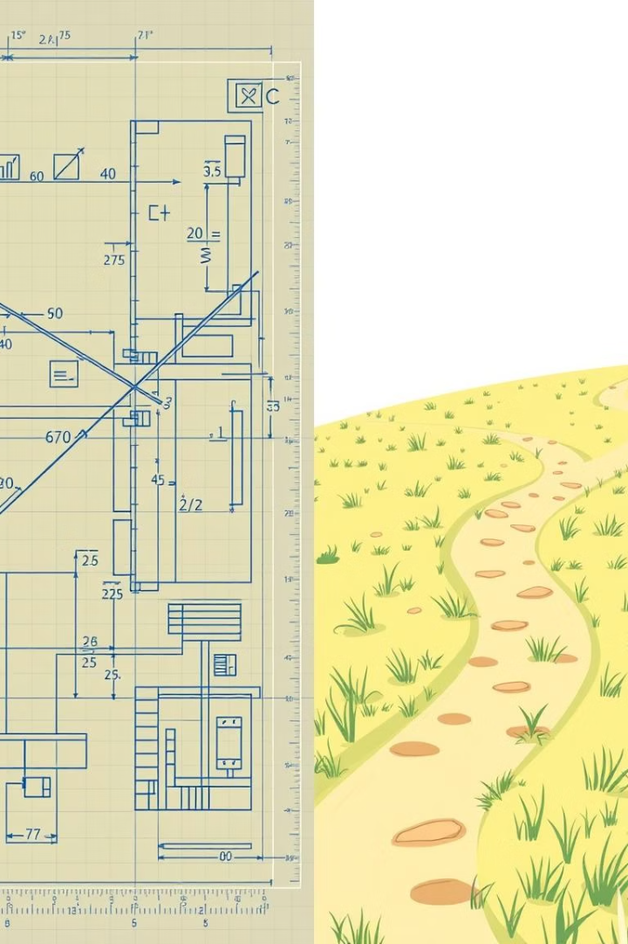
Comparison: DP vs. MC
Feature
Dynamic Programming
Monte Carlo
Model Requirement
Full MDP knowledge
No model, learns from episodes
Convergence Speed
Fast (hundreds of iterations)
Slow (tens of thousands of episodes)
Accuracy
High (precise under model)
Variable (depends on exploration)
Scalability
Limited to small/medium state spaces
More scalable with function approximation

Slide 11




Conclusion & Improvements
DP for Known, Small Environments
1
Achieves optimal results faster with full model knowledge.
MC for Unknown, Interactive Environments
2
Learns from experience, more flexible despite slower convergence.
MC Improvement
3
Implement decaying epsilon for better exploration-exploitation.
DP Improvement
4
Prioritized sweeping for larger state spaces.

Slide 12




Future Research Directions
Complex Environments
Explore dynamic, partially observable, and multi-agent systems. Focus on advanced game theory.
Transfer Learning
Develop methods to apply learned policies to new, related tasks. Enhance adaptation capabilities.
Explainable AI (XAI)
Increase transparency in agent decision-making. Build trust and interpretability in RL models.
Real-World Deployment
Integrate robust RL solutions into robotics, healthcare, and finance. Address safety and reliability.

