Slide 1
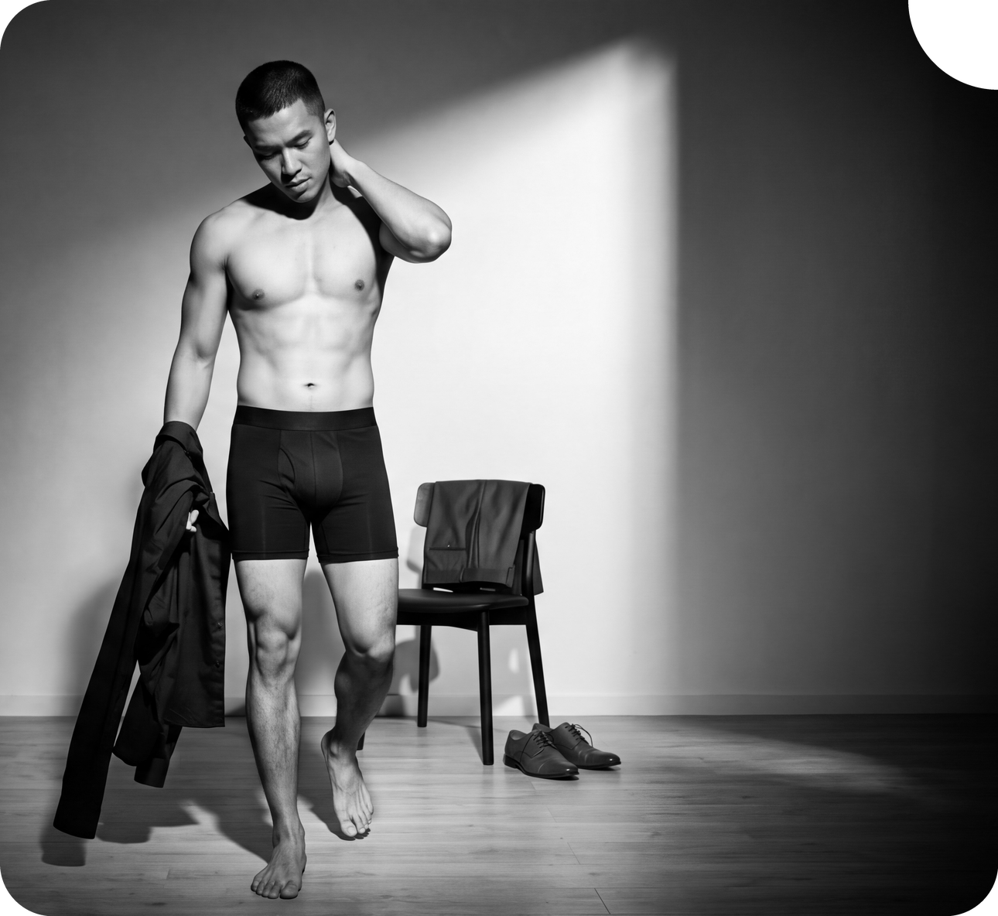

PRODUCT KNOWLEDGE · 2026
Engineered for
Every Body
Tailored essentials for everyday comfort. What the product is, what it is made of, and how to size it.
MODALCLOUD™
FLOWLITE™
FIT LAB
toni.black
Notes:
Semua materi di deck ini diambil dari toni.black.

Slide 2
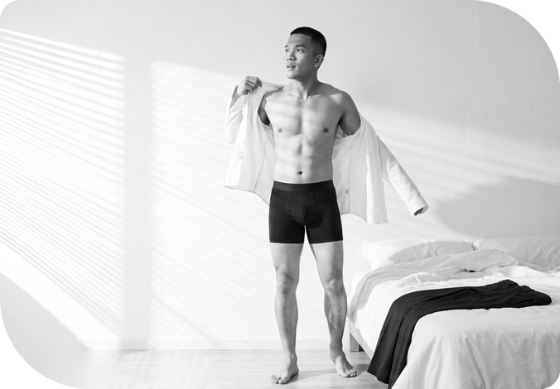
01 Brand
PRODUCT KNOWLEDGE
Tailored essentials,
nothing extra
Toni Black makes everyday underwear for men across Asia-Pacific. The work goes into what you actually feel: the waistband, the fabric, the stretch, the support.
THE BLACK-FIRST RULE
MARKETS
Black is not a colour choice.
It is a design discipline.
5
One colour means fewer lines, less overproduction, less waste.
COLOUR
1
Singapore · Malaysia · Australia · New Zealand · Indonesia
Notes:
Poin utama: satu warna itu keputusan desain, bukan keterbatasan stok.

Slide 3
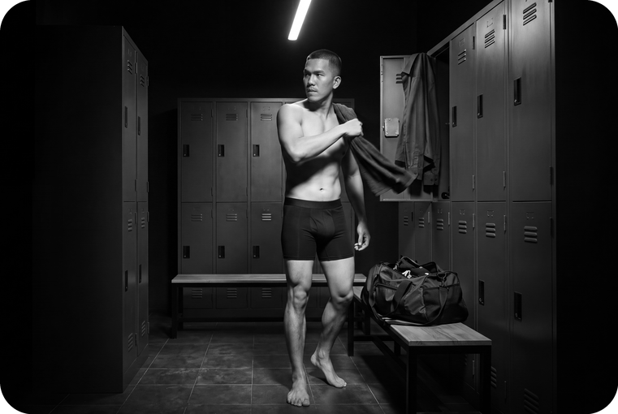
02 Numbers
PRODUCT KNOWLEDGE
The product in four numbers
MODAL
ELASTANE
SIZES
COLOUR
91%
9%
S – 3XL
Black
SIZING
TRIAL
Fit Lab
First Pair
Guarantee
Two inputs — height and weight. One confident answer, built on real garment measurements and real bodies.
If the first pair misses on fit, comfort or quality, contact support. One claim per customer.
Notes:
Empat angka ini yang paling sering ditanya calon pembeli.

Slide 4
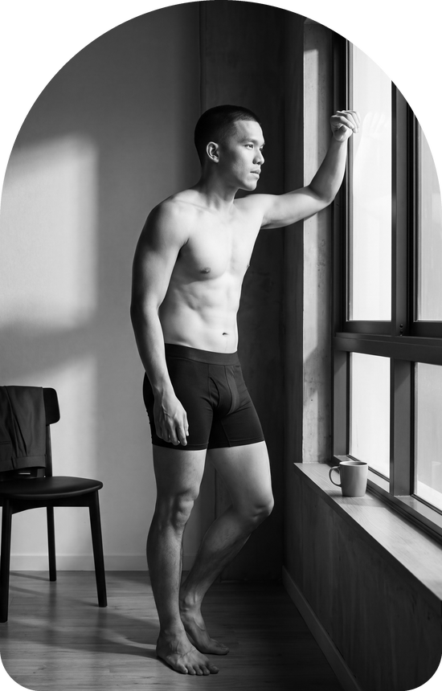
03 Fabric
PRODUCT KNOWLEDGE
ModalCloud™
THE SIGNATURE FABRIC
Cloud-like comfort from MicroModal. Soft, breathable, light, and it moves naturally with the body.
COMPOSITION
Modal 91% · Elastane 9%
The elastane is what gives it 4-way stretch and recovery.
EVERYDAY
WORK
TRAVEL
USED IN
Brief
MOISTURE
Boxer Brief 5"
50% more than cotton
Inner Singlet
Absorbs more, releases it faster, and resists yellowing over washes.
Inner Crewneck T
Notes:
ModalCloud dipakai di hampir semua produk. FlowLite hanya di loose boxer.

Slide 5
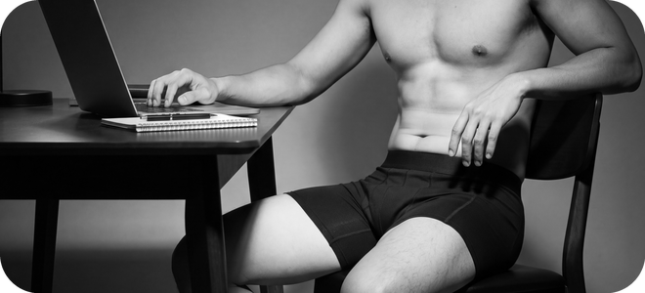
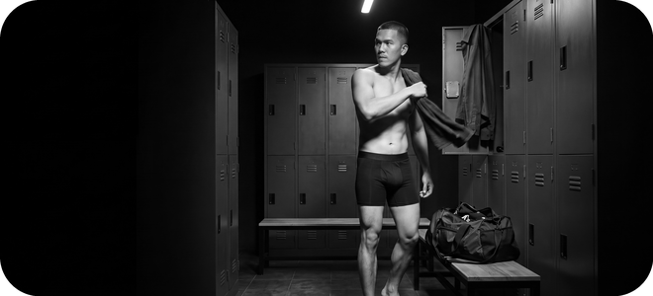
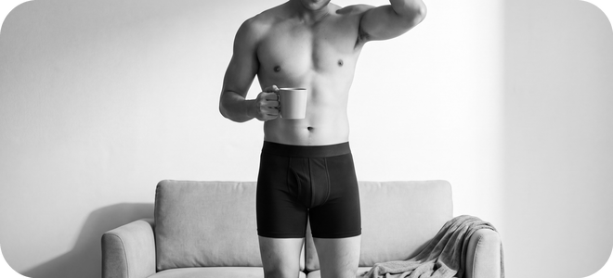
04 Build
PRODUCT KNOWLEDGE
Built from three things
01
02
03
ModalCloud™
FlowLite™
Soft Elastic Waistband
MicroModal with a touch of elastane. Soft, breathable, light. The fabric behind most of the range.
A lyocell-based fibre, finer and more fluid than modal. The lightest fabric Toni Black makes.
A secure hold without harsh pressure. Follows the natural waistline. Minimal branding.
FABRIC
FABRIC
CONSTRUCTION
Notes:
Tiga hal ini yang membedakan produknya. Dua kain, satu konstruksi.

Slide 6
05 Range
PRODUCT KNOWLEDGE
The men's range
Style | Fabric | Cut | From
Brief | ModalCloud™ | Minimal leg coverage. Under fitted trousers. | Rp 79.000
Boxer Brief 5" | ModalCloud™ | Balanced coverage. Work, travel, light activity. | Rp 99.000
Loose Fit Boxer | FlowLite™ | Relaxed and low compression. Sleep and home. | Rp 109.000
Inner Singlet | ModalCloud™ | Base layer under a shirt. White. | Rp 109.000
Inner Crewneck T | ModalCloud™ | Covers the underarm under a work shirt. White. | Rp 149.000
Every style comes in S, M, L, XL, 2XL and 3XL. Black, except the two white inner layers.
Notes:
Harga di atas harga satuan. Multipack ada di slide berikutnya.

Slide 7
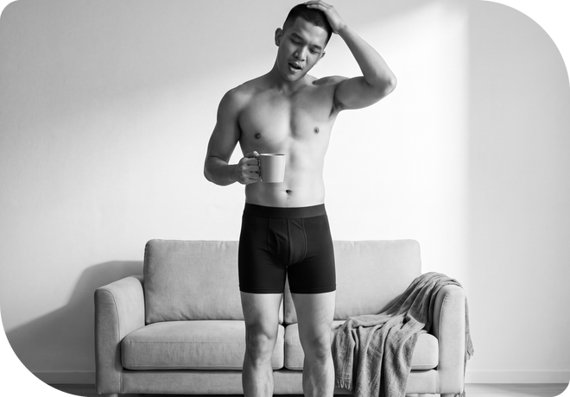
06 Packs & Kids
PRODUCT KNOWLEDGE
Buy more, pay less per pair
Pack | Brief | Boxer Brief 5"
Single | Rp 79.000 | Rp 99.000
3 Pack | Rp 199.000 | Rp 249.000
6 Pack | Rp 379.000 | Rp 469.000
A 6 Pack Brief works out at Rp 63.200 a pair — 20% under the single price.
KIDS
ALSO IN THE PACK RANGE
Boys
Loose Fit Boxer: 2 Pack Rp 179.000, 4 Pack Rp 339.000.
Inner Singlet: 2 Pack Rp 199.000, 4 Pack Rp 349.000. Crewneck T: 2 Pack Rp 249.000, 4 Pack Rp 479.000.
Brief from Rp 59.900, Boxer Brief from Rp 69.900. Sizes 8, 10, 12 and 14.
Notes:
Multipack adalah cara paling mudah menaikkan nilai transaksi.

Slide 8
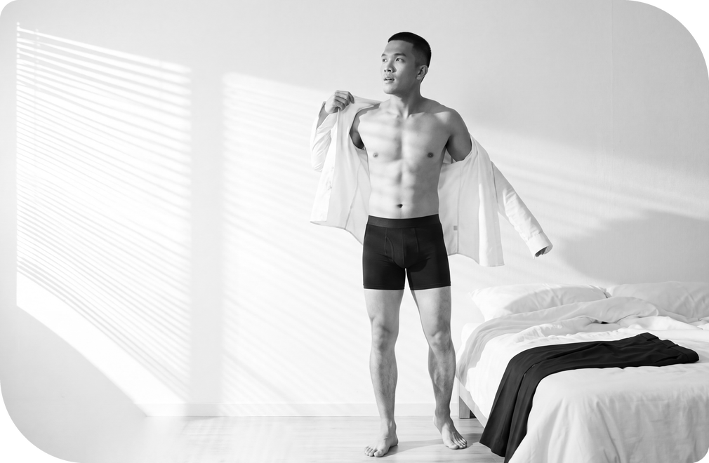
07 Fit Lab
PRODUCT KNOWLEDGE
Two inputs.
One answer.
Fit Lab is built on real garment measurements and real bodies. Enter height and weight, and it returns one size — calibrated against Toni Black's own garments and customer fit tests.
The waistband has high stretch and full recovery, so the answer holds.
INPUTS
SIZES
Between two sizes, most customers take the smaller one.
Height + weight
S – 3XL
Notes:
Fit Lab ada di toni.black/pages/sizing-guide.

Slide 9
08 Sizing
PRODUCT KNOWLEDGE
How a customer finds their size
01
02
03
Open Fit Lab
Enter height and weight
Take the answer
On toni.black, under Sizing Guide. No tape measure needed.
Two inputs. Nothing else to fill in.
One size back. Between two, most customers take the smaller.
WHEN THE ANSWER IS WRONG
The First Pair Guarantee covers it. If the first pair misses on fit, comfort or quality, the customer contacts support within the guarantee period. One claim per customer, item unworn and unwashed.
Notes:
Tiga langkah ini yang dipakai affiliate saat menjawab pertanyaan ukuran.

Slide 10
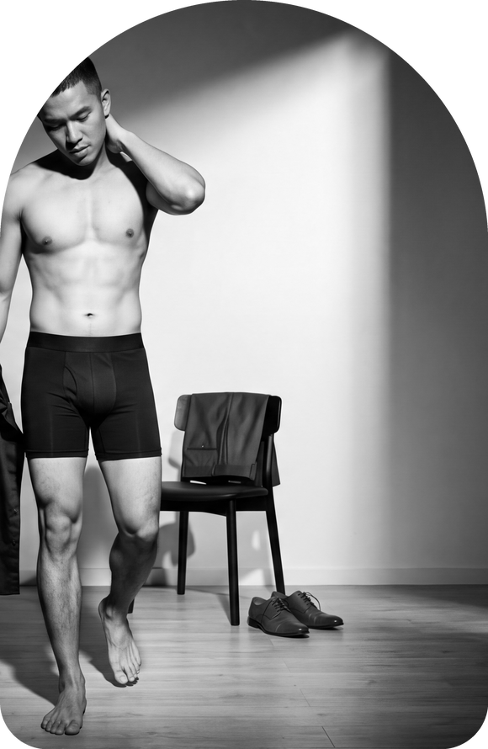
09 Waistband
PRODUCT KNOWLEDGE
The part you feel all day
The waistband is one of the most important parts of underwear.
Smooth elastic feel
Built for daily movement
Secure hold without harsh pressure
Minimal visual branding, for a cleaner look
Follows the natural waistline
Less pressure at the waist means a cleaner hold — and less adjusting through the day.
ON THE LOOSE FIT BOXER
FlowLite™ uses a covered soft waistband — no exposed elastic edge at all.
Notes:
Waistband adalah alasan paling sering disebut pembeli yang repeat order.

Slide 11

10 Use
PRODUCT KNOWLEDGE
Work, workout, rest
WORK
WORKOUT
REST
Boxer Brief 5"
4-way stretch
FlowLite™ Loose Fit
Balanced coverage under trousers, jeans or a uniform. Smooth, supportive front shape.
Modal with 9% elastane moves with the body and recovers its shape after.
Looser leg, lower compression, the lightest fabric in the range. For the hours the body is still.
Notes:
Satu produk, tiga momen. Ini cara paling gampang menjelaskan rangenya.

Slide 12
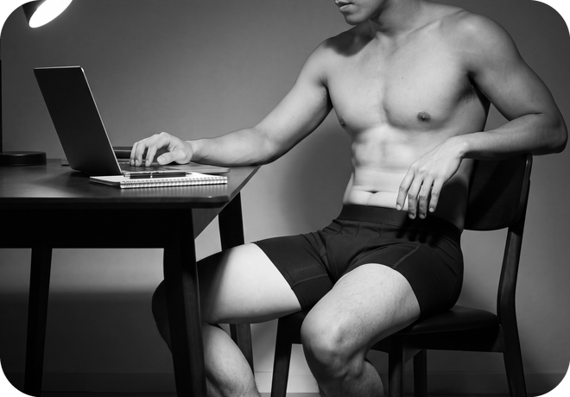
11 Markets
PRODUCT KNOWLEDGE
Five markets, one product
Toni Black sells across Asia-Pacific. The same fabric, the same fit system and the same single colour in every market.
01
02
03
04
05
Singapore
Malaysia
Australia
New Zealand
Indonesia
HOME MARKET
Indonesia
MARKETS
SIZES, EVERY MARKET
5
S – 3XL
Prices in this deck are the Indonesian list prices.
Notes:
Harga di deck ini harga Indonesia.

Slide 13
12 Channels
PRODUCT KNOWLEDGE
Where people buy it
OWN SITE
MARKETPLACE
SOCIAL COMMERCE
AFFILIATE
toni.black
Shopee
TikTok Shop
BLACKLIST
The full range and Fit Lab.
Official store.
Live selling and short video.
The affiliate programme.
SOCIAL
Instagram · TikTok · Facebook
toni.black
Same product, same prices. The affiliate commission is 15% plus ads.
Notes:
BLACKLIST adalah nama program affiliate Toni Black.

Slide 14
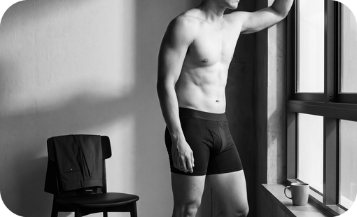
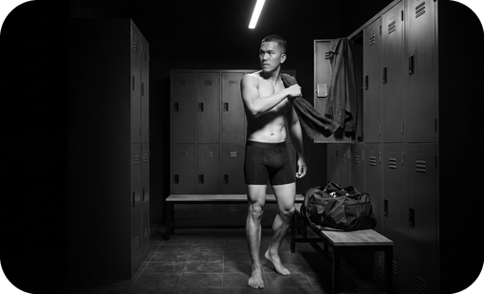
13 Care
PRODUCT KNOWLEDGE
Care, returns, guarantee
CARE
GUARANTEE
The same for every style
First Pair Guarantee
Machine wash cold, gentle cycle
If the first pair does not meet expectations for fit, comfort or quality, the customer contacts support within the guarantee period. One claim per customer.
Non-chlorine bleach only when needed
Tumble dry low
Iron low
RETURNS
Unworn, unwashed, in original packaging, within the stated return period.
Notes:
Care instruction sama untuk semua produk. Sumber: halaman produk toni.black.

