Slide 1



cimsa_rapor
View in Power BI
Last data refresh:
3/21/2024 8:45:48 PM UTC
Downloaded at:
3/21/2024 8:51:49 PM UTC

Slide 2
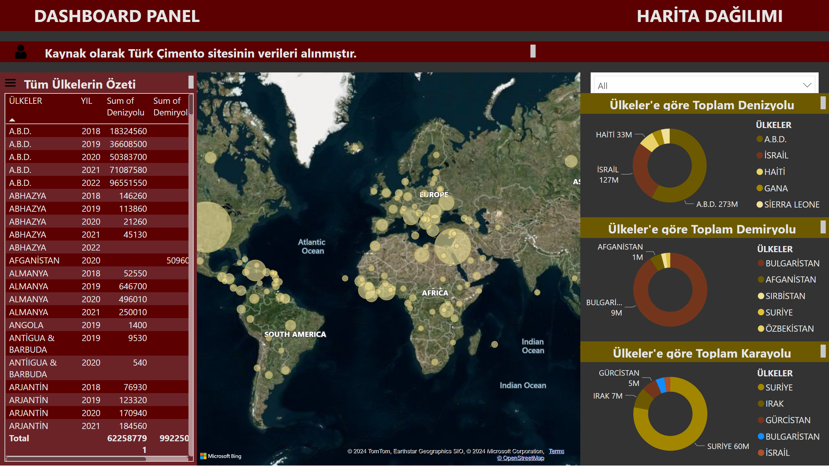
1. sayfa
Notes:
textbox
No alt text provided
textbox
No alt text provided
shape
No alt text provided
shape
No alt text provided
textbox
No alt text provided
map
No alt text provided
tableEx
No alt text provided
shape
No alt text provided
shape
No alt text provided
slicer
No alt text provided
donutChart
No alt text provided
textbox
No alt text provided
textbox
No alt text provided
textbox
No alt text provided
donutChart
No alt text provided
donutChart
No alt text provided
textbox
No alt text provided
image
No alt text provided
image
No alt text provided

