Slide 1
Group Project – Dataverse CMPE 275
Instructor – Prof. John Gash
By
Priya Khadke
Harshada Jivane
Manasa Hari
Ankit Thanekar
Shailesh Nayak

Slide 2
Introduction
Problem statement - To build a dataverse architecture
Our use case - File upload and download
Criteria:
1) Massive registration
2) Support to all file extensions
3) Efficient storage and search capabilities

Slide 3
Technical Emphasis
Loosely coupled architecture
Single responsibility principle throughout the system
Two main optimizations:
Caching
Parallel execution (threads)
Service availability (Handle when an instance is down)

Slide 4
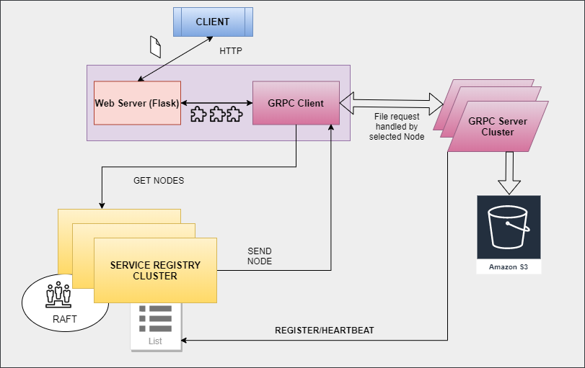
System Design

Slide 5
Implementation - Consensus
Implemented RAFT in Service Registry
Ensures the replication of two core maps,
active GRPC (streaming ) servers
details on storing file
Leader coordinates write operation
Uses PySynObj library in python

Slide 6
Implementation - Scaling
Scaling at three levels
Web(Application) Server is decoupled from Service Registry allowing it to scale freely.
Service Registry is a cluster(3-7) of highly available servers which are only responsible for load balancing and bookkeeping.
GRPC Server(Worker) cluster can be scaled independently.

Slide 7
Implementation - Fault Tolerance
Service Registry is aimed at being highly fault tolerant by the use of RAFT Consensus algorithm for persistent storage.
Streaming server cluster has capability to scale horizontally which makes this cluster fault tolerant (unless all fail, ofcourse)
S3 replicates these chunks internally to provide resilience to failures or data loss.

Slide 8
Implementation - Load Balancing
We will have a separately numbered ids, so data would be balanced between the two machines based on the load size
Service Registry is responsible for providing the GRPC client with the server node which it needs to forward the requests from Web Server

Slide 9
Implementation - Sharding
Each file is divided into chunks of specified size - 30MB
These chunks are then stored on the same/different nodes according to a sharding algorithm - Consistent Hash
The Service Registry maintains metadata that holds details of chunks and their cache location
Each chunk of the file is also uploaded to a cloud based file system - Amazon S3

Slide 10
Implementation - Optimization
GRPC servers perform caching of file chunks upon the first download request
On cache miss, the servers fetch the requested chunk from cloud based file storage (Amazon S3)

Slide 11
Performance
Setup
EC2 T2 micro Ubuntu server
Every GRPC server first registers with the service registry
Test Results
Single GRPC server with s3 upload and Download
22MB Upload 1 Chunk 15.9 seconds Download time 4.76 Seconds
62MB Upload 2 Chunks 37.17 seconds Download time 13.36 seconds
169MB Upload 6 Chunks 86.7 seconds Download time 29.4 seconds
2 GRPC server with s3 upload and Download
62MB Upload 2 Chunks 38.92 seconds Download time 10.15 seconds
169MB Upload 6 Chunks 79.4 seconds Download time 21.64 seconds
3 GRPC server with s3 upload and Download
169MB Upload 6 Chunks 79.32 seconds Download time 25.32 seconds

Slide 12
Conclusion
►Current Standing
►Future Scope
►gRPC servers & Webserver can be scaled horizontally.
►Efficient multithreading.
►More robust architecture for security.

Slide 13
Demo

Slide 14
References
https://ops.tips/blog/sending-files-via-grpc/
https://grpc.io/docs/tutorials/basic/python/
https://www.nginx.com/blog/service-discovery-in-a-microservices-architecture/
https://raft.github.io/
https://boto3.amazonaws.com/v1/documentation/api/latest/guide/s3-examples.html

Slide 15
Thank You!

