Slide 1
COMPLIANCE
By Ashni B.J.
BPT
Final Year

Slide 2
DEFINITION
Compliance is the ability of the lungs and thorax to expand, or it is the expansibility of lungs and thorax. It is defined as the change in volume per unit change in the pressure.
Significance of Determining Compliance
Determination of compliance is useful as it is the measure of stiffness of lungs. Stiffer the lungs, less is the compliance.

Slide 3
NORMAL VALUES
Compliance is expressed by two ways:
1. In relation to intra alveolar pressure
2. In relation to intrapleural pressure.

Slide 4
Compliance in Relation to Intra-alveolar Pressure
Compliance is the volume increase in lungs per unit increase in the intra-alveolar pressure.
1. Compliance of lungs and thorax together: 130 mL/1 cm H2O pressure
2. Compliance of lungs alone: 220 mL/1 cm H2O pressure.

Slide 5
Compliance in Relation to Intrapleural Pressure
Compliance is the volume increase in lungs per unit decrease in the intrapleural pressure.
1. Compliance of lungs and thorax together: 100 mL/1 cm H2O pressure
2. Compliance of lungs alone: 200 mL/1 cm H2O pressure.

Slide 6
Thus, if lungs could be removed from thorax, the expansibility (compliance) of lungs alone will be doubled.
It is because of the absence of inertia and restriction exerted by the structures of thoracic cage, which interfere with expansion of lungs.

Slide 7
Specific Compliance
The term specific compliance is introduced to assess the stiffness of lung tissues more accurately. Specific compliance is the compliance per liter of lung volume. It is usually reported for expiration at functional residual capacity.
It is the compliance divided by functional residual capacity.
Specific compliance of lungs = compliance of lungs/Functional residual capacity
Functional residual capacity is the volume of air present in lungs at the end of normal expiration.

Slide 8
TYPES OF COMPLIANCE
Compliance is of two types:
1. Static compliance
2. Dynamic compliance.

Slide 9
1. Static Compliance
Static compliance is the compliance measured under static conditions, i.e., by measuring pressure and volume when breathing does not take place.
Static compliance is the pressure required to overcome the elastic resistance of respiratory system for a given tidal volume under zero flow (static) condition.

Slide 10
2. Dynamic Compliance
Dynamic compliance is the compliance measured during dynamic conditions, i.e., during breathing.

Slide 11
Static Compliance Vs Dynamic Compliance
In healthy subjects, there is little difference between static and dynamic compliance. In patients with stiff lungs, the dynamic compliance decreases while little change occurs in the static compliance.

Slide 12
MEASUREMENT OF COMPLIANCE
Measurement of Static Compliance
To measure the static compliance, the subject is asked to inspire air periodically at regular steps from a spirometer. In each step, a known volume of air is inspired. At the end of each step, intrapleural pressure is measured by means of an esophageal balloon.
Then, the air is expired in steps until the volume returns to original preinspiratory level. Intrapleural pressure is measured at the end of each step.

Slide 13
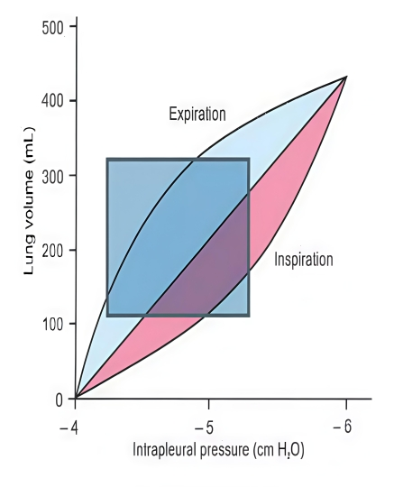

Values of volume and pressure are plotted to obtain a curve, which is called pressure-volume curve.
From this curve compliance can be calculated. This curve also shows the difference in inspiration and expiration

Slide 14
Measurement of Dynamic Compliance
Dynamic compliance is measured during normal breathing. It is measured by determining the lung volume and esophageal pressure (intrapleural pressure) at the end of inspiration and expiration when the lungs are apparently stationary.

Slide 15
Factors that affect lung compliance
1. The size of the lung and its initial volume
The lung compliance depends on its size; thus a lung of a mouse has a smaller compliance than that of an elephant, and a patient with one lung has nearly 1/2 normal compliance, and children have 2-3 times smaller compliance than adults.

Slide 16
2. The surface tension of the alveolar fluid
This decreases the compliance. Such effect is demonstrated by removing the lung of a cat outside its body and inflating & deflating it, once with saline and once with air while measuring the intrapulmonary pressure
Saline decreases the surface tension to nearly zero, and the pressure-volume curve obtained with saline shows a higher compliance and less hysteresis, compared with that obtained when air was used for inflation and deflation of the lung

Slide 17
3. Diseases:
The compliance is decreased in the RDS and diseases that cause lung stiffness(e.g. pulmonary fibrosis, edema & congestion). In such cases, the pressure-volume curve is shifted downward & to the right.
On the other hand, the curve is shifted upward & to the left in conditions that cause increase of the lung compliance, e.g., emphysema and old age.

Slide 18
The thoracic compliance is decreased in cases of
Deformities of the vertebral column e.g. kyphosis(= antero-posterior bending) and scoliosis (lateral bending)
Arthritis of the joints of the thoracic cage or the vertebral column
Skeletal muscle diseases
Obesity

Slide 19
THANK YOU

