Slide 1
MULTIPLE INPUT MULTIPLE OUTPUT SYSTEMS (MIMO)

Slide 2
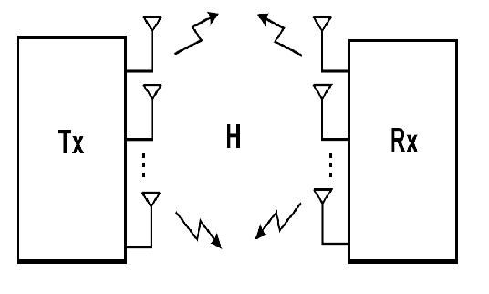
MIMO Systems:
  use multiple inputs and multiple outputs from a single channel
  are defined by Spatial Diversity and Spatial Multiplexing
  take advantage of multipath propagation
Notes:
In an urban environment, these signals will bounce off trees,buildings, etc. and continue on their way to their destination (the
receiver) but in different directions.“Multi-path” occurs when the different signals arrive at the receiver
at various times. With MIMO, the receiving end uses an algorithm or special signal processing to sort out the multiple signals to produce one signal that has the originally transmitted data.

Slide 3
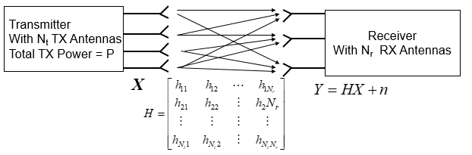
MIMO Channel Model
Channel can be deterministic, or slowly changing
Channel state information (CSI) may be unknown to both TX and RX
Known to RX only
Known to both RX and TX

Slide 4
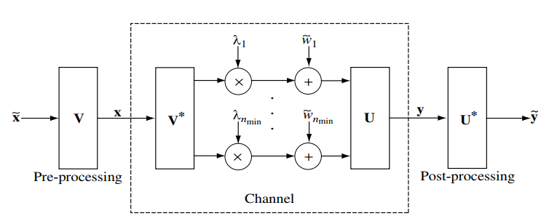
Parallel Decomposition of MIMO Channels
Converting the MIMO channel into a parallel channel.
Notes:
Parallel decomposition provides multiplexing gains by decomposing the MIMO channel into R parallel independent channels and multiplexing data onto there channles.
We get a R-fold increase in data rate.

Slide 5
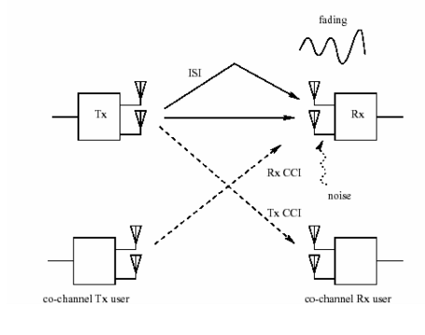
Wireless transmission introduces:
Fading: multiple paths with different phases add up at the receiver,giving a random (Rayleigh/Ricean) amplitude signal.
ISI: multiple paths come with various delays, causing intersymbol interference.
CCI: Co-channel users create interference to the target user
Noise: electronics suffer from thermal noise, limiting the SNR.

Slide 6
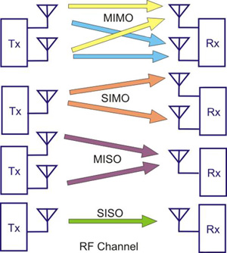
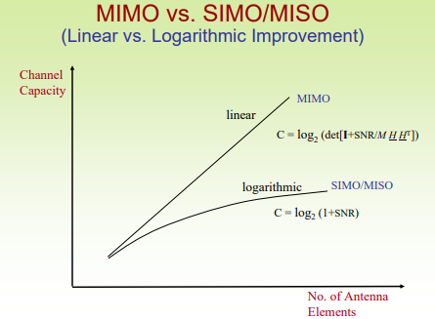
Different Configurations
Notes:
MIMO has better capacity than others as we see

Slide 7
Spatial Diversity and Spatial Multiplexing
Spatial Diversity
  Signal copies are transferred from multiple antennas or received at more than one antenna
  Redundancy is provided by employing an array of antennas, with a minimum separation of λ/2 between neighbouring antennas
Spatial Multiplexing
  The system is able to carry more than one data stream over one frequency, simultaneously
Notes:
The objective of spacial mutiplexing is to increase the data rate.

Slide 8
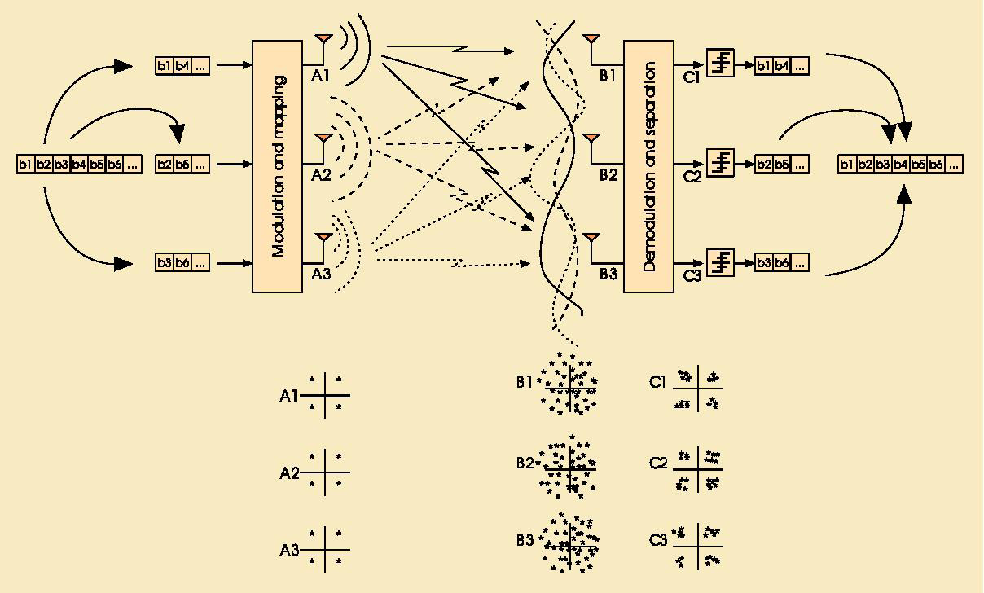
Spatial Multiplexing
MIMO channels can be decomposed into a number of R parallel independent channels → Multiplexing Gain
  Principle: Transmit independent data signals from different antennas to increase the throughput, capacity.

Slide 9
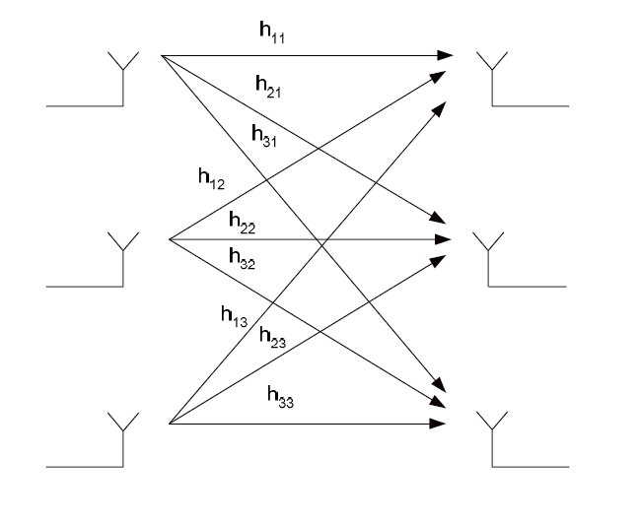
Spatial Diversity
Improves the signal quality and achieves a higher SNR at the receiver-side
Principle of diversity relies on the transmission of structured redundancy
x_{i}
y_{i}

Slide 10
Why MIMO?
There is always a need for increase in performance in wireless systems
  Significant increase in spectral efficiency and data rates
  High Quality of Service (QoS)
  Wide coverage, etc.
Wireless channel that we are using is very unfriendly
  Suffers from Co–channel interference and signal level fading
  provides a limited bandwidth
  Power falls off with distance

Slide 11
MIMO System solutions
By using Multiple Output Multiple Input (MIMO) systems
  Diversity gain mitigates the fading and increases coverage and improves QoS
  Multiplexing gain increases capacity and spectral efficiency with no additional power or bandwidth expenditure
  Array gain results in an increase in average receive SNR.

Slide 12

MIMO Channel Capacity
Capacity depends on whether the channel is static or fading, and what is known about the channel at the transmitter and receiver.
For a static channel known at the transmitter and receiver capacity is given by
This leads to a water-filling power allocation in space.

Slide 13
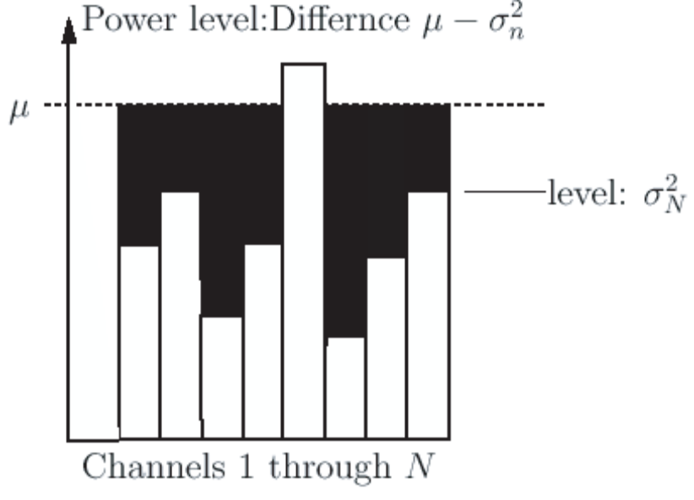
With the channel known at the transmitter, the total power
allocation the each channel will be based on watterfilling.
  Watterfilling: Strong Sub-channel, with low noise power
  level will be assigned with a higher signal power.
  Where σ_{N}² = σ² / │h_{n}²│
Illustrating Watterfilling

Slide 14

When channel is unknown at transmitter, uniform power allocation is optimal, but this leads to an outage probability since the transmitter doesn’t know what rate to transmit at:
In fading, capacity with both transmitter and receiver knowledge is the average of the capacity for the static channel, with power allocated either by a short-term or long-term power constraint.
Without transmitter knowledge, outage probability is the right metric for capacity.

Slide 15
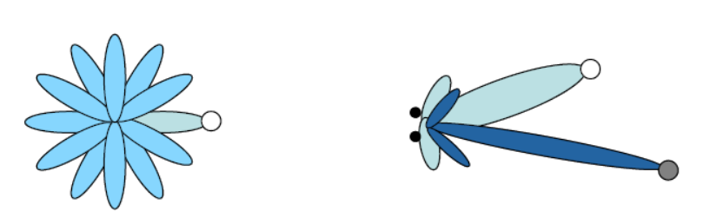
MIMO Systems: Beamforming
Beamforming sends the same symbol over each transmit antenna with a different scale factor.
At the receiver, all received signals are coherently combined using a different scale factor.
This produces a transmit/receiver diversity system, whose SNR can be maximized by optimizing the scale factors (MRC).
Beamforming leads to a much higher SNR than on the individual channels in the parallel channel decomposition.
Thus, there is a design tradeoff in MIMO systems between capacity and diversity.
Notes:
Beamforming is the method used to create the radiation pattern of an antenna array. It can be applied in all antenna array systems as well as MIMO Systems.

Slide 16
Applications
WLAN – WiFi 802.11n
Mesh Networks (e.g., MuniWireless)
WMAN – WiMAX 802.16e
4G
RFID
Digital Home
Notes:
The applications using mimo technique

Slide 17
Conclusion
The capacity of Receive or Transmit Diversity grows logarithmically with the number of antennas
Capacity of MIMO increases linearly with the number of antennas
Using Spatial Diversity:
  The SNR increases and Pe decreases when using MIMO
Spatial Multiplexing and Spatial Diversity are conflicting objectives

Slide 18
References
[1] MIMO Architecture for Wireless Communication: Intel Technology Journal, vol. 10, Issue 02, May 2006
[2] MIMO Systems and Transmit Diversity,
www.comm.utoronto.ca/~rsadve/Notes/DiversityTransmit.pdf
[3] R.A. Carrasco, Space-time Diversity Codes for fading Channel,
Staffordshire University
[4] D. Gesbert, M.Shafi, D. Shiu, P. Smith, and A. Naguib, “From Theory to Practice: An Overview of MIMO Space–Time Coded Wireless Systems”
IEEE JOURNAL ON SELECTED AREAS IN COMMUNICATIONS, VOL. 21, NO. 3, APRIL 2003
[5] Introduction to MIMO Systems: Application Note 1MA102, Rohde & schwarz

