Slide 1

Data Manipulation
Matthew J Martinez, PhD

Slide 2
Agenda
Raw Data
Processing Script
Tidy Data
Data Table

Slide 3

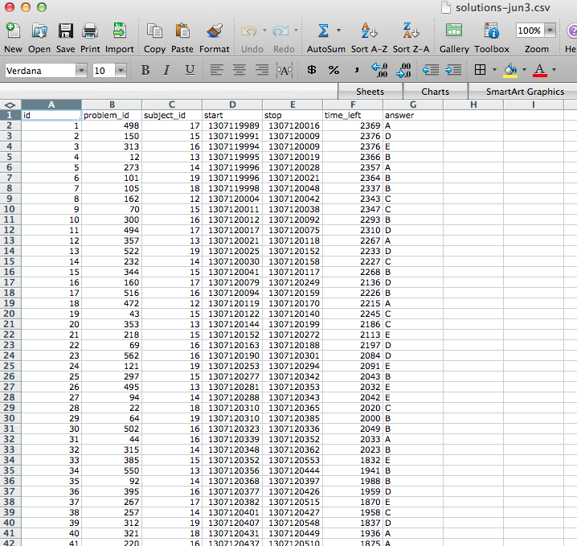
Ideal Data

Slide 4
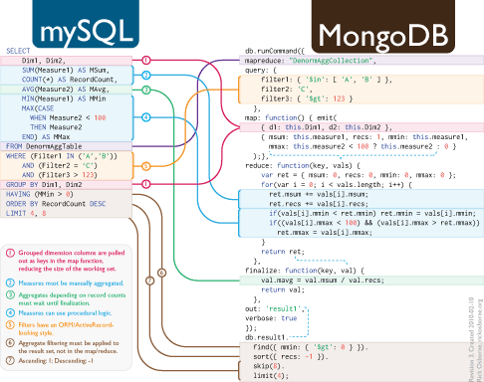
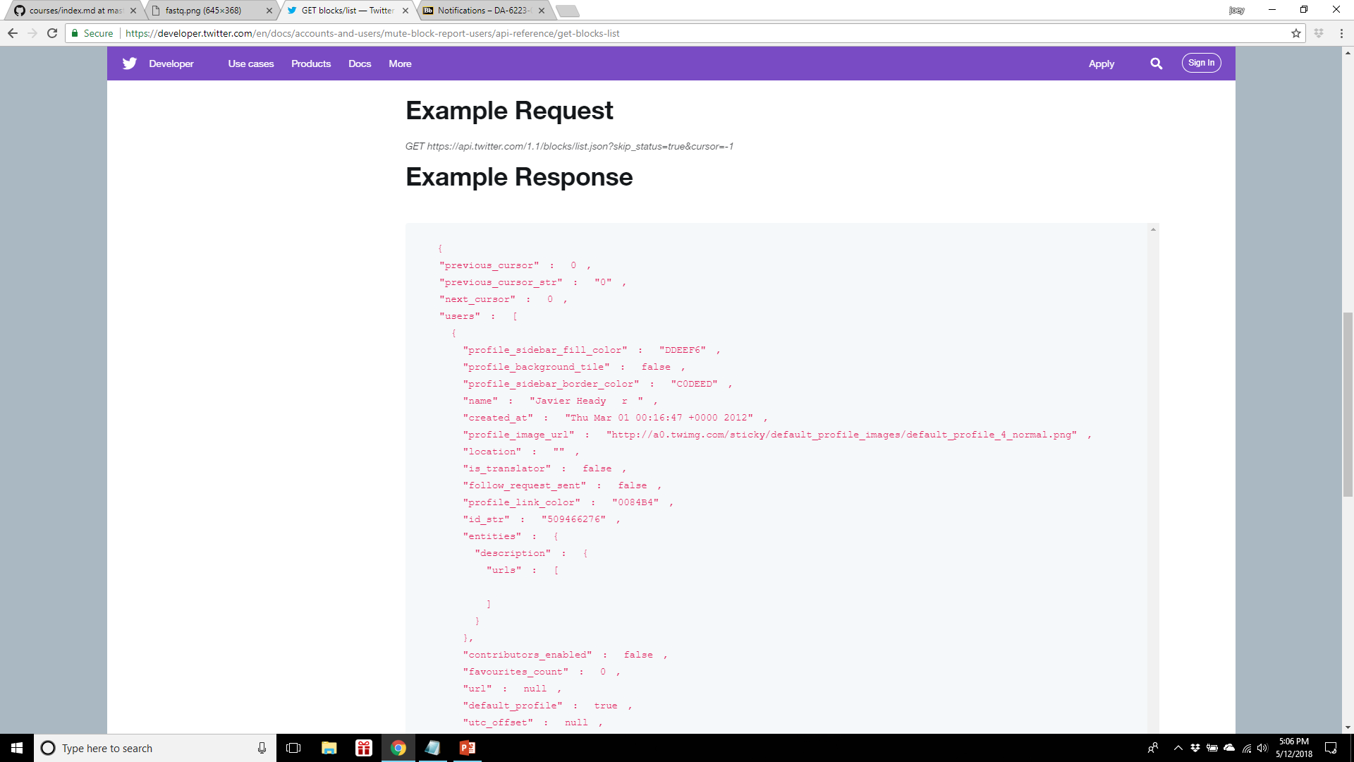
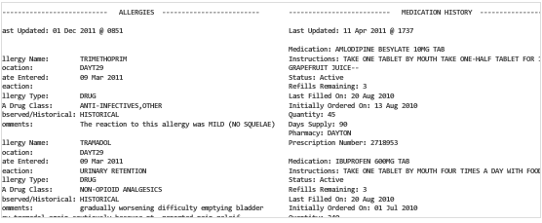
Real Data

Slide 5
Raw Data
The strange binary file your measurement machine spits out
The unformatted Excel file with 10 worksheets the company you contracted with sent you
The complicated JSON data you got from scraping the Twitter API
The hand-entered numbers you collected looking through a microscope

Slide 6
The tidy data
Each variable you measure should be in one column
Each different observation of that variable should be in a different row
There should be one table for each "kind" of variable
If you have multiple tables, they should include a column in the table that allows them to be linked
Include a row at the top of each file with variable names.
Make variable names human readable AgeAtDiagnosis instead of AgeDx
In general data should be saved in one file per table.

Slide 7
Raw versus processed data
Raw data
The original source of the data
Often hard to use for data analyses
Raw data may only need to be processed once
Processed data
Data that are ready for analysis
Merging, subsetting, transforming, etc.
There may be standards for processing
All steps should be recorded

Slide 8
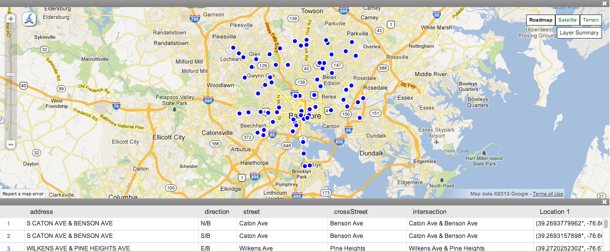
From Raw Data to Processed Data Example Baltimore camera data

Slide 9
Homework
Complete ‘Work with Data’ module on rstudio.cloud
https://rstudio.cloud/learn/primers/2

