Slide 1
FLIGHT ANALYSIS
End-to-End Data Analytics Project
Excel → Python → SQL → Power BI
DATASET
AVERAGE PRICE
MAX PRICE
DASHBOARD
10,683 rows
₹9,087.06
₹79,512
3 Pages
Airline pricing • routes • timing • duration • stops

Slide 2
Project Overview
Objective, workflow and analytical scope
OBJECTIVE
WORKFLOW
BUSINESS QUESTIONS
Analyze flight data to identify pricing patterns, popular routes, airline performance, timing effects and stop/duration relationships.
1. Excel data review 2. Python cleaning & EDA 3. SQL business analysis 4. Power BI dashboard 5. Key insights & recommendations
• Which airlines are expensive/affordable? • Which sources and destinations dominate? • Which routes are popular, cheap or expensive? • Does duration affect price? • Does number of stops affect price? • Which months and departure hours have higher prices? • What are the cheapest and most expensive flights?
Flight Analysis Portfolio Project • 2

Slide 3
Dataset & Excel Preparation
Initial structure and data preparation
DATASET
MAIN FIELDS
CLEANING STATUS
10,683 rows
Airline • Route • Price
No null values
Flight pricing and journey information
Journey, source, destination, timing and duration fields
Duplicate-looking combinations can be valid because flights repeat
Important columns used
• airline, source, destination, route
• day_of_journey, month_of_journey, year_of_journey
EXCEL / CLEAN DATA PREVIEW
• dep_hour, dep_min
Insert actual Power BI screenshot here
• duration_hour, duration_min, duration_category
• total_stops, additional_info, price
Flight Analysis Portfolio Project • 3

Slide 4
Python — Data Cleaning & Preparation
Pandas-based cleaning, transformation and exploratory analysis
• Loaded the cleaned flight dataset with Pandas.
df.info() df.isnull().sum() df["total_duration"] = ( df["duration_hour"] * 60 + df["duration_min"] ) df.to_csv( "Flight_analysis_clean_nootbook.csv", index=False )
• Checked data types and missing values.
• Handled journey date components and time-related fields.
• Prepared duration information using hours and minutes.
• Created/used duration categories for comparison.
• Validated the cleaned dataset before SQL loading.
Python prepared the reliable SQL-ready dataset.
Flight Analysis Portfolio Project • 4

Slide 5
Python — Exploratory Analysis
Examples of business questions explored in Python
AIRLINE PRICE
SOURCE ANALYSIS
TIME ANALYSIS
Average price by airline
Flights & price by source
Hour / month patterns
Group → mean → sort
Count + average price
Volume + price trends
DURATION
ROUTES
STOPS
Duration vs price
Popular & expensive routes
Stops vs price
Short / medium / long
Route-level aggregation
Average price by stops
The same business logic was later reproduced and validated in SQL.
Flight Analysis Portfolio Project • 5

Slide 6
SQL — Data Validation
Database loading and structure checks
SELECT COUNT(*) FROM fltdata; DESCRIBE fltdata; SELECT * FROM fltdata;
ROW COUNT
10,683
Validated after loading cleaned data into MySQL
SQL covered airline, source, destination, route, departure time, duration, journey month, price, stops and additional information.
• GROUP BY + AVG() for pricing analysis
• GROUP BY + COUNT() for flight volume
• ORDER BY + LIMIT for Top/Bottom results
• MIN(), MAX(), AVG() for overall price statistics
Flight Analysis Portfolio Project • 6

Slide 7
SQL — Airline, Source & Destination Insights
Core business results
HIGHEST AVG AIRLINE PRICE
LOWEST AVG AIRLINE PRICE
MOST FLIGHTS
Jet Airways Business — ₹58,358.67
Trujet — ₹4,140.00
Jet Airways — 3,849
TOP SOURCE BY VOLUME
HIGHEST SOURCE AVG PRICE
TOP DESTINATION BY VOLUME
Delhi — 4,537
Delhi — ₹10,539.44
Cochin — 4,537
HIGHEST DESTINATION AVG
LOWEST SOURCE AVG
LOWEST DESTINATION AVG
New Delhi — ₹11,917.72
Chennai — ₹4,789.89
Kolkata — ₹4,789.89
Flight Analysis Portfolio Project • 7

Slide 8
SQL — Route & Departure Analysis
Route popularity, pricing and departure-hour patterns
MOST POPULAR ROUTE
MOST EXPENSIVE ROUTE
CHEAPEST ROUTE
DEL → BOM → COK
BOM → DED → DEL → HYD
BOM → HYD
2,376 flights
₹24,115 average
₹3,932.81 average
MOST FLIGHTS BY HOUR
HIGHEST AVG PRICE HOUR
LOWEST AVG PRICE HOUR
09:00
03:00
01:00
916 flights
₹10,474.63 average
₹4,354.62 average
Route analysis supports both demand and pricing comparisons.
Flight Analysis Portfolio Project • 8

Slide 9
SQL — Duration, Journey & Price Analysis
Time, duration and overall price findings
LONG DURATION
MEDIUM DURATION
SHORT DURATION
₹11,463.15 avg
₹10,329.12 avg
₹5,032.37 avg
4,759 flights
2,400 flights
3,524 flights
MOST FLIGHTS MONTH
HIGHEST AVG PRICE MONTH
LOWEST AVG PRICE MONTH
May
March
April
AVERAGE PRICE
MIN PRICE
MAX PRICE
₹9,087.06
₹1,759
₹79,512
Flight Analysis Portfolio Project • 9

Slide 10
SQL — Stops, Expensive/Cheap Flights & Additional Info
Additional business insights
MOST COMMON STOPS
STOP EFFECT
MOST COMMON INFO
1 Stop
Higher stops → higher avg price
No info
MOST EXPENSIVE FLIGHT
CHEAPEST FLIGHT
Jet Airways Business
SpiceJet
Banglore → New Delhi BLR → BOM → DEL • 1 stop • ₹79,512
Mumbai → Hyderabad BOM → HYD • 0 stops • ₹1,759
Additional information was compared with flight count and average price.
Flight Analysis Portfolio Project • 10

Slide 11
Power BI — Dashboard Architecture
Three analytical pages
PAGE 1
PAGE 2
PAGE 3
Flight Overview
Price & Route Analysis
Time, Duration & Stops
KPI cards + airline, source, destination, duration, stops and monthly pricing. Overall market view.
Price KPIs + popular/expensive routes + cheapest/expensive route charts + airline comparison. Pricing and route view.
4 KPI cards + 7 charts + 5 slicers. Timing, duration and stop view.
Flight Analysis Portfolio Project • 11

Slide 12
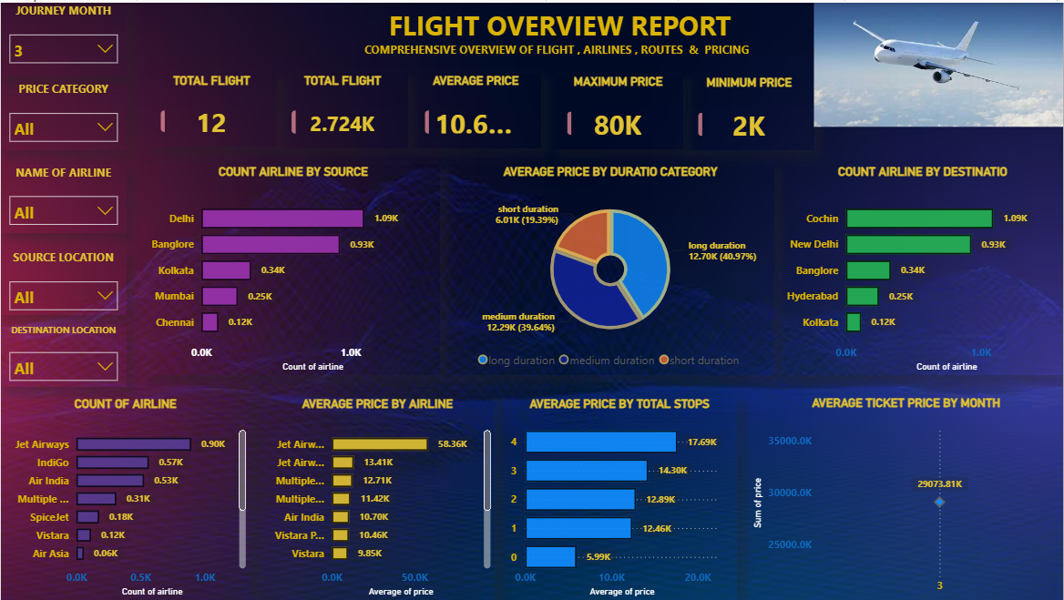
Power BI — Page 1: Flight Overview
Airline, source, destination, duration, stops and monthly price
POWER BI — PAGE 1: FLIGHT OVERVIEW
Insert actual Power BI screenshot here
Paste the actual dashboard screenshot on this slide for the final presentation.
Flight Analysis Portfolio Project • 12

Slide 13
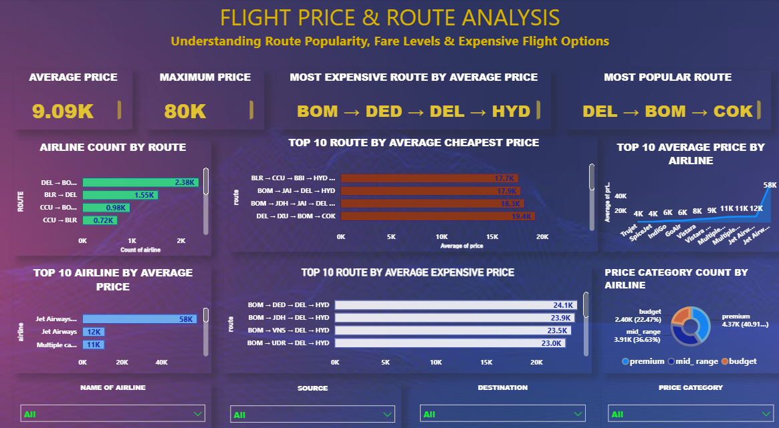
Power BI — Page 2: Price & Route Analysis
Average/max price, popular route, expensive route and cheapest routes
POWER BI — PAGE 2: PRICE & ROUTE ANALYSIS
Insert actual Power BI screenshot here
Paste the actual dashboard screenshot on this slide for the final presentation.
Flight Analysis Portfolio Project • 13

Slide 14
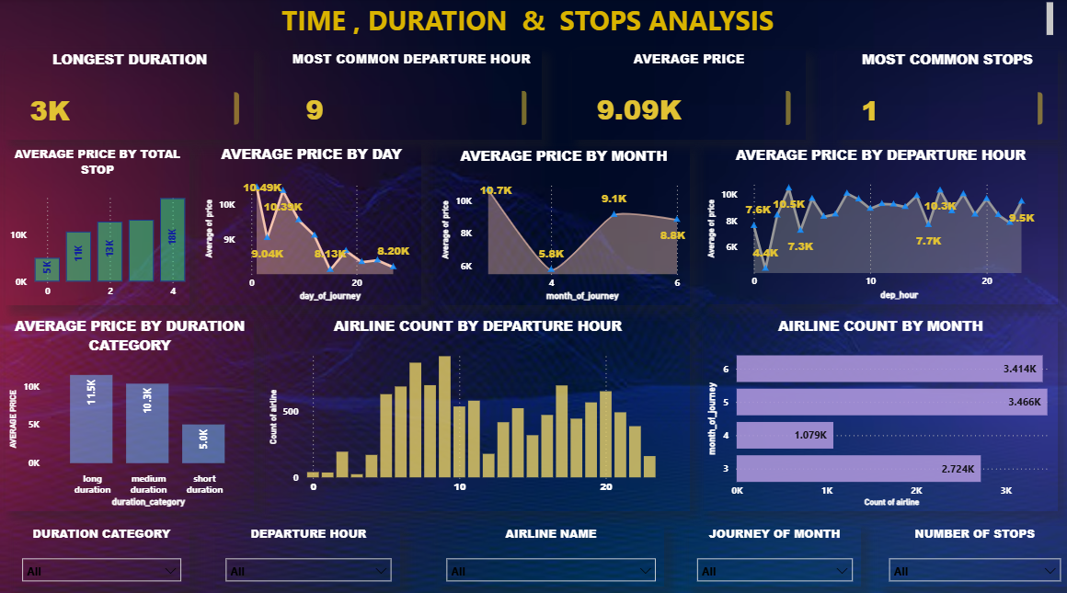
Power BI — Page 3: Time, Duration & Stops
4 KPI cards, 7 charts and 5 slicers
POWER BI — PAGE 3: TIME, DURATION & STOPS
Insert actual Power BI screenshot here
Paste the actual dashboard screenshot on this slide for the final presentation.
Flight Analysis Portfolio Project • 14

Slide 15
Key Business Insights
What the analysis tells us
• Jet Airways Business has the highest average ticket price among airlines in the analysis.
• Trujet has the lowest average ticket price among airlines.
• Jet Airways operates the highest number of flights.
• Delhi leads source-city flight volume and has the highest source-level average price.
• Cochin is the leading destination by flight volume.
• DEL → BOM → COK is the most popular route.
• BOM → DED → DEL → HYD has the highest average route price.
• Long-duration flights have a substantially higher average price than short-duration flights.
• March has the highest average ticket price among journey months.
• The most expensive observed flight costs ₹79,512; the cheapest costs ₹1,759.
Flight Analysis Portfolio Project • 15

Slide 16
Recommendations & Business Use
How the insights can support decision-making
PRICING
CUSTOMER VALUE
CAPACITY
Monitor high-price routes
Identify affordable options
Focus on high-volume markets
Use route, duration and stop patterns.
Compare airlines and routes with lower averages.
Use popular sources, destinations and routes.
TIMING
ROUTE STRATEGY
DASHBOARD
Understand departure patterns
Compare route economics
Interactive monitoring
Use hourly price and volume trends.
Separate high-demand and high-price routes.
Filter by airline, month, route, duration and stops.
Flight Analysis Portfolio Project • 16

Slide 17
Project Deliverables
Portfolio-ready outputs
• Cleaned flight dataset ready for SQL loading.
TOOLS
• Python notebook for data preparation and exploratory analysis.
Excel • Python • SQL • Power BI
• MySQL database table with business-question queries.
DATA
• Power BI dashboard with 3 analytical pages.
10,683 flight records
• KPI cards, charts and slicers for interactive analysis.
OUTPUT
• Business insights covering airline, source, destination, route, time, duration, stops and price.
Interactive BI dashboard
• Presentation documenting the complete analytics workflow.
Flight Analysis Portfolio Project • 17

Slide 18
THANK YOU
Flight Analysis — End-to-End Data Analytics Project
Excel → Python → SQL → Power BI

