Slide 1
INDIAN E-COMMERCE
Performance Analysis Dashboard
Python | SQL | Power BI Jan 2023 – Dec 2025
1,00,000 orders · 25,000 customers · 9 data tables · 4 dashboard pages

Slide 2
Project Overview
Raw data to business decisions in three steps
1,00,000
25,000
550
36 months
Orders
Customers
Products
Jan 2023 – Dec 2025
1. Python
2. SQL
3. Power BI
Cleaned 9 tables with pandas: checked duplicates, filled missing values, fixed date types.
Answered business questions in MySQL: customers, products, revenue, repeat purchase, campaigns.
Built 4 dashboard pages with DAX measures: Executive Overview, Product & Sales, Customers, Operations.

Slide 3
Data Sources
9 tables, linked through order_id, customer_id, product_id and campaign_id
Table | Rows | What it holds
orders | 1,00,000 | Order date, status, state, amount, channel
order_items | 2,54,331 | Quantity, revenue, cost, profit per item
customers | 25,000 | Segment, loyalty tier, status, signup year
products | 550 | Category, brand, price, cost
shipments | 89,681 | Dispatch, delivery days, delay flag
payments | 1,00,000 | Method, status, amount, refund
customer_reviews | 77,530 | Rating, sentiment
returns | 12,075 | Reason, status, refund amount
marketing_campaigns | 151 | Channel, cost, revenue, ROI

Slide 4
Cleaning and Methodology
What was changed in the data, and how the metrics are defined
Python cleaning
Metric definitions
No duplicate rows found in any table; no rows deleted
Missing review sentiment (233) filled from the rating
Missing age (250) filled with the median of its age group
Missing preferred device (125) set to "Unknown"
Missing product rating (4) filled with the category median
Text dates converted to date type; year, month, day columns added
Revenue and profit: Delivered orders only (₹1.98bn, ₹158.6M)
Margin = profit ÷ item revenue
Churn rate = churned ÷ customers who ever bought (58.9%)
Late delivery = delayed flag on delivered shipments (42.9%)
Return rate = orders with a return ÷ all orders (9.5%)
Customer spend fields include all order statuses

Slide 5
Business at a Glance
Delivered orders, Jan 2023 – Dec 2025
₹1.98bn
₹158.6M
8%
1,00,000
₹24.6K
9.5%
Revenue
Profit
Profit margin
Total orders
Avg order value
Return rate
What this shows
2025 revenue grew 68% over 2024
Orders rose 74% in 2025
Margin stayed steady: 7.8%, 7.9%, 8.2%

Slide 6
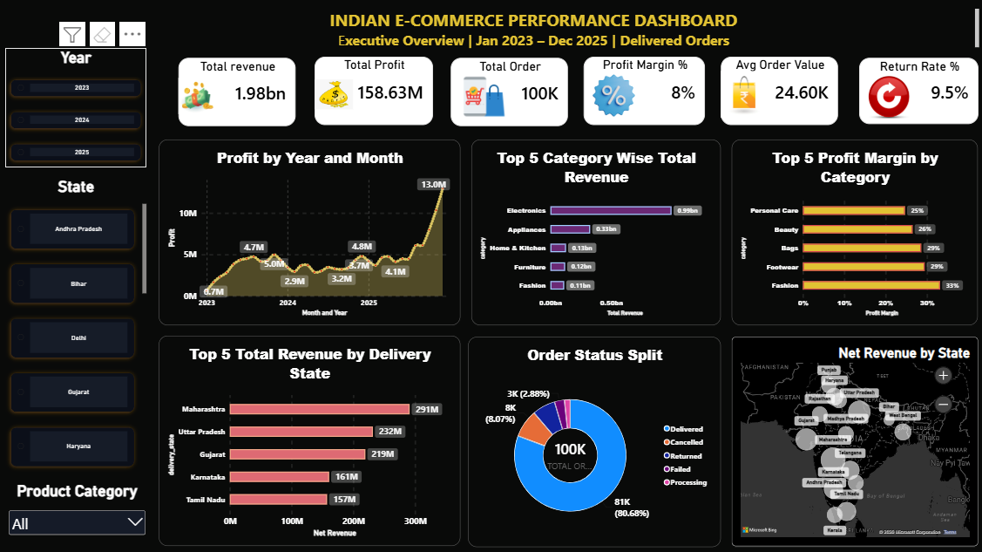
Executive Overview
Power BI dashboard, page 1
₹1.98bn
Revenue, ₹158.6M profit, 8% margin
3.5x
Dec 2025 orders (9.6K) vs Dec 2024 (2.7K)
~50% / 1%
Electronics: share of revenue / profit margin

Slide 7
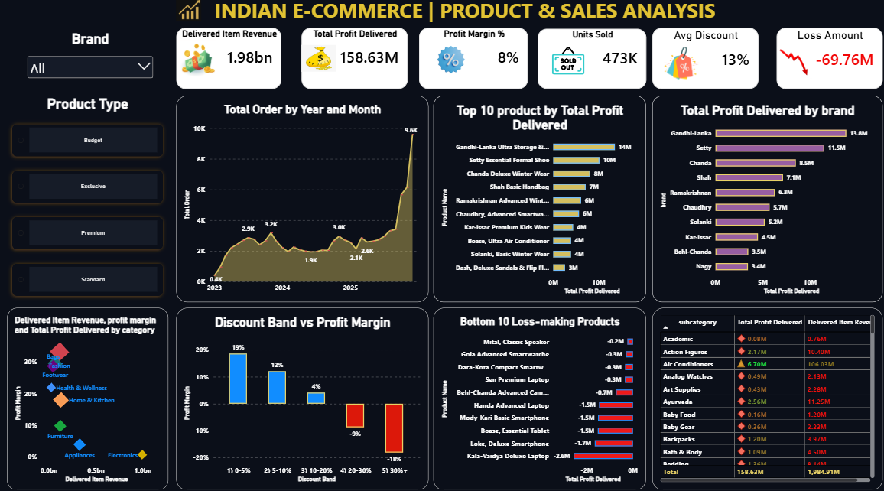
Product & Sales
Power BI dashboard, page 2
-18%
Margin above 30% discount (-9% for 20-30%)
-₹69.8M
Lost on loss-making items
24% / 1%
Smartwatches: share of revenue / margin

Slide 8
Product Deep Dive
The biggest category earns the least
~50%
20%
33%
of revenue is Electronics, at 0.6% margin
is the discount level where margin turns negative
margin in Fashion, the most profitable category

Slide 9
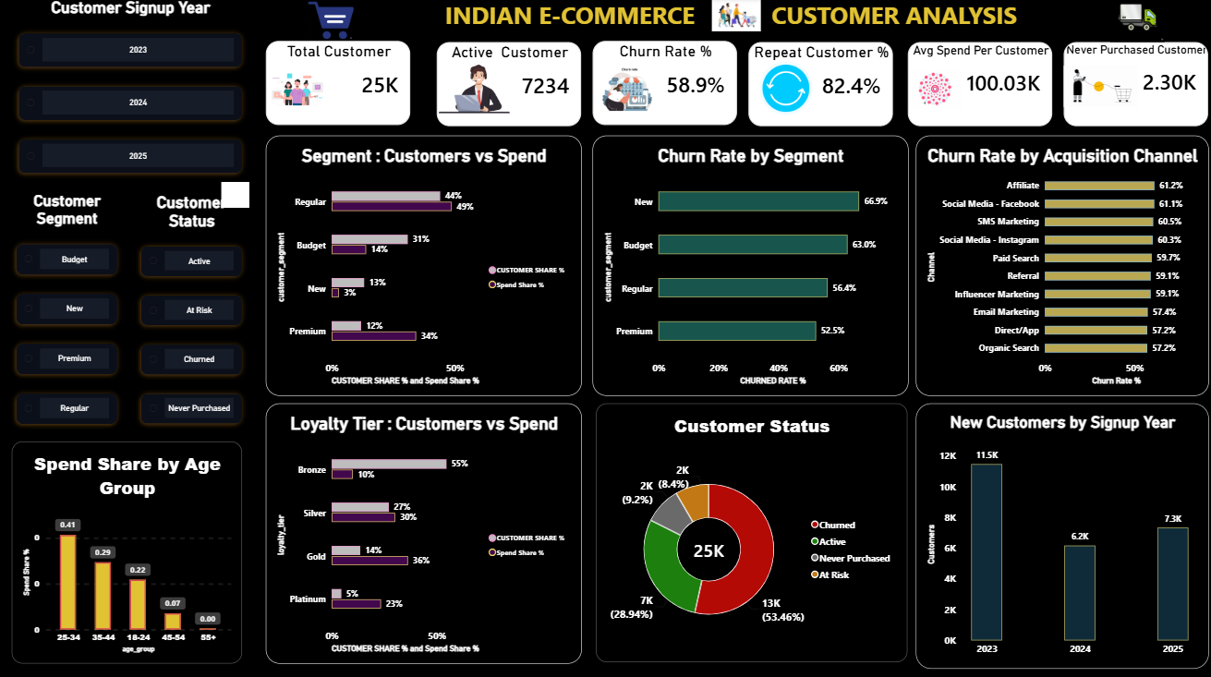
Customers
Power BI dashboard, page 3
58.9%
Churn among buyers (53.5% of all 25,000)
4.5% → 23.5%
Platinum: share of customers → share of spend
11.5K → 6.2K
New signups 2023 → 2024 (7.3K in 2025)

Slide 10
Customer Deep Dive
Few customers bring most of the money, and most of them leave
18% → 60%
66.9%
57–61%
Platinum + Gold customers → share of spend
churn in the New segment (Premium 52.5%)
churn in every channel, so it is not one channel

Slide 11
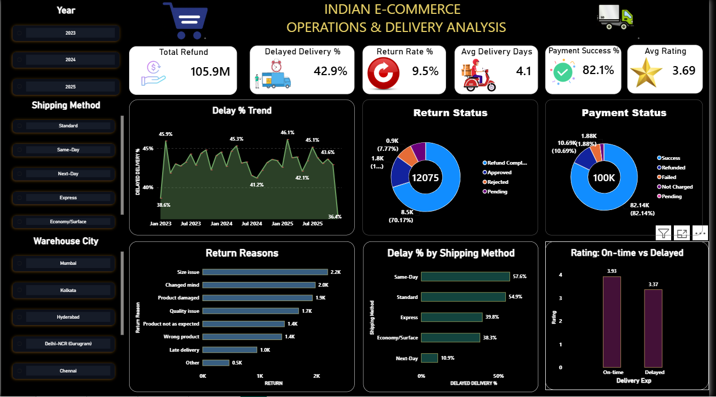
Operations
Power BI dashboard, page 4
42.9%
of deliveries are late
3.93 vs 3.37
Rating: on-time vs late delivery
12,075
returns, ₹105.9M refunded

Slide 12
Operations Deep Dive
Delivery promises are missed, and many returns are avoidable
45%
35.5%
82.1%
of delivered shipments use Standard, and 55% of them are late
of returns: damaged, wrong product or late delivery
payment success, 82–83% for every method

Slide 13
Key Insights
Eight findings from the data
Growth
Concentration
2025 revenue rose 68% with a steady 8% margin
Electronics gives ~50% of revenue at 0.6% margin
Discounts
Loss items
Above 20% discount, every order loses money
₹69.8M lost on loss-making items; Laptops and Smartphones are negative
Customers
Retention
Top 20% of customers give 63% of spend
58.9% of buyers have churned, in every channel alike
Delivery
Impact
42.9% late; Same-Day 57.6%, Standard 54.9%
Late delivery cuts rating from 3.93 to 3.37

Slide 14
Recommendations
What to do next, and what to track
Metric to track
Cap discounts at 20%
Orders above 20% discount lose money. Review every coupon and campaign above that level.
Margin by discount band
Fix Electronics pricing
Half the revenue earns about 1%. Review cost and price for Smartwatches, Laptops, Smartphones.
Electronics margin
Fix Standard and Same-Day
55–58% are late. Set realistic promises and review courier performance.
Late delivery %
Protect top customers
Gold and Platinum give ~60% of spend. Add a retention program and better onboarding for New customers.
Churn rate
Cut avoidable returns
Improve packaging, quality checks, order accuracy and size guides.
Return rate

Slide 15
Limitations and Next Steps
What to keep in mind, and where the project can grow
Limitations
Next steps
Customer spend and order counts come from stored customer fields, which cover all order statuses and differ slightly from the orders table
Churn comes from the dataset's customer status field
Late delivery and low ratings move together, but this does not prove delay is the only cause
Revenue and profit exclude cancelled, failed and returned orders
Rebuild the same dashboards in Tableau
Marketing deep dive: ROI of 151 campaigns by channel
Customer metrics from the orders table, Delivered only
Build a churn prediction model in Python
Forecast monthly orders for 2026

Slide 16
Thank You
Tools: Python (pandas) · MySQL · Power BI · DAX
Questions and feedback are welcome.

