Slide 1
A Test Presentation (title)
An exploration of how Powerpoint works (subtitle)

Slide 2
Page 2 title bullets
Normal text
The first bullet point
The second bullet point
First auto number
Second auto number
First auto with letter from 10.
Second auto with letter from 10.
Indented auto with letter from a.

Slide 3
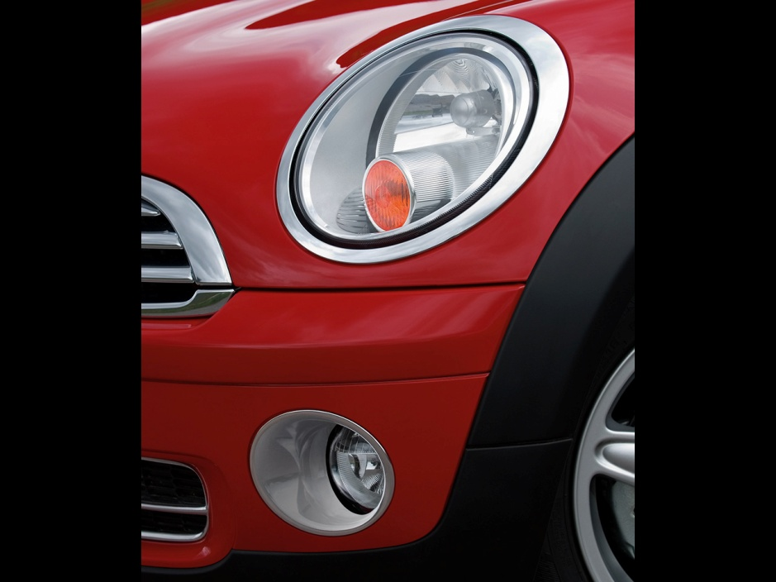
Page 3 title – an image (mini cooper)

Slide 4
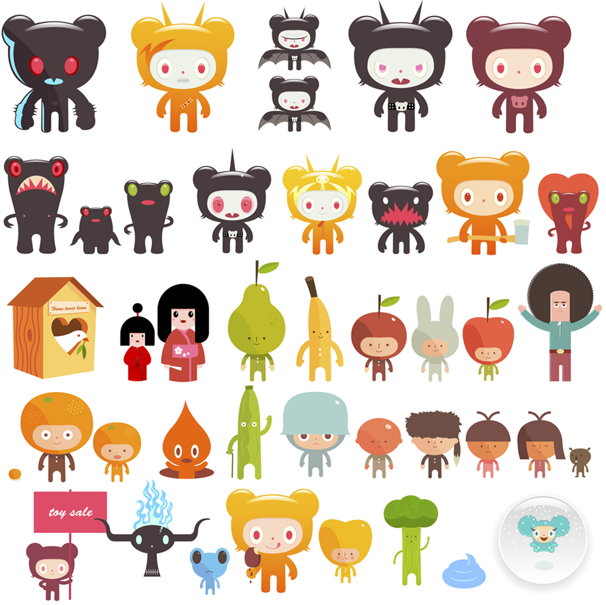
Page 4 title – some clipart (resized to 70%)

Slide 5
Page 5 title – the final slide – just text
The quick brown fox jumped over the very lazy dog who couldn’t be bothered to move. This text is centred, has no hanging indent and is the default colour and point size. It should be noted that under power point, that this text currently takes up a total of six lines.

Slide 6
Page 6 title – mixed fonts
normal bold italic bold italic underlined striked.
Some colours red, green, blue, orange.
Theme colours red, green, blue, orange.
Custom colours red, green, blue.
Standard colour picker red, green, blue.
Left Tabbed
Right
Centred

Slide 7
Page 7 title - indentation
Normal text Calibri 32
First level indentation with a lot of text so that it wraps onto the next line. Calibri 28
Third level indentation. It appears odd, as though each indentation makes the text smaller. Calibri 24
Suspect that by default there are nine levels, as per the master template. Calibri 20
Back to first level. Calibri 28
And now back to base. Calibri 32

