Slide 1
Separation of Concerns for Identifiers in USD
Aaron Luk • NVIDIA • Alliance for OpenUSD

Slide 2
The Problem

Slide 3
Every System Has Its Own Notion of Identity
USD has one kind of identifier. The world has thousands.
A Revit ElementId. An IFC GlobalId. A PLM part number.
An OPC UA NodeId. A shot-tracking database key.
They all point at “the same thing” — but they don’t agree on what that thing is.
USD namespace paths were never meant to carry all of this.
And yet, today, there’s nowhere else to put it.

Slide 4
This Is Not a Flaw in USD
It was never specific to USD — and nothing before USD could solve it
Every scene graph and interchange format has struggled here
USD is the first with the composition model, cross-industry adoption, and standards body to solve it properly
The GUID debate? A symptom, not the disease.

Slide 5
The Separation of Concerns

Slide 6
Two Problems Are Being Conflated
Separating them changes everything
USD NAMESPACE PATH
SOURCE IDENTIFIER
Unique per prim instance
Governed by grammar rules (XID)
Primary key for composition
Tied to position in hierarchy
May be shared across instances
Any characters, any format
Traceability, BOM, compliance
Survives renames and refactors

Slide 7
Why Now
The window is open — and closing
displayName is migrating into uiHints (UI Hints, implemented)
Pipelines using it for source IDs face API breakage today
Every month without a standard = more ad-hoc debt
New industries are adopting USD faster than conventions can form

Slide 8
Cross-Industry Evidence

Slide 9
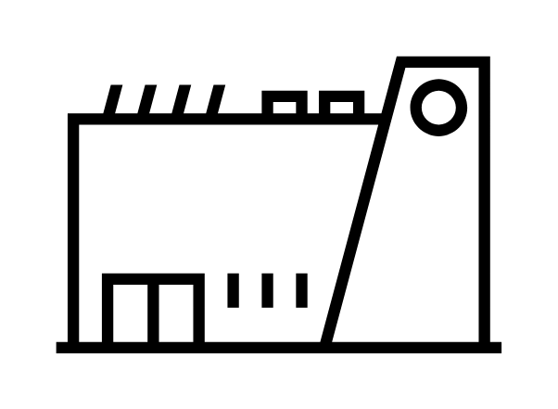

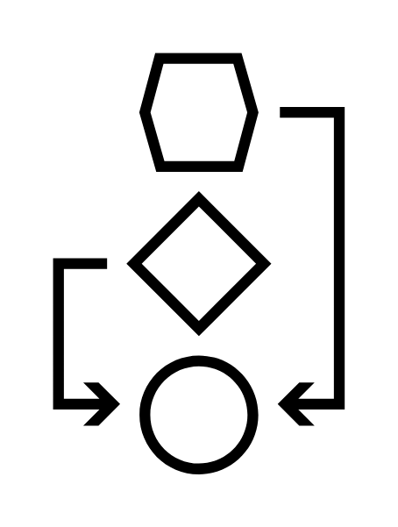

The Problem Shows Up Everywhere
Different domains, same gap — the common thread is traceability
AECO
Manufacturing
Digital Engineering
Media & Entertainment
IFC GlobalIds
Classification codes
Revision workflows
Part & serial numbers
BOM traceability
Identity across processes
Equipment tags
OPC UA NodeIds
Telemetry bindings
Asset database IDs
Shot & sequence tracking
Production management

Slide 10
Source Identity Is the Primary Gap
Instance identity already works. Source identity doesn’t exist yet.
30 doors, same catalog number — unique prim paths, shared source identity
Real objects carry identifiers from multiple systems simultaneously
A chiller unit: PLM part number + IFC GlobalId + OPC UA NodeId
This needs a mechanism keyed by domain, not a single field

Slide 11
Candidate Approaches

Slide 12
Approach A vs. Approach B
Evaluating both before committing
EXTEND ASSETINFO
LEVERAGE APPLIED SCHEMAS
Stratified sub-dictionaries
✓ Existing composition semantics
✓ Low barrier to adoption
✓ Domains move independently
✗ Not in UsdPrimDefinition
✗ Dumping-ground risk (more acute)
Typed properties
✓ Full discoverability
✓ Schema versioning & validation
✓ More rigorous structure
✗ Agreement on schema slows adoption
✗ Heterogeneous packages are hard
✗ Requires distributing plugins

Slide 13
The Hard Part Isn’t Technical
Both approaches require curation — and curation slows production
No one wants to wait for consensus before proving what works
The design must let domains move independently…
…while still converging on interoperable conventions over time
AI can help derive linkages across uncurated identifiers —
but only human agreement makes the answer verifiable

Slide 14
Design Principles
Seven guardrails for the evaluation
1
2
3
4
Separation of concerns
Industry agnosticism
Composability
Discoverability
5
6
7
External queryability
Round-trip fidelity
Minimal disruption

Slide 15
What’s Next

Slide 16
Next Steps
Consensus at every step — stakeholder engagement accelerates the work
1. Submit as PR to OpenUSD-proposals
2. Align on the problem statement across industries
3. Gather additional use cases
4. Evaluate Approach A vs. B (or hybrid)
5. Draft a solution proposal with mechanism, semantics, and API

