Slide 1
Geospatial scenes with shared placement
A railway, a site asset and a scalar field should retain their source coordinates while participating in one scene.
Rendering, world-position queries, bounds and physics need the same resolved placement.
Notes:
Source: README.md, section 'Geospatial scenes with shared placement'. README SHA-256: e512bd3c3fbf3e7eb75113d38137faab41e2e0f278309127fefa59ee82e02110.
A railway, a site asset and a scalar field should retain their source coordinates while participating in one scene.
Rendering, world-position queries, bounds and physics need the same resolved placement.
Figure provenance, if used: docs/figures/manifest.json and DATASETS.md; figures.py reproduces these data plots.

Slide 2
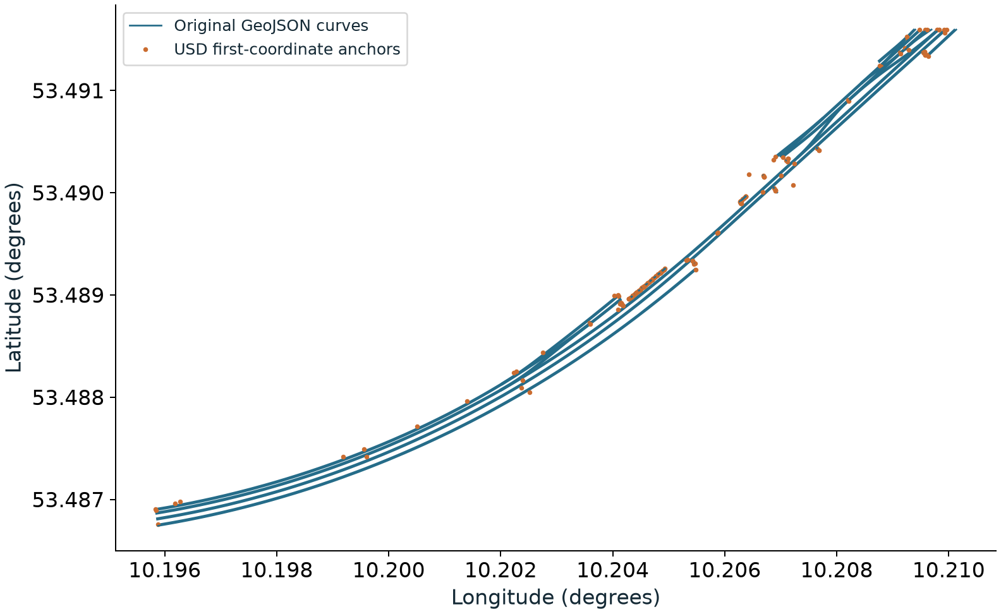
Railway source and scene identity
1,473 source features match USD object identities and first-coordinate anchors.
186 railway curves retain 3,526 vertices by count; interior placement is still unchecked.
These checks establish what survived conversion; they do not establish resolved rails-on-map placement.
Original source curves and matching USD anchors; this is a data plot, not a runtime render.
2 / 8
Notes:
Source: README.md, section 'Railway source and scene identity'. README SHA-256: e512bd3c3fbf3e7eb75113d38137faab41e2e0f278309127fefa59ee82e02110.
1,473 source features match USD object identities and first-coordinate anchors.
186 railway curves retain 3,526 vertices by count; interior placement is still unchecked.
These checks establish what survived conversion; they do not establish resolved rails-on-map placement.
Original source curves and matching USD anchors; this is a data plot, not a runtime render.
Figure provenance, if used: docs/figures/manifest.json and DATASETS.md; figures.py reproduces these data plots.

Slide 3
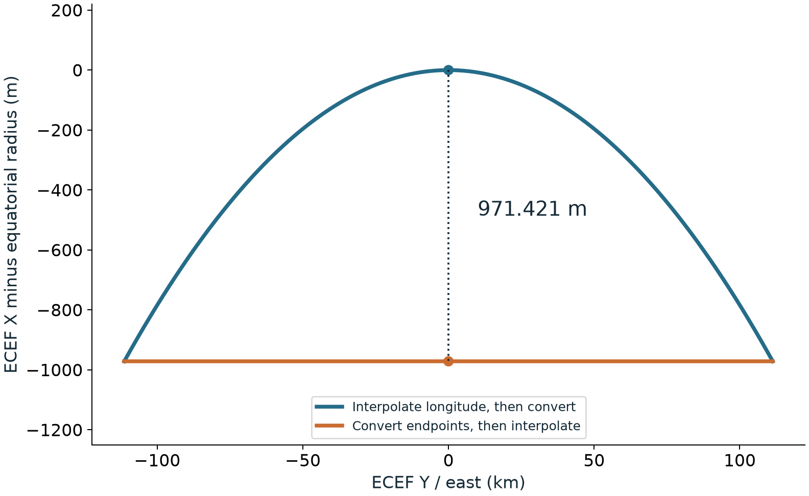
Native interpolation preserves the authored path
R20, Positions between recorded moments: interpolate recorded coordinates in their CRS, then convert.
Interpolating converted endpoints puts the equatorial midpoint 971.421 m inside the ellipsoid.
This is an analytic component example; the scene position carrier and its sampling rules remain open.
Equatorial samples at minus and plus one degree; vertical scale is exaggerated and axes use different units.
3 / 8
Notes:
Source: README.md, section 'Native interpolation preserves the authored path'. README SHA-256: e512bd3c3fbf3e7eb75113d38137faab41e2e0f278309127fefa59ee82e02110.
R20, Positions between recorded moments: interpolate recorded coordinates in their CRS, then convert.
Interpolating converted endpoints puts the equatorial midpoint 971.421 m inside the ellipsoid.
This is an analytic component example; the scene position carrier and its sampling rules remain open.
Equatorial samples at minus and plus one degree; vertical scale is exaggerated and axes use different units.
Figure provenance, if used: docs/figures/manifest.json and DATASETS.md; figures.py reproduces these data plots.

Slide 4
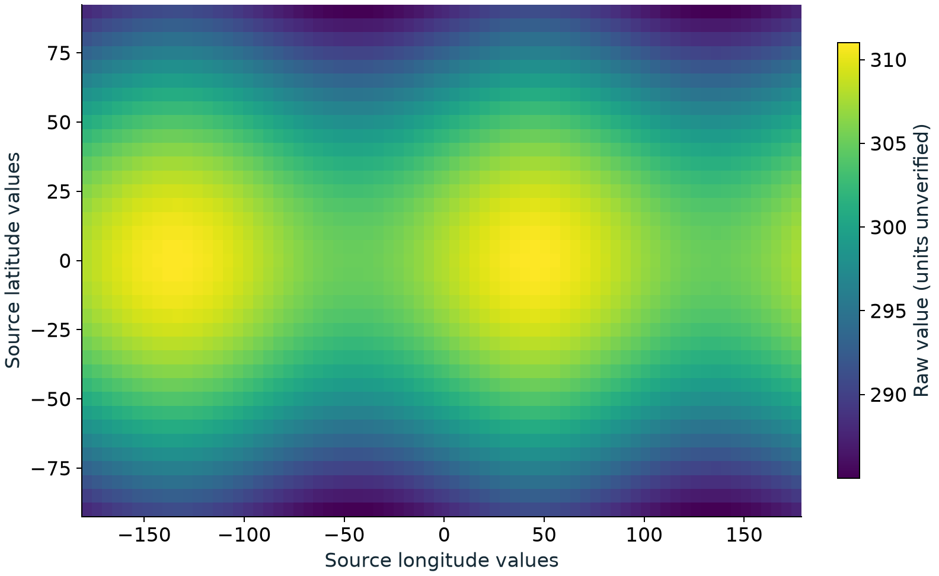
Scalar data and a removable visualization
2,664 scalar samples on a 37 by 72 grid exercise coordinate reporting; a three-sample overlay is removable.
The stock-USD overlay leaves source values intact. Geospatial placement of that overlay is still pending.
Forecast origin, timestamp, CRS metadata and value units are unverified; the filename is not provenance.
Raw values from the retained scalar-field fixture, without an inferred physical unit.
4 / 8
Notes:
Source: README.md, section 'Scalar data and a removable visualization'. README SHA-256: e512bd3c3fbf3e7eb75113d38137faab41e2e0f278309127fefa59ee82e02110.
2,664 scalar samples on a 37 by 72 grid exercise coordinate reporting; a three-sample overlay is removable.
The stock-USD overlay leaves source values intact. Geospatial placement of that overlay is still pending.
Forecast origin, timestamp, CRS metadata and value units are unverified; the filename is not provenance.
Raw values from the retained scalar-field fixture, without an inferred physical unit.
Figure provenance, if used: docs/figures/manifest.json and DATASETS.md; figures.py reproduces these data plots.

Slide 5
Proposed runtime contract
Composed declarations establish CRS scope; source coordinates and asset conventions remain authored data.
Resolution evaluates native positions and offsets into one selected output CRS without modifying the stage.
Queries and consumers share the result; failures and operation provenance remain explicit.
5 / 8
Notes:
Source: README.md, section 'Proposed runtime contract'. README SHA-256: e512bd3c3fbf3e7eb75113d38137faab41e2e0f278309127fefa59ee82e02110.
Composed declarations establish CRS scope; source coordinates and asset conventions remain authored data.
Resolution evaluates native positions and offsets into one selected output CRS without modifying the stage.
Queries and consumers share the result; failures and operation provenance remain explicit.
Figure provenance, if used: docs/figures/manifest.json and DATASETS.md; figures.py reproduces these data plots.

Slide 6
Two runtime targets
Non-Hydra: a renderer-independent scene resolver for placements, coordinate queries and bounds. Not built.
Hydra: a scene-index adapter consuming the same resolved placement and propagating changes. Not built.
Consumer consistency is distinct from R29, Implementable from the text alone, which requires different transformation engines.
6 / 8
Notes:
Source: README.md, section 'Two runtime targets'. README SHA-256: e512bd3c3fbf3e7eb75113d38137faab41e2e0f278309127fefa59ee82e02110.
Non-Hydra: a renderer-independent scene resolver for placements, coordinate queries and bounds. Not built.
Hydra: a scene-index adapter consuming the same resolved placement and propagating changes. Not built.
Consumer consistency is distinct from R29, Implementable from the text alone, which requires different transformation engines.
Figure provenance, if used: docs/figures/manifest.json and DATASETS.md; figures.py reproduces these data plots.

Slide 7
Next complete demonstration
Import the railway and a site asset, resolve them into one project CRS, and verify placement against independent controls.
Relocate an asset, scrub time and compose another layer; compare non-Hydra queries with Hydra results after each change.
State placement error and valid extent, preserve source data, and fail visibly when a required operation cannot run.
7 / 8
Notes:
Source: README.md, section 'Next complete demonstration'. README SHA-256: e512bd3c3fbf3e7eb75113d38137faab41e2e0f278309127fefa59ee82e02110.
Import the railway and a site asset, resolve them into one project CRS, and verify placement against independent controls.
Relocate an asset, scrub time and compose another layer; compare non-Hydra queries with Hydra results after each change.
State placement error and valid extent, preserve source data, and fail visibly when a required operation cannot run.
Figure provenance, if used: docs/figures/manifest.json and DATASETS.md; figures.py reproduces these data plots.

Slide 8
Review requests
Review the proposed runtime prose against the functional requirements and close the carrier, placement and scope decisions.
Supply source CRS/epoch/vertical metadata, expected control points and a distance-and-extent acceptance criterion.
Use the next railway/site demonstration to review both consumer paths and separate engine agreement from correctness.
8 / 8
Notes:
Source: README.md, section 'Review requests'. README SHA-256: e512bd3c3fbf3e7eb75113d38137faab41e2e0f278309127fefa59ee82e02110.
Review the proposed runtime prose against the functional requirements and close the carrier, placement and scope decisions.
Supply source CRS/epoch/vertical metadata, expected control points and a distance-and-extent acceptance criterion.
Use the next railway/site demonstration to review both consumer paths and separate engine agreement from correctness.
Figure provenance, if used: docs/figures/manifest.json and DATASETS.md; figures.py reproduces these data plots.

