Slide 1
Geospatial scenes with shared placement
Place railway data, a calibrated site and a removable scalar overlay while retaining their source data.
Headless queries, native Hydra/Storm and Omniverse Fabric consume the same evaluated placement.
Execute every workflow and test alternative rules; use the failures and discrepancies to improve the design.
Notes:
Source: README.md, section 'Geospatial scenes with shared placement'. README SHA-256: 7f49781b36513aff2f602a87ca5600ad589859816434af8a2664edccc2a57f12.
Place railway data, a calibrated site and a removable scalar overlay while retaining their source data.
Headless queries, native Hydra/Storm and Omniverse Fabric consume the same evaluated placement.
Execute every workflow and test alternative rules; use the failures and discrepancies to improve the design.
Figure provenance, if used: docs/figures/manifest.json and DATASETS.md; figures.py reproduces these data plots.

Slide 2
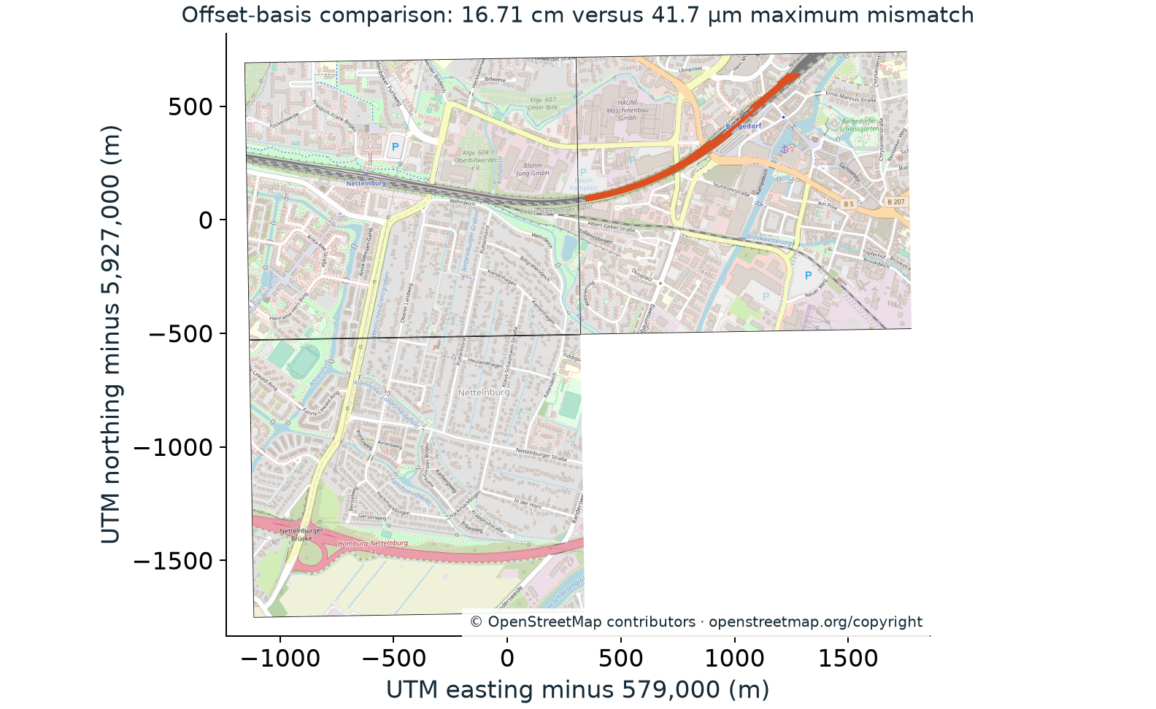
Railway source and scene identity
1,473 source features resolve with all 15,822 vertices, object identities and polygon rings checked.
Across 186 curves, offset-basis choice changes maximum mismatch from 16.71 cm to 41.7 micrometres.
Three map tiles share the output frame. Height interpretation is explicit; survey metadata remains unknown.
Resolved railway boundaries over the retained map tiles in the selected projected frame.
2 / 8
Notes:
Source: README.md, section 'Railway source and scene identity'. README SHA-256: 7f49781b36513aff2f602a87ca5600ad589859816434af8a2664edccc2a57f12.
1,473 source features resolve with all 15,822 vertices, object identities and polygon rings checked.
Across 186 curves, offset-basis choice changes maximum mismatch from 16.71 cm to 41.7 micrometres.
Three map tiles share the output frame. Height interpretation is explicit; survey metadata remains unknown.
Resolved railway boundaries over the retained map tiles in the selected projected frame.
Figure provenance, if used: docs/figures/manifest.json and DATASETS.md; figures.py reproduces these data plots.

Slide 3
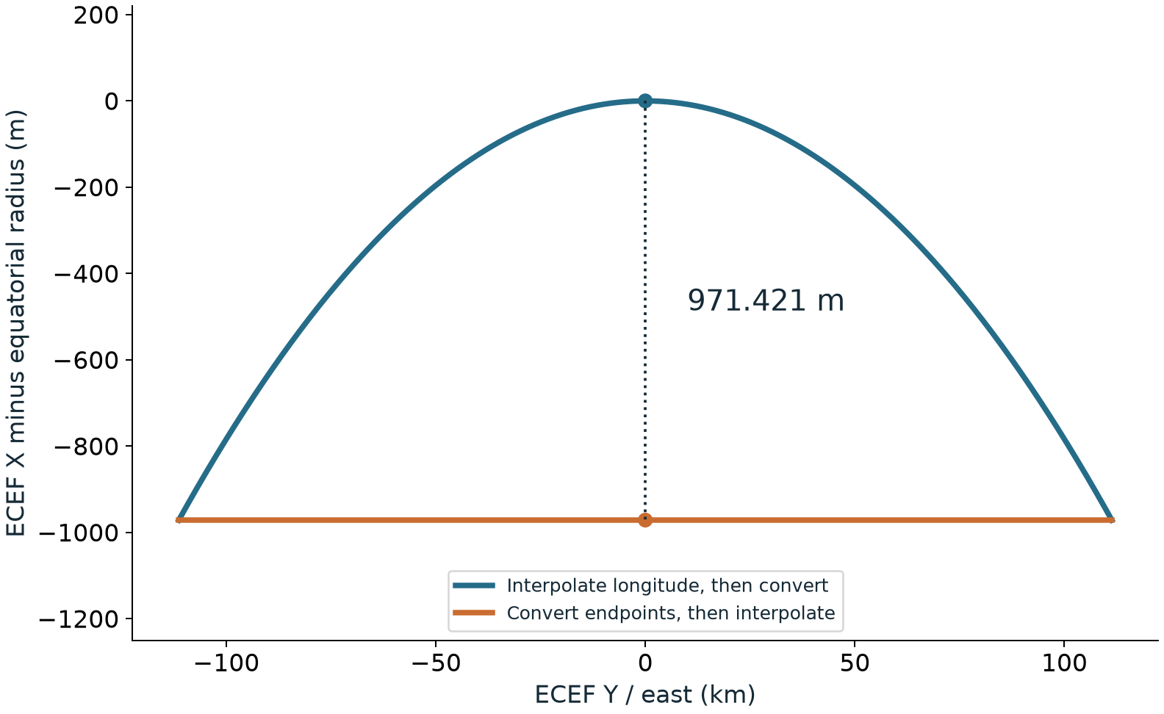
Native interpolation preserves the authored path
Both experimental position carriers interpolate recorded native coordinates before conversion.
Interpolating converted endpoints puts the equatorial midpoint 971.421 m inside the ellipsoid.
Edits invalidate evaluated results; explicit export records its CRS and sampled times.
Native interpolation and the erroneous Cartesian chord; axes use different units and vertical scale is exaggerated.
3 / 8
Notes:
Source: README.md, section 'Native interpolation preserves the authored path'. README SHA-256: 7f49781b36513aff2f602a87ca5600ad589859816434af8a2664edccc2a57f12.
Both experimental position carriers interpolate recorded native coordinates before conversion.
Interpolating converted endpoints puts the equatorial midpoint 971.421 m inside the ellipsoid.
Edits invalidate evaluated results; explicit export records its CRS and sampled times.
Native interpolation and the erroneous Cartesian chord; axes use different units and vertical scale is exaggerated.
Figure provenance, if used: docs/figures/manifest.json and DATASETS.md; figures.py reproduces these data plots.

Slide 4
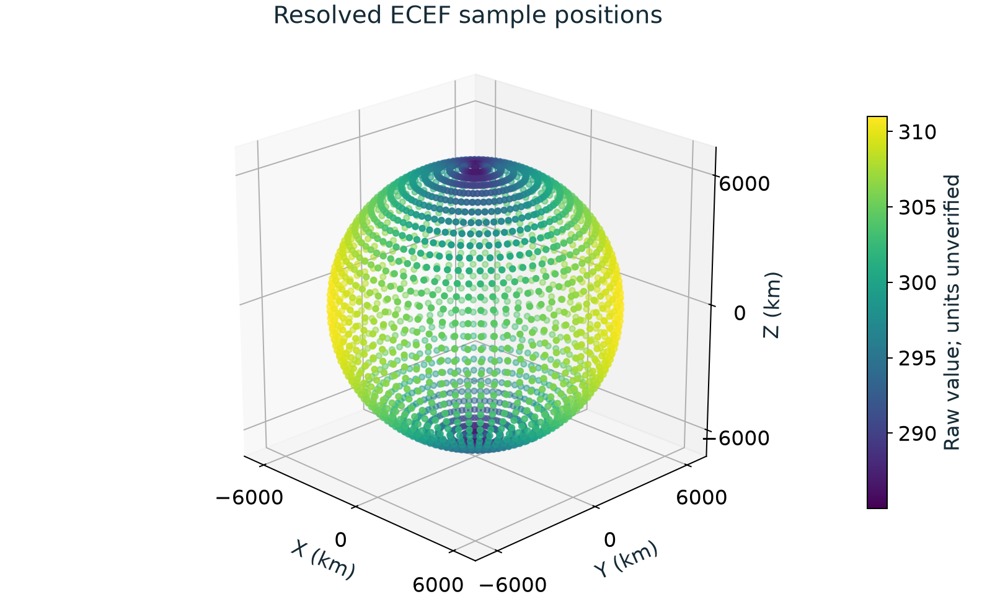
Scalar data and a removable visualization
All 2,664 scalar samples resolve; all 2,664 visualization markers are removed through the consumer update path.
Omniverse Fabric and native Hydra receive the same placements while source values remain unchanged.
Physical units, forecast origin, timestamp and source CRS metadata remain unverified.
All scalar sample locations resolved into ECEF under the explicit WGS84/zero-height hypothesis; colors are raw values.
4 / 8
Notes:
Source: README.md, section 'Scalar data and a removable visualization'. README SHA-256: 7f49781b36513aff2f602a87ca5600ad589859816434af8a2664edccc2a57f12.
All 2,664 scalar samples resolve; all 2,664 visualization markers are removed through the consumer update path.
Omniverse Fabric and native Hydra receive the same placements while source values remain unchanged.
Physical units, forecast origin, timestamp and source CRS metadata remain unverified.
All scalar sample locations resolved into ECEF under the explicit WGS84/zero-height hypothesis; colors are raw values.
Figure provenance, if used: docs/figures/manifest.json and DATASETS.md; figures.py reproduces these data plots.

Slide 5

Site placement remains separate from asset conformance
The supplied local-grid calibration places the complete tower in Lambert-93 with IGN69 height.
Project relocation and a constructed incline change placement while the source asset stays unchanged.
The image is a real Storm render of the new native scene index; no retired geospatial plugin is loaded.
Storm renders the resolved site asset directly from the native Hydra adapter.
5 / 8
Notes:
Source: README.md, section 'Site placement remains separate from asset conformance'. README SHA-256: 7f49781b36513aff2f602a87ca5600ad589859816434af8a2664edccc2a57f12.
The supplied local-grid calibration places the complete tower in Lambert-93 with IGN69 height.
Project relocation and a constructed incline change placement while the source asset stays unchanged.
The image is a real Storm render of the new native scene index; no retired geospatial plugin is loaded.
Storm renders the resolved site asset directly from the native Hydra adapter.
Figure provenance, if used: docs/figures/manifest.json and DATASETS.md; figures.py reproduces these data plots.

Slide 6
Two runtime targets
Non-Hydra: read-only scene resolution, coordinate and relative-placement queries, bounds, edits and export.
Hydra: a compiled scene index with geometry, topology and change notices, rendered directly by Storm.
Omniverse Fabric is an additional real consumer; independent Karney arithmetic checks geodetic consistency.
6 / 8
Notes:
Source: README.md, section 'Two runtime targets'. README SHA-256: 7f49781b36513aff2f602a87ca5600ad589859816434af8a2664edccc2a57f12.
Non-Hydra: read-only scene resolution, coordinate and relative-placement queries, bounds, edits and export.
Hydra: a compiled scene index with geometry, topology and change notices, rendered directly by Storm.
Omniverse Fabric is an additional real consumer; independent Karney arithmetic checks geodetic consistency.
Figure provenance, if used: docs/figures/manifest.json and DATASETS.md; figures.py reproduces these data plots.

Slide 7
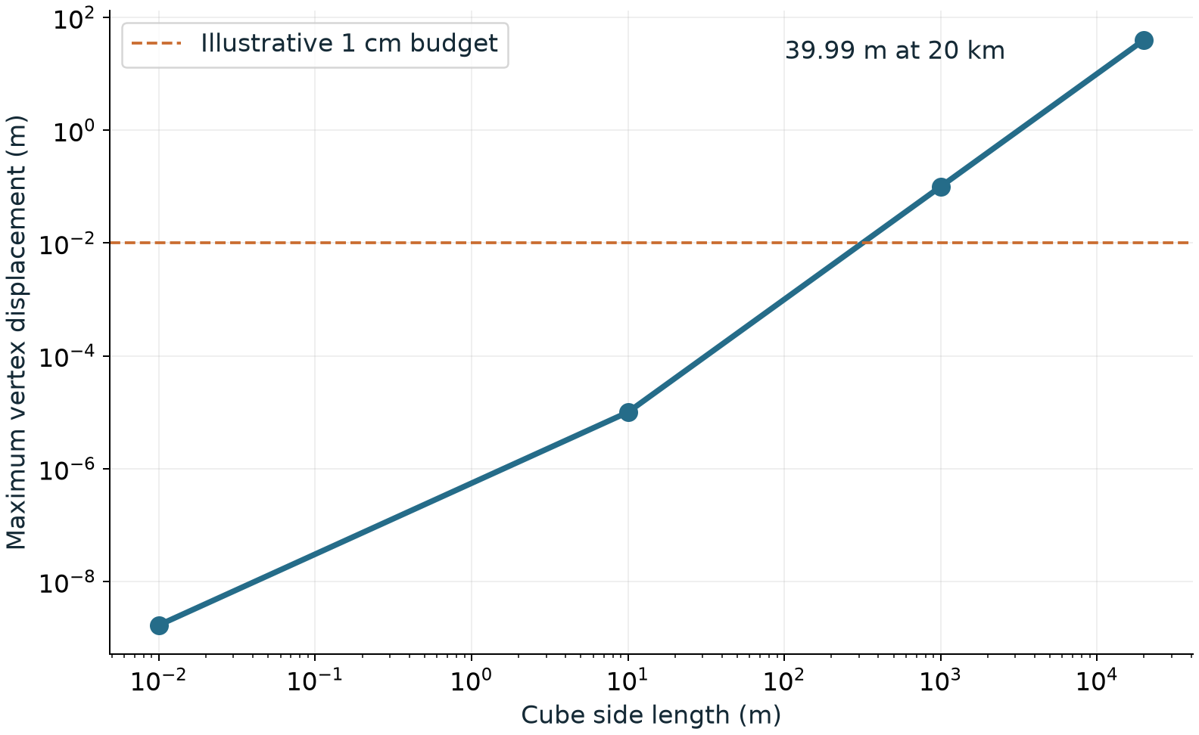
Design choices exercised by the complete run
Affine and pointwise placement are both implemented; extent sweeps reveal where one matrix loses fidelity.
Applying an ancestor transform after an absolute position produces a tested 1,000 m violation.
Missing grids or coordinate epochs fail observably; animation time never supplies a coordinate epoch.
Measured affine-versus-pointwise displacement as geometry footprint grows; bounds cover tested vertices.
7 / 8
Notes:
Source: README.md, section 'Design choices exercised by the complete run'. README SHA-256: 7f49781b36513aff2f602a87ca5600ad589859816434af8a2664edccc2a57f12.
Affine and pointwise placement are both implemented; extent sweeps reveal where one matrix loses fidelity.
Applying an ancestor transform after an absolute position produces a tested 1,000 m violation.
Missing grids or coordinate epochs fail observably; animation time never supplies a coordinate epoch.
Measured affine-versus-pointwise displacement as geometry footprint grows; bounds cover tested vertices.
Figure provenance, if used: docs/figures/manifest.json and DATASETS.md; figures.py reproduces these data plots.

Slide 8
Review requests
Approve the drafted functional requirements and select among the executed runtime alternatives.
Clarify the extent/bound domain, unit and offset basis, project placement and dependency/target rules.
Supply certified vertical/epoch metadata and control points where accuracy claims are required.
8 / 8
Notes:
Source: README.md, section 'Review requests'. README SHA-256: 7f49781b36513aff2f602a87ca5600ad589859816434af8a2664edccc2a57f12.
Approve the drafted functional requirements and select among the executed runtime alternatives.
Clarify the extent/bound domain, unit and offset basis, project placement and dependency/target rules.
Supply certified vertical/epoch metadata and control points where accuracy claims are required.
Figure provenance, if used: docs/figures/manifest.json and DATASETS.md; figures.py reproduces these data plots.

