Slide 1
Part 2 Process Management Chapter 2 Process Concept
*Most details of this presentation obtainED from
“Silberschatz A., P.B. Galvin and G. Gagne. Operating System Concepts, 8th edition” textbook

Slide 2
Outline
Overview of Process
Overview of Thread
Process Scheduling
Operations on Processes
Interprocess Communication

Slide 3
Overview of Process

Slide 4
Overview of Process Concept
Early computer systems allowed only one program to be executed at a time.
This program had complete control of the system and had access to all the system’s resources.
Current-day computer systems allow multiple programs to be loaded into memory and executed concurrently.
This evolution required firmer control and more compartmentalization of the various program.
These needs resulted in the notion of a process, which is a program in execution.
A process is the unit of work in a modern time-sharing system.
OVERVIEW OF PROCESS
Notes:
Firmer = เด็ดขาดขึ้น,มั่นคงขึ้น ; compartmentalization = การจัดแบ่ง ; resulted = เป็นผล,บังเกิดผล,ลงเอย ; notion = แนวคิด
--------------------------------------------------------------------------------------------------------------------------
- เมื่อมีหลายๆ โปรแกรม ที่ถูกอนุญาตให้ประมวลผลในเวลาเดียวกัน จึงจำเป็นต้องมี การควบคุมและจัดแบ่ง โปรแกรมต่างๆ เหล่านั้น เช่น กำหนดพื้นที่ memory ที่ใช้เก็บ, เก็บข้อมูลต่างๆ ของ process เช่น state เป็นต้น ให้สามารถประมวลผลบนทรัพยากรที่ใช้ร่วมกันได้ ซึ่งตรงนี้ เป็นผลให้เกิดแนวคิดของ Process
- เมื่อหลายๆ โปรแกรม ถูกอนุญาตให้ประมวลผลพร้อมกัน โดยเราเรียก โปรแกรมที่อยู่ในการประมวลผล ว่า process เมื่อมีหลายๆ โปรเซส บนระบบที่ต้องใช้ทรัพยากรร่วมกัน ทำให้เราต้องมีกลไกควบคุมและจัดแบ่ง process ต่างๆ เหล่านี้ เพื่อใช้งานทัรพยากรร่วมกัน โดยเรามองได้ว่า process เป็น unit of work ของระบบนั่นเอง

Slide 5
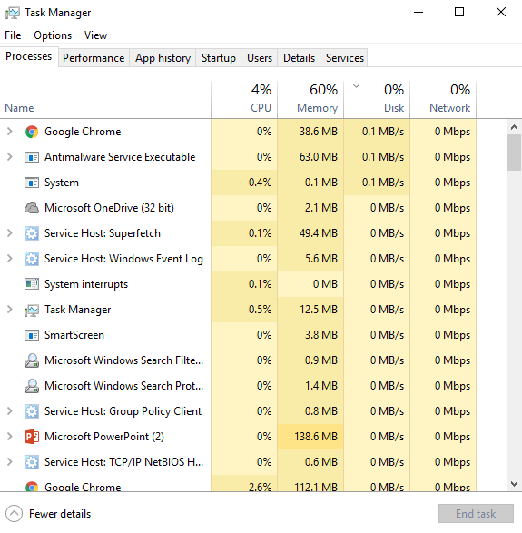
Overview of Process Concept
OVERVIEW OF PROCESS

Slide 6
Overview of Process Concept
A system consists of a collection of processes:
Operating system processes executing system code.
User processes executing user code.
Potentially, all these processes can execute concurrently, with the CPU (or CPUs) multiplexed among them.
By switching the CPU between processes, the operating system can make the computer more productive.
OVERVIEW OF PROCESS
Notes:
Productive = ให้ผลดีหรือมาก, เป็นประโยชน์

Slide 7
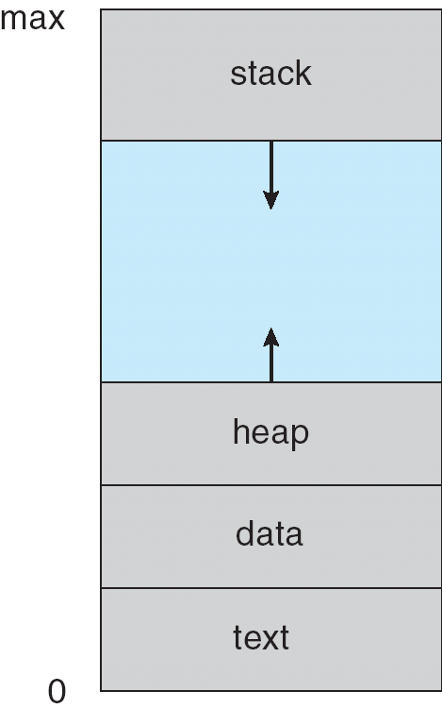
Process
A process is a program in execution.
A process is more than the program code, which is sometimes known as the text section
It also includes the current activity, as represented by the value of the program counter (specifying the next instruction to execute) and the contents of the processor’s registers.
A process generally also includes:
A data section, which contains global variables.
The process stack, which contains temporary data (such as function parameters, return addresses, and local variables).
A heap, which is memory that is dynamically allocated during process run time.
OVERVIEW OF PROCESS
Notes:
คำอธิบายเพิ่มเติม [อ้างอิงจาก http://en.wikipedia.org/wiki/Memory_management]
The task of fulfilling an allocation request consists of locating a block of unused memory of sufficient size. Memory requests are satisfied by allocating portions from a large pool of memory called the heap. At any given time, some parts of the heap are in use, while some are "free" (unused) and thus available for future allocations. Several issues complicate implementation, such as internal and external fragmentation, which arises when there are many small gaps between allocated memory blocks, which invalidates their use for an allocation request. The allocator's metadata can also inflate the size of (individually) small allocations. This is managed often by chunking. The memory management system must track outstanding allocations to ensure that they do not overlap and that no memory is ever "lost" as a memory leak.

Slide 8
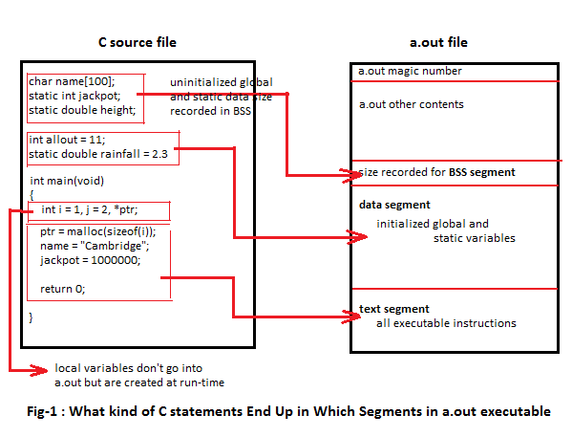
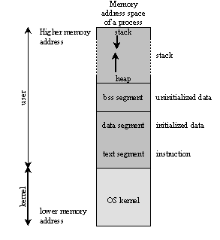
Process in Memory
http://www.tenouk.com/ModuleZ.html
http://www.sanfoundry.com/c-question-run-time-stack-usage/
OVERVIEW OF PROCESS

Slide 9

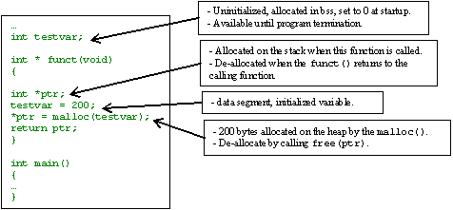
Process in Memory
Which section should it be?
Which section should it be?
Which section should it be?
Which section should it be?
http://www.tenouk.com/ModuleZ.html
OVERVIEW OF PROCESS

Slide 10
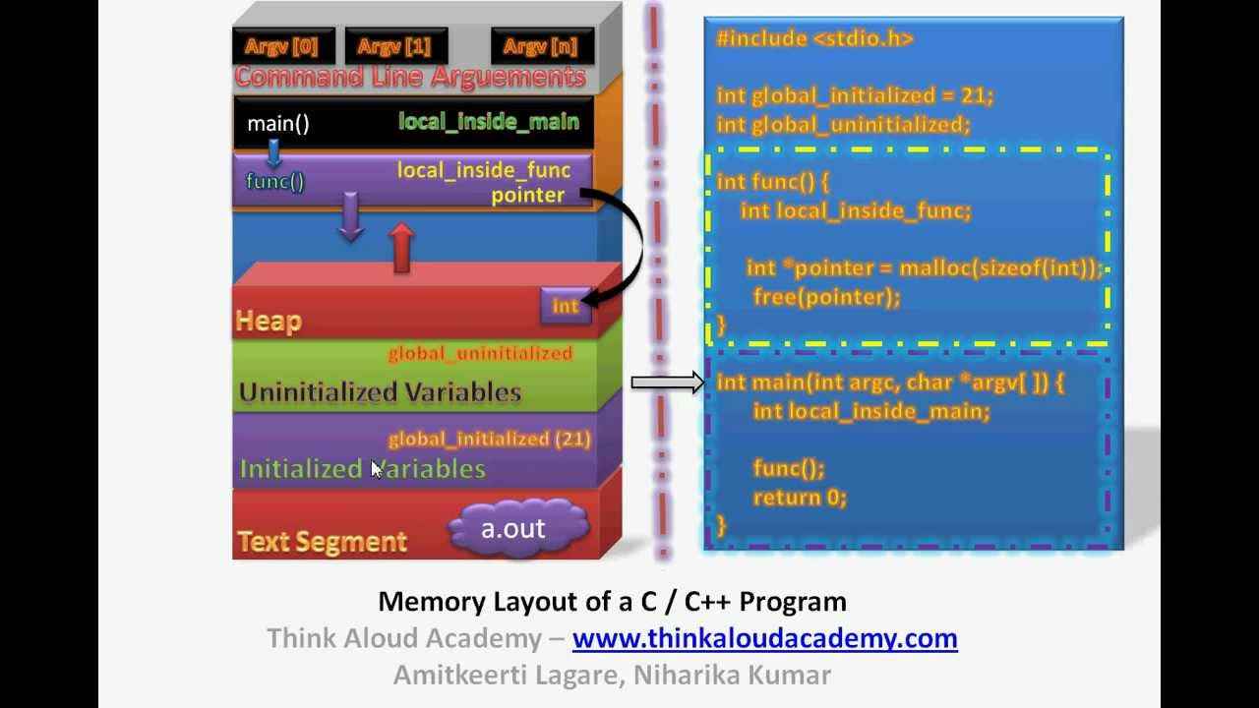
Process in Memory
OVERVIEW OF PROCESS

Slide 11
Process
Emphasize that a program by itself is not a process.
A program is a passive entity, such as a file containing a list of instructions stored on disk (often called an executable file).
A process is an active entity, with a program counter specifying the next instruction to execute and a set of associate resources.
A program becomes a process when an executable file is loaded into memory.
OVERVIEW OF PROCESS
Notes:
Nevertheless = แม้กระนั้น
ทดลองเปิด Notepad 2 อัน ดูจะเห็น process แยกกัน

Slide 12
Process
Although two processes may be associated with the same program, they are nevertheless considered two separate execution sequences.
For instance, several users may be running different copies of the mail program, or the same user may invoke many copies of the web browser program.
Each of these is a separate process; and although the text sections are equivalent, but the data, heap, and stack sections vary.
OVERVIEW OF PROCESS
Notes:
Passive = อยู่เฉยๆ ; entity = รูปธรรม

Slide 13
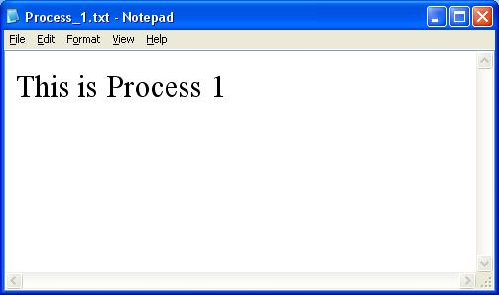
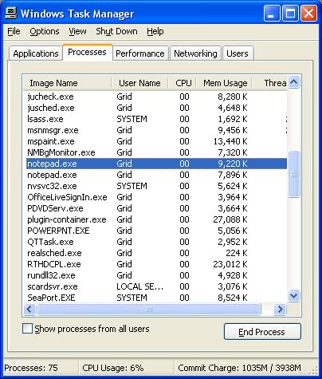
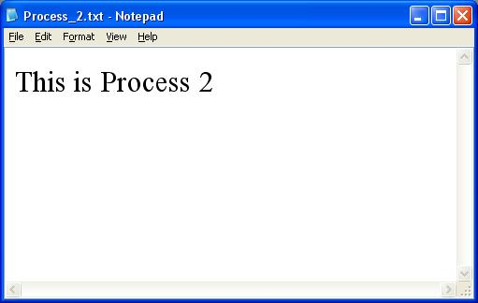
Process
OVERVIEW OF PROCESS

Slide 14
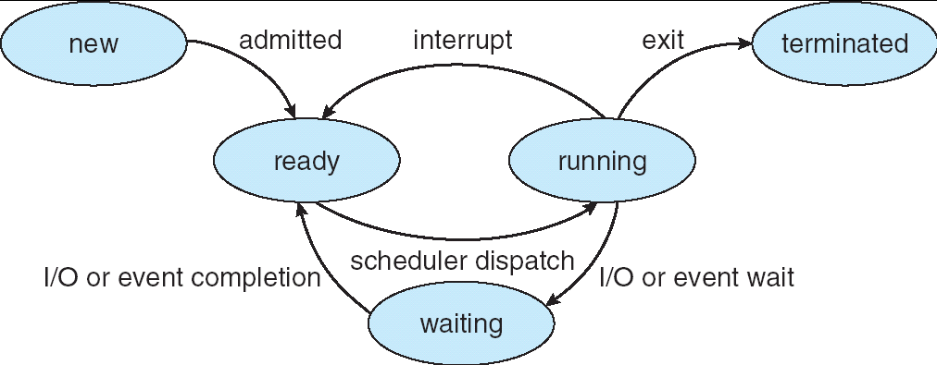
Process State
As a process executes, it changes state. The state of a process is defined in part by the current activity of that process.
Each process may be in one of the following states:
The process is being created
The process has finished execution
The process is waiting to be assigned to a processor
Instructions
are being executed
The process is waiting for some event to occur
(such as an I/O completion or reception of a signal)
OVERVIEW OF PROCESS

Slide 15
Process
The process state names are arbitrary, and they vary cross operating systems.
The states that they represent are found on all systems.
It is important to realize that only one process can be running on any processor at any instant, Many processes may be ready and waiting.
OVERVIEW OF PROCESS

Slide 16
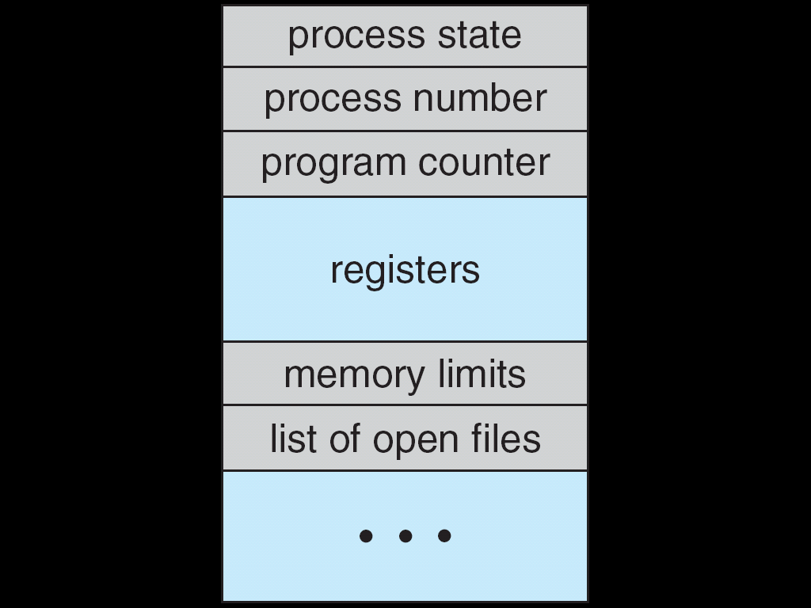
Process Control Block
Each process is represented in the operating system by a process control block (PCB).
Serves as the repository for any information that may vary from process to process.
OVERVIEW OF PROCESS
Notes:
Serve = ทำหน้าที่เป็น ; repository = โกดัง

Slide 17
Process Control Block
PCB contains many pieces of information associated with a specific process, including these:
Process state – may be new, ready, running, waiting, halted, and so on.
Program counter – indicates the address of the next instruction to be executed for this process.
CPU-scheduling information – includes a process priority, pointers to scheduling queues, and any other scheduling parameters.
Memory-management information – may include such information as the value of the base and limit registers, the page tables, or the segment tables.
OVERVIEW OF PROCESS

Slide 18
Process Control Block
Account information – includes the amount of CPU and real time used, time limits, account numbers, process numbers, and so on.
I/O status information – includes the list of I/O devices allocated to the process, a list of open files, and so on.
CPU registers – The registers vary in number and type, depending on the computer architecture.
They include accumulators, index registers, stack pointers, and general-purpose registers, plus any condition-code information.
Along with the program counter, this state information must be saved when an interrupt occurs, to allow the process to be continued correctly afterward.
OVERVIEW OF PROCESS

Slide 19
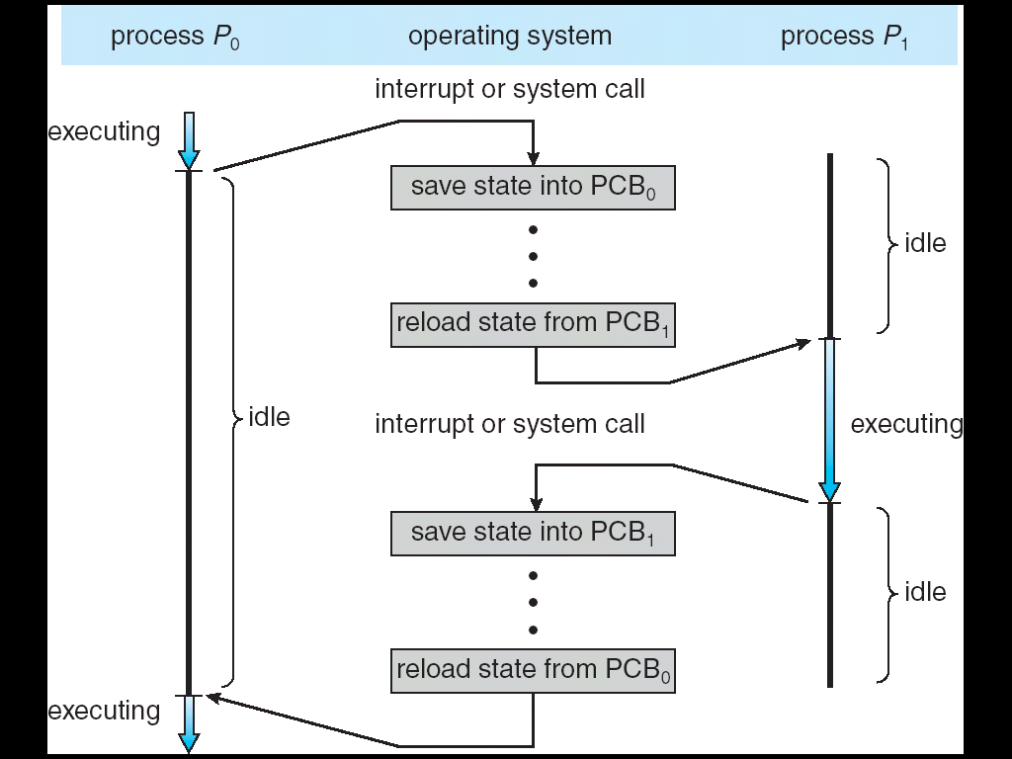
CPU Switch from Process to Process
OVERVIEW OF PROCESS

Slide 20
Context Switch
Interrupts cause OS to change a CPU from its current task and to run a kernel routine.
When interrupt occurs, the system needs to save the current context of the process currently running on the CPU.
So that it can restore that context when its processing is done, essentially suspending the process and then resuming it.
The context is represented in the PCB of process; it includes the value of the CPU registers, the process state, and memory-management information.
Generically, we perform a state save of the current state of the CPU and then a state restore to resume operations.
OVERVIEW OF PROCESS
Notes:
Context = สภาพแวดล้อม, บริบท

Slide 21
Context Switch
Switching the CPU to another process requires performing a state save of the current process and a state restore of a different process. This task known as a context switch.
When a context switch occurs, the kernel saves the context of the old process in its PCB and loads the saved context of the new process scheduled to run.
Context switch time is pure overhead, because the system does no useful work while switching.
Its speed varies from machine to machine, depending on the memory speed, the number of registers that must be copied, and the existence of special instructions (such as a single instruction to load or store all registers).
OVERVIEW OF PROCESS
Notes:
Context = สภาพแวดล้อม, บริบท ; overhead = ค่าใช้จ่ายในการดำเนินการทางธุรกิจ

Slide 22
Overview of Thread

Slide 23

Thread of Execution
What is a sequence of execution of program?
Is it possible to execute both functions (no dependency) on different CPUs at the same time?
Single Thread
…..
int a[100], b[100];
void functionA ( )
{
for (i=1; i<100; i++)
a[i] = a[i-1] + 1;
}
void functionB ( )
{
for (i=1; i<100; i++)
b[i] = b[i-1] + 1;
}
void main ( )
{
functionA( );
functionB( );
……
}
FuncA
FuncA
FuncB
FuncB
time
time
time
Multiple Threads
OVERVIEW OF THREAD

Slide 24
Threads
The process model discussed so far has implied that a process is a program that performs a single thread of execution.
For example, when a process is running a word-processor program, a single thread of instructions is being executed.
This single thread of control allows the process to perform only one task at one time. The user cannot simultaneously type in characters and run the spell checker within the same process, for example.
Many modern operating systems have extended the process concept to allow a process to have multiple threads of execution and thus to perform more than one task at a time.
OVERVIEW OF THREAD

Slide 25
Threads
A process is an executing program that has at least a single thread of control.
A traditional (or heavyweight) process has a single thread of control.
Most modern operating systems now provide features enabling a process to contain multiple threads of control.
If a process has multiple threads of control, it can perform more than one task at a time.
OVERVIEW OF THREAD
Notes:
Traditional = แบบดั้งเดิม, โบราณ, เก่าแก่

Slide 26
Threads
A process is a unit of work in the system.
A thread is a basic unit of CPU utilization.
Each thread comprises a thread ID, a program counter, a register set, and a stack.
Each thread shares with other threads belonging to the same process its text (code) section, data section, and other OS resources, such as open files and signals.
OVERVIEW OF THREAD
Notes:
Belong to = เป็นสมาชิกของ, เป็นของ

Slide 27
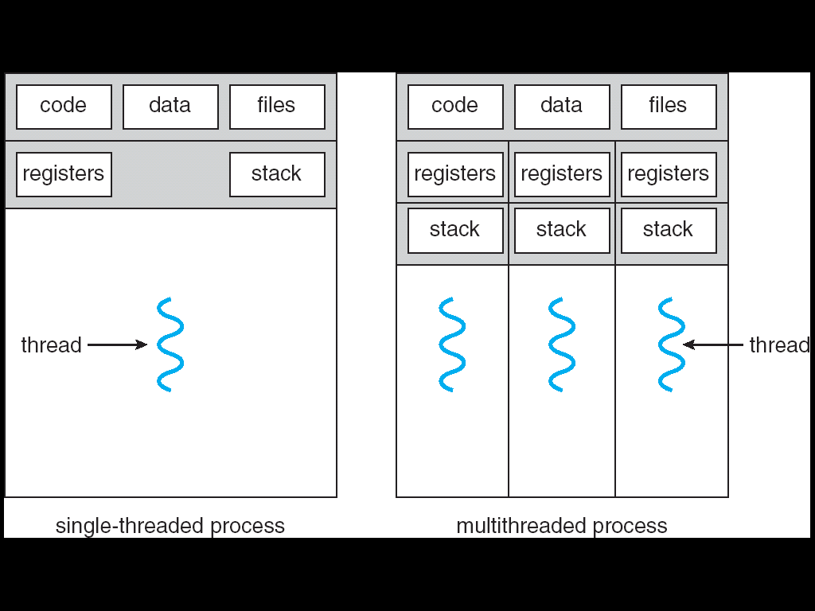
Single & Multithreaded Processes
Shared
Separated
OVERVIEW OF THREAD

Slide 28
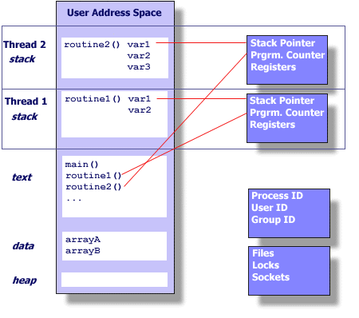
Memory Layout of Multithreaded Process
Reference from “Robert Sayegh. POSIX vs. Win32 Threads. 2008.”
OVERVIEW OF THREAD

Slide 29
Motivation of Multithread
Many software packages that run on modern desktop PCs are multithreaded.
An application typically is implemented as a separate process with several threads of control, for example:
A web browser might have one thread display images or text while another thread retrieves data from network.
A word processor may have a thread for displaying graphics, another thread for responding to keystrokes from the user, and a third thread for performing spelling and grammar checking in the background.
OVERVIEW OF THREAD

Slide 30
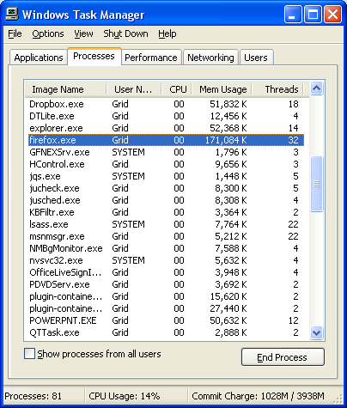
Multithread Processes
OVERVIEW OF THREAD

Slide 31
Motivation of Multithread
In certain situations, a single application may be required to perform several similar tasks, for example:
A web server accepts client requests for web pages, images, sound, and so forth.
A busy web server may have several (perhaps thousands) of clients concurrently accessing it.
If the web server ran as a traditional single-threaded process, it would be able to service only one client at a time.
The amount of time that a client might have to wait for its request to be serviced could be enormous.
OVERVIEW OF THREAD
Notes:
Enormous = ใหญ่โต, มหึมา

Slide 32
Motivation of Multithread
In certain situations, a single application may be required to perform several similar tasks, for example: (cont’d)
One solution is to have the server run as a single process that accepts requests. When the server receives a request, it creates a separate process to service that request.
In fact, this process-creation method was in common use before threads become popular.
Process creation is time-consuming and resource intensive.
If the new process will perform the same tasks as the existing process, why incur all that overhead?
OVERVIEW OF THREAD
Notes:
Incur = ก่อให้เกิด, ประสบ, ได้รับ

Slide 33
Motivation of Multithread
In certain situations, a single application may be required to perform several similar tasks, for example: (cont’d)
It is generally more efficient to use one process that contains multiple threads.
This approach would multithread the web-server process. The server would create a separate thread that would listen for client requests.
When a request was made, rather than creating another process, the server would create another thread to service the request.
OVERVIEW OF THREAD

Slide 34
Motivation of Multithread
Many operating system kernels are now multithreaded.
Several threads operate in the kernel.
Each thread performs a specific tasks, such as managing memory, devices or interrupt handling.
OVERVIEW OF THREAD

Slide 35
Benefit of Multithread
Responsiveness
Multithreading an interactive application may allow a program to continue running even if part of it is blocked or is performing a lengthy operation, thereby increasing responsiveness to the user.
For instance, a multithreaded web browser could still allow user interaction in one thread while an image was being loaded in another thread.
OVERVIEW OF THREAD
Notes:
Lengthy = ยืดยาว

Slide 36
Benefit of Multithread
Resource sharing
By default, threads share the memory and the resources of the process to which they belong.
The benefit of sharing code and data is that it allows an application to have several different threads of activity within the same address space.
OVERVIEW OF THREAD

Slide 37
Benefit of Multithread
Economy
Allocating memory and resources for process creation is costly.
Because threads share resources of the process to which they belong, it is more economical to create and context-switch threads.
Empirically gauging the difference in overhead can be difficult, but in general it is much more time consuming to create and manage processes than threads.
OVERVIEW OF THREAD
Notes:
Costly = แพง, มีราคาสูง ; Economy = การประหยัด, ความมัธยัสถ์, ที่ราคาถูกกว่า, เศรษฐกิจ ; gauging = วัด, ประเมิน

Slide 38
Benefit of Multithread
Utilization of multiprocessor architectures
A single-threaded process can only run on one CPU, no matter how many are available.
The benefits of multithreading can be greatly increased in a multiprocessor architecture, where threads may be running in parallel (concurrency) on different processors.
OVERVIEW OF THREAD
Notes:
Utilization = การใช้ให้เป็นประโยชน์, การทำให้เป็นประโยชน์

Slide 39



Sequential vs. Concurrent threads
Sequential threads
Concurrent threads running simultaneously on two processors
Concurrent threads (with gaps in their executions) interleaved on one processor
OVERVIEW OF THREAD
Notes:
Interleave = ใส่แผ่นแทรก, เพิ่มใบแทรก
-------------------------------------------------------------------------
การทำงานของเธรด
เธรดที่สร้างขึ้นมาสามารถทำงานแบบตามลำดับ (sequential) หรือ ทำงานพร้อมๆกัน (concurrent) ได้ โดยการทำงานแบบตามลำดับนั้น เธรดหนึ่งจะทำงานไปตั้งแต่คำสั่งแรกถึงคำสั่งสุดท้าย จากนั้นอีกเธรดหนึ่งจึงเริ่มทำงานของตนเองจากคำสั่งแรกไปจนถึงคำสั่งสุดท้าย ดังแสดงในรูปแรก ส่วนการทำงานไปพร้อมๆ กันนั้น มีได้สองแบบ กล่าวคือ หากระบบมีหน่วยประมวลผลพอที่จะรันแต่ละเธรดได้ ทั้งสองเธรดก็จะสามารถทำงานไปพร้อมๆ กันได้ (รูปที่สอง) แต่หากระบบมีแค่หน่วยประมวลผลเดียว เพื่อให้ทั้งสองเธรดเดินหน้าไปได้ ระบบสามารถแบ่งงานของแต่ละเธรดเป็นส่วนๆ และทำงานเป็นส่วนๆ ไป (รูปที่สาม) โดยแต่ละเธรดก็จะมีความก้าวหน้าในการทำงาน เสมือนมีสองหน่วยประมวลผล แต่จริงๆ แล้วเป็นการทำงานบนหน่วยประมวลผลเดียว แต่สลับกันทำงานของสองเธรด ซึ่งสิ่งที่ต้องแลกมาคือการทำคอนเทคสวิชชิงระหว่างเธรด แต่อย่างไรก็ตามก็ยังมีความคุ้มค่าเนื่องจากการทำคอนเทคสวิชชิงเธรดจะถูกกว่าการทำกับโพรเซส

Slide 40
Process Scheduling

Slide 41
Process Scheduling
The objective of multiprogramming is to have some process running at all times, to maximize CPU utilization.
The objective of time sharing is to switch the CPU among processes so frequently that users can interact with each program while it is running.
To meet these objectives, the process scheduler selects an available process (possibly from a set of several available processes) for program execution on the CPU.
For a single-processor system, there will never be more than one running process. If there are more processes, the rest will have to wait until the CPU is free and can be rescheduled.
PROCESS SCHEDULING

Slide 42
Scheduling Queues
As processes enter the system, they are put into a job queue, which consists of all processes in the system.
The processes that are residing in main memory and are ready and waiting to execute are kept on a list called the ready queue.
PROCESS SCHEDULING
Notes:
Residing = มีอยู่ใน, อยู่อาศัย ; while = ชั่วขณะหนึ่ง

Slide 43
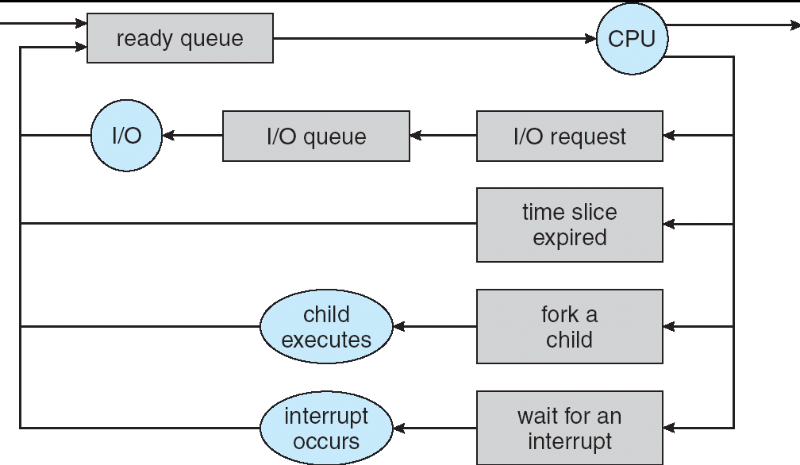
Ready Queue and Various I/O Device Queues
PROCESS SCHEDULING
Notes:
คำอธิบายเพิ่มเติม
A new process is initially put in the ready queue. It waits there until it is selected for execution, or is dispatched. Once the process is allocated the CPU and is executing, one of several events could occur:
The process could issue an I/O request and then be placed in an I/O queue.
The process could create a new subprocess and wait for the subprocess’s termination
The process could be removed forcibly from the CPU, as a result of an interrupt, and be put back in the ready queue.
In the first two cases, the process eventually switches from the waiting state to the ready state and is then put back in the ready queue. A process continues this cycle until it terminates, at which time it is removed from all queues and has its PCB and resource deallocated.

Slide 44
Scheduling Queues
The system also includes other queues.
When a process is allocated the CPU, it executes for a while and eventually quits, is interrupted, or waits for the occurrence of a particular event, such as the completion of an I/O request.
Suppose the process makes an I/O request to a shared device, such as a disk. Since there are many processes in the system, the disk may be busy with the I/O request of some other process. The process therefore may have to wait for the disk.
The list of processes waiting for a particular I/O device is called device queue. Each device has its own device queue.
PROCESS SCHEDULING
Notes:
Residing = มีอยู่ใน, อยู่อาศัย ; while = ชั่วขณะหนึ่ง

Slide 45
Schedulers
A process migrates among the various scheduling queues throughout its lifetime.
OS must select processes from these queues in some fashion.
The selection process is carried out by the appropriate scheduler.
PROCESS SCHEDULING

Slide 46
Operations on Processes

Slide 47
Operations on Processes
The processes in most systems can execute concurrently, and they may be created and deleted dynamically.
The systems must provide a mechanism for:
Process Creation
Process Termination
OPERATIONS ON PROCESSES

Slide 48
Process Creation
A process may create several new process, via a create-process system call, during the course of execution.
The creating process is called a parent process, and the new processes are called the children of that process.
Each of these new processes may in turn create other processes, forming a tree of processes.
Most OS (including UNIX and the Windows family of OS) identify processes according to a unique process identifier (or pid), which is typically an integer number.
OPERATIONS ON PROCESSES
Notes:
Course = ช่วงวิถี, การก้าวไปข้างหน้า

Slide 49
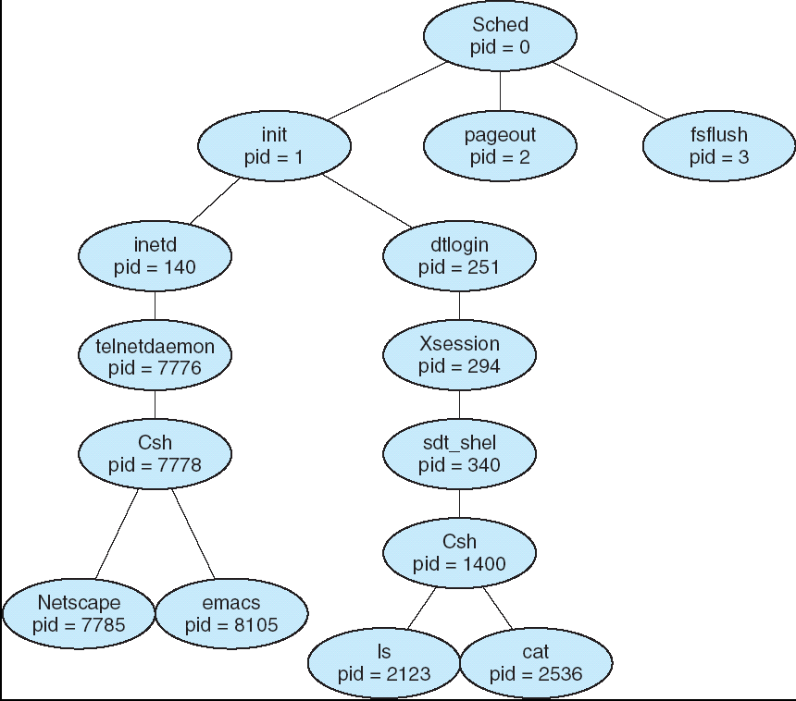
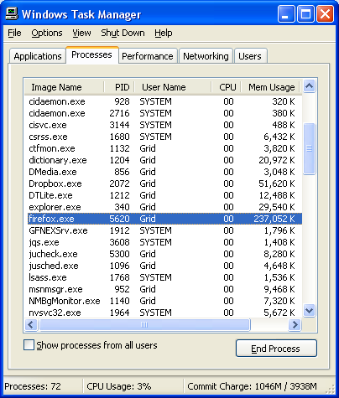
Tree of Processes
OPERATIONS ON PROCESSES

Slide 50
Process Creation
When a process creates a new process, three possibilities exist in terms of resource sharing:
Parent and children share all resources.
Children share subset of parent’s resources.
Parent and child share no resources.
When a process creates a new process, two possibilities exist in terms of execution:
The parent continues to execute concurrently with its children.
The parent waits until some or all of its children have terminated.
OPERATIONS ON PROCESSES

Slide 51
Process Creation
There are also two possibilities in terms of the address space of the new process:
The child process is a duplicate of the parent process (it has the program and data as the parent).
The child process has a new program loaded into it.
UNIX example of process creation:
fork system call creates new process.
exec system call used after a fork to replace the process’s memory space with a new program.
OPERATIONS ON PROCESSES

Slide 52
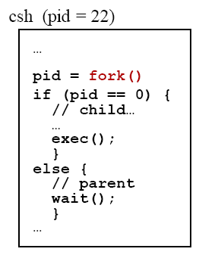
Example: Process Creation in UNIX
OPERATIONS ON PROCESSES

Slide 53
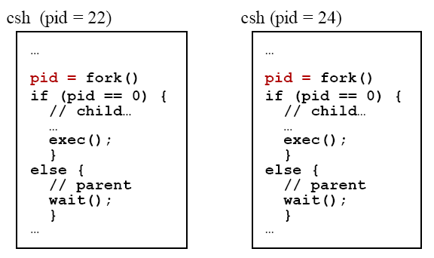
Example: Process Creation in UNIX
The return code for the fork() is process identifier (nonzero) of the child
The return code for the fork() is zero for the new (child) process
OPERATIONS ON PROCESSES

Slide 54
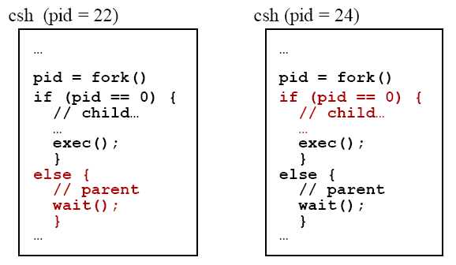
Example: Process Creation in UNIX
OPERATIONS ON PROCESSES

Slide 55
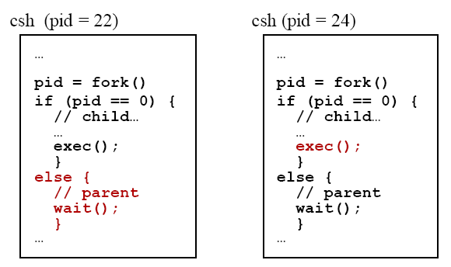
Example: Process Creation in UNIX
The exec() system call loads a binary file into memory and starts its execution
OPERATIONS ON PROCESSES

Slide 56
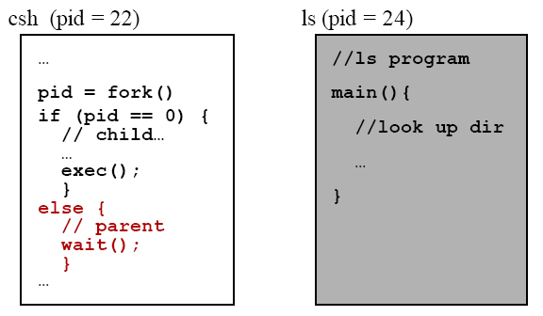
Example: Process Creation in UNIX
OPERATIONS ON PROCESSES

Slide 57
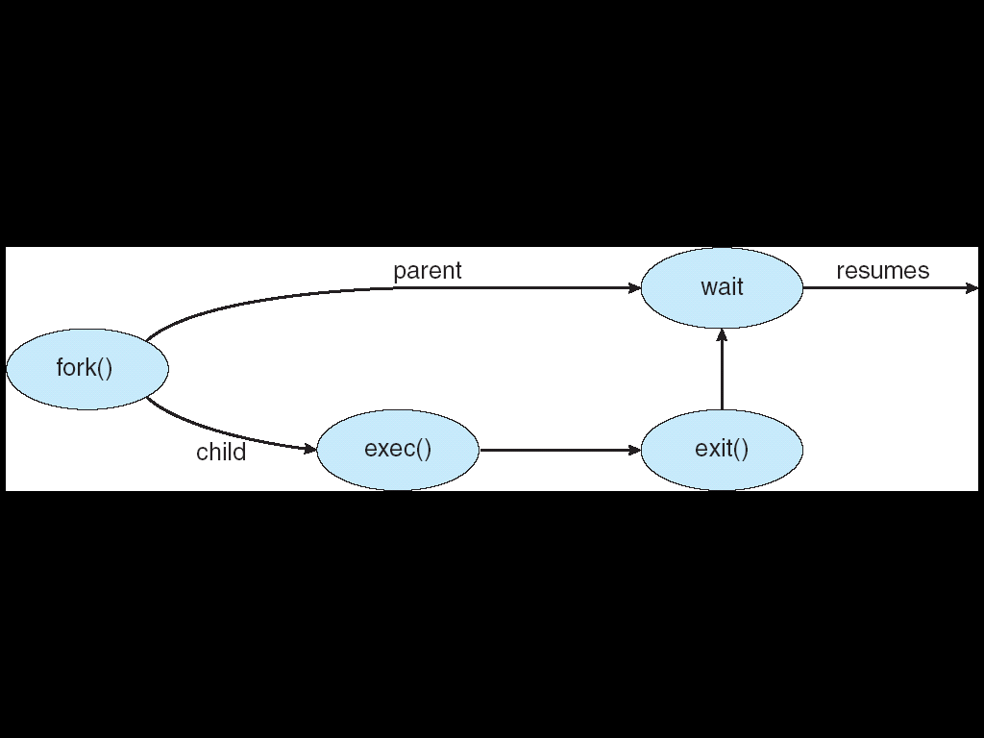
Example: Process Creation in UNIX
OPERATIONS ON PROCESSES

Slide 58
Process Termination
A process terminates when it finishes executing its final statement and asks OS to delete it by using the exit() system call.
All the resources of the process are deallocated by OS.
The process may return a status value (typically an integer) to its parent process (via the wait() system call).
OPERATIONS ON PROCESSES

Slide 59
Process Termination
A process can cause the termination of another process via an appropriate system call (e.g, TerminateProcess() in Win32).
Such a system call can be invoked only by the parent of the process that is to be terminated (a parent needs to know the identities of its children).
Thus, when one process creates a new process, the identity of the newly created process is passed to the parent.
Otherwise, users could arbitrarily kill each other’s jobs.
OPERATIONS ON PROCESSES

Slide 60
Process Termination
A parent may terminate the execution of one of its children (abort) for a variety reasons, such as these:
The child has exceeded its usage of some of the resources that it has been allocated.
The task assigned to child is no longer required.
The parent is exiting, and OS does not allow a child to continue if its parent terminates.
If a process terminates (either normally or abnormally), then all its children must also be terminated. This phenomenon, referred to as cascading termination.
OPERATIONS ON PROCESSES
Notes:
Abort = ทำให้ล้มเหลว, แท้ง, คลอดก่อนกำหนด ; cascading = ไหลลงมาเป็นชั้นๆ

Slide 61
Interprocess Communication

Slide 62
Cooperating Processes
Processes executing concurrently in OS my be either independent processes or cooperating processes.
A process is independent if it cannot affect or be affected by the other processes executing in the system.
Any process that does not share data with any other process is independent.
A process is cooperating if it can affect or be affected by the other processes executing in the system.
Any process that shares data with other processes is a cooperating process.
INTERPROCESS COMMUNICATION

Slide 63
Cooperating Processes
There are several reasons for providing an environment that allows process cooperation:
Information sharing – Since several users may be interested in the same piece of information (for instance, a shared file).
Computation speedup – A particular task can be run faster with breaking it into subtasks, each of which will be executing in parallel with the others. Such a speedup can be achieved only if the computer has multiple processing elements (such as CPUs or I/O channels).
INTERPROCESS COMMUNICATION

Slide 64
Cooperating Processes
There are several reasons for providing an environment that allows process cooperation: (cont’d)
Modularity – To construct the system in a modular fashion, dividing the system functions into separate processes or threads.
Convenience – Even an individual user may work on many tasks at the same time. For instance, a user may be editing and printing in parallel.
INTERPROCESS COMMUNICATION

Slide 65
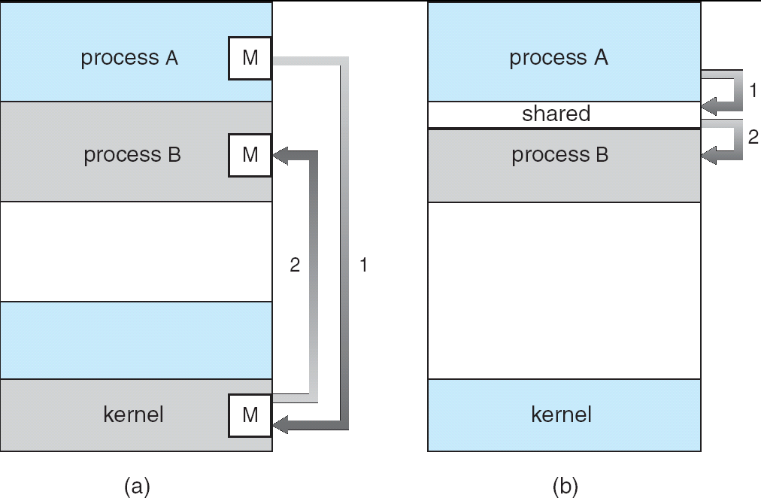
Interprocess Communication
Cooperating processes require an interprocess communication (IPC) mechanism that will allow them to exchange data.
There are two fundamental models of IPC: Shared memory and Message passing.
Message Passing
Shared Memory
INTERPROCESS COMMUNICATION

Slide 66
Shared Memory
IPC using shared memory requires communicating processes to establish a region of shared memory.
A region memory that is shared by cooperating processes is established.
Processes can then exchange information by reading and writing data to the shared region.
Recall that, normally, OS tries to prevent one process from accessing another process’s memory.
Shared memory requires that two or more processes agree to remove this restriction.
INTERPROCESS COMMUNICATION

Slide 67
Shared Memory
A shared-memory region resides in the address space of the process creating the shared-memory segment.
Other processes that wish to communicate using this shared-memory segment must attach it to their address space.
The form of the data and the location are determined by these processes and are not under OS’s control.
The processes are responsible for ensuring that they are not writing to the same location simultaneously.
INTERPROCESS COMMUNICATION

Slide 68
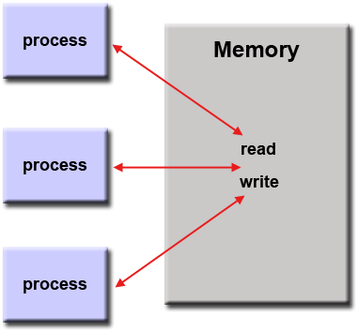
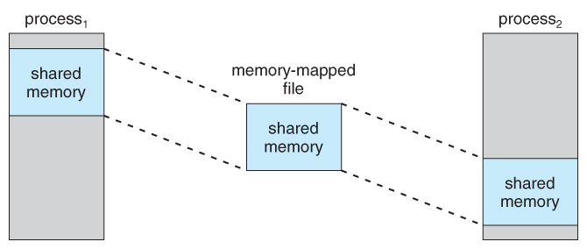
Shared Memory
http://www.learnabouttravelmaps.info/pics/s/shared-memory-example.html
https://computing.llnl.gov/tutorials/parallel_comp/
INTERPROCESS COMMUNICATION

Slide 69
Message Passing
Communication takes place by means of message (shared data) exchanged between the cooperating processes.
Message passing provides a mechanism to allow processes to communicate and to synchronize their actions without sharing the same address space.
It is particularly useful in a distributed environment, where the communicating processes may reside on different computers connected by a network.
INTERPROCESS COMMUNICATION

Slide 70
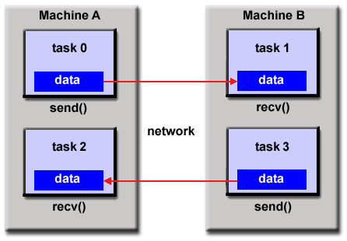
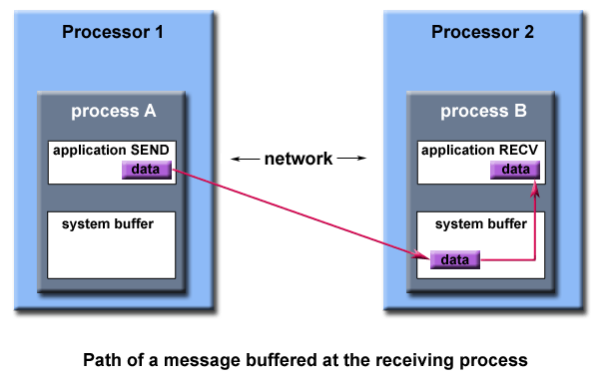
Message Passing
https://behelmy.wordpress.com/parrallel-computing/shared-memory-vs-message-passing-programming-model/
https://computing.llnl.gov/tutorials/mpi/
INTERPROCESS COMMUNICATION

Slide 71
Shared Memory vs. Message Passing
Shared memory is faster than message passing.
Message passing systems are implemented using system calls and thus require the more time consuming task of kernel intervention.
Shared memory systems, system calls are required only to establish shared-memory regions. Once shared memory is established, all accesses are treated as routine memory accesses, and no assistance from the kernel is required.
Shared memory allows maximum speed, as it can be done at memory speeds when within a computer only.
INTERPROCESS COMMUNICATION
Notes:
Intervention = การอยู่ระหว่างกลาง, การแทรกแซง

Slide 72
Shared Memory vs. Message Passing
Message passing is also easier to implement than is shared memory for IPC.
Message passing is useful for exchanging smaller amounts of data, because no conflicts need be avoided.
INTERPROCESS COMMUNICATION
Notes:
Intervention = การอยู่ระหว่างกลาง, การแทรกแซง

Slide 73
Reference
Silberschatz A., P.B. Galvin, and G. Gagne. Operating System Concepts, 8th edition. John Wiley, 2009.
REFERENCE

