Slide 1


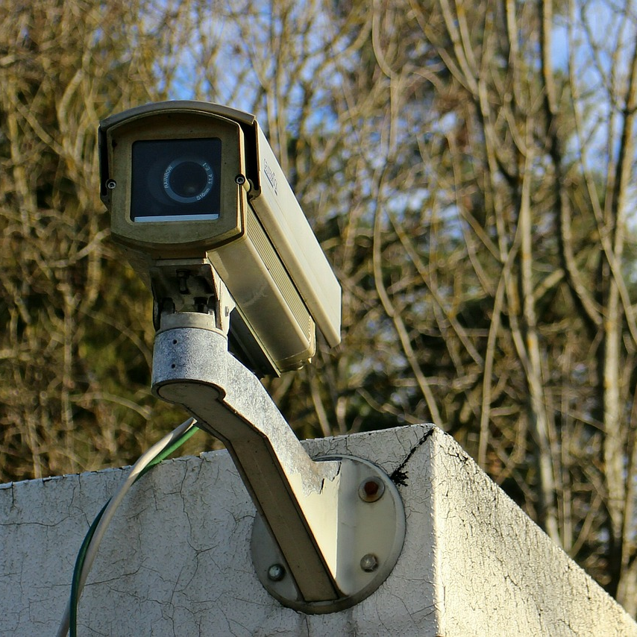
Smart Security System
Based on IoT
Prepared by:
Mr. Abdeljabbar Elassali
Mr. El Habib Jalyl
Prepared for:
Pr. Anas Bouayad

Slide 2


Overview
Problem
In 2018, almost 490,000 households reported having been the victim of a burglary or attempted burglary of their main residence, according to the Ministry of the Interior.
Solution
Smart Security System based on IoT.

Slide 3



Summary
Overview
Required parts
Architecture
Function
Schematic diagram
Demonstration
Conclusion

Slide 4

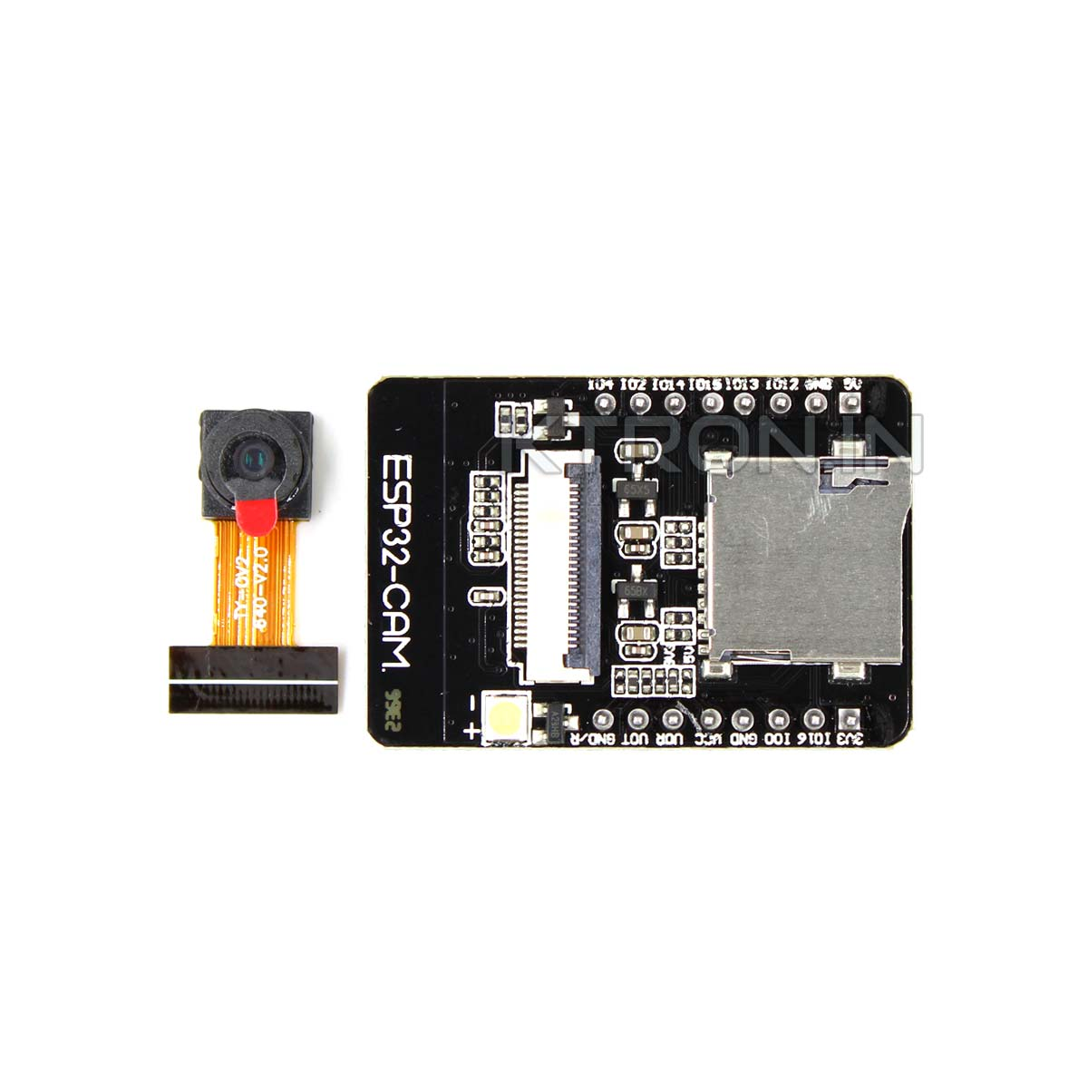
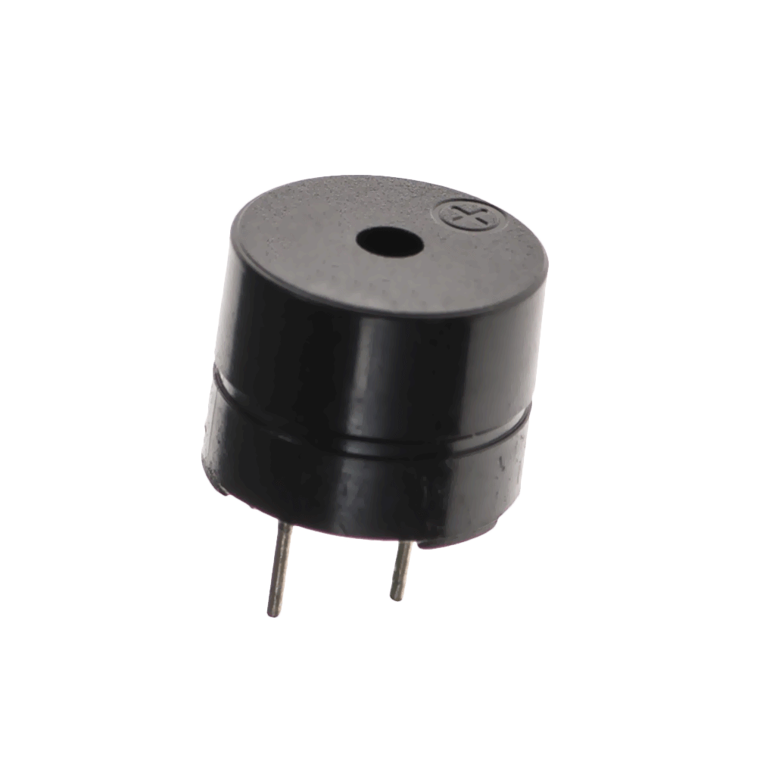

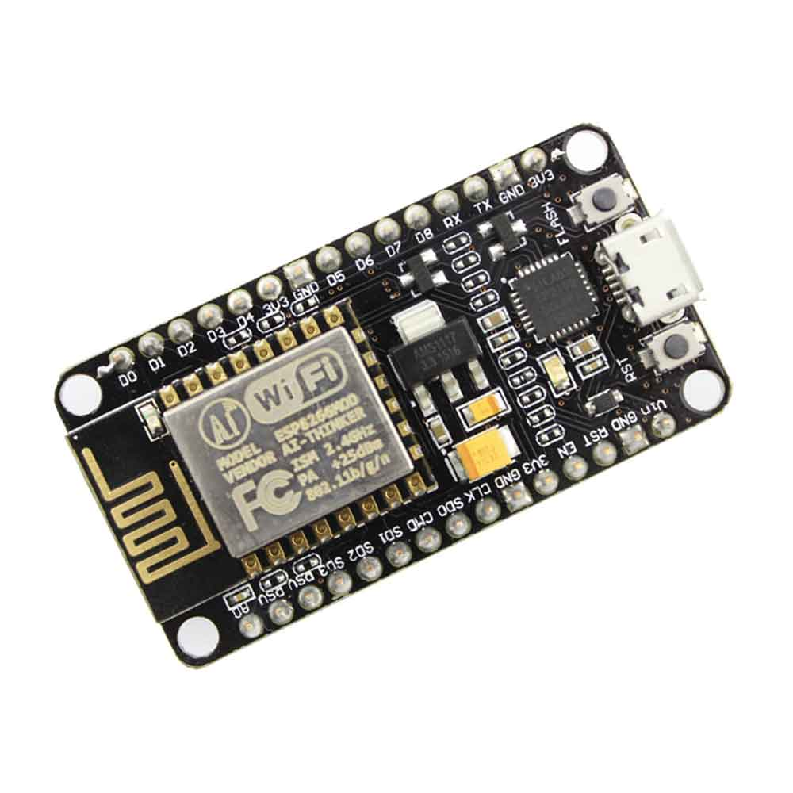
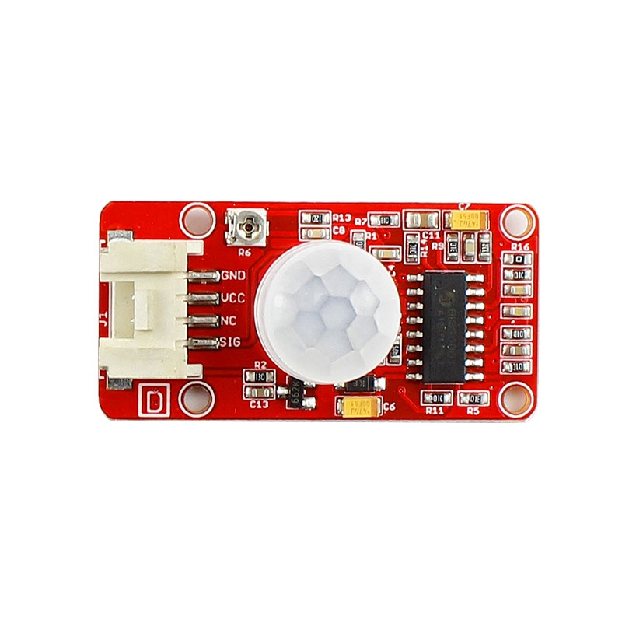
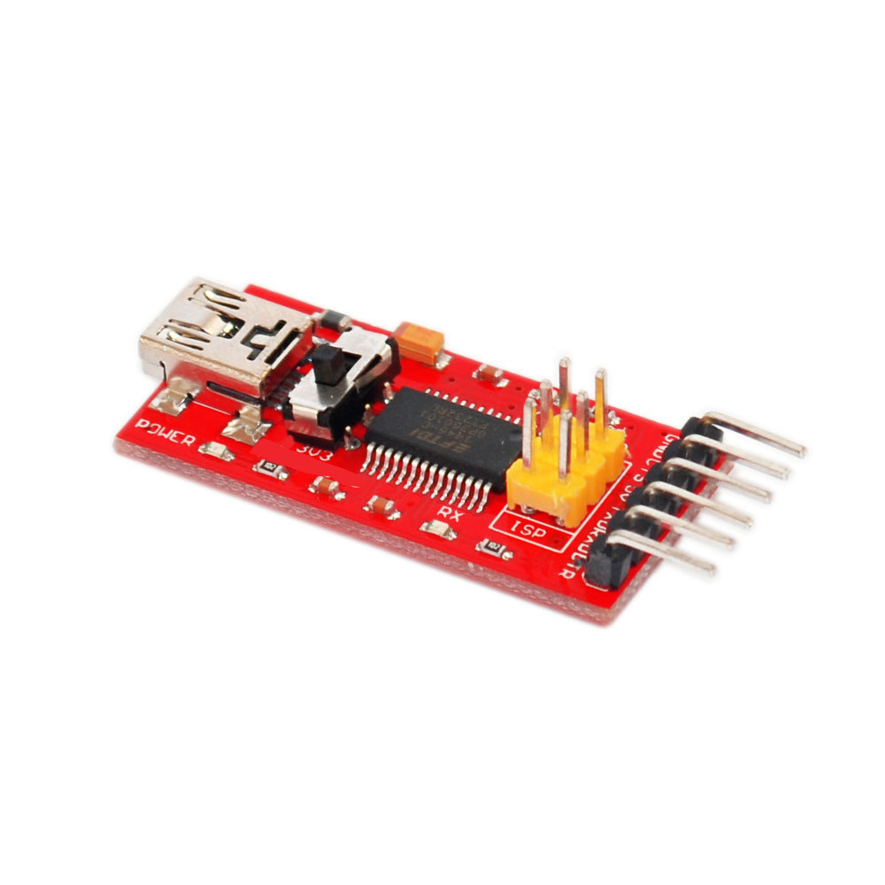

Required parts
Buzzer
ESP32-CAM
ESP8266
Sensor Motion
FTDI Programmer
LED

Slide 5









Architecture
subscribe
Node 2
ESP32 CAM
publish
Node 1
MQTT Server
ESP8266
PIR
Motion
sensor
LED
Buzzer
ON
Alarm
Telegram

Slide 6

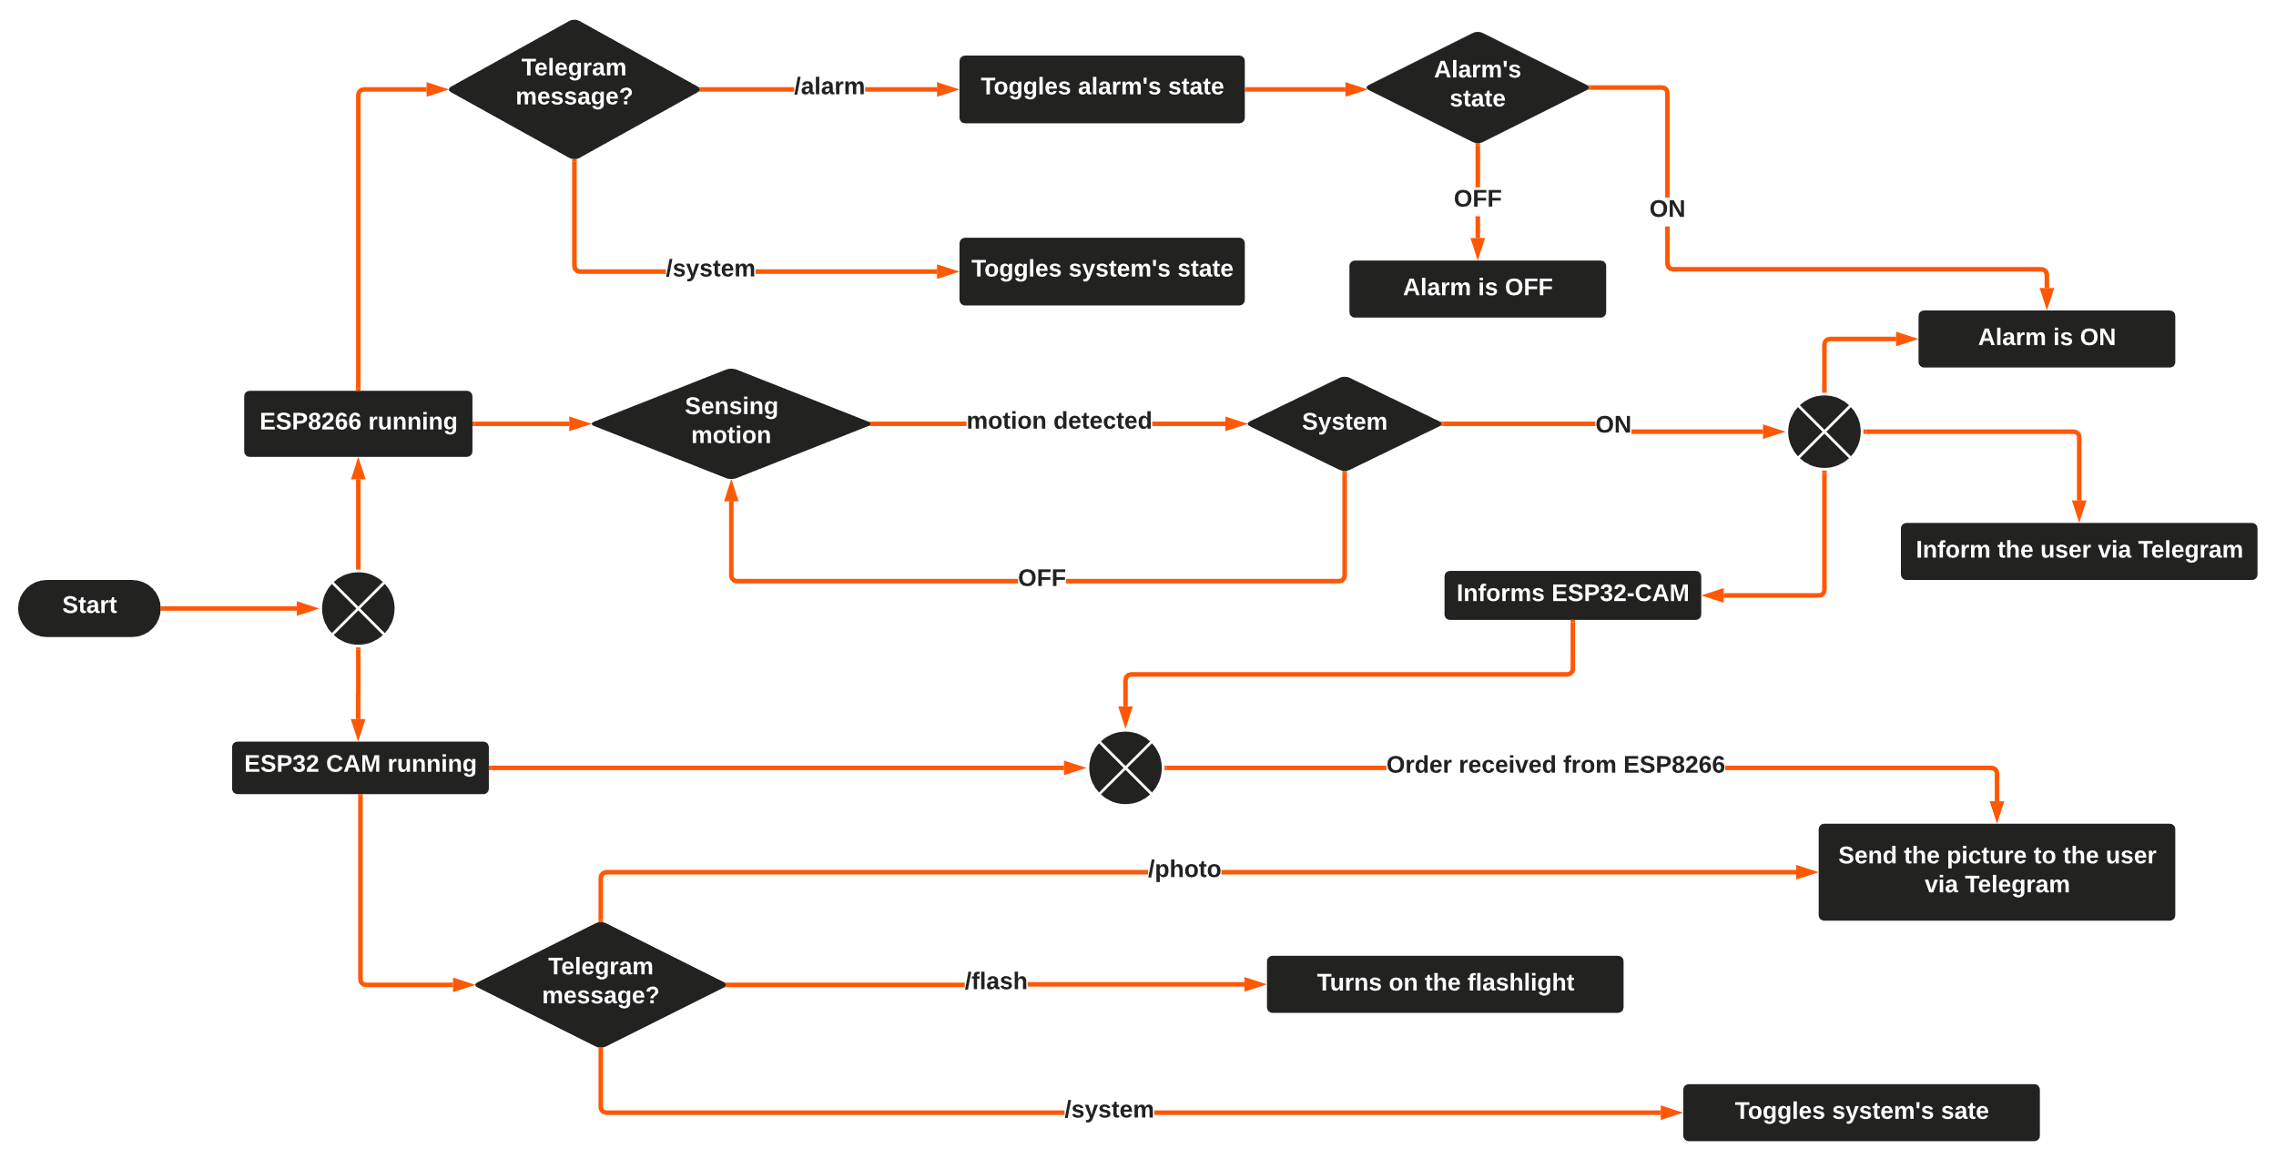
Function

Slide 7


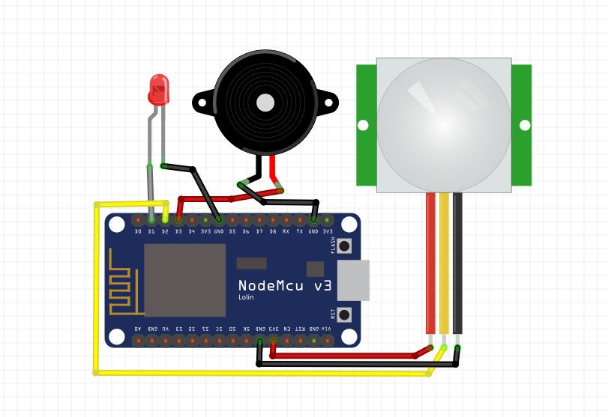

Schematic diagram
ESP8266 circuit
LED
Buzzer
PIR Sensor Motion

Slide 8
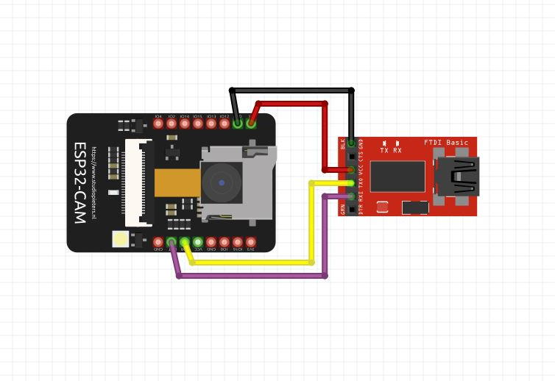
Schematic diagram
ESP32 CAM circuit
FTDI programmer

Slide 9

Demonstration

Slide 10


Conclusion

