Slide 1
CS60092 Information Retrieval Project
Title : Evidence Retrieval for fact verification
Members:
Agnibha Sinha (20EC10001)
Daksh Varshney (20EC10025)
Dhruv Rathi (20EC10098)
Kaushal Jadhav (20EC30019)

Slide 2
Problem Statement
Fact or claim verification is a two step process :
Evidence Retrieval
Claim Verification
In this project, we focus on the first step i.e. Evidence Retrieval

Slide 3
FEVER Dataset Description
id
The id of the claim
Training Data
SUPPORTS
label
The annotated label for the claim.
REFUTES
FEVER DATASET
NOT ENOUGH INFO
claim
The text of the claim.
evidence
A list of evidence sets.

Slide 4
Workflow
We removed the evidences which had the label not enough info
We compared the tokenized claims with the query using cosine similarity to rank them.
We train a LSTM model to classify the query as supported or refuted from evidences
Data Preprocessing
Cosine Similarity
LSTM
Tokenization
Document Retrieval
Fact Verification
We tokenized the claim using nltk tokenizer and removed stop words and stored it in a csv
After getting scores through cosine similarity, we take the top 5 documents
We also applied the FEVER scorer to check if the documents are relevant or not

Slide 5
Results
Labels | Precision | Recall | f1-score | Accuracy
Refute | 0.79 | 0.27 | 0.4 | 0.79
Support | 0.79 | 0.97 | 0.87

Slide 6
Project Demonstration
Now let’s see a live demonstration of the working code of the project.

Slide 7
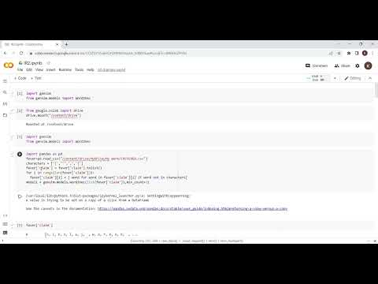

Slide 8
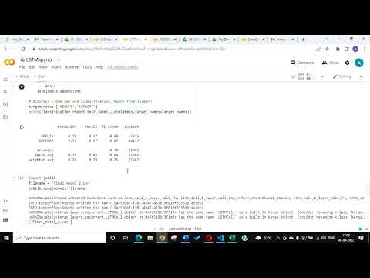

Slide 9
Work Distribution
Team member | Contributions
Agnibha Sinha | Code for verification using LSTM & made the report and helped in presentation
Daksh Varshney | Code for tokenization. Made presentation and helped with report.
Dhruv Rathi | Code for Data pre-processing. Helped with presentation and report.
Kaushal Jadhav | Code for FEVER scorer and document retrieval using cosine similarity.Helped with presentation and report.

Slide 10
What we learnt in this project?
Document Retrieval
1
Fact Verification
2
Proper Documentation
3
Analysing Research Papers
4
Teamwork
5

Slide 11
Thank You
Now we are open to questions

