Slide 1

Critical Thinking and Data Analysis

Slide 2
What is critical thinking?
“Critical thinking is reasonable, reflective thinking that is focused on deciding what to believe and what to do" – Robert Ennis
“Critical thinking is skillful, responsible thinking that is conductive to good judgement because it is sensitive to context, relies on criteria, and is self-correcting” – Matthew Lipman
“Critical thinking is thinking about your thinking, while you’re thinking, in order to make your thinking better” – Richard Paul

Slide 3
Features of critical thinking
Critical thinking is reflective: involves thinking about your thinking
Critical thinking involves standards: creating criteria for judgement
Critical thinking is authentic: involves thinking about real, “ill-posed” problems, where answers are not trivial
Critical thinking is reasonable/thoughtful/mindful/flexible: sensitive to context, goals and other realities
Critical thinking is not (necessarily) emotionless
Critical thinking is not fast
Notes:
Critical thinking is not (necessarily) negative
people have proposed using the term “effective thinking” or “clear thinking”
Critical thinking is not (necessarily) emotionless
Joy of discovery, weight of crucial decisions
Want to avoid emotions that can decrease clarity (e.g., rage, panic)

Slide 4
Three parts of critical thinking
Critical thinking involves asking questions
Critical thinking involves trying to answer those question by reasoning them out
Critical thinking involves believing the result of our reasoning

Slide 5
One more thought
“… guard against the idea that having no questions shows you understand something. For any subject matter that is at all complicated, the opposite is the case: If no questions arise for you, it probably means you do not understand it deeply enough to see the many paths of questioning that arise.”
- Nosich (2012)

Slide 6
Some background on data

Slide 8
Object: An individual unit of observation/measurement
  E.g., one student, one playing card, one shape

Slide 9
Population: A set of objects (units of measurements)
  E.g., a class of students, a deck of playing cards, a collection of shapes (1-30)

Slide 10
Sample: A subset of objects (units of measurements)
  E.g., one lab section of students, half a deck of playing cards, a subset of the shapes (1, 2, 9, 10, 26)

Slide 11



$$y$$
$$(x_{1},y_{1})$$
$$x$$
Property: a descriptor/characteristic/measurement of an object
  E.g., a student’s GPA, a student’s program, the suit of playing cards, the position of the shape

Slide 12
Constant: a property that stays the same across all objects in the set
Variable: a property that differs across some objects in the set

Slide 13
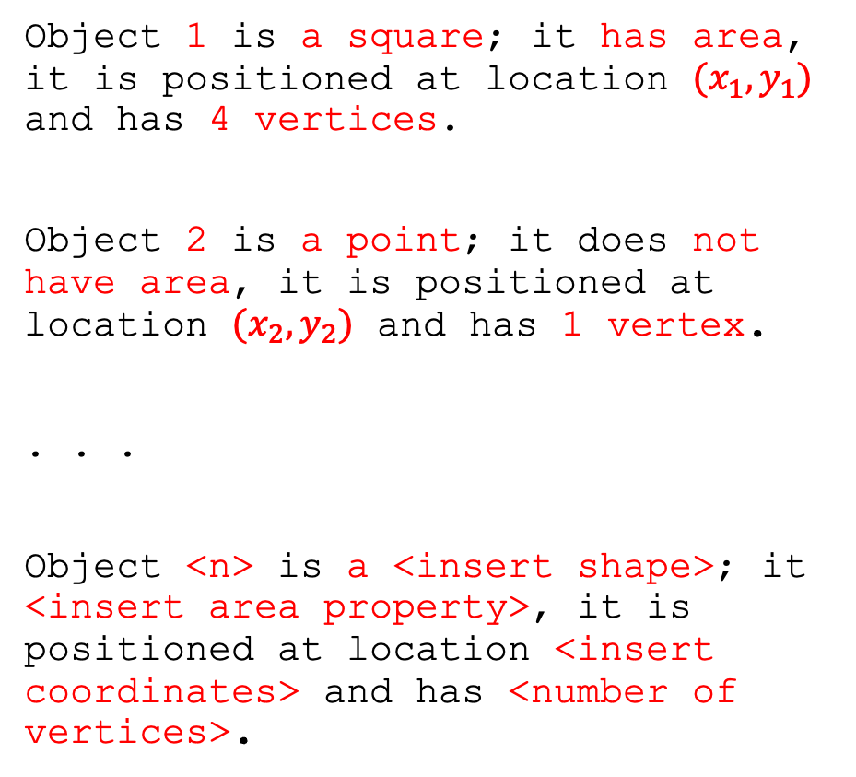
Datum – an individual piece of information
Data – multiple pieces of information; a collection of datum
Structured data – data that has predictable structure; can be readily analyzed
Unstructured data – data that has unpredictable structure; must be processed prior to analysis
Object 1 is a square; it has area, it is positioned at location $(x_{1},y_{1})$ and has 4 vertices.
Object 2 is a point; it does not have area, it is positioned at location $(x_{2},y_{2})$ and has 1 vertex.
. . .
Object <n> is a <insert shape>; it <insert area property>, it is positioned at location <insert coordinates> and has <number of vertices>.

Slide 14
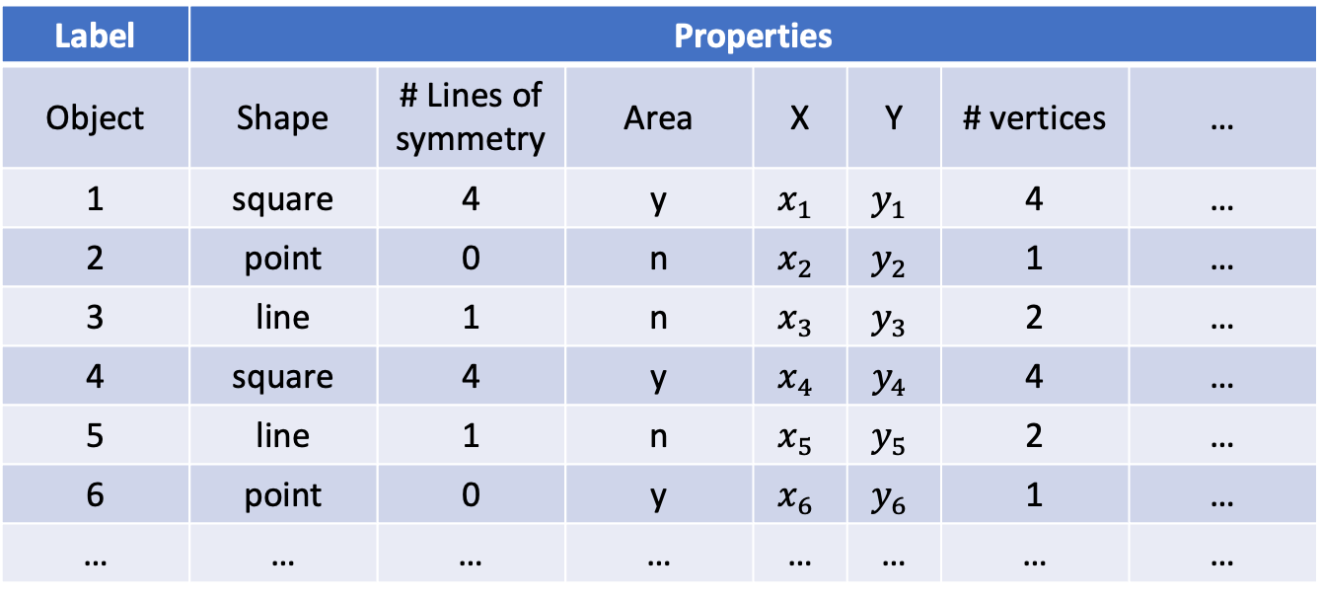
Usually not written down
Label | Properties
Object | Shape | # Lines of symmetry | Area | X | Y | # vertices | …
1 | square | 4 | y | $$x_{1}$$ | $$y_{1}$$ | 4 | …
2 | point | 0 | n | $$x_{2}$$ | $$y_{2}$$ | 1 | …
3 | line | 1 | n | $$x_{3}$$ | $$y_{3}$$ | 2 | …
4 | square | 4 | y | $$x_{4}$$ | $$y_{4}$$ | 4 | …
5 | line | 1 | n | $$x_{5}$$ | $$y_{5}$$ | 2 | …
6 | point | 0 | y | $$x_{6}$$ | $$y_{6}$$ | 1 | …
… | … | … | … | … | … | … | …
header
data
matrix
data
Number of properties for each object = dimensionality
Data matrix: a standard format for recording and organizing the properties of objects in a sample/population (1 row of header information plus the data)

Slide 15
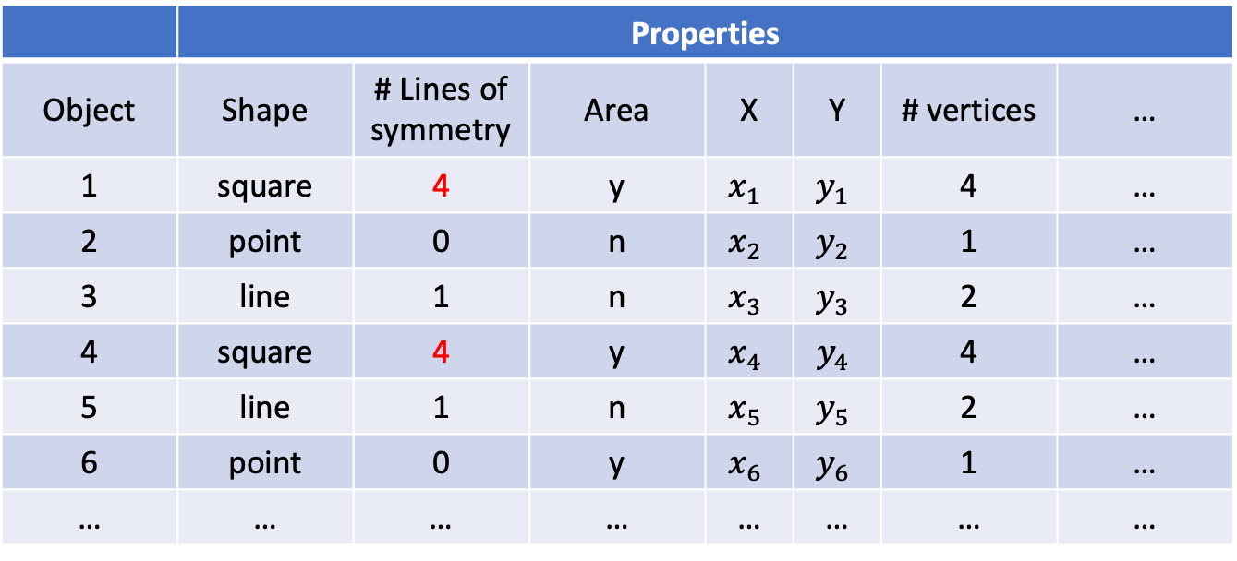
Dichotomous/binary variable
 | Properties
Object | Shape | # Lines of symmetry | Area | X | Y | # vertices | …
1 | square | 4 | y | $$x_{1}$$ | $$y_{1}$$ | 4 | …
2 | point | 0 | n | $$x_{2}$$ | $$y_{2}$$ | 1 | …
3 | line | 1 | n | $$x_{3}$$ | $$y_{3}$$ | 2 | …
4 | square | 4 | y | $$x_{4}$$ | $$y_{4}$$ | 4 | …
5 | line | 1 | n | $$x_{5}$$ | $$y_{5}$$ | 2 | …
6 | point | 0 | y | $$x_{6}$$ | $$y_{6}$$ | 1 | …
… | … | … | … | … | … | … | …
Nominal data: data that can be be categorized in discrete categories where order of category has no significance

Slide 16
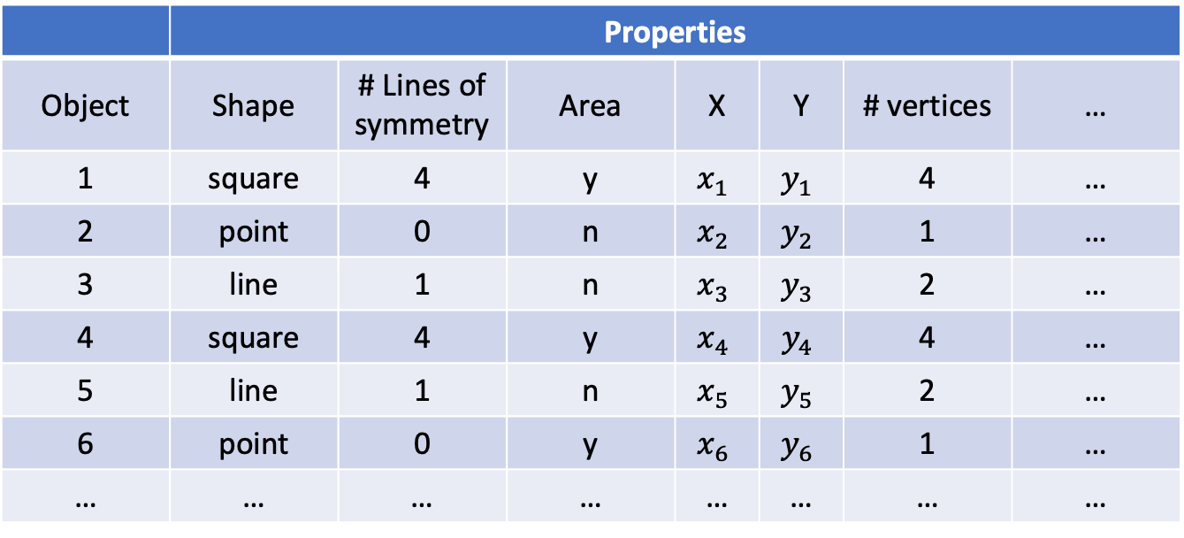
 | Properties
Object | Shape | # Lines of symmetry | Area | X | Y | # vertices | …
1 | square | 4 | y | $$x_{1}$$ | $$y_{1}$$ | 4 | …
2 | point | 0 | n | $$x_{2}$$ | $$y_{2}$$ | 1 | …
3 | line | 1 | n | $$x_{3}$$ | $$y_{3}$$ | 2 | …
4 | square | 4 | y | $$x_{4}$$ | $$y_{4}$$ | 4 | …
5 | line | 1 | n | $$x_{5}$$ | $$y_{5}$$ | 2 | …
6 | point | 0 | y | $$x_{6}$$ | $$y_{6}$$ | 1 | …
… | … | … | … | … | … | … | …
Ordinal data: data that can be be categorized in discrete categories where order of category has significance

Slide 17
 | Properties
Object | Shape | # Lines of symmetry | Area | X | Y | # vertices | …
1 | square | 4 | y | $$x_{1}$$ | $$y_{1}$$ | 4 | …
2 | point | 0 | n | $$x_{2}$$ | $$y_{2}$$ | 1 | …
3 | line | 1 | n | $$x_{3}$$ | $$y_{3}$$ | 2 | …
4 | square | 4 | y | $$x_{4}$$ | $$y_{4}$$ | 4 | …
5 | line | 1 | n | $$x_{5}$$ | $$y_{5}$$ | 2 | …
6 | point | 0 | y | $$x_{6}$$ | $$y_{6}$$ | 1 | …
… | … | … | … | … | … | … | …
Continuous data: data that can take on any value within a range

Slide 18
Case Study 1: Does shot gun brand effect pellet scatter pattern?
Target | gun | range | sqrt.area | Target | gun | range | sqrt.area | Target | gun | range | sqrt.area
1 | Stevens | 40 | 12.54 | 21 | Stevens | 20 | 6.96 | 41 | Stevens | 40 | 11.03
2 | Remington | 40 | 13.01 | 22 | Stevens | 20 | 6.32 | 42 | Stevens | 30 | 8.24
3 | Remington | 50 | 13.13 | 23 | Stevens | 40 | 11.47 | 43 | Remington | 20 | 5.73
4 | Stevens | 50 | 13.74 | 24 | Remington | 50 | 17.47 | 44 | Stevens | 30 | 7.38
5 | Remington | 10 | 3.29 | 25 | Stevens | 20 | 6.84 | 45 | Stevens | 10 | 2.6
6 | Remington | 30 | 7.95 | 26 | Stevens | 10 | 3.06 | 46 | Remington | 50 | 16.07
7 | Remington | 40 | 10.81 | 27 | Stevens | 10 | 3.35 | 47 | Remington | 50 | 14.9
8 | Stevens | 40 | 16.13 | 28 | Remington | 40 | 10.19 | 48 | Stevens | 20 | 6.29
9 | Remington | 10 | 3.01 | 29 | Remington | 20 | 5 | 49 | Stevens | 50 | 16.94
10 | Remington | 20 | 5.1 | 30 | Remington | 30 | 8.09 | 50 | Stevens | 50 | 14.09
11 | Stevens | 10 | 3.38 | 31 | Remington | 40 | 11.17 | 51 | Remington | 10 | 3.02
12 | Remington | 10 | 3.2 | 32 | Remington | 20 | 5.29 | 52 | Stevens | 20 | 5.85
13 | Remington | 30 | 8.62 | 33 | Remington | 50 | 14.21 | 53 | Stevens | 20 | 5.95
14 | Remington | 10 | 3.11 | 34 | Remington | 50 | 11.93 | 54 | Stevens | 50 | 20.13
15 | Remington | 40 | 11.33 | 35 | Stevens | 40 | 14.1 | 55 | Stevens | 10 | 3.33
16 | Stevens | 40 | 10.28 | 36 | Remington | 20 | 5.57 | 56 | Stevens | 30 | 6.72
17 | Stevens | 30 | 6.51 | 37 | Remington | 30 | 8.62 | 57 | Remington | 10 | 3
18 | Stevens | 30 | 9.84 | 38 | Remington | 30 | 8.41 | 58 | Remington | 20 | 5.42
19 | Remington | 30 | 6.8 | 39 | Stevens | 50 | 5.18 | 59 | Remington | 40 | 9.35
20 | Stevens | 10 | 3.85 | 40 | Stevens | 30 | 9.42 | 60 | Stevens | 50 | 11.8
Notes:
60 objects in our population, we have 3 properties per object (the shot gun brand used to shoot at the target), the distance from which the object was shot

Slide 19
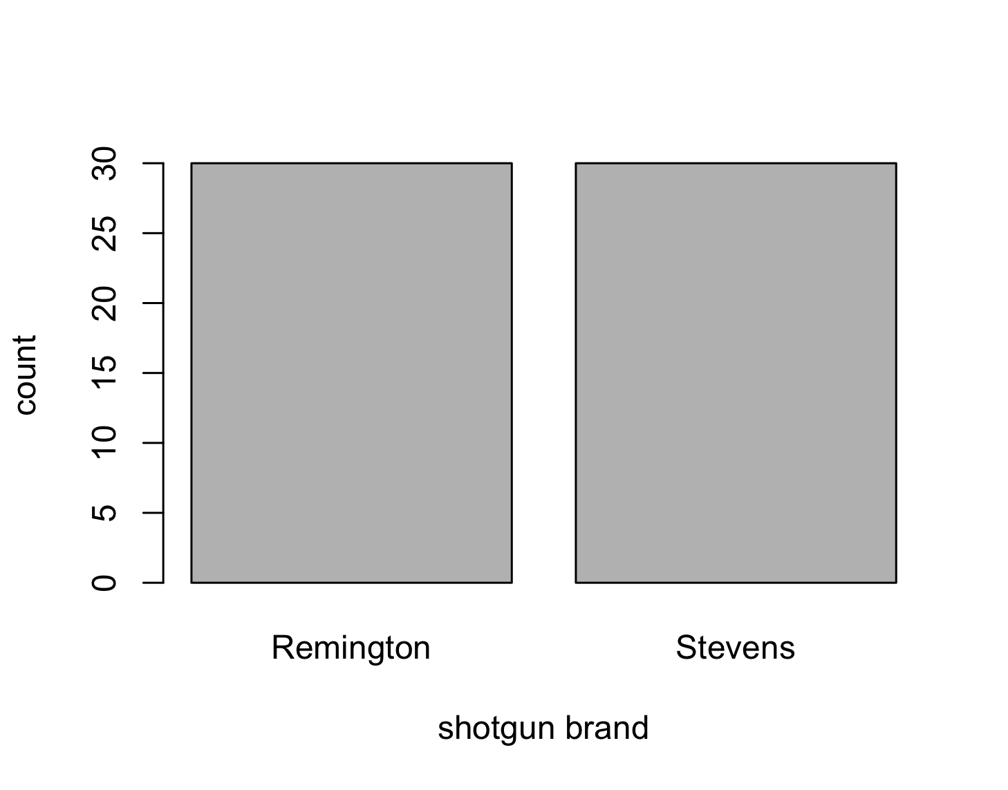
Univariate Categorical Data
A bar chart or bar plot is a popular method for showing counts of categorical variables
  Can be drawn horizontally or vertically
  In a vertical bar plot (like the one shown here), height of bars indicate count and widths of bars have no meaning
  Can potentially show multiple categorical variables on a single “stacked” bar plot

Slide 20
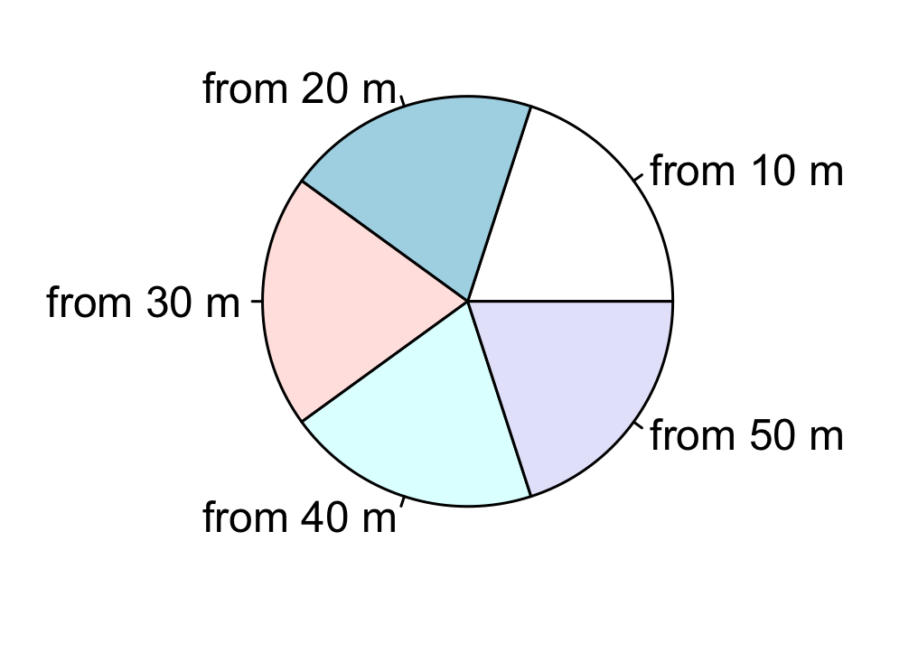
Univariate Categorical Data
A pie chart is a popular method for showing counts of categorical variables
  Area of pie is proportional to count
  Can only show a single variable
Same information can often be transmitted more precisely and as easily using a table

Slide 21
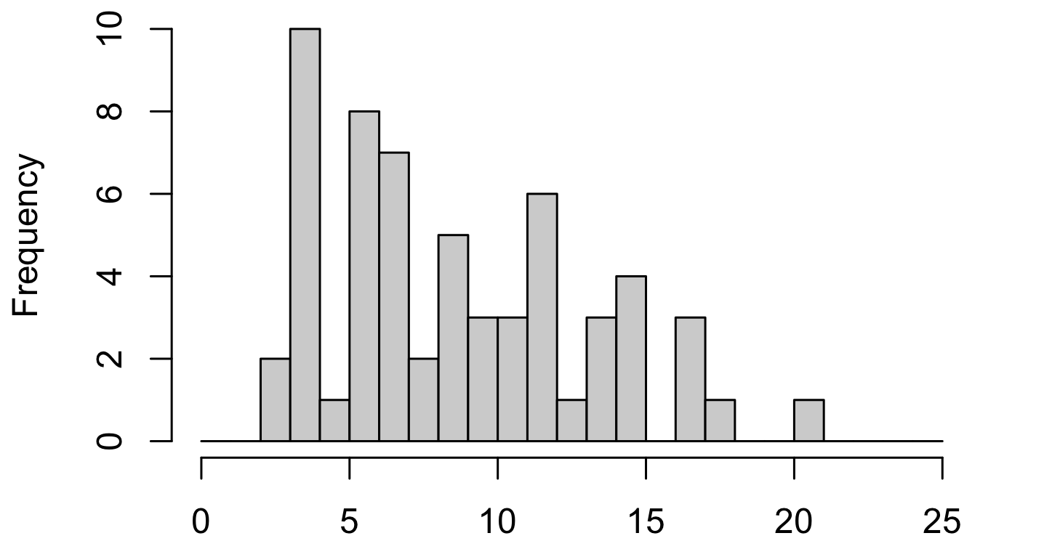
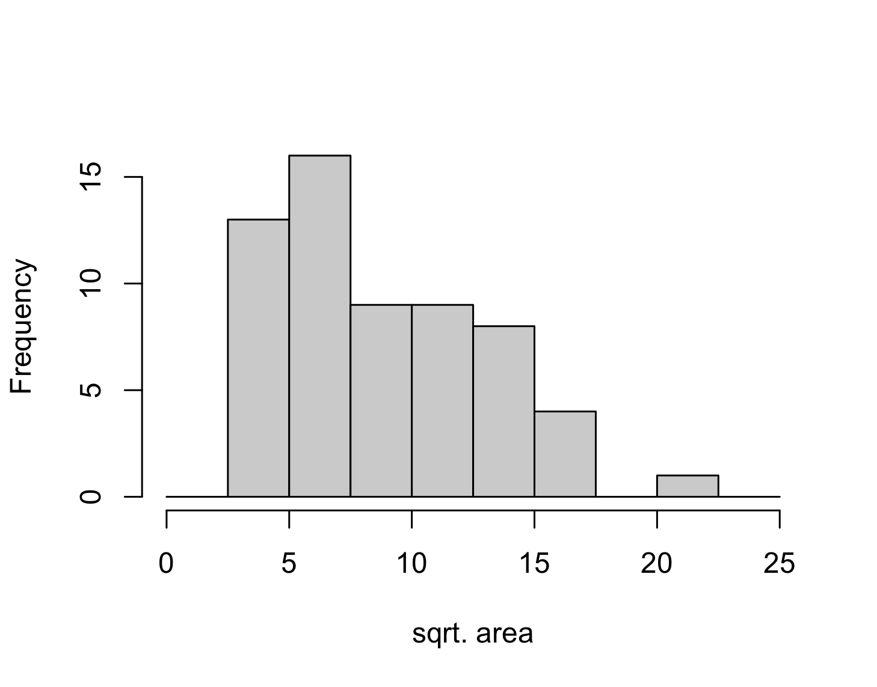
Univariate Numeric Data
A histogram is a very popular method for summarizing the count of numeric data for a single variable
  Most commonly vertical (as shown to the right) but can be drawn horizontally
  Bar widths tell us something about how the numeric variable (the x-axis) is discretized, and the bar height tells us the count

Slide 22
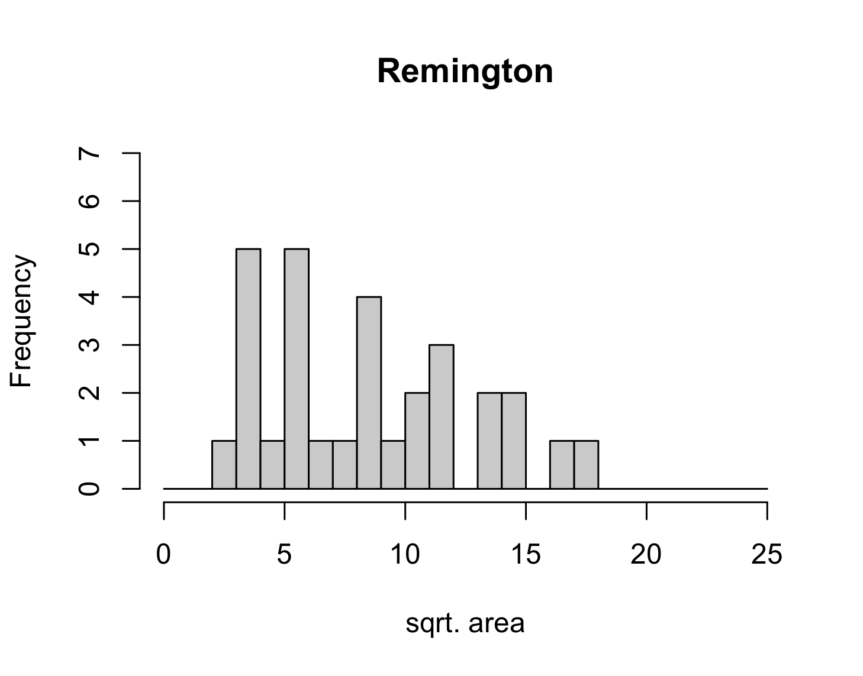
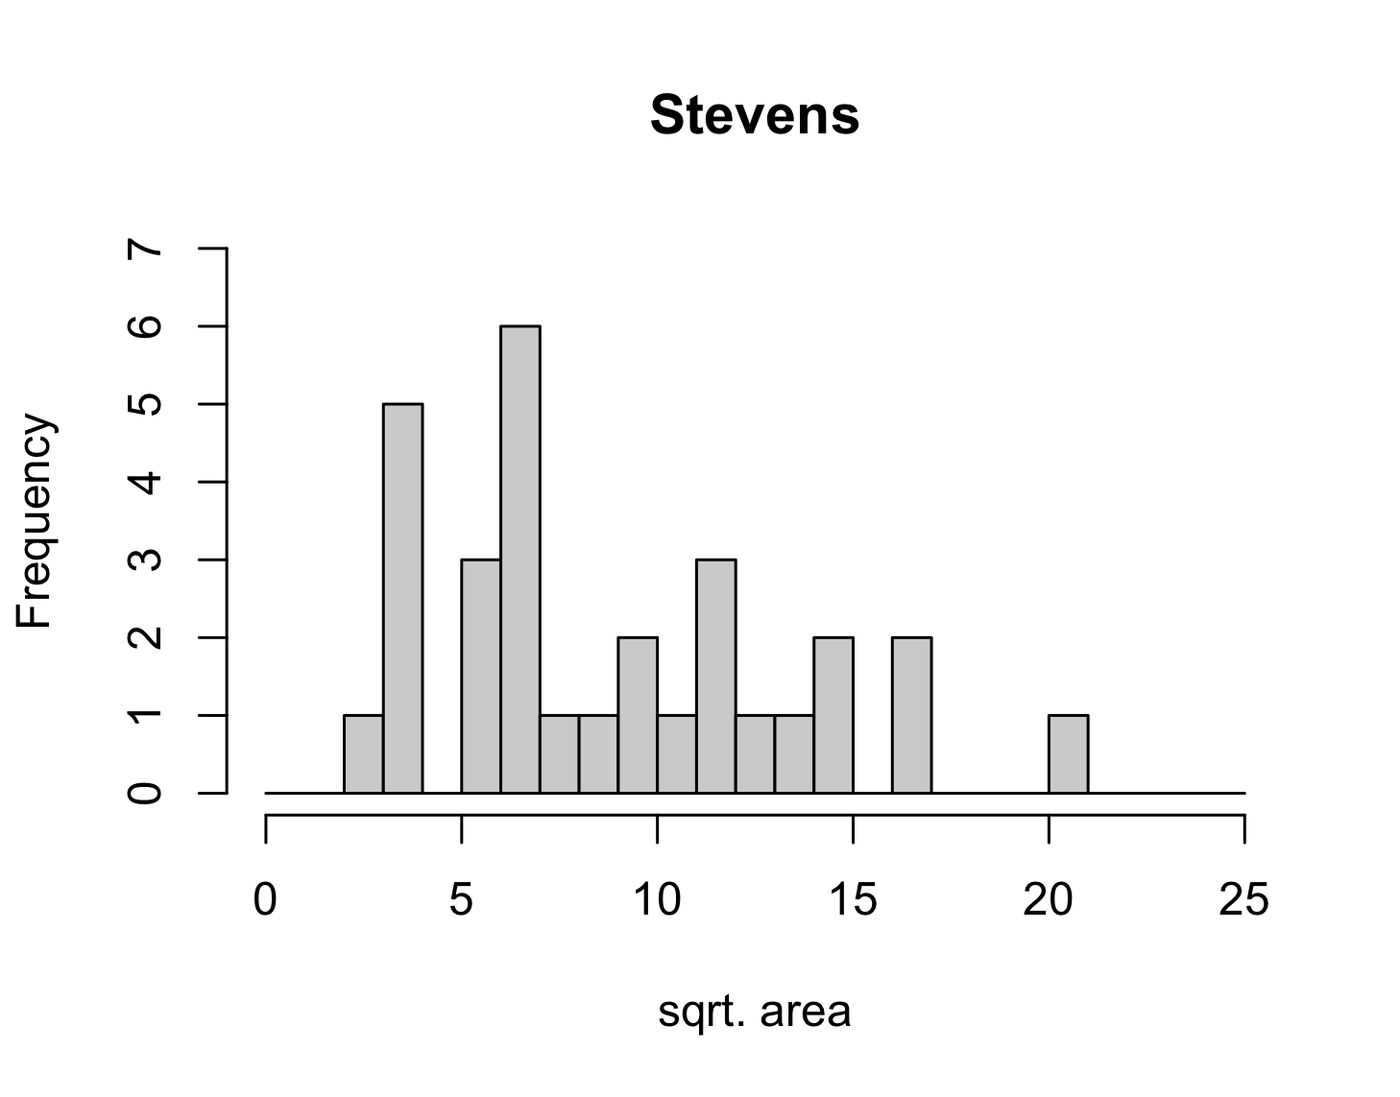
Two-dimensions (number vs category)
Can parse your data on categories and create several “univariate numeric data” problems.

Slide 23
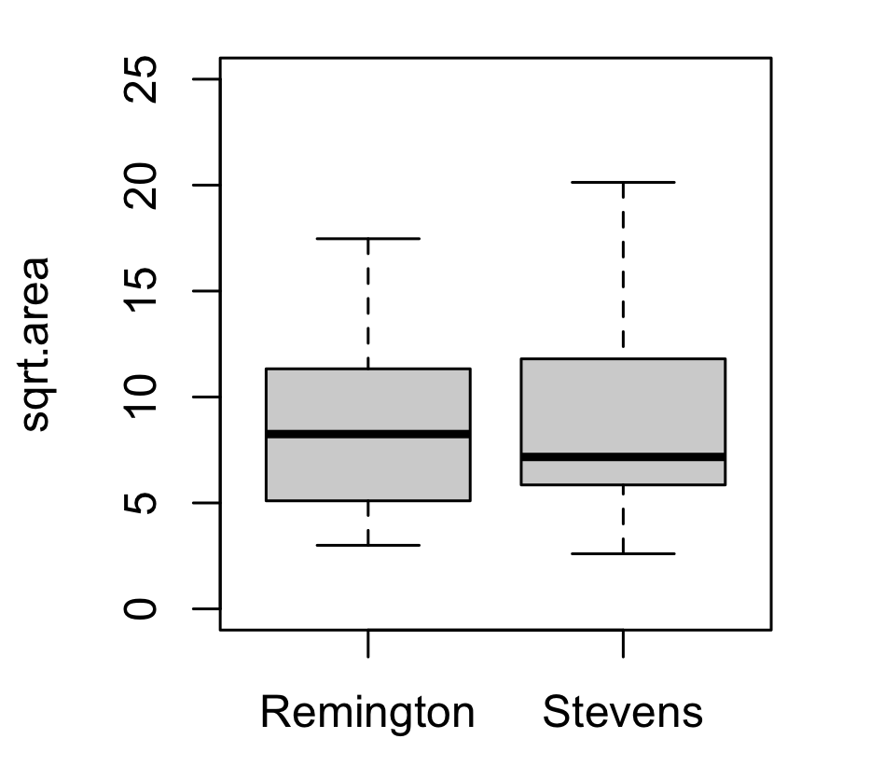
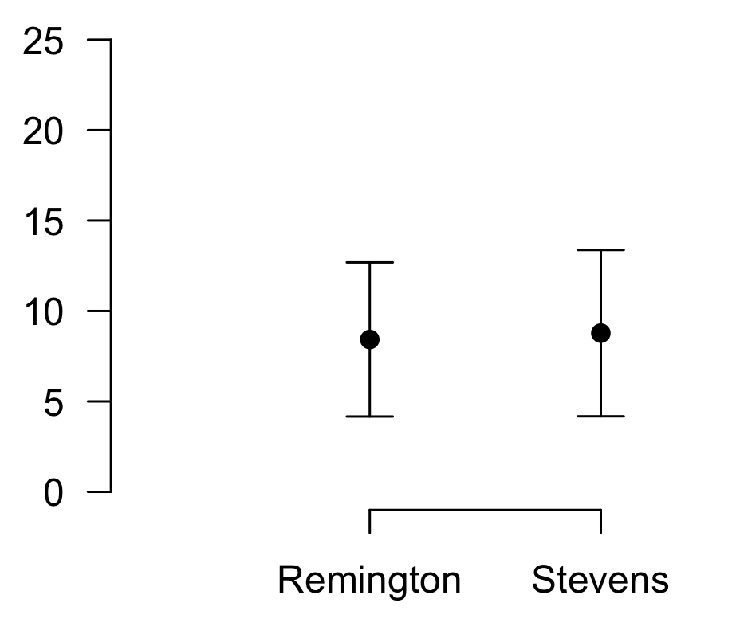
Two-dimensions (number vs category)
A boxplot is a good method for comparing numeric data with respect to a categories
Sometimes referred to as a box and whisker plot
Each “box and whisker” is constructed using summary statistics (based on the histogram) for the numeric variable for each category

Slide 24
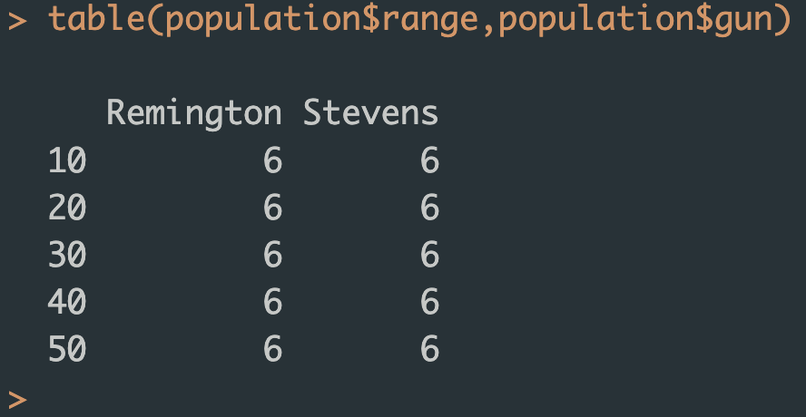
Two-dimensions (category vs category)
A contingency table is a good method for comparing the counts of two categorical variables in the data set

Slide 25
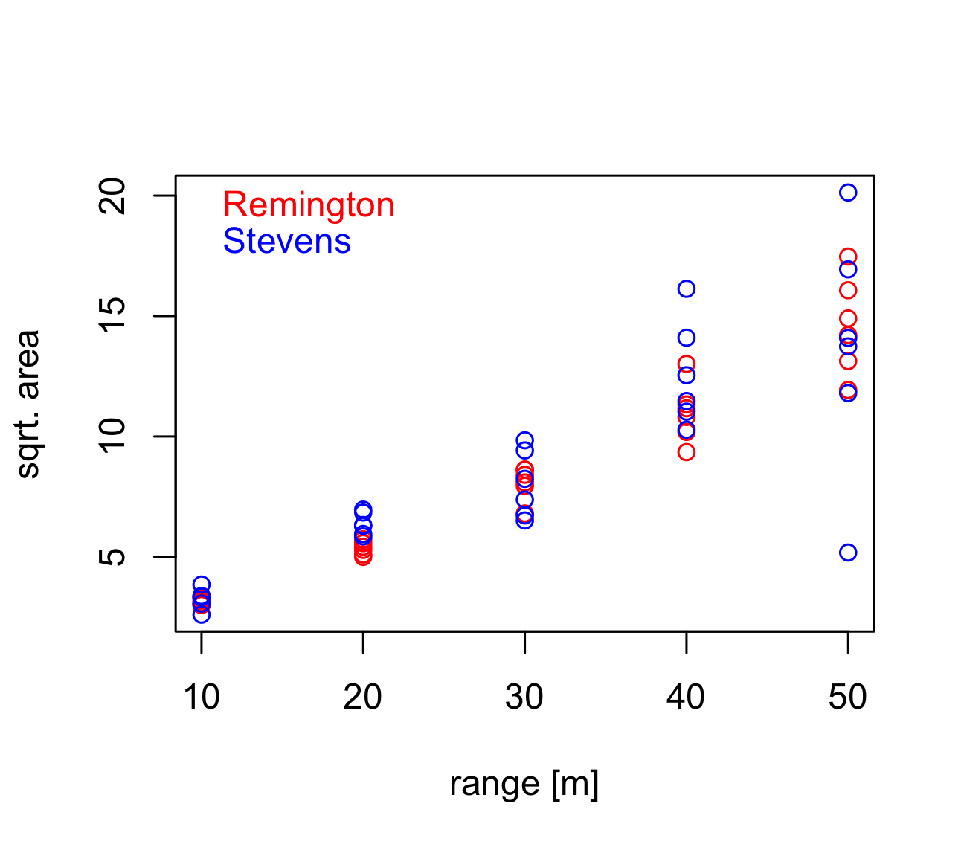
Two-dimensions (number vs number)
A scatter plot is a good method for comparing two numeric properties of the observations in the data set
Can also display more information if you are creative with marker shapes, sizes, and colours
  Numeric Dimension 1 = x position
  Numeric Dimension 2 = y position
  Numeric Dimension 3 = marker size
  Categorical Dimension 1 = marker colour
  Categorical Dimension 2 = marker shape

Slide 26
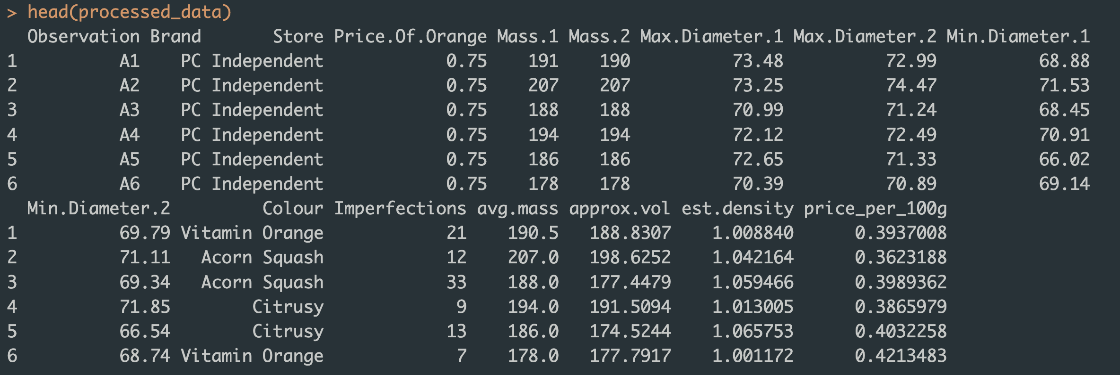
Case Study 2: Which store in Peterborough sells the best oranges?
Notes:
40 objects in our population, we have 2 fixed properties (independent variables),

Slide 27
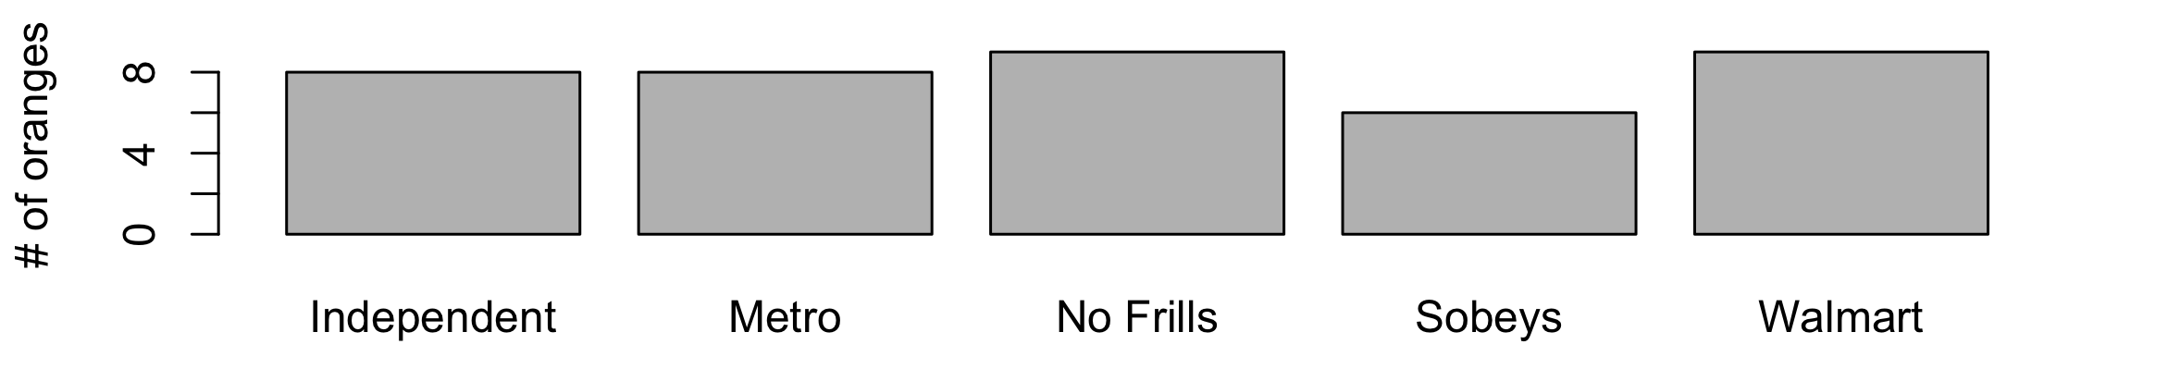
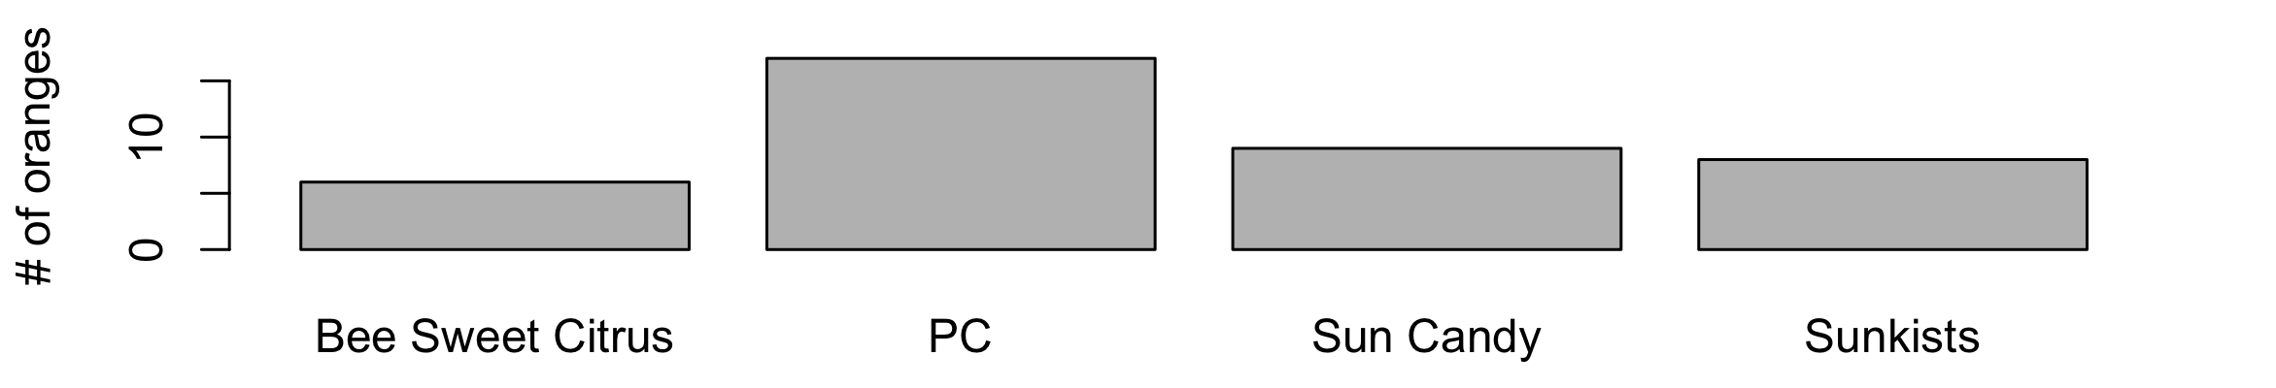
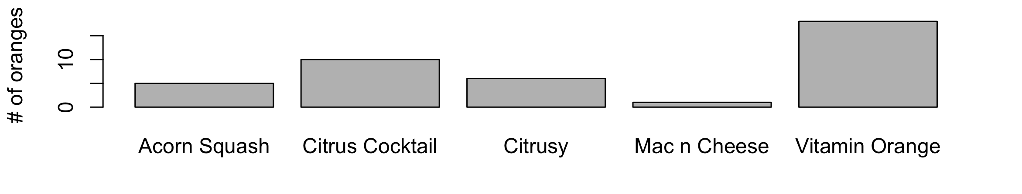
Univariate Categorical Data
By Store
By Brand
By Colour

Slide 28
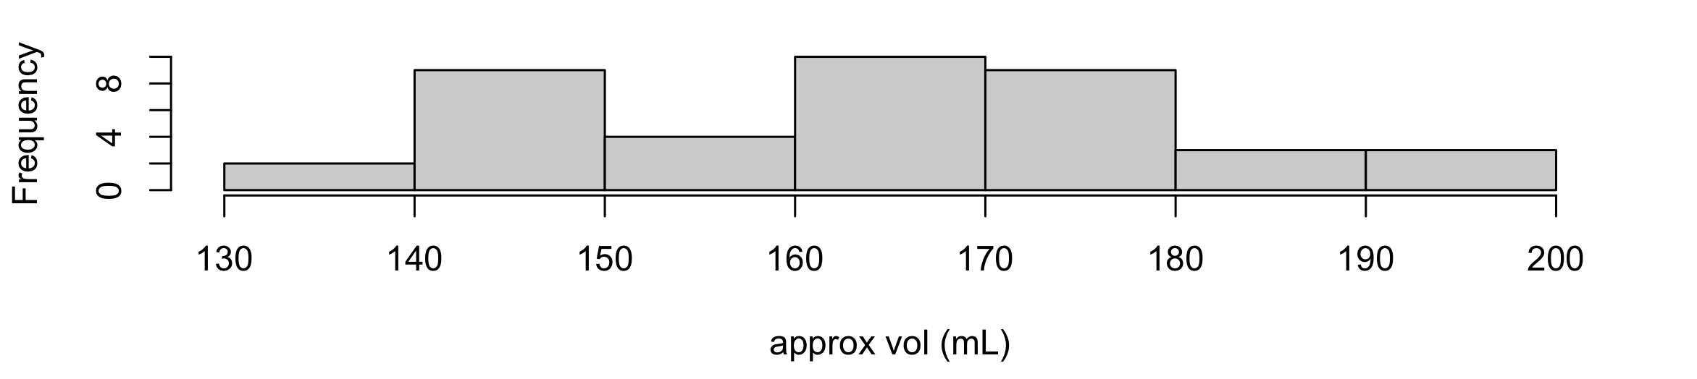
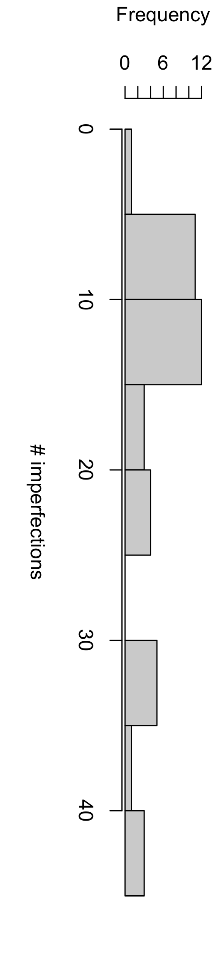
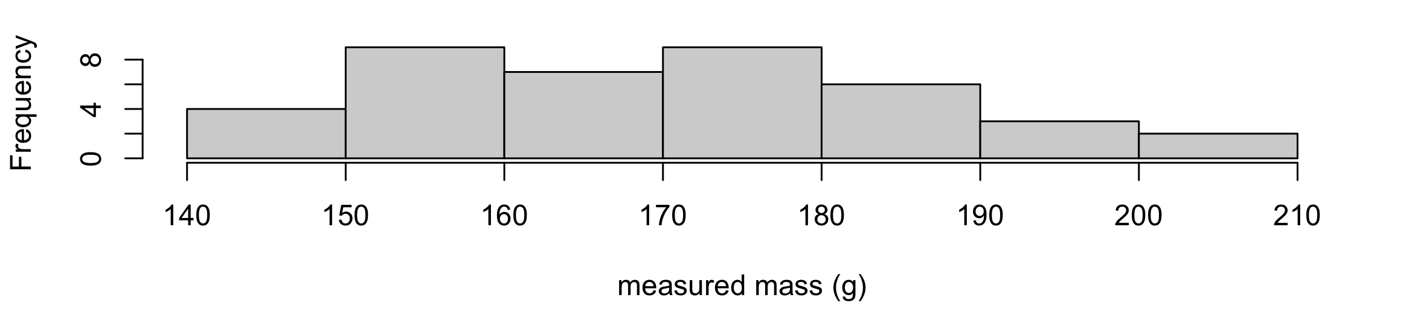
Univariate Numerical Data

Slide 29
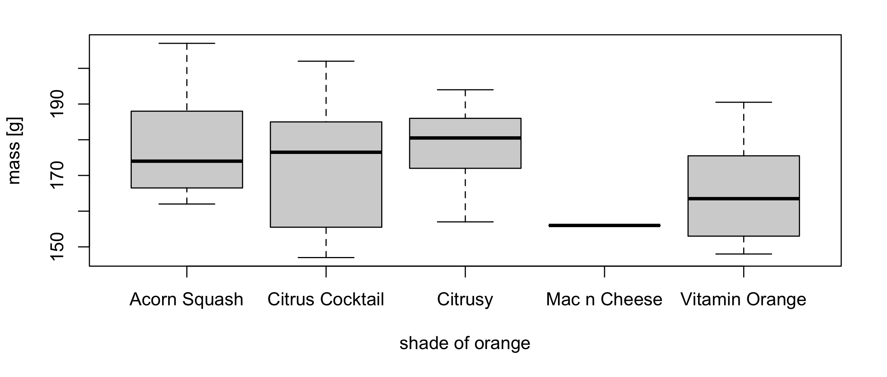
Two-dimensions (number vs. category)

Slide 30
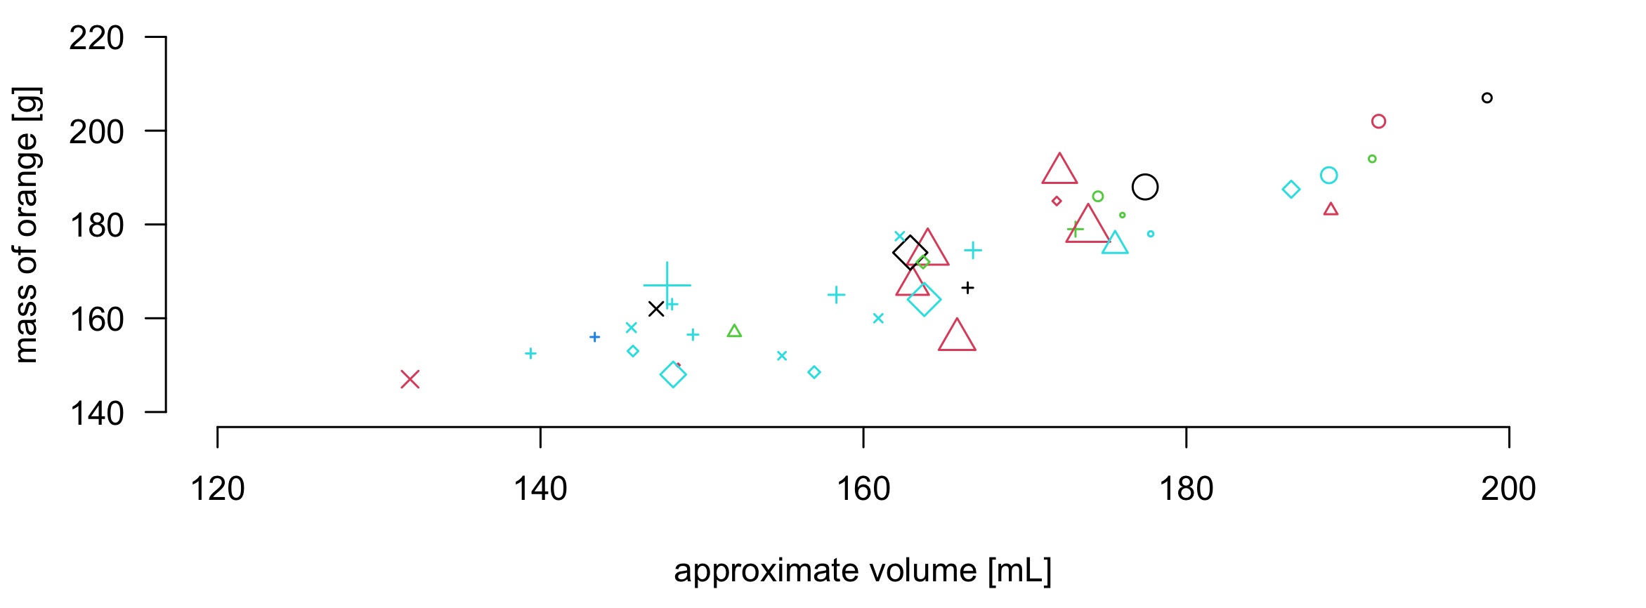
Multivariate mixed data
A scatter plot of 40 oranges studied by the 2025 MScFS students in FRSC 5003: position on the x-axis is the orange’s approximate volume, position on the y-axis is its measured mass, the shape of the symbol indicates from what store it was purchased, the symbol color indicates its shade of orange, and the symbol size is proportional to the observed number of imperfections.

Slide 31
Why visualize?
“A good graph is almost better than any statistical analysis” – J.M. Curran
“Graphics reveal data. Indeed, graphics can be more precise and revealing than conventional statistical computation” – E.R. Tufte
Graphics (drawings, plots, etc.) all help us analyze data AND communicate results
Important: A good graphic, like a good statistical analysis, requires good data

Slide 32
Tools for data visualization
All spreadsheet software (e.g., MS Excel, Google Sheets, Numbers) will have some basic plotting functionality
  Be careful that the software is plotting what you think its plotting (recommended plots can be misleading)
  Read the documentation carefully
Most programming languages (e.g., R, Python, Matlab) will have one or more “plotting” or “graphics” library so you can create plots with code
Several free cloud-based AI tools that allow you to create visuals
  Be careful to verify whether your data is secure and private

Slide 33
Created with Microsoft Excel
Created with Microsoft Excel

Slide 34
Created with Base R

Slide 35
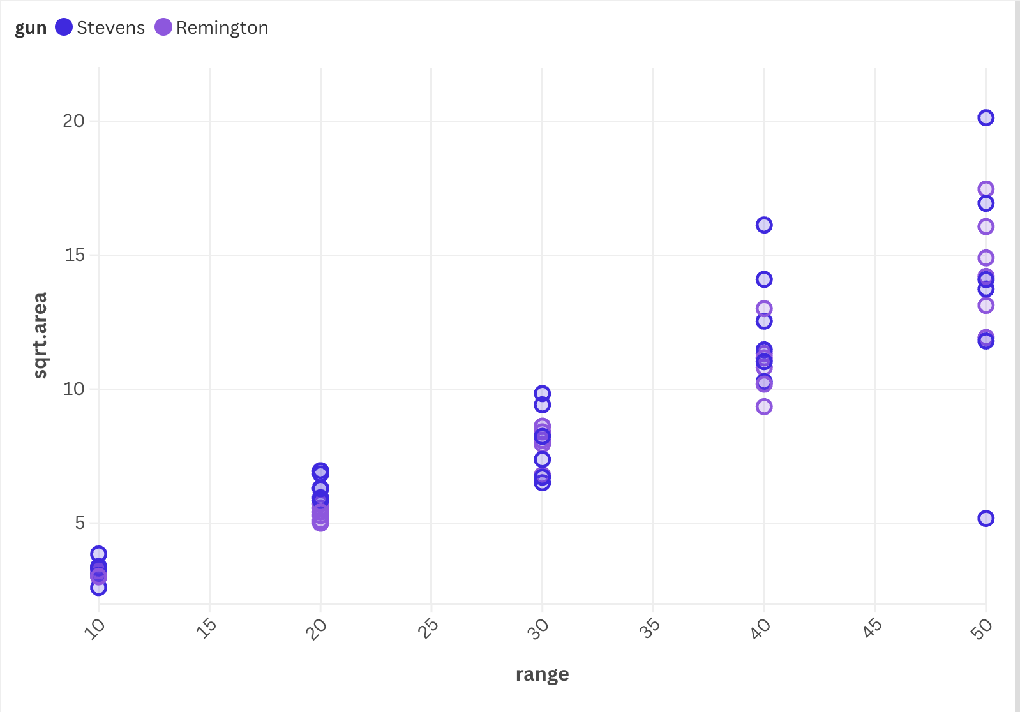
Created with Flourish

Slide 36
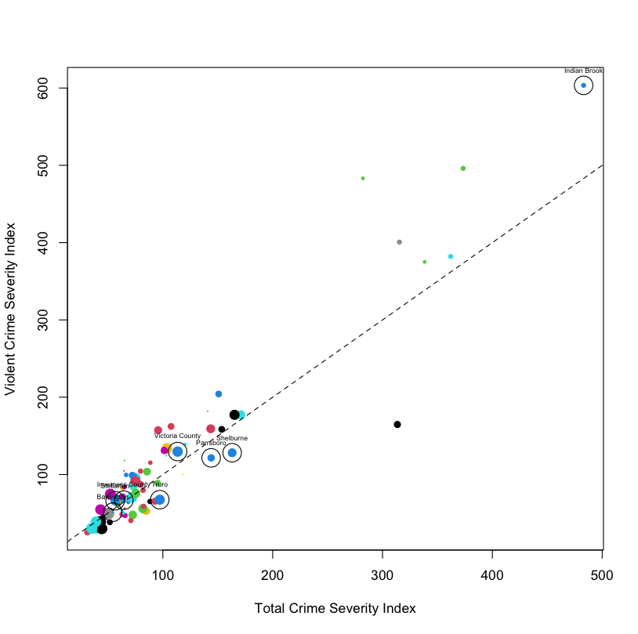
Enhancing plots
Several ways we can make plots more informative:
  Legends
  Lines of fit
    Linear
    Curves
    Loess
  Colors
  Texts, arrows, highlights
Figure captions and text descriptions are still essential

Slide 37
A review of probability
Probability: a formal measure of the certainty that a particular event or outcome will occur.
  Theoretical Probability: calculated through analysis of potential outcomes in a specific situation. Sometimes referred to as aleatoric probability.
    E.g., Probability of flipping a head with a fair coin is 1/2. The probability of rolling the same number with a pair of fair dice is 1/6.
  Empirical Probability: estimated from past measurements or observations (using statistical tools).
    E.g., As per available historical data, the probability of an eye-witness making an incorrect observation is 0.35. As per available historical data, the probability of it snowing in August in Peterborough is 0.0001.
    (I made these two numbers up...)

Slide 38
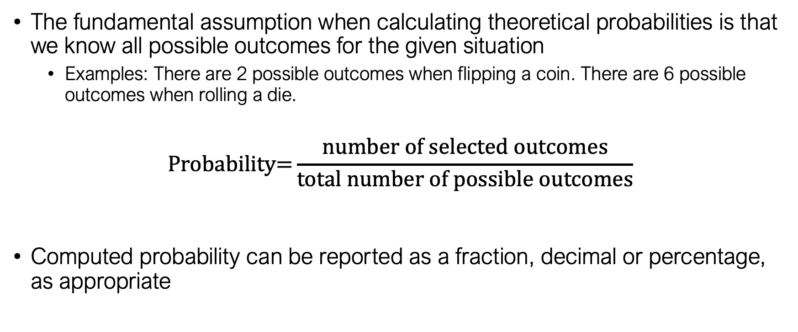
Calculating probabilities
The fundamental assumption when calculating theoretical probabilities is that we know all possible outcomes for the given situation
  Examples: There are 2 possible outcomes when flipping a coin. There are 6 possible outcomes when rolling a die.
$$\text{Probability=}\frac{\text{number of selected outcomes}}{\text{total number of possible outcomes}}$$
Computed probability can be reported as a fraction, decimal or percentage, as appropriate

Slide 39
Calculating probabilities
Example 1: A deck of playing cards contains four suits – spades and clubs, which are black, and diamonds and hearts, which are red. Each suit contains an ace, nine numbered cards (2-10) and three royal cards – king, queen and jack. There are 52 cards in a deck. The cards are fully shuffled to randomize their order before each experiment. Calculate the probability of drawing:
  A red card
  A club
  A royal card

Slide 40
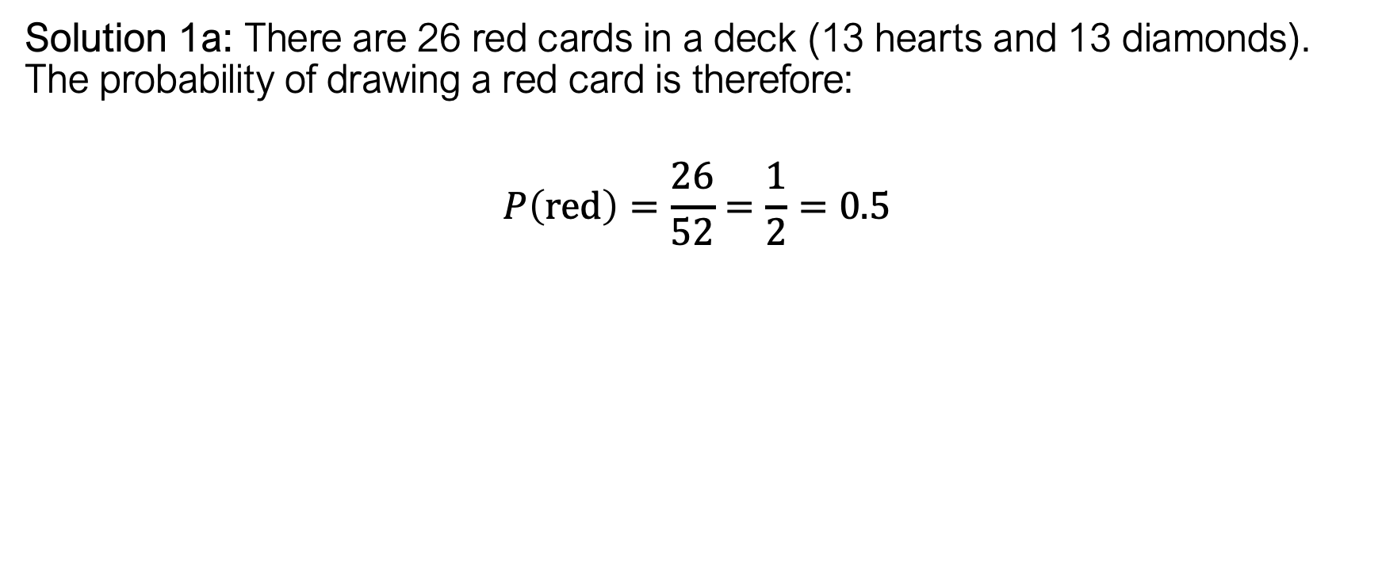
Calculating probabilities
Solution 1a: There are 26 red cards in a deck (13 hearts and 13 diamonds). The probability of drawing a red card is therefore:
$$P\left(\text{red}\right)=\frac{26}{52}=\frac{1}{2}=0.5$$

Slide 41
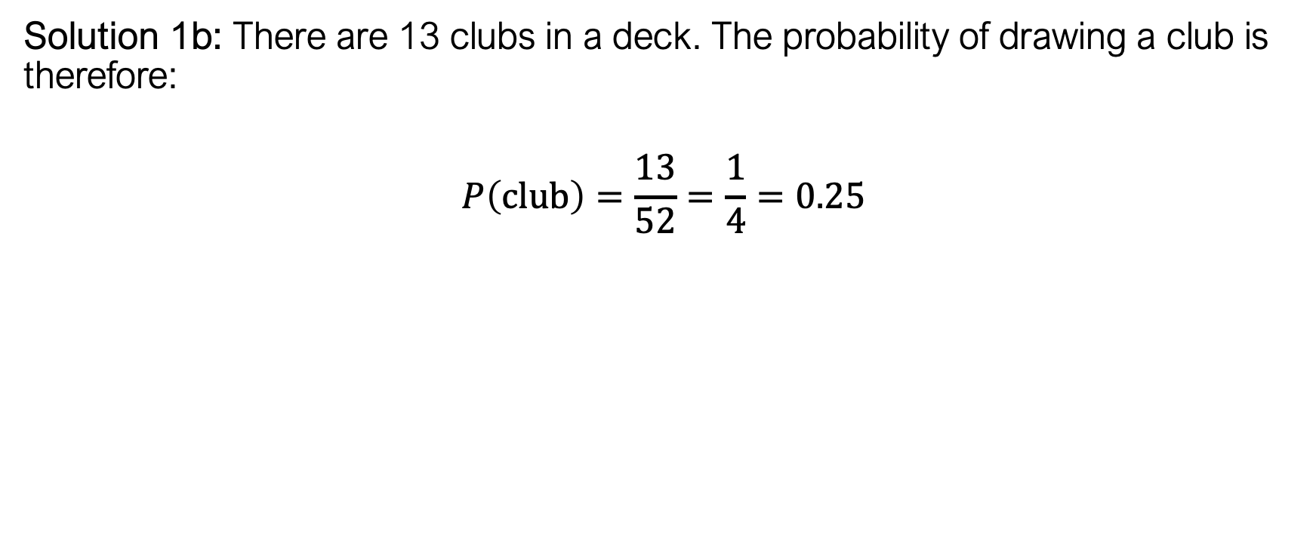
Calculating probabilities
Solution 1b: There are 13 clubs in a deck. The probability of drawing a club is therefore:
$$P\left(\text{club}\right)=\frac{13}{52}=\frac{1}{4}=0.25$$

Slide 42
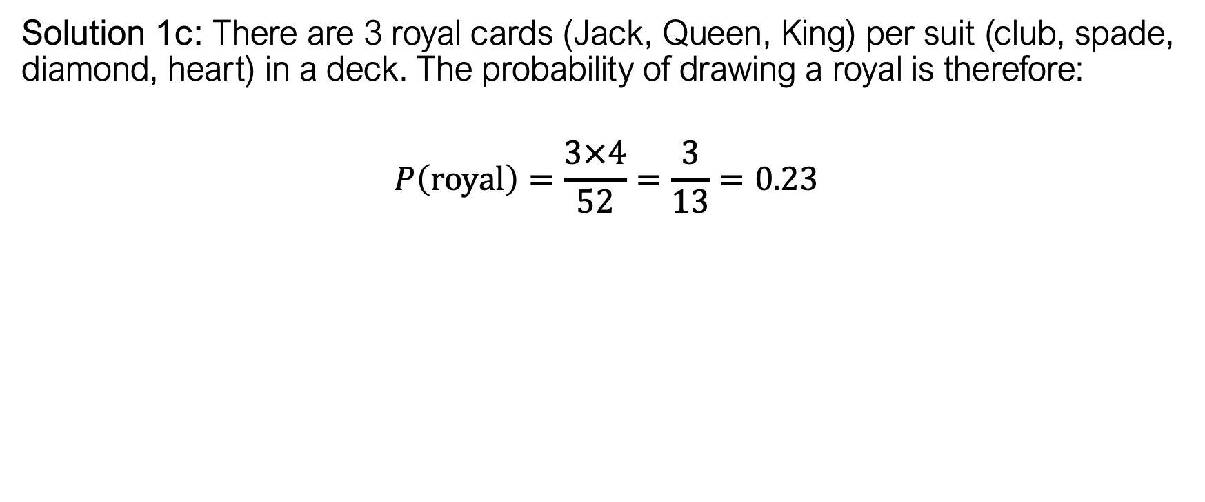
Calculating probabilities
Solution 1c: There are 3 royal cards (Jack, Queen, King) per suit (club, spade, diamond, heart) in a deck. The probability of drawing a royal is therefore:
$$P\left(\text{royal}\right)=\frac{3×4}{52}=\frac{3}{13}=0.23$$

Slide 43
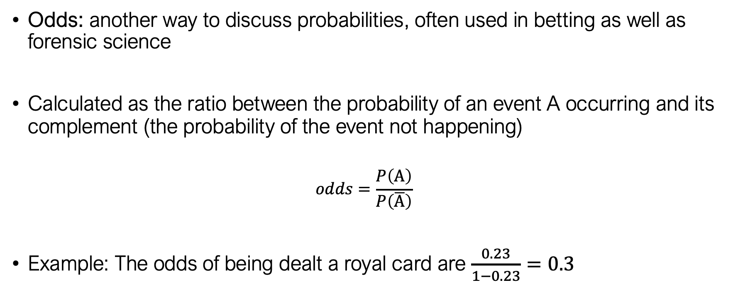
Calculating odds
Odds: another way to discuss probabilities, often used in betting as well as forensic science
Calculated as the ratio between the probability of an event A occurring and its complement (the probability of the event not happening)
$$odds=\frac{P\left(A\right)}{P\left(\overline{A}\right)}$$
Example: The odds of being dealt a royal card are $\frac{0.23}{1−0.23}=0.3$

Slide 44
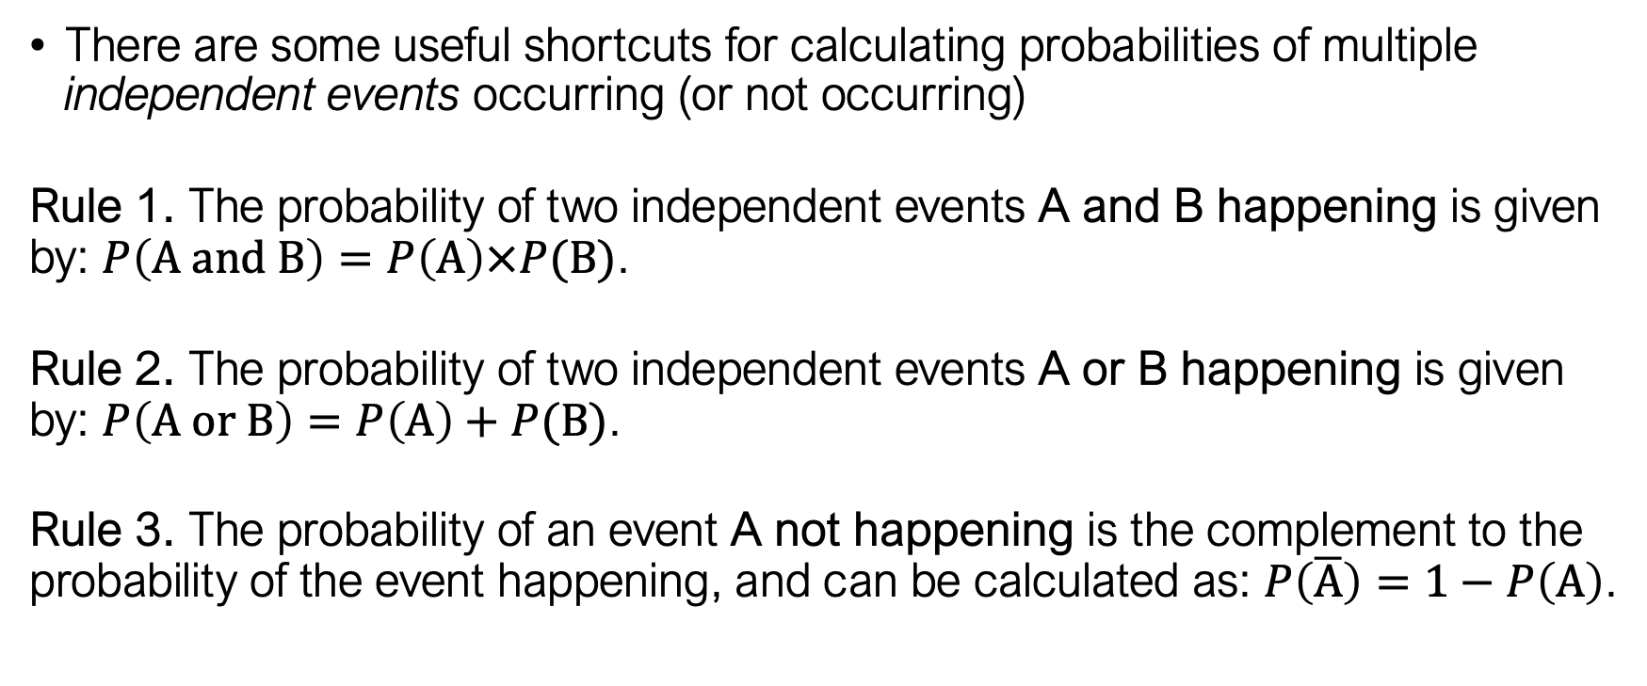
Combining probabilities
There are some useful shortcuts for calculating probabilities of multiple independent events occurring (or not occurring)
Rule 1. The probability of two independent events A and B happening is given by: $P\left(\text{A and B}\right)=P\left(A\right)×P(B)$.
Rule 2. The probability of two independent events A or B happening is given by: $P\left(\text{A or B}\right)=P\left(A\right)+P(B)$.
Rule 3. The probability of an event A not happening is the complement to the probability of the event happening, and can be calculated as: $P\left(\overline{A}\right)=1−P\left(A\right)$.

Slide 45
Combining probabilities
Example 2: You have a bag with 8 green marbles and 4 red marbles (12 marbles total). You shake the bag up, pull a marble out of the bag and record its colour. You put the marble back, shake the bag up, and then pull a marble out of the bag and record its colour. What is the probability that
you pulled a green marble and then a red marble?
you pulled two marbles of the same colour?
you pulled one marble of each colour?

Slide 46
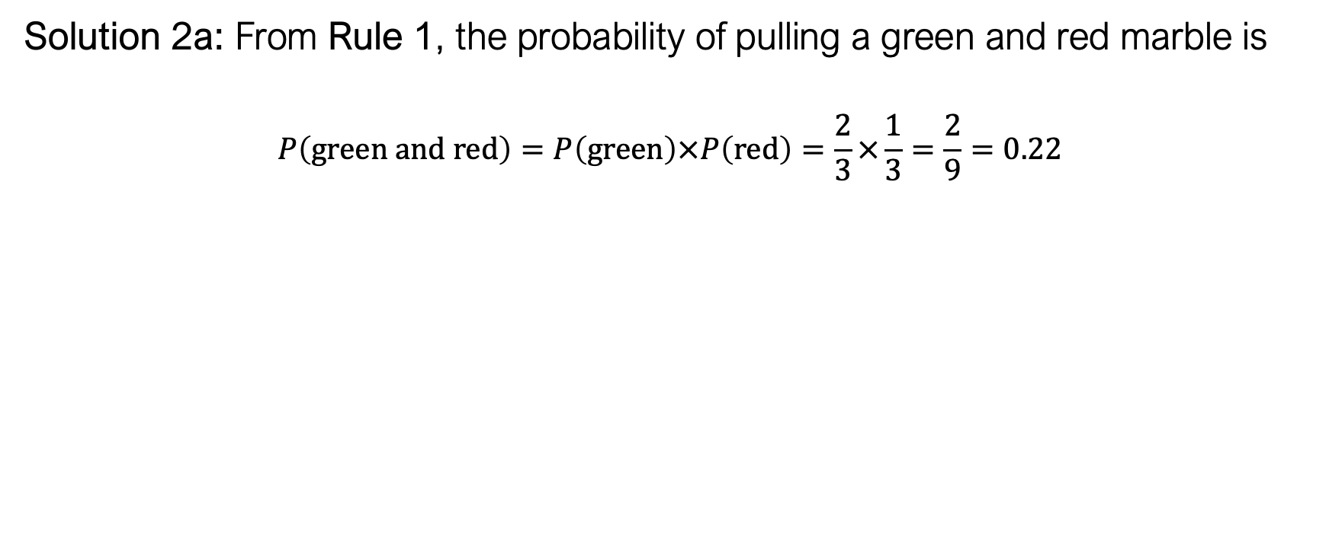
Combining probabilities
Solution 2a: From Rule 1, the probability of pulling a green and red marble is
$$P\left(green and \text{red}\right)=P\left(green\right)×P\left(red\right)=\frac{2}{3}×\frac{1}{3}=\frac{2}{9}=0.22$$

Slide 47
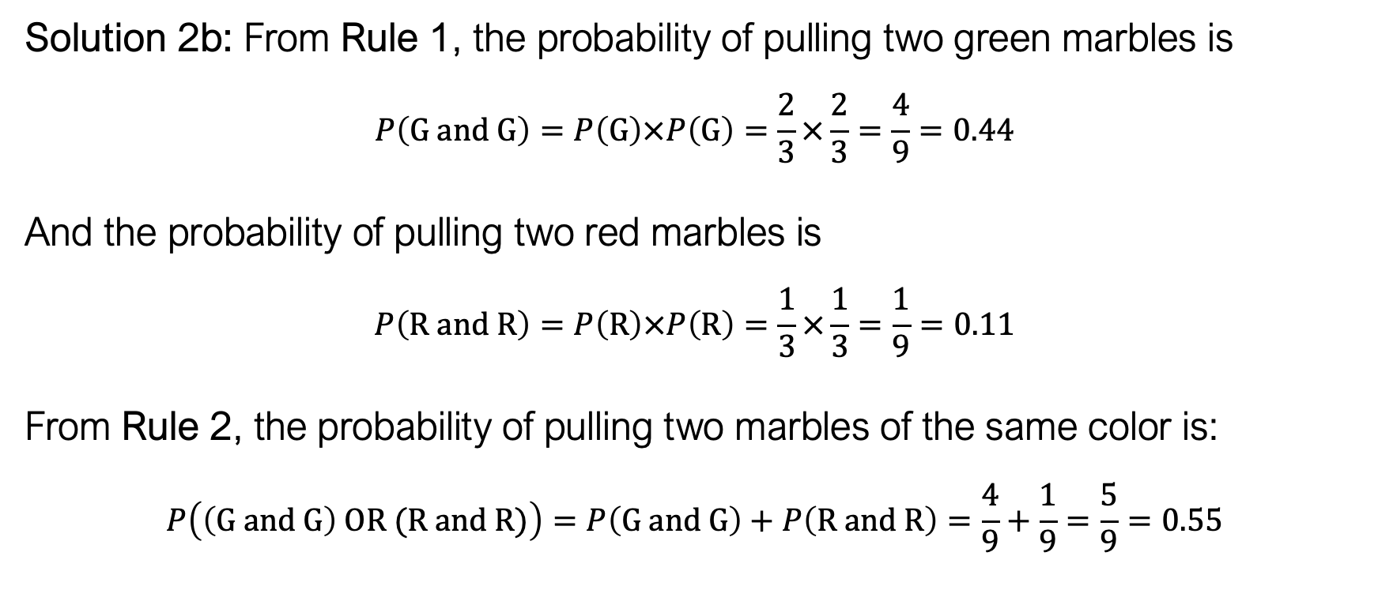
Combining probabilities
Solution 2b: From Rule 1, the probability of pulling two green marbles is
$$P\left(G and \text{G}\right)=P\left(G\right)×P\left(G\right)=\frac{2}{3}×\frac{2}{3}=\frac{4}{9}=0.44$$
And the probability of pulling two red marbles is
$$P\left(R and \text{R}\right)=P\left(R\right)×P\left(R\right)=\frac{1}{3}×\frac{1}{3}=\frac{1}{9}=0.11$$
From Rule 2, the probability of pulling two marbles of the same color is:
$$P\left(\left(G and G\right) OR (R and R)\right)=P\left(G and G\right)+P\left(R and R\right)=\frac{4}{9}+\frac{1}{9}=\frac{5}{9}=0.55$$

Slide 48
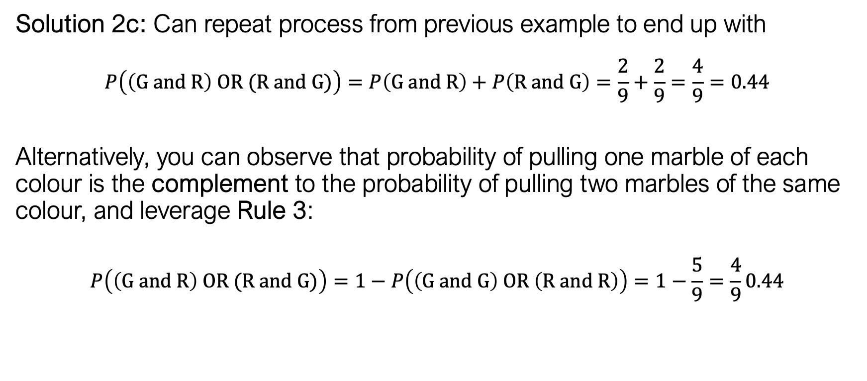
Combining probabilities
Solution 2c: Can repeat process from previous example to end up with
$$P\left(\left(G and R\right) OR (R and G)\right)=P\left(G and R\right)+P\left(R and G\right)=\frac{2}{9}+\frac{2}{9}=\frac{4}{9}=0.44$$
Alternatively, you can observe that probability of pulling one marble of each colour is the complement to the probability of pulling two marbles of the same colour, and leverage Rule 3:
$$P\left(\left(G and R\right) OR (R and G)\right)=1−P\left(\left(G and G\right) OR \left(R and R\right)\right)=1−\frac{5}{9}=\frac{4}{9}0.44$$

Slide 49
Combining probabilities
Example 3: The distribution of men’s shoe sizes in a large hypothetical city is shown below.
Calculate the probability that
a) a man selected at random will have a shoe size of 9 or 10.
b) two men selected at random will have the same size shoe.
c) two men selected at random will not have the same size shoe.
Size | 5 | 6 | 7 | 8 | 9 | 10 | 11 | 12
% | 7 | 11 | 10 | 14 | 16 | 18 | 16 | 8

Slide 50
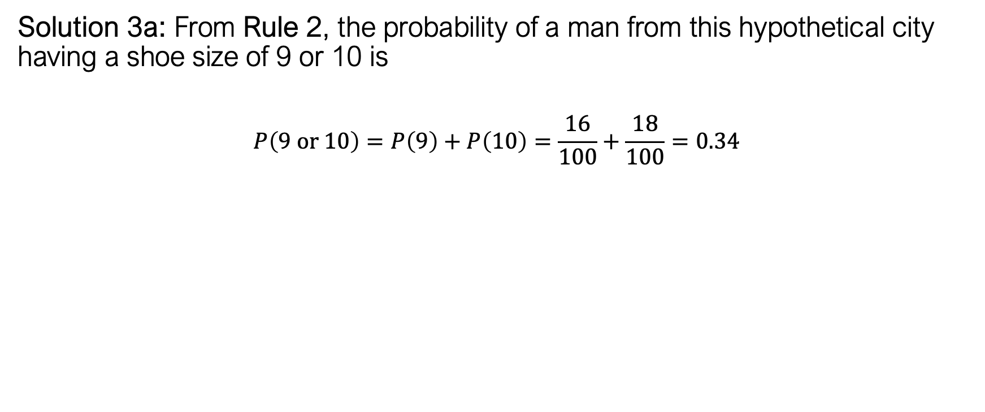
Combining probabilities
Solution 3a: From Rule 2, the probability of a man from this hypothetical city having a shoe size of 9 or 10 is
$$P\left(9 or \text{10}\right)=P\left(9\right)+P\left(10\right)=\frac{16}{100}+\frac{18}{100}=0.34$$

Slide 51
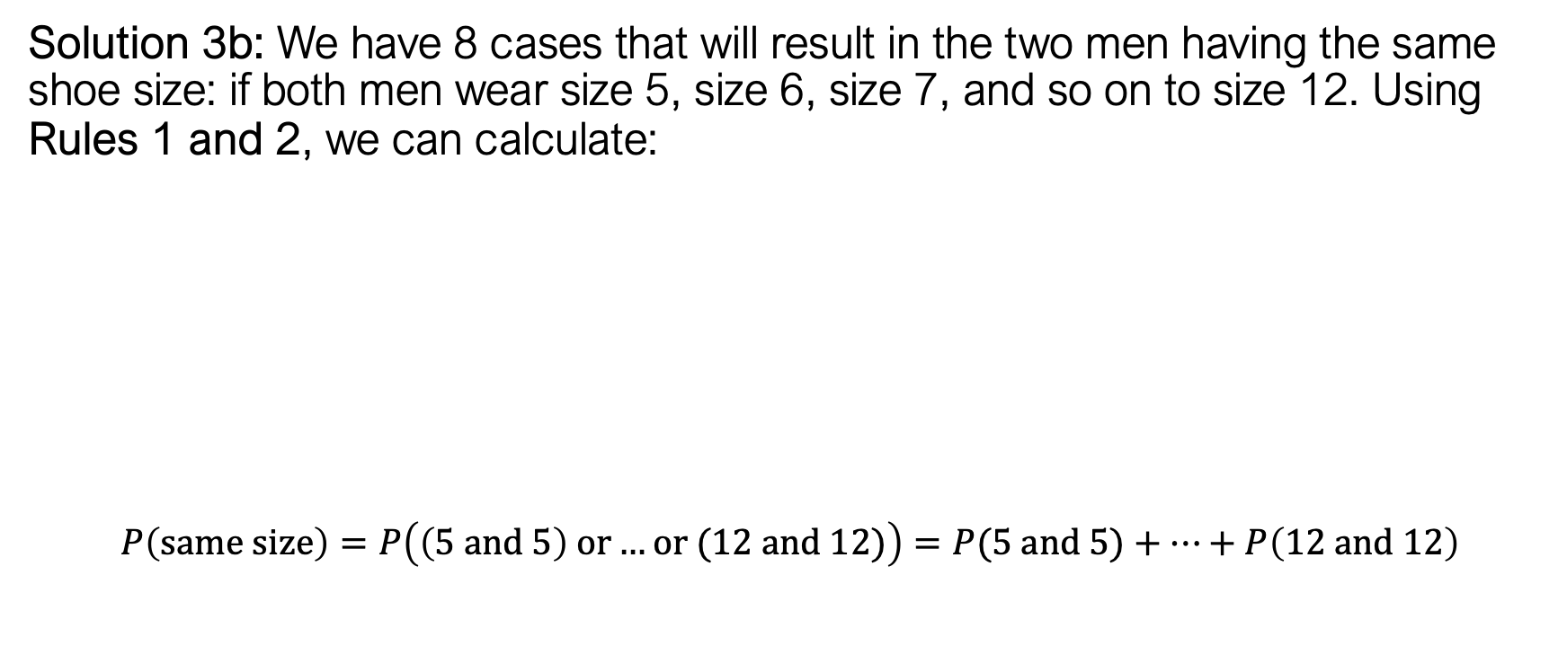
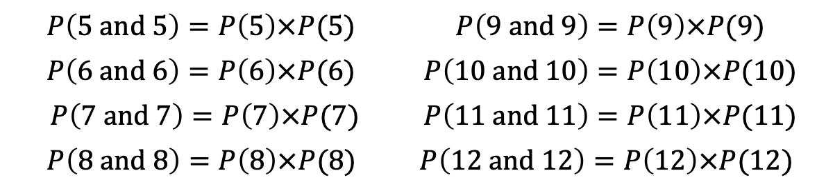
Combining probabilities
Solution 3b: We have 8 cases that will result in the two men having the same shoe size: if both men wear size 5, size 6, size 7, and so on to size 12. Using Rules 1 and 2, we can calculate:
$$P\left(same size\right)=P\left(\left(5 and 5\right) or…or (12 and 12)\right)=P(5 and 5)+…+P\left(12 and 12\right)$$
$$P\left(5 and \text{5}\right)=P\left(5\right)×P(5)$$ | $P\left(9 and \text{9}\right)=P\left(9\right)×P(9)$
$$P\left(6 and \text{6}\right)=P\left(6\right)×P(6)$$ | $P\left(10 and \text{10}\right)=P\left(10\right)×P(10)$
$P\left(7 and \text{7}\right)=P\left(7\right)×P(7)$ | $P\left(11 and \text{11}\right)=P\left(11\right)×P(11)$
$$P\left(8 and \text{8}\right)=P\left(8\right)×P(8)$$ | $$P\left(12 and \text{12}\right)=P\left(12\right)×P(12)$$

Slide 52
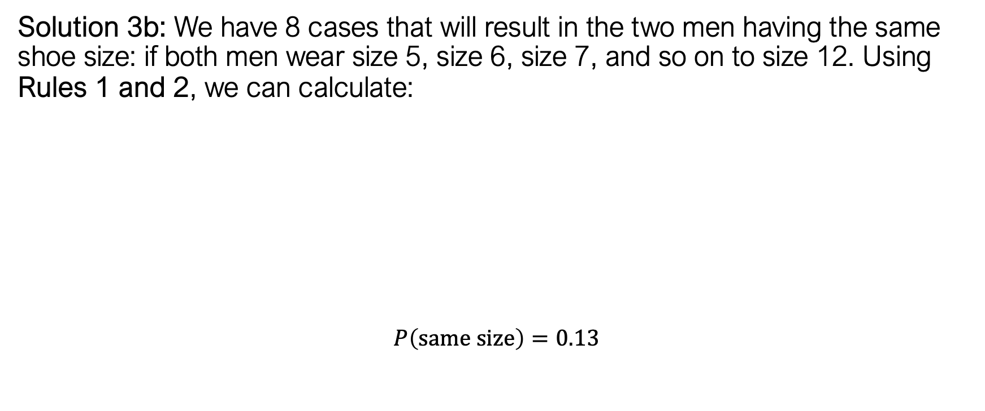
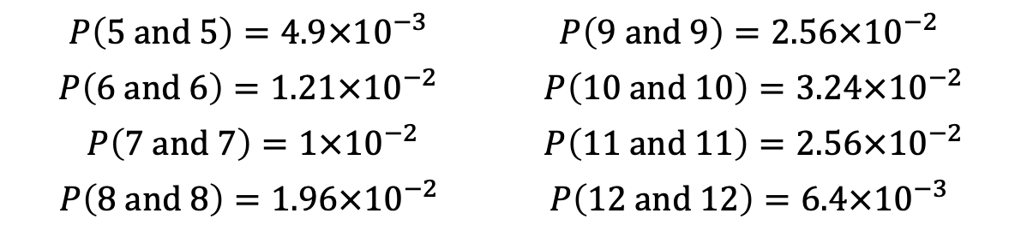
Combining probabilities
Solution 3b: We have 8 cases that will result in the two men having the same shoe size: if both men wear size 5, size 6, size 7, and so on to size 12. Using Rules 1 and 2, we can calculate:
$$P\left(same size\right)=0.13$$
$$P\left(5 and \text{5}\right)=4.9×{10}^{−3}$$ | $$P\left(9 and \text{9}\right)=2.56×{10}^{−2}$$
$$P\left(6 and \text{6}\right)=1.21×{10}^{−2}$$ | $P\left(10 and \text{10}\right)=3.24×{10}^{−2}$
$P\left(7 and \text{7}\right)=1×{10}^{−2}$ | $P\left(11 and \text{11}\right)=2.56×{10}^{−2}$
$$P\left(8 and \text{8}\right)=1.96×{10}^{−2}$$ | $$P\left(12 and \text{12}\right)=6.4×{10}^{−3}$$

Slide 53
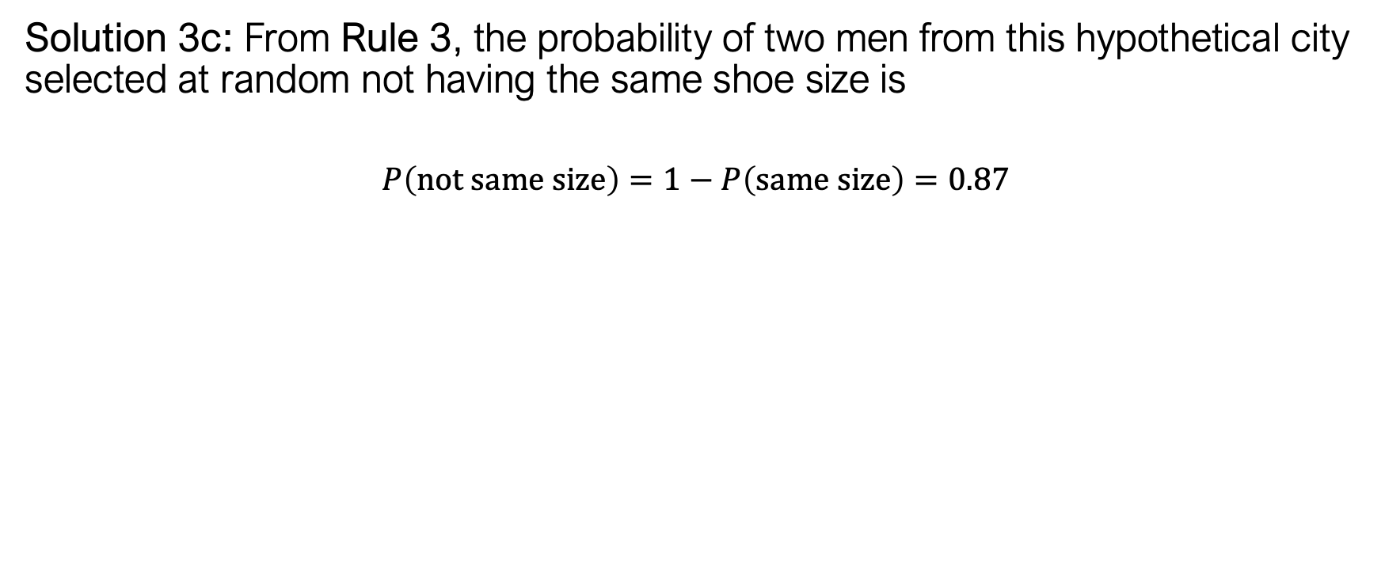
Combining probabilities
Solution 3c: From Rule 3, the probability of two men from this hypothetical city selected at random not having the same shoe size is
$$P\left(not same size\right)=1−P\left(same size\right)=0.87$$

Slide 54
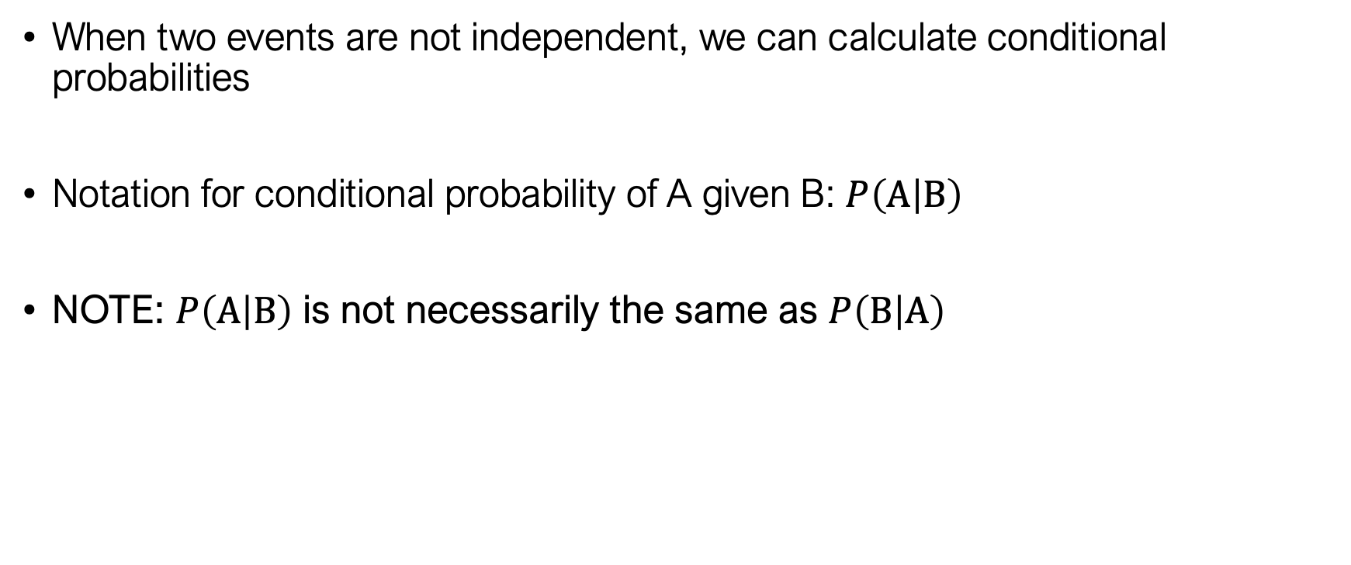
Conditional probabilities
When two events are not independent, we can calculate conditional probabilities
Notation for conditional probability of A given B: $P\left(A | B\right)$
NOTE: $P\left(A | B\right)$ is not necessarily the same as $P\left(B | A\right)$

Slide 55
Conditional probabilities
Example 4: You have a bag with 8 green marbles and 4 red marbles (12 marbles total). You shake the bag up, pull a marble out of the bag and record its colour. You shake the bag up again, and then pull another marble out of the bag and record its colour. What is the probability that
The first marble is green and the second marble is red
Both marbles are green
The first marble is red and the second marble is red or green

Slide 56
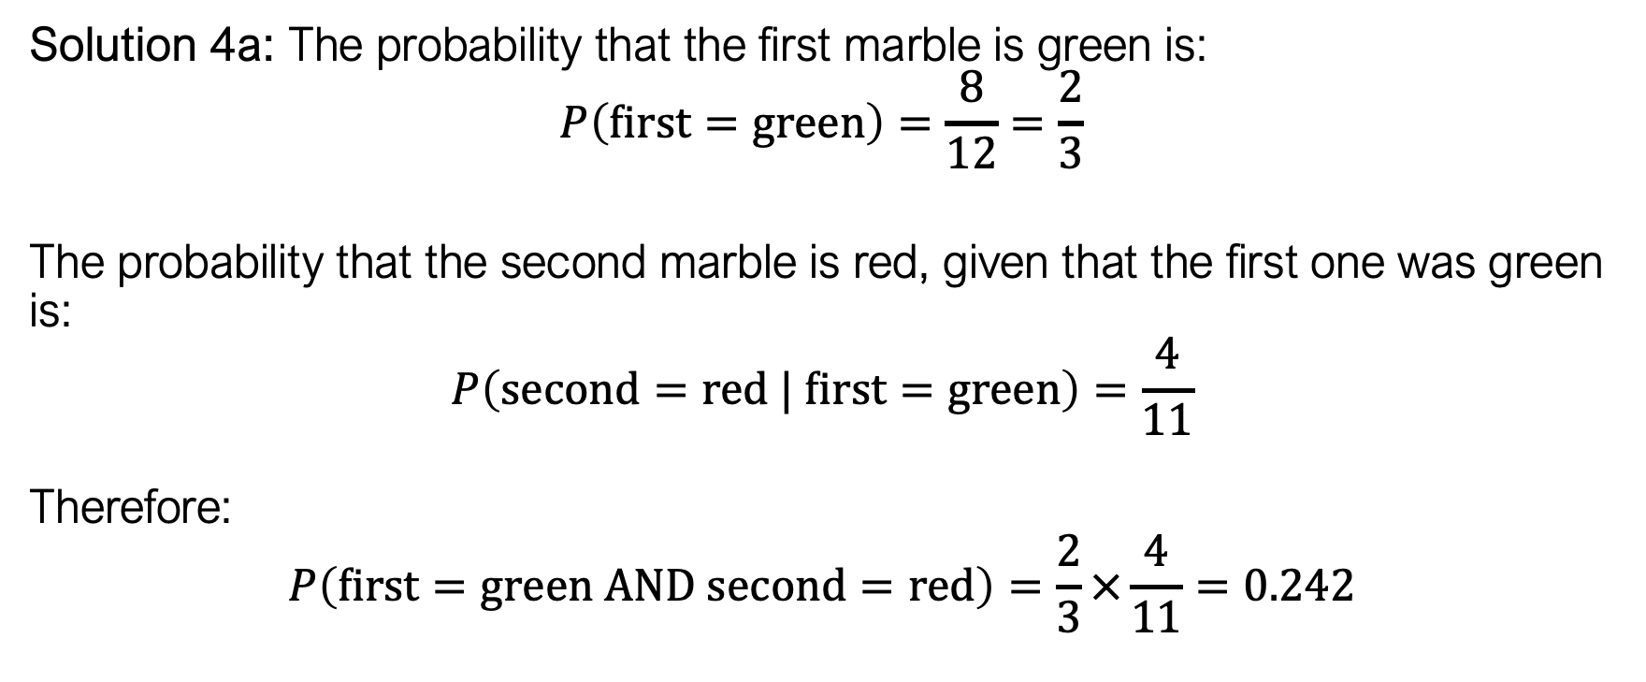
Conditional probabilities
Solution 4a: The probability that the first marble is green is:
$$P\left(first=green\right)=\frac{8}{12}=\frac{2}{3}$$
The probability that the second marble is red, given that the first one was green is:
$$P\left(second=red | first=green\right)=\frac{4}{11}$$
Therefore:
$$P\left(first=green AND second=red\right)=\frac{2}{3}×\frac{4}{11}=0.242$$

Slide 57
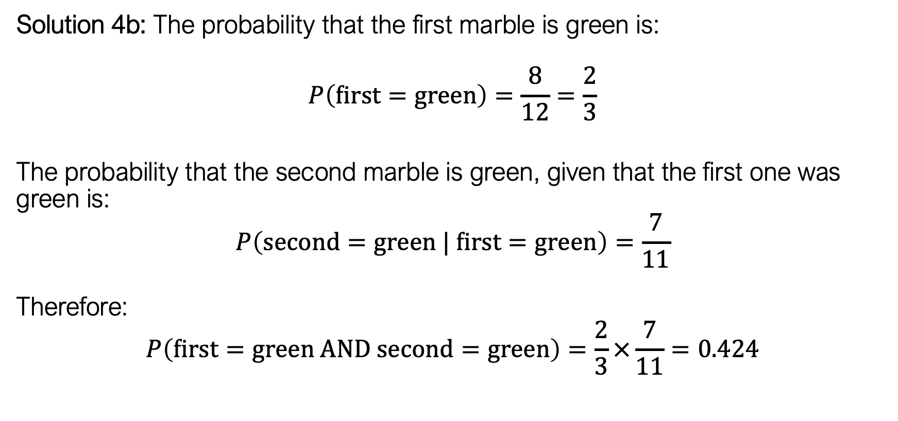
Conditional probabilities
Solution 4b: The probability that the first marble is green is:
$$P\left(first=green\right)=\frac{8}{12}=\frac{2}{3}$$
The probability that the second marble is green, given that the first one was green is:
$$P\left(second=green | first=green\right)=\frac{7}{11}$$
Therefore:
$$P\left(first=green AND second=green\right)=\frac{2}{3}×\frac{7}{11}=0.424$$

Slide 58
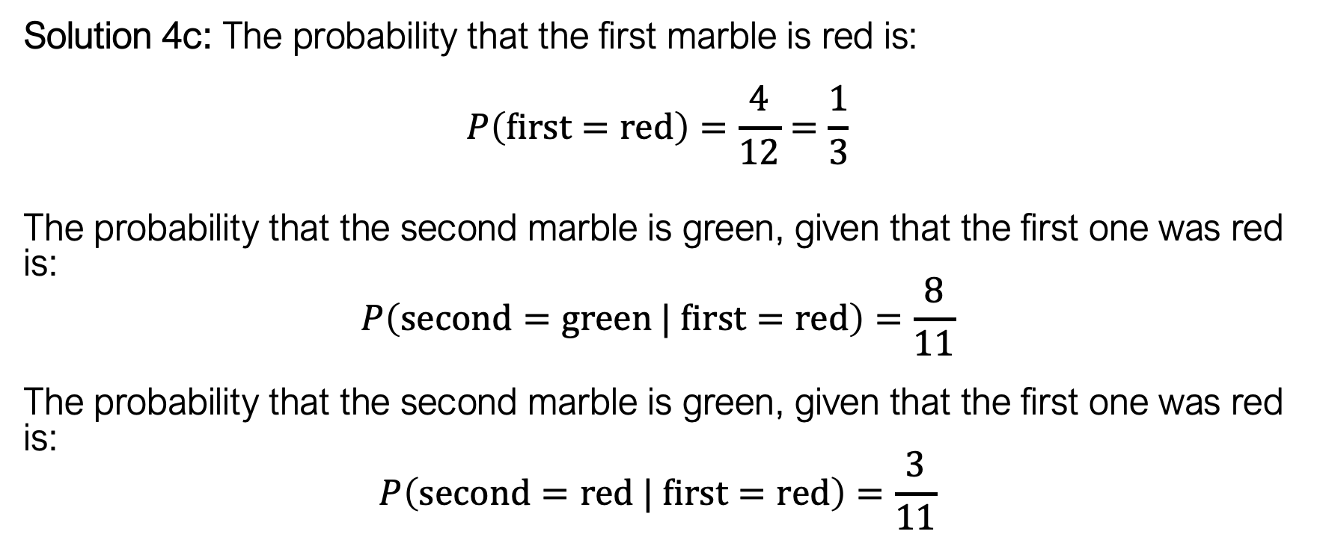
Conditional probabilities
Solution 4c: The probability that the first marble is red is:
$$P\left(first=red\right)=\frac{4}{12}=\frac{1}{3}$$
The probability that the second marble is green, given that the first one was red is:
$$P\left(second=green | first=red\right)=\frac{8}{11}$$
The probability that the second marble is green, given that the first one was red is:
$$P\left(second=red | first=red\right)=\frac{3}{11}$$

Slide 59
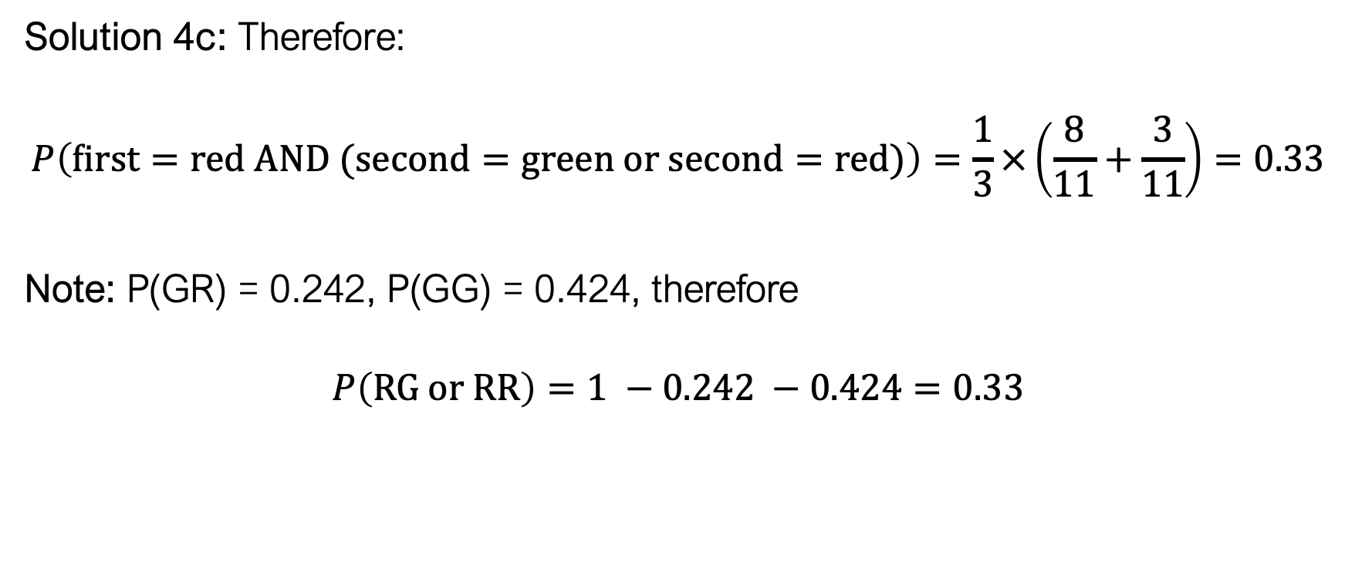
Conditional probabilities
Solution 4c: Therefore:
$$P\left(first=red AND (second=green or second=red)\right)=\frac{1}{3}×\left(\frac{8}{11}+\frac{3}{11}\right)=0.33$$
Note: P(GR) = 0.242, P(GG) = 0.424, therefore
$$P\left(RG or RR\right)=1 −0.242 −0.424=0.33$$

Slide 60
Probability distributions
Probability distribution: A mathematical function that maps between specific outcomes/events (inputs) and the probability of their occurrence (outputs)
  Probability mass function: discrete inputs
  Probability density function: continuous inputs
Several common well-characterized probability distributions that we encounter in forensic science:
  Normal Distribution
  Binomial Distribution
Can be approximated from data

Slide 61
Probability and Statistics
A population is a set of objects
Every object has properties
Some properties are constant across the population, others are variable

Slide 62
Probability and Statistics
A histogram is a way of visualizing a single variable from the sample (or population): Frequency Distribution

Slide 63
Probability and Statistics
A histogram is a way of visualizing a single variable from the sample (or population): Frequency Distribution
A histogram using relative frequencies can be interpreted as a probability distribution

Slide 64
Practice Problems
Selecting a shape at random, what is the probability that you’ll pick a triangle?
Selecting a shape at random, what is the probability that you won’t pick a pentagon?
Selecting a shape at random, what is the probability that you’ll pick a triangle OR a square?

Slide 65
Foundations of statistics
Parameter: a property/characteristic of the variable across the population; a property or characteristic of a frequency distribution of the population

Slide 66
Types of parameters
10
Central Tendency: the “typical” value of a variable
  E.g., mean, median, mode
Dispersion: how different are values of the variable
  E.g., standard deviation, variance, range
Skewness/Kurtosis: advanced descriptions of location and spread
6
6
5
3
IMPORTANT: Just because a parameter can be computed doesn’t mean it tells us anything useful.

Slide 67
Foundations of statistics
2
2
1
1
1
Statistic: a property/characteristic of the variable across a sample; a property or characteristic of the frequency distribution of a sample

Slide 68
Key language to remember
A property is a characteristic by which we can describe an object
A statistic is a characteristic by which we can describe a sample
A parameter is a characteristic by which we can describe a population

Slide 69
Case Study 1: Does shot gun brand effect pellet scatter pattern?
Target | gun | range | sqrt.area | Target | gun | range | sqrt.area | Target | gun | range | sqrt.area
1 | Stevens | 40 | 12.54 | 21 | Stevens | 20 | 6.96 | 41 | Stevens | 40 | 11.03
2 | Remington | 40 | 13.01 | 22 | Stevens | 20 | 6.32 | 42 | Stevens | 30 | 8.24
3 | Remington | 50 | 13.13 | 23 | Stevens | 40 | 11.47 | 43 | Remington | 20 | 5.73
4 | Stevens | 50 | 13.74 | 24 | Remington | 50 | 17.47 | 44 | Stevens | 30 | 7.38
5 | Remington | 10 | 3.29 | 25 | Stevens | 20 | 6.84 | 45 | Stevens | 10 | 2.6
6 | Remington | 30 | 7.95 | 26 | Stevens | 10 | 3.06 | 46 | Remington | 50 | 16.07
7 | Remington | 40 | 10.81 | 27 | Stevens | 10 | 3.35 | 47 | Remington | 50 | 14.9
8 | Stevens | 40 | 16.13 | 28 | Remington | 40 | 10.19 | 48 | Stevens | 20 | 6.29
9 | Remington | 10 | 3.01 | 29 | Remington | 20 | 5 | 49 | Stevens | 50 | 16.94
10 | Remington | 20 | 5.1 | 30 | Remington | 30 | 8.09 | 50 | Stevens | 50 | 14.09
11 | Stevens | 10 | 3.38 | 31 | Remington | 40 | 11.17 | 51 | Remington | 10 | 3.02
12 | Remington | 10 | 3.2 | 32 | Remington | 20 | 5.29 | 52 | Stevens | 20 | 5.85
13 | Remington | 30 | 8.62 | 33 | Remington | 50 | 14.21 | 53 | Stevens | 20 | 5.95
14 | Remington | 10 | 3.11 | 34 | Remington | 50 | 11.93 | 54 | Stevens | 50 | 20.13
15 | Remington | 40 | 11.33 | 35 | Stevens | 40 | 14.1 | 55 | Stevens | 10 | 3.33
16 | Stevens | 40 | 10.28 | 36 | Remington | 20 | 5.57 | 56 | Stevens | 30 | 6.72
17 | Stevens | 30 | 6.51 | 37 | Remington | 30 | 8.62 | 57 | Remington | 10 | 3
18 | Stevens | 30 | 9.84 | 38 | Remington | 30 | 8.41 | 58 | Remington | 20 | 5.42
19 | Remington | 30 | 6.8 | 39 | Stevens | 50 | 5.18 | 59 | Remington | 40 | 9.35
20 | Stevens | 10 | 3.85 | 40 | Stevens | 30 | 9.42 | 60 | Stevens | 50 | 11.8
Notes:
60 objects in our population, we have 3 properties per object (the shot gun brand used to shoot at the target), the distance from which the object was shot

Slide 70
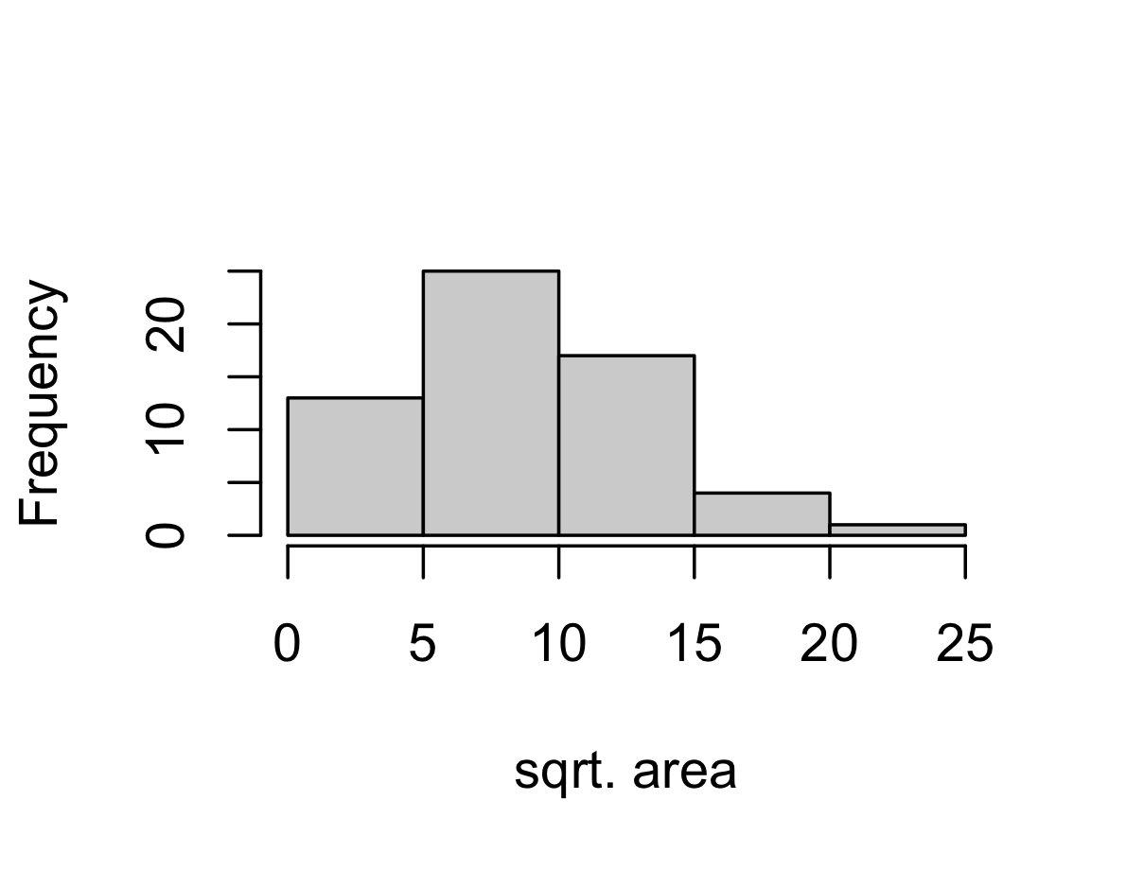
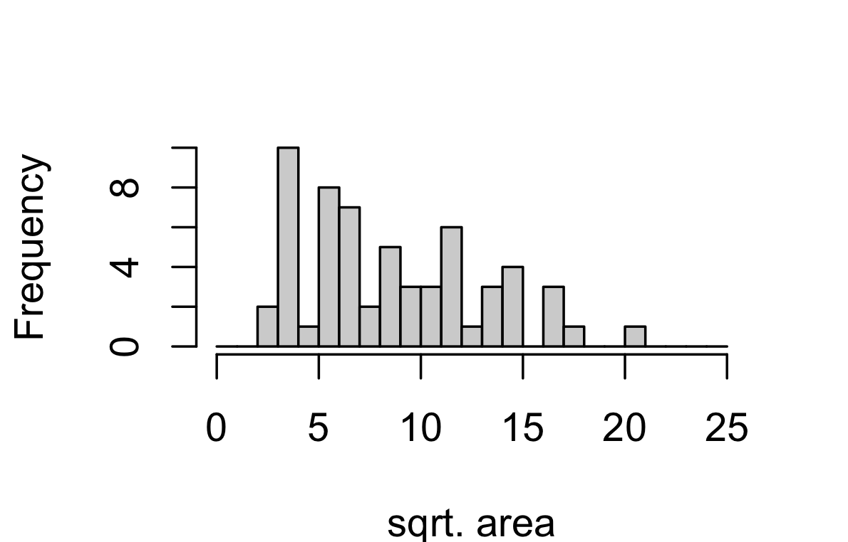
Computing descriptive statistics
What is the central tendency?
  Arithmetic Mean
  Median
  Mode
What is the dispersion?
  Range
  Variance
  Standard Deviation
Mean = 8.602
Median = 8.02
Variance = 19.36
St. Dev = 4.40
Skewness = 0.5
Kurtosis = 2.44

Slide 71
Computing descriptive statistics
Mean = 8.43
Median = 8.25
Variance = 18.16
St. Dev = 4.26
Mean = 8.78
Median = 7.17
Variance = 21.17
St. Dev = 4.60
Can parse your data on categories and create several “univariate numeric data” problems.

Slide 72
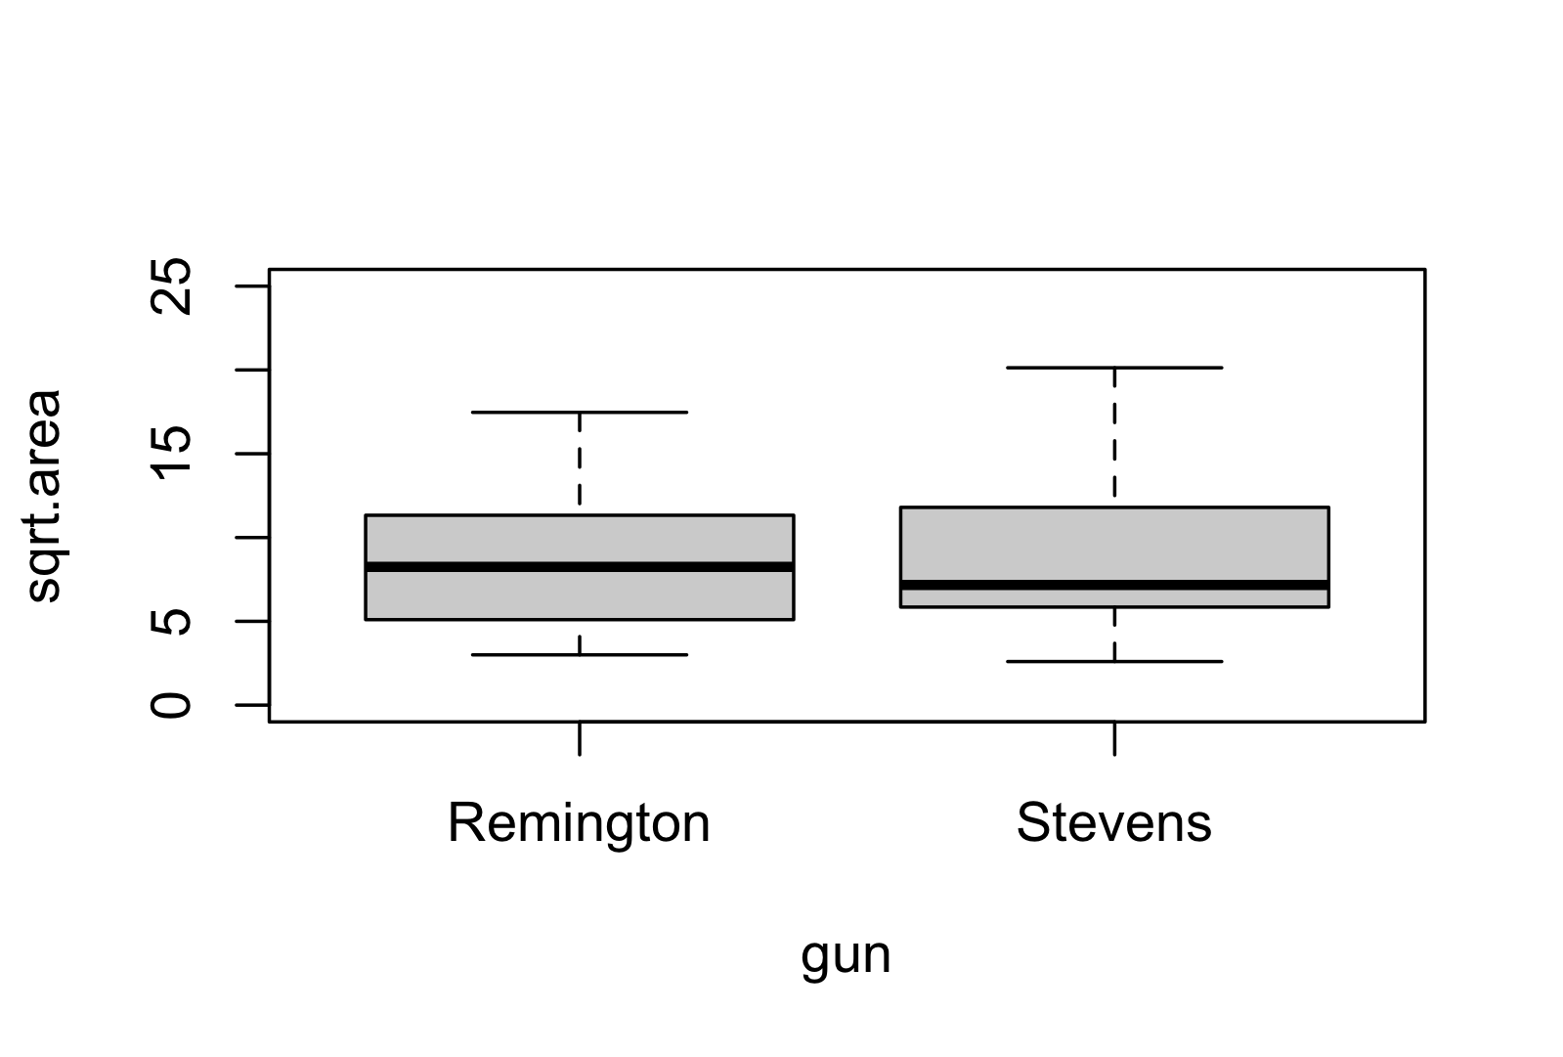
Computing descriptive statistics
Remington
Mean = 8.43
Median = 8.25
Variance = 18.16
St. Dev = 4.26
Stevens
Mean = 8.78
Median = 7.17
Variance = 21.17
St. Dev = 4.60

Slide 73
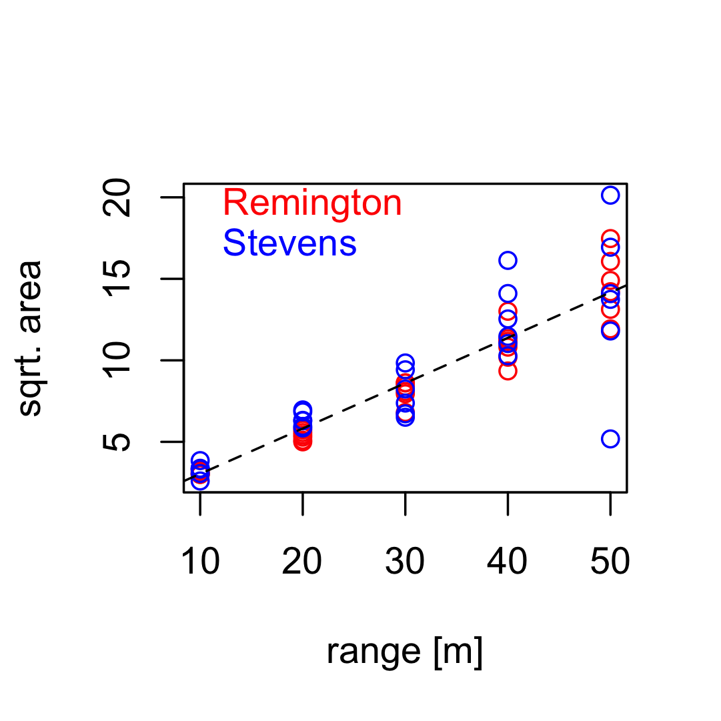
Computing descriptive statistics
What is the “central tendency”?
  Correlation Coefficient
    Strong vs weak, positive vs negative
  Model Coefficients
  (e.g., slope and intercept of
  line of best fit)
What is the “dispersion”?
  Sum of squared variance
Y = 0.28*X+0.26
R² = 0.813

Slide 74
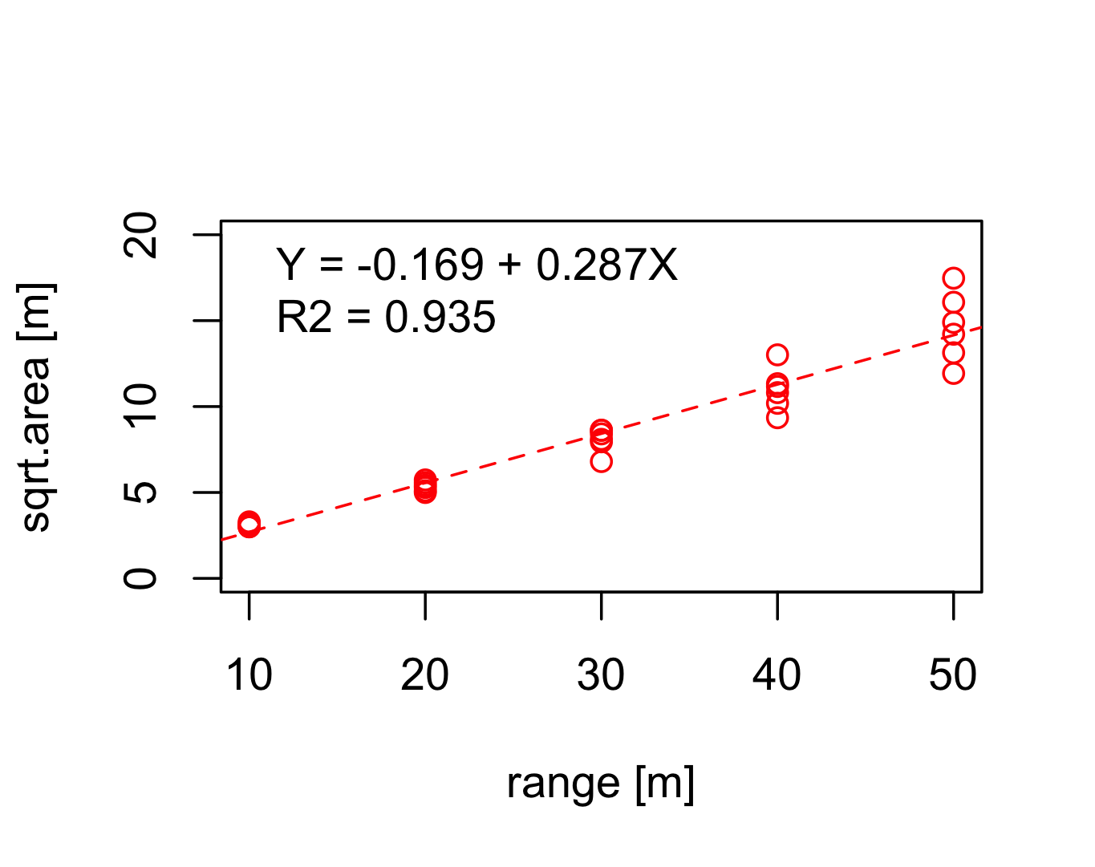

From a result to an interpretation
Remington
Stevens

Slide 75
Inference: from sample to population
Statistical inference is the process of inferring (or estimating) population parameters using sample statistics
  Point Estimation
  Interval Estimation
  Hypothesis Testing

Slide 76
Inference: from sample to population
Point estimation: The process of predicting a specific parameter value from a sample statistic
$$x$$
Ω
2
2
1
1
1
Sample Mean Number of Vertices
$$\overline{x}=2.57$$
Mean Number of Vertices
$$\overline{Ω}=3.167$$

Slide 77
Some new concepts
A sampling distribution is the distribution of a statistic, when computed for randomly selected samples of the same size

Slide 78
Some new concepts
$$x_{1}$$
A sampling distribution is the distribution of a statistic, when computed for randomly selected samples of the same size
2
2
1
1
1
$${\overline{x}}_{1}=2.57$$

Slide 79
Some new concepts
$$x_{2}$$
A sampling distribution is the distribution of a statistic, when computed for randomly selected samples of the same size
2
2
1
1
1
$${\overline{x}}_{1}=2.57$$
2
2
1
1
1
$${\overline{x}}_{2}=2.86$$

Slide 80
Some new concepts
A sampling distribution is the distribution of a statistic, when computed for randomly selected samples of the same size
$$x_{3}$$
2
2
1
1
1
$${\overline{x}}_{1}=2.57$$
2
2
1
1
1
$${\overline{x}}_{2}=2.86$$
4
1
1
1
$${\overline{x}}_{3}=3.43$$
0

Slide 81
Some new concepts
A sampling distribution is the distribution of a statistic, when computed for randomly selected samples of the same size
$$x_{4}$$
2
2
1
1
1
$${\overline{x}}_{1}=2.57$$
2
2
1
1
1
$${\overline{x}}_{2}=2.86$$
3
4
2
1
1
$${\overline{x}}_{4}=3.86$$
0
1
1
1
$${\overline{x}}_{3}=3.43$$
0

Slide 82

Some new concepts
A sampling distribution is the distribution of a statistic, when computed for randomly selected samples of the same size
$$x_{4}$$
2
2
1
1
1
$${\overline{x}}_{1}=2.57$$
2
2
1
1
1
$${\overline{x}}_{2}=2.86$$
$y=\{{\overline{x}}_{1},{\overline{x}}_{2}$, ${\overline{x}}_{3}$, ${\overline{x}}_{4}\}$
$$\overline{y}=3.18$$
4
1
1
1
$${\overline{x}}_{3}=3.43$$
0
3
2
1
1
$${\overline{x}}_{4}=3.86$$
0

Slide 83
Some new concepts
A sampling distribution is the distribution of a statistic, when computed for randomly selected samples of the same size
$$x_{4}$$
2
2
1
1
1
$${\overline{x}}_{1}=2.57$$
2
2
1
1
1
$${\overline{x}}_{2}=2.86$$
$y=\{{\overline{x}}_{1},{\overline{x}}_{2}$, ${\overline{x}}_{3}$, ${\overline{x}}_{4}\}$
$$\overline{y}=3.18$$
4
1
1
1
$${\overline{x}}_{3}=3.43$$
0
3
2
1
1
$${\overline{x}}_{4}=3.86$$
0

Slide 84
Some new concepts
A sampling distribution is the distribution of a statistic, when computed for randomly selected samples of the same size
$$x_{4}$$
2
2
1
1
1
$${\overline{x}}_{1}=2.57$$
2
2
1
1
1
$${\overline{x}}_{2}=2.86$$
$y=\{{\overline{x}}_{1},{\overline{x}}_{2}$, ${\overline{x}}_{3}$, ${\overline{x}}_{4}\}$
$$\overline{y}=3.18$$
4
1
1
1
$${\overline{x}}_{3}=3.43$$
$$\overline{Ω}=3.167$$
0
3
2
1
1
$${\overline{x}}_{4}=3.86$$
0

Slide 85
Inference: from sample to population
Statistical inference is the process of inferring (or estimating) population parameters using sample statistics
  Point Estimation
  Interval Estimation
  Hypothesis Testing

Slide 86
Interval estimation
Interval estimation: The process of predicting a range (interval) within which a parameter value exists.

Slide 87
Interval estimation
Interval estimation: The process of predicting a range (interval) within which a parameter value exists.
2
2
1
1
1
$$x$$
Ω
Range of values in $x$:
$$R=[1−5]$$
Mean Number of Vertices
$$\overline{Ω}=3.167$$

Slide 88
Interval estimation
Interval estimation: The process of predicting a range (interval) within which a parameter value exists.
2
2
1
1
1
$$x$$
Ω
Range of values in $x$:
$$R=[1−5]$$
This range does encapsulate the parameter value—but it’s not very precise.
Mean Number of Vertices
$$\overline{Ω}=3.167$$

Slide 89
Interval estimation
Interval estimation: The process of predicting a range (interval) within which a parameter value exists.
4
3
$$x$$
Ω
Range of values in $x$:
$$R=[1−2]$$
Also, making an inference from a single random selection of data could fail – by chance.
Mean Number of Vertices
$$\overline{Ω}=3.167$$

Slide 90

Interval estimation
A sampling distribution is the distribution of a statistic, when computed for randomly selected samples of the same size

Slide 91
Interval estimation
A sampling distribution is the distribution of a statistic, when computed for randomly selected samples of the same size
From central limit theorem, we know that all sampling distributions tend to a normal distribution as the number of samples approaches infinity

Slide 92

Interval estimation
A sampling distribution is the distribution of a statistic, when computed for randomly selected samples of the same size
From central limit theorem, we know that all sampling distributions tend to a normal distribution as the number of samples approaches infinity

Slide 93
Interval estimation
There are several well-studied theoretical probability distributions with known properties.

Slide 94
Interval estimation
There are several well-studied theoretical probability distributions with known properties.
For a variable that follows a normal distribution, we know that 95% of the data falls within $±1.96 se$ of the mean value – refer to this as a confidence interval

Slide 95
Interval estimation
There are several well-studied theoretical probability distributions with known properties.
For a variable that follows a normal distribution, we know that 95% of the data falls within $±1.96 se$ of the mean value – refer to this as a confidence interval
I am 95% confident that the mean number of vertices in the collection of shapes is
$$3.18±1.17$$

Slide 96

Working through an example
SCENARIO: You’re given the fentanyl mass measurements for 2000 pills (see histogram to the right). The mean mass for your set is 1.51 mg and the standard deviation for the set is 0.15 mg.
Given this information, what is your best estimate for the mass of fentanyl in a new pill?
Answer 1: 1.51 mg

Slide 97
Working through an example
Answer 2: Assuming that the mass measurements are normally distributed, we know that 95% of the data is within approximately 2 standard errors of the mean.
Mean = 1.51; Standard Deviation = 0.15; n = 2000
Standard Error = 0.15/sqrt(2000) = 0.003
95% CI = 2 x 0.003 = 0.006
Therefore, 1.51±0.01 mg (1.50 – 1.52 mg) with 95% confidence

Slide 98
Inference: from sample to population
Statistical inference is the process of inferring (or estimating) population parameters using sample statistics
  Point Estimation: Using sample statistics to predict/estimate a specific parameter value.
  Interval Estimation: Using sample statistics to predict/estimate a range (interval) the parameter value lives in.
  Hypothesis Testing: Using sample statistics to evaluate an assumed parameter value.

Slide 99
Key Terms
Hypothesis: A premise or claim for the value of a parameter.
Null Hypothesis ($H_{0}$) – The accepted hypothesis. (no change)
Alternative Hypothesis ($H_{a}$) – The competing hypothesis. (some change)
Note: Null and alternative hypothesis must be mutually exclusive (both premises cannot be simultaneously true)

Slide 100
Example
Based on historic seizure data, the average amount of fentanyl found in a typical illicitly distributed pills is 0.5 mg. Researchers believe that estimate of the mean is not representative of the current drug market. Outline the null and alternative hypotheses that they should test.
$$H_{0}: μ=0.5$$
$$H_{a}: μ≠0.5$$

Slide 101
Key Terms
Hypothesis Test: A statistical procedure for evaluating two competing hypotheses using sample evidence (statistics), the results of which allow us to:
  Reject the null hypothesis, or
  Fail to reject the null hypothesis
Significance Level ($α$): A user-prescribed value (between 0 and 1) for deciding whether the sample evidence is sufficient (or insufficient) for rejecting the null hypothesis.
Compliment of a confidence level, i.e., ($α=1−C)$

Slide 102
Key Terms
P-value: The probability that you would observe the sample evidence if the null hypothesis were true.
  If p-value is less than $α$, the hypothesis test rejects the null hypothesis.
  If p-value is greater than $α$, the hypothesis test fails to rejects the null hypothesis
  If p-value is less than $α$, the observed “effect size” (difference between parameter values) is said to be significant

Slide 103
Key Terms
Type 1 Error (false positive conclusion):
  Test incorrectly rejects $H_{0}$
  To minimize Type 1 errors, you want to decrease $α$
Type 2 Error (false negative conclusion):
  Test incorrectly fails to reject $H_{0}$
  To minimize Type 2 errors, you want to increase “statistical power”

Slide 104
How all hypothesis tests work
Set significance level ($α$) for hypothesis test
Use sample statistics and assumed parameter values to compute a test statistic (sample evidence)
Determine the p-value for test statistic using probability distribution implied by the null hypothesis
Compare p-value to significance level to make inference

Slide 105
Which hypothesis test should you use?
Depends on several factors
  Data type (continuous vs ordinal vs categorical)
  Population parameter being estimated / question being asked
Important hypothesis tests:
  T-tests
  ANOVA
  Non-parametric versions

Slide 106
Example 1
Scenario: The average concentration of THC in seized marijuana is 4%. In a recent seizure of 20-1g bags, the concentration of THC is as described on the right.
How different is the average concentration of THC in the recent seizure from past seizures? Is this difference significant?
Obs. | Conc. | Obs. | Conc.
1 | 6.89 | 11 | 7.22
2 | 2.33 | 12 | 8.32
3 | 7.82 | 13 | 3.41
4 | 3.91 | 14 | 5.63
5 | 6.02 | 15 | 8.23
6 | 7.54 | 16 | 9.21
7 | 6.02 | 17 | 3.87
8 | 6.37 | 18 | 7.45
9 | 6.17 | 19 | 5.35
10 | 5.21 | 20 | 5.41

Slide 107
(Student’s) T-test
A hypothesis test used to evaluate whether there is a significant difference (in mean) between two groups
  One-sample T-test: When comparing a sample to a population
  Two-sample T-test: When comparing two independent samples
  Paired T-test: When comparing samples that are not independent
Requirements: Data is continuous, normally distributed
Test Statistic: T-statistic ; Test Distribution: T-distribution
Non-parametric alternative: Wilcoxon

Slide 108

Solution 1
Finding the difference between averages is easy: The reported average is 4% whereas the sample average is 6.14%. Therefore, the difference is 2.14%.
To determine the significance of this difference, we can turn to a t-test (one sample t-test)
D5=(D1-D4)/(D2/SQRT(D3))
D6=T.DIST.2T(D5,D3-1)

Slide 109
Solution 1
Finding the difference between averages is easy: The reported average is 4% whereas the sample average is 6.14%. Therefore, the difference is 2.14%.
To determine the significance of this difference, we can turn to a t-test (one sample t-test)

Slide 110
Example 2
location | strain | percentage
A | 1 | 3.85618697
A | 2 | 4.06354438
A | 2 | 3.99682508
B | 1 | 3.94848585
B | 2 | 4.09798208
B | 3 | 4.10475134
C | 1 | 3.94827211
C | 2 | 4.05966656
C | 3 | 4.02955828
D | 1 | 3.7740048
D | 2 | 4.11053965
D | 3 | 4.13544068
E | 1 | 3.947227
E | 2 | 3.99462977
E | 3 | 4.10785979
Scenario: Your lab measures the percentage THC in three different strains of marijuana from 5 different locations. The measurements are summarized in the data matrix to the right.
Are there significant differences due to location or strain?

Slide 111
Analysis of Variance (ANOVA)
A hypothesis test used to evaluate whether there is a significant difference between more than 2 groups
  One-way ANOVA: Comparing groups that differ by one categorical variable
  Two-way ANOVA: Comparing groups that differ by two categorical variable
  More variants
Requirements: residuals are normally distributed, homoscedasticity
Test Statistic: F-statistic (F-ratio); Test Distribution: F-Distribution
Non-parametric alternatives: Kruskal-Wallis Test

Slide 112


Solution 2
To determine if there are significant differences, we can use a two-way ANOVA analysis

Slide 113
Good luck with content quizzes 6a and 6b!
(Due November 19th at 11:59 PM)

