Slide 1

Research 101

Slide 2
What is research?
Activities undertaken to help update our knowledge and/or improve our understanding of a subject.
  Learning is personal: we carry out learning activities (e.g., taking classes, reading) to extend or improve our personal understanding of a subject.
    Assumption: Knowledge is known to someone
  Research is social: We carry out research activities (e.g., designing models and experiments, publish papers) to extend or improve our communities understanding of a subject.
    Assumption: Knowledge is not known to someone

Slide 3
Reasons people conduct research
Depth of knowledge: Need cutting-edge understanding of a subject matter (e.g., to be an expert)
Solving problems: Need deeper understanding of a subject matter (and its limitations) to solve a problem
Making decisions: Need deeper understanding of a subject matter (and its limitations) to create an effective strategy
Notes:
I want to highlight the word ”deeper” here is relative.. The depth of research I need to do to solve a problem may be different than you need to do to solve the same problem, just because of our different experience levels AND based on the complexity of the problem they are trying to solve or the importance of the decision they are trying to make

Slide 4
Methods vs Methodology
Research Methods: the specific tools and approaches used to complete a research project
  An important part of a research paper, thesis, case report, etc.
  Needed for reproducibility
Research Methodology: the study of methods; the general strategies and approaches for approaching/conducting a research project
  “the craft of research”

Slide 5
General steps in the craft of research
Problem formulation: The goal in this step is to identify one or more “robust” (tractable, feasible) research questions that are worth pursuing.
  critical thinking, literature review
Experimentation and analysis: The goal in this step is to design specific experiments and analytical methods that best answer research questions.
  critical thinking, literature review, models and experimentation, data analysis
Dissemination: The goal in this step is to present your findings so that others in the community can benefit from the work.
  Publishing papers, dissertations, technical reports … podcasts, blog posts, videos

Slide 6
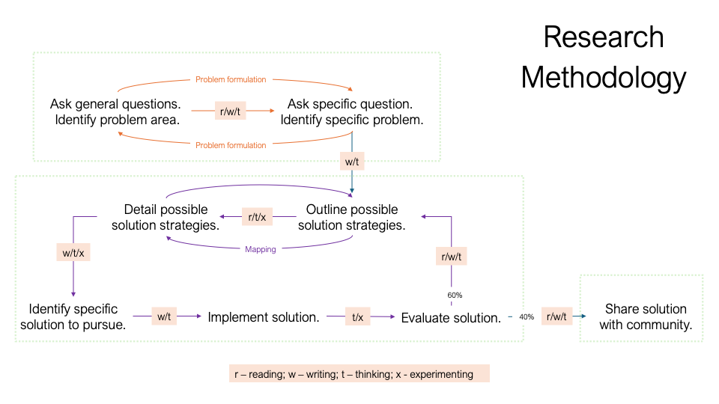

Slide 12
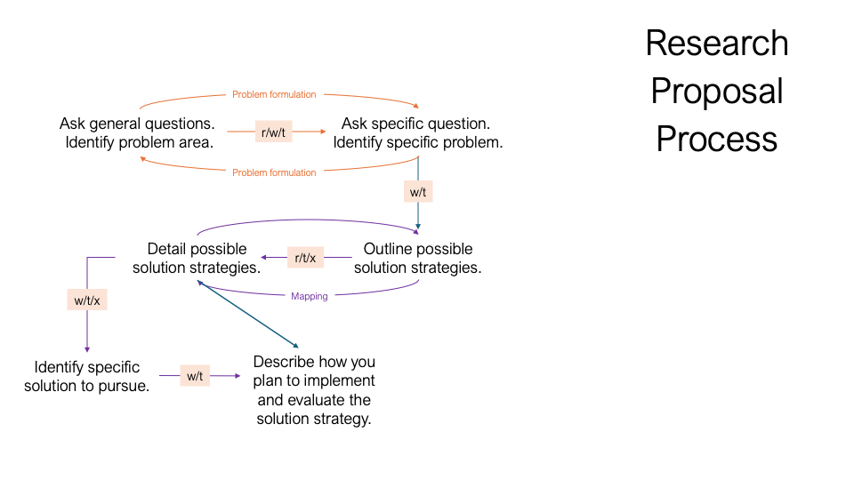

Slide 13
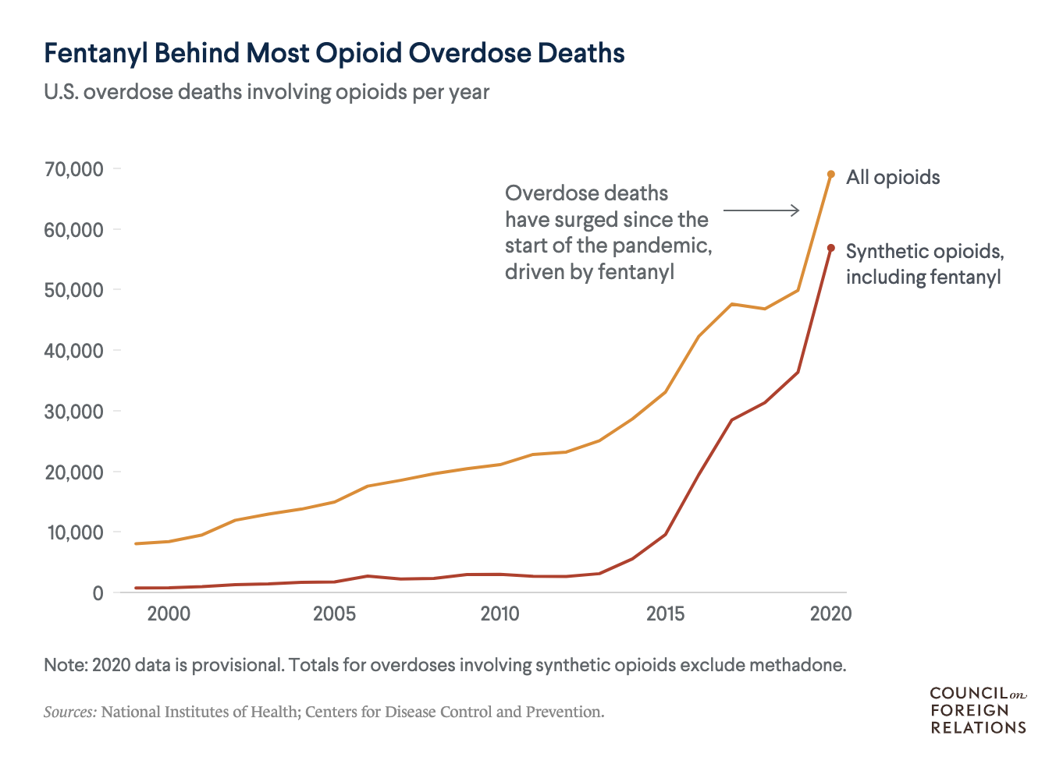
Opioid Epidemic
In 2016, I was assigned the task
“help law enforcement (forensic science labs) identify fentanyl analogs”
Challenge 1: Figure out why forensic science labs were unable to identify fentanyl analogs.
Challenge 0: Figure out how forensic science labs identify any drugs.
References:
https://www.cfr.org/in-brief/us-fentanyl-crisis-what-know

Slide 14
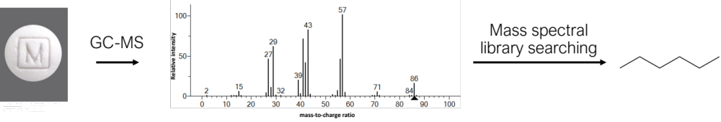
How forensic science labs identify drugs

Slide 15
How forensic science labs identify drugs
Mass spectral library searching only works if you have a representative reference spectrum of your analyte.

Slide 19
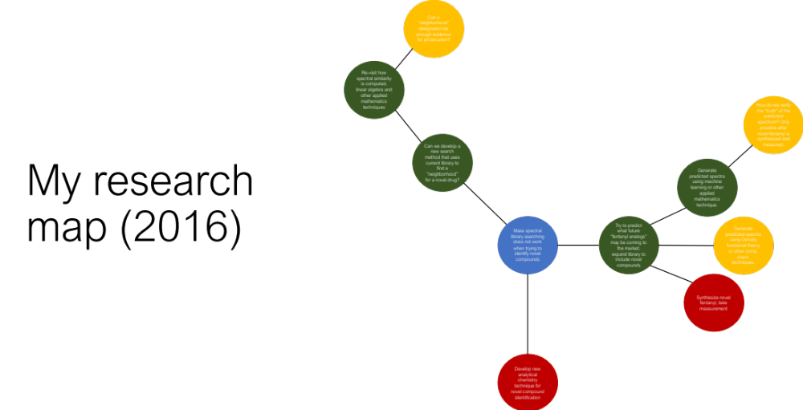

Slide 28
Step 1
Step 2

Slide 30
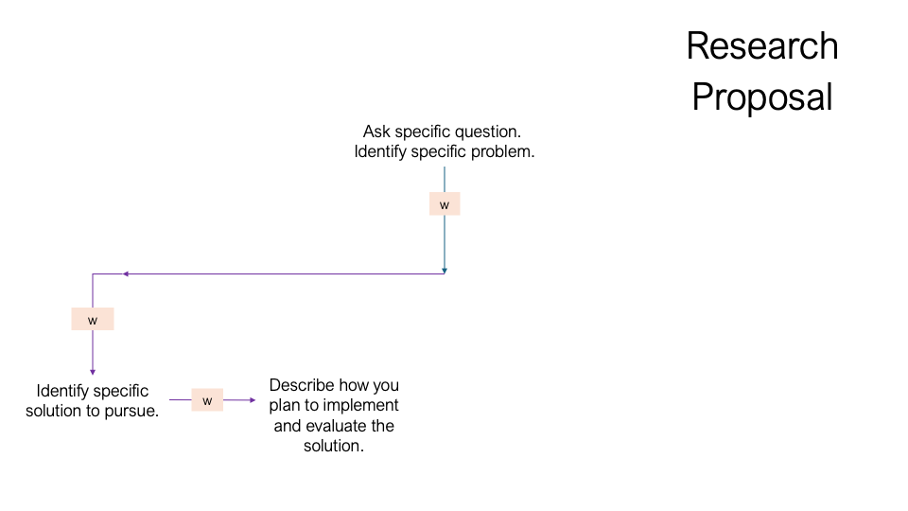

Slide 31
What is a research proposal?
A research proposal (or project proposal or project plan) is a formal document or presentation used to advocate for a potential research project
Goal of a research proposal is to convince the reader (or listener) that:
  The research project will be successful, AND
  The results will be meaningful
Can achieve these goals with
  Including thoughtful details in your methodology and plan
  Making strong connections to the real-world in the background and motivation

Slide 32
Parts of a research proposal/plan
Essential
  Title: Describes the contents of the proposal/plan
  Background: Explains the question(s)/objective(s) and relevant background necessary to understand the plan; provide motivation for the research
  Method/Plan: Provides step-by-step details about how the research will be conducted
  Expected Outcomes/Impacts: Another opportunity to explain why you think the research is important (will be meaningful)
  Acknowledgments: A note to people, institutions, resources that supported the plan.
  References
Nice-to-haves:
  Timeline, budgets, personnel involved
  Mitigation Strategies: Alternative strategies if something goes wrong
Notes:
Show rubric and template

Slide 33
Research Teams
Principal Investigator (PI)
  The person responsible for all the research coming out of the group. Usually involved with conceptualization, acquiring support (e.g., funding), mentoring/training, reviewing/editing material.
Co-Principal Investigators (Co-PIs)
  The people responsible for all the research coming out of the group. Usually involved with all aspects of research activity.

Slide 34
Research Teams
Staff Scientist / Postdoctoral Fellows / Research Associate
  People involved with leading one or more projects. Usually involved with conceptualization, experimentation/analysis, and writing original drafts of material. May be involved with mentoring. Has work approved by PI before publication/dissemination.
Research Assistants (RA) / Technicians
  People involved with supporting one or more projects. Usually involved with experimentation/analysis, writing original drafts of material and/or reviewing/editing material. Usually mentored/supervised by PI or other senior personnel. Has work approved by senior personnel before publication/dissemination.

Slide 35
Research at Trent – UG Classes
FRSC 3900H: Reading Course
Provides an opportunity for more intensive or broader study of a selected topic in forensic science under the guidance of a faculty member. Students may take only one reading course. May be taken as a science credit with permission of the department chair. Prerequisite: 10.0 university credits and permission of course supervisor. Open only to students in Forensic Science (single- or joint-major), Forensic Anthropology, Forensic Biology, or Forensic Chemistry.

Slide 36
Research at Trent – UG Classes
FRSC 4010Y: Independent Project
This self-directed research course requires students to investigate research topics relating to forensic science and to prepare a thorough, detailed research proposal in an area of research pertinent to forensic science. Students defend their research questions and their proposed methodology in a class discussion. Research is carried out individually or working in small groups. Open only to students in Forensic Science (single-major), Forensic Biology, or Forensic Chemistry

Slide 37
Research at Trent – UG Classes
FRSC 4890Y: Community Based Research Projects
Designed to allow fourth-year students the opportunity to work on a research project with a forensic community agency under the supervision of a faculty member. Students must contact the Forensic Science department before the end of the Winter term of third year. Only open to students enrolled in the BScFS or joint-major in Forensic Science program. Prerequisite: a minimum 75% cumulative average and 14.0 university credits, including at least 3.0 FRSC credits at the 2000 or 3000 level.

Slide 38
Research at Trent – UG Classes
FRSC 4020D / 4021Y: Research Thesis
Students design and carry out research under the supervision of a faculty member. Permission of the program and the availability of a thesis supervisor are required. Prerequisite: A minimum 80% cumulative average. Students with a cumulative average lower than 80% will be considered provided they include a written letter of support from a prospective supervisor with their application. Open only to students in Forensic Science (single- or joint-major), Forensic Biology, or Forensic Chemistry. FRSC 4020D is a double credit, 4021Y is a single credit course (must be taken with another thesis course)

Slide 39
Research at Trent – UG Work
Some FRSC Faculty members may have Research Assistantship (RA) opportunities in their labs
  Lab work, documentation, code checking
  May or may not be funded
NSERC USRA: Undergraduate Summer Research Assistantship
  14-16-week research internships (May to August)
  ~$10,000 value
  Work with a faculty advisor to outline a proposal
  https://www.trentu.ca/ori/funding/undergraduate-graduate-postdoctoral-fellow-funding-opportunities/nserc-undergraduate

Slide 40
Research at Trent – Graduate School
Several course-based and thesis-based graduate programs at Trent; all graduate programs have a research requirement
  Course-based Master’s program might have a research placement (e.g., 4-month project) or a major research paper (e.g., 12-month project) under supervision of a placement host or faculty advisor
  Thesis-based Master’s programs require students to complete a program of research under supervision of a faculty advisor, deemed appropriate by an examination committee (on average 24-months)
  (Thesis-based) Doctorate (PhD) program require students to complete a program of research under supervision of a faculty advisor, deemed appropriate by an examination committee (on average 60-months)

Slide 41
Advisors and mentors
A research advisor oversees the research conducted in their lab, offering guidance and advice to trainees (students, technical staff); may also provide advice and guidance on future research and career ventures
Having a strong relationship with your faculty advisor is a good idea. This can be assisted by:
  Finding a research advisor that shares similar research interests as you
  Finding a research advisor that meshes with your style of work
  Being honest and professional in your communications and behavior; taking initiative and doing good work

Slide 42
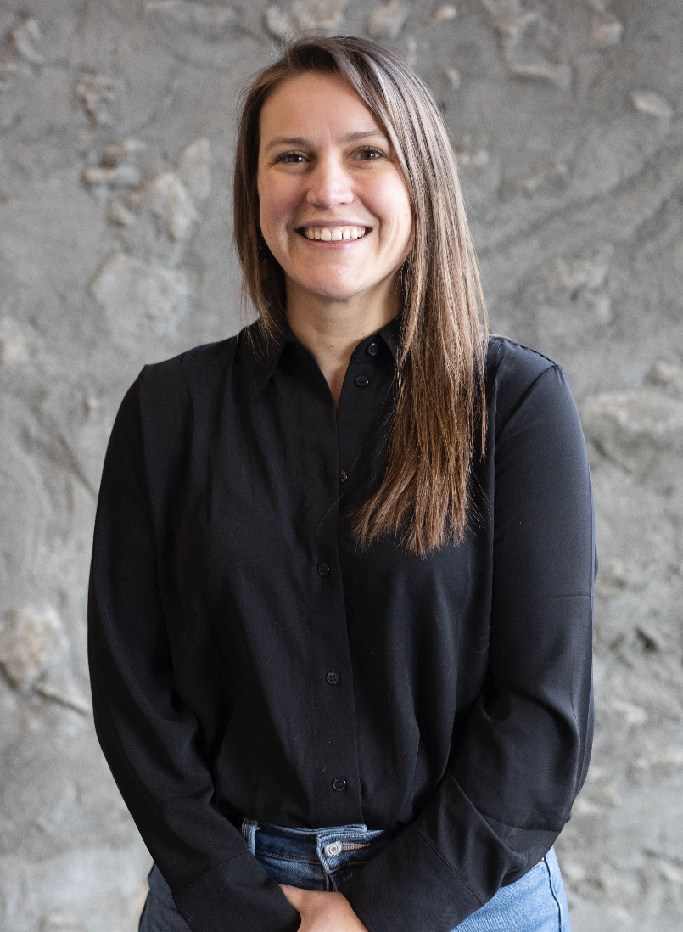
Research at Trent University – Faculty
Mary-Claire Buell
Assistant Professor (cross-appointed with The School of the Environment)
TRACE Lab: https://tracelab.ca/
maryclairebuell@trentu.ca
Dr. Buell’s research interests include investigating the source, fate, transport, and impacts of legacy and contemporary contaminants. Her research also includes examining the connections between contaminants and environmental justice through transdisciplinary approaches bringing together environmental toxicology, chemistry, and community knowledges. Dr. Buell is the founder and CEO of Collective Environmental, a consulting and research firm focused on collaborative approaches to investigating environmental issues impacting Indigenous communities.

Slide 43
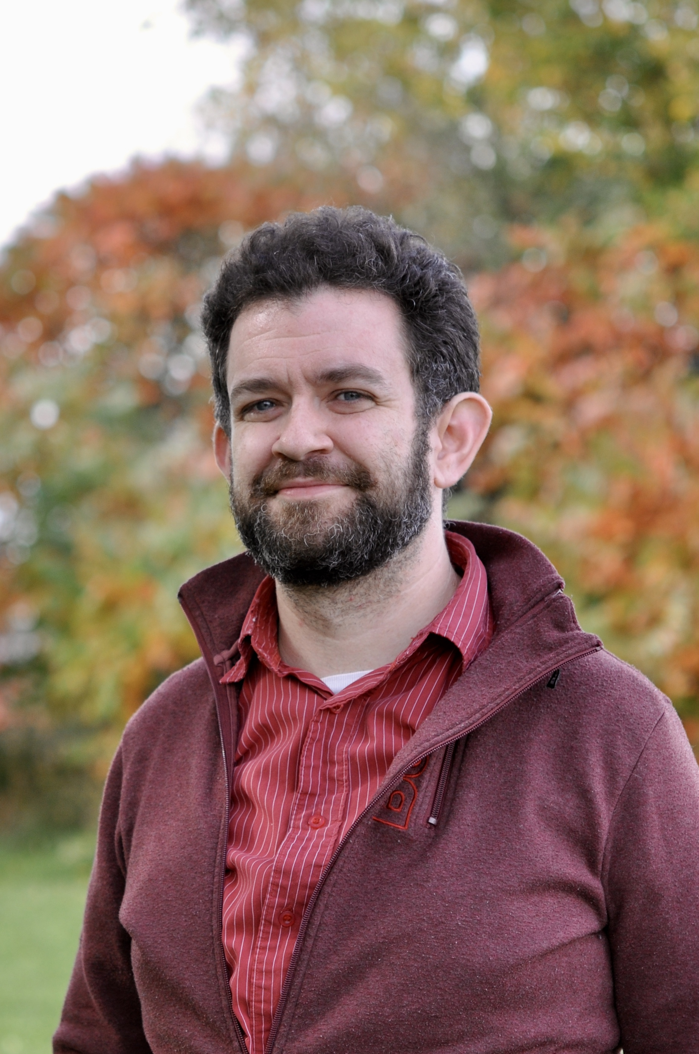
Research at Trent University – Faculty
Joel Cahn
Assistant Professor
joelcahn@trentu.ca
Dr. Cahn’s research interests include data comparison methods in forensic anthropology, bioarchaeology, and paleopathology, with a current focus on reporting practices in forensic anthropology, including how they affect and are affected by perceptions of ancestry, sex, and gender in various communities.

Slide 44
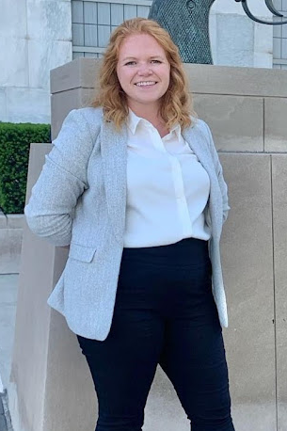
Research at Trent University – Faculty
Bailey Henwood
Assistant Professor
baileyhenwood@trentu.ca
Dr. Henwood is interested in all aspects of firearms research. Her ongoing research focuses on the forensic exploitation of firearms, with particular interest in the recovery of obliterated markings from sanitized firearms involved in criminal activity and illicit trafficking investigations.

Slide 45
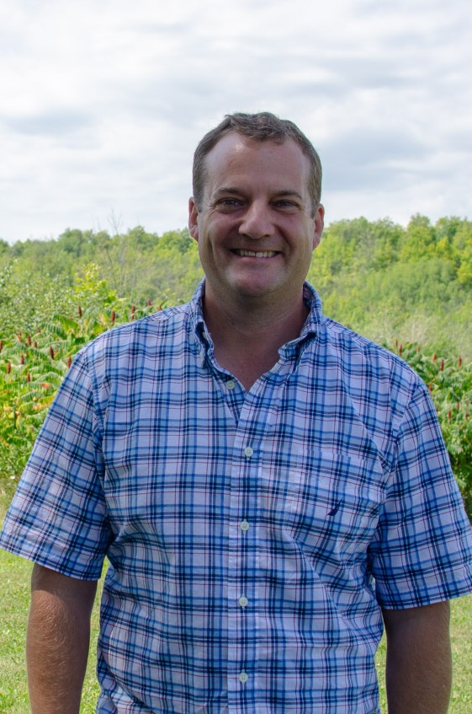
Research at Trent University – Faculty
Christopher Kyle
Full Professor, Director - Natural Resources DNA Profiling and Forensics Centre (NRDPFC), Director of the Forensic Science Graduate Program
NRDPFC: nrdpfc.ca/
christopherkyle@trentu.ca
Dr. Kyle’s research interests include wildlife genomics, wildlife disease, and wildlife forensics to support conservation and management initiatives and further our understanding of the ecology and evolution of species. Current research systems include bats, bison, Arctic fox and muskoxen and how these species respond to rapid changes in their ecosystems, such as from the introduction of invasive diseases.

Slide 46
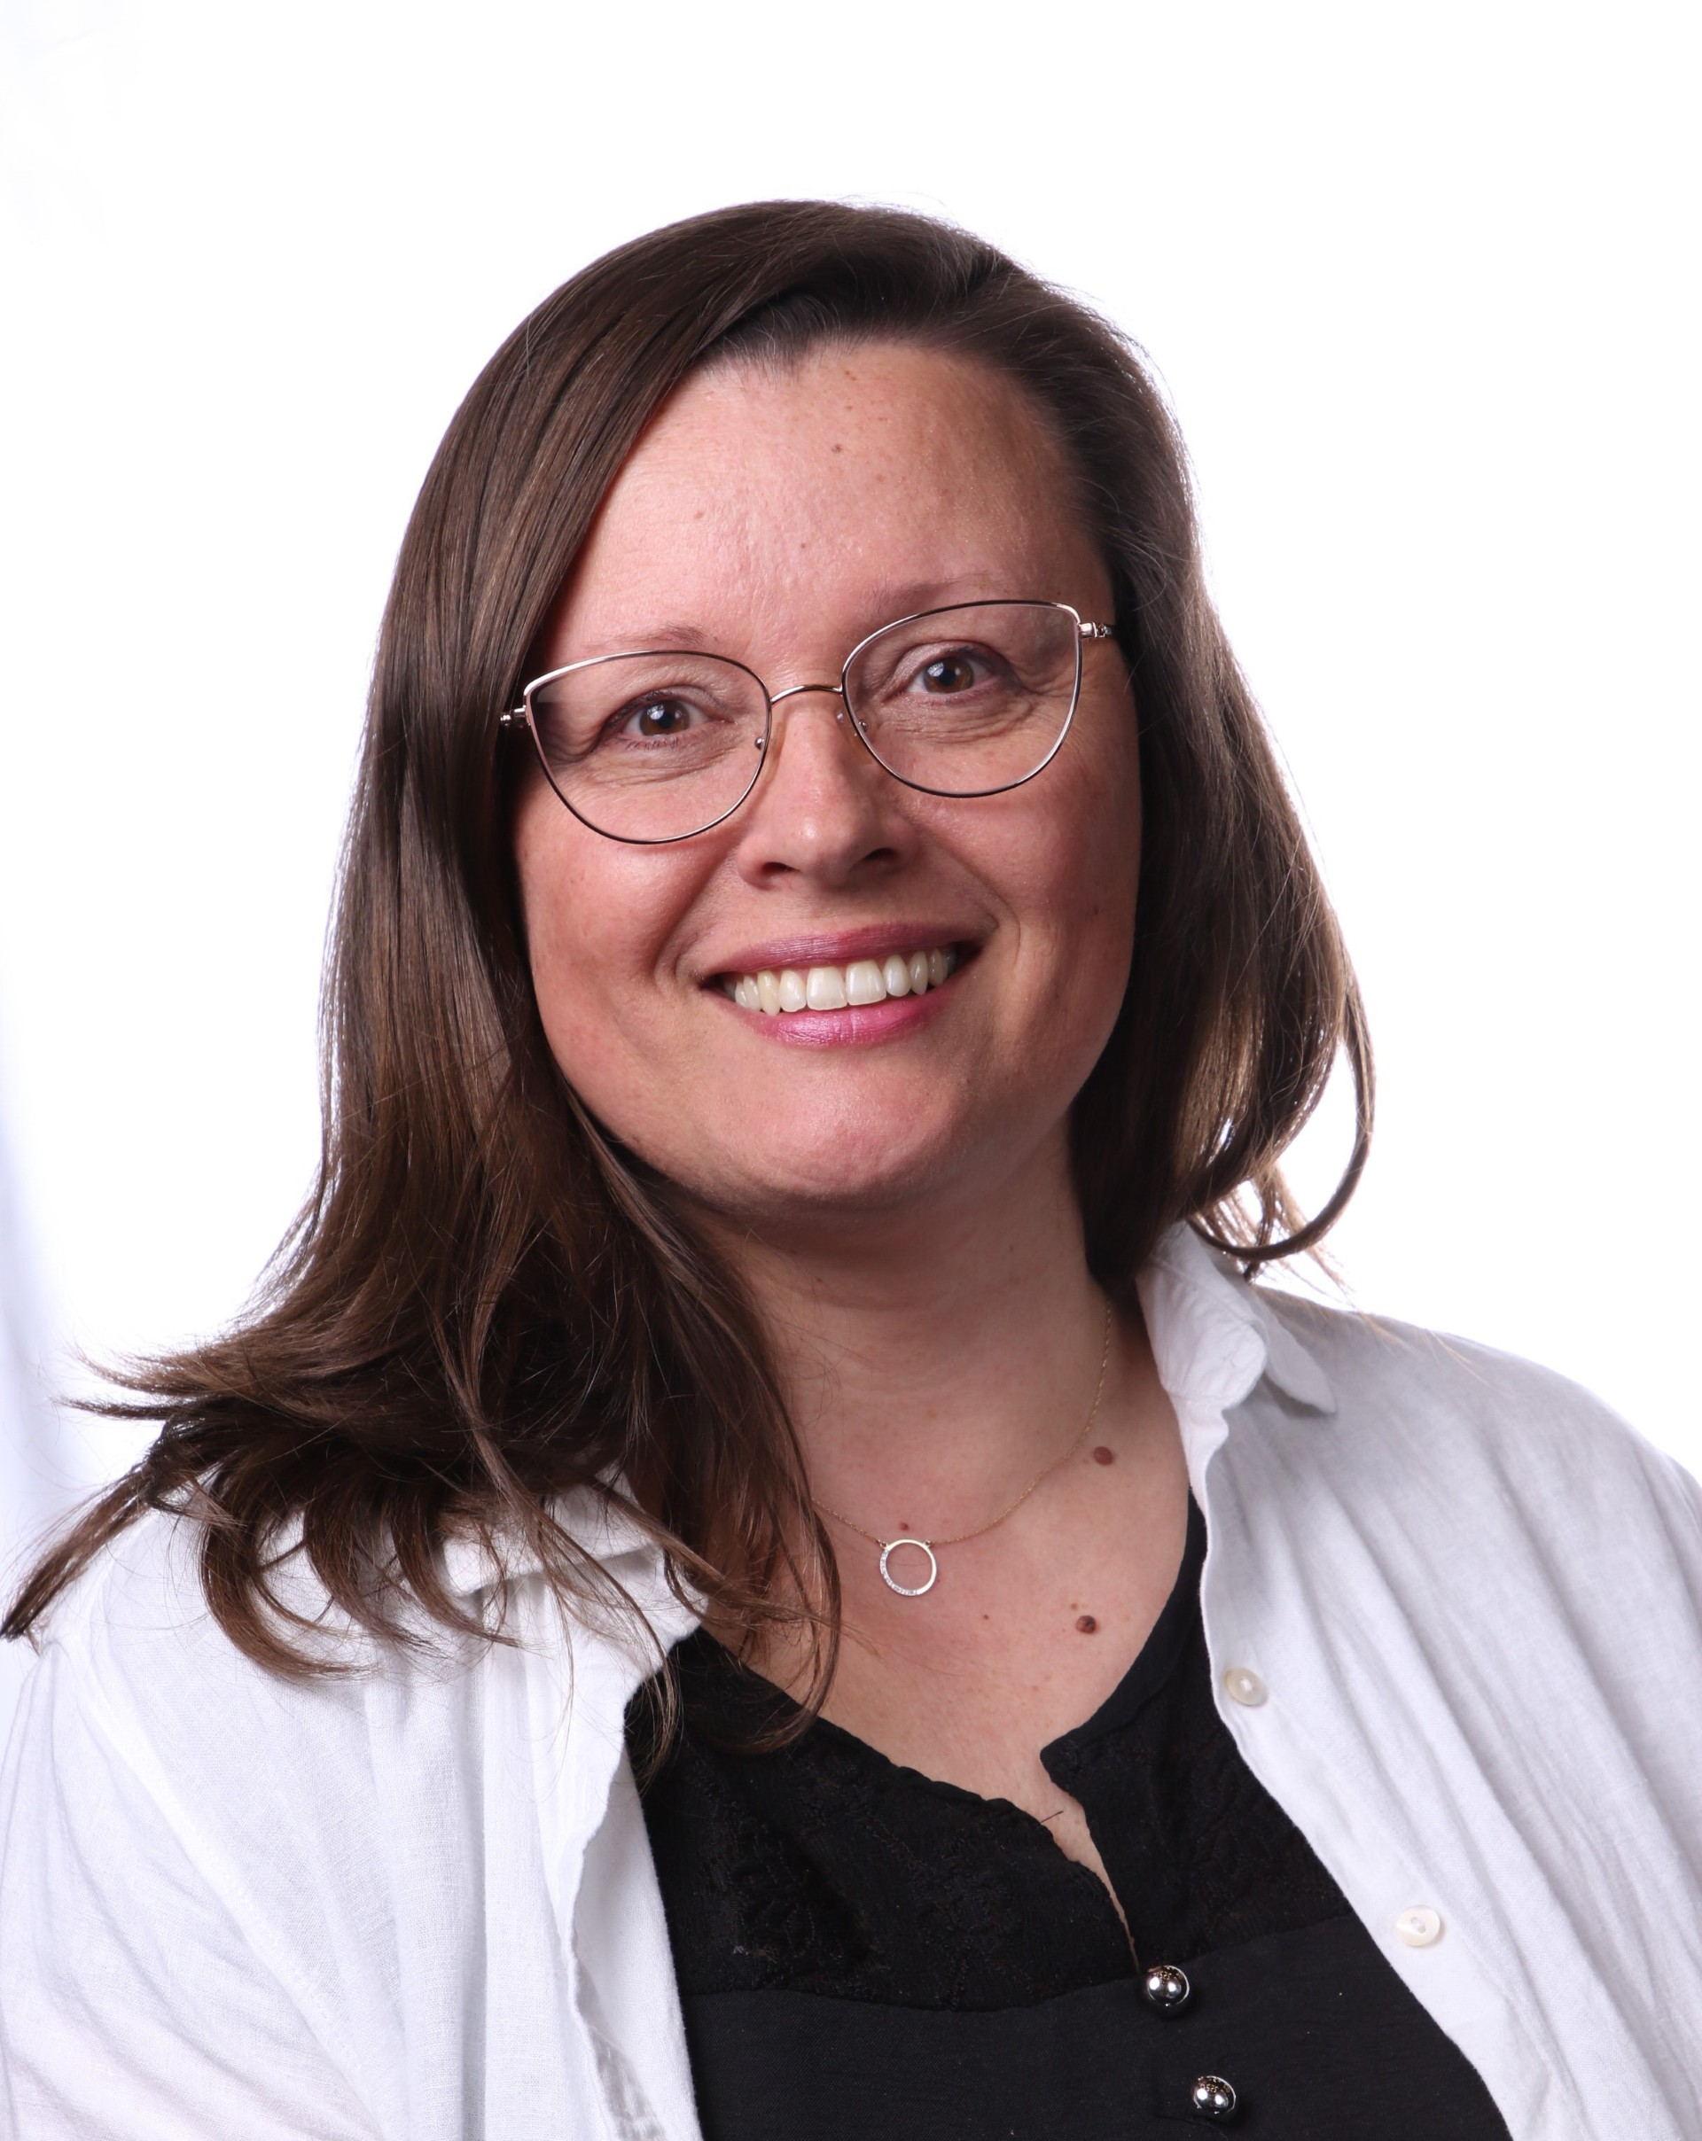
Research at Trent University – Faculty
Sanela Martic
Associate Professor, Chair of Forensic Science
Martic Lab: LINK
sanelamartic@trentu.ca
The research in Martic lab is focused on using chemistry for forensics, materials, environmental and biomedical applications. The fundamental aspects of chemistry are also being explored for design and development of greener and sustainable technologies and functional in-field devices.

Slide 47
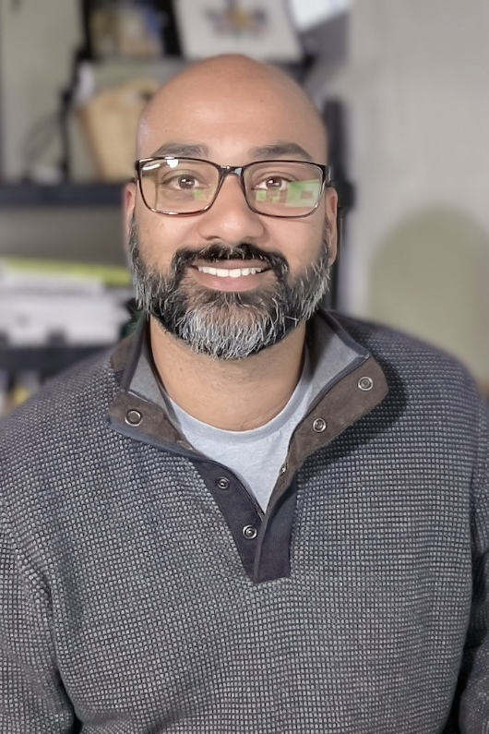
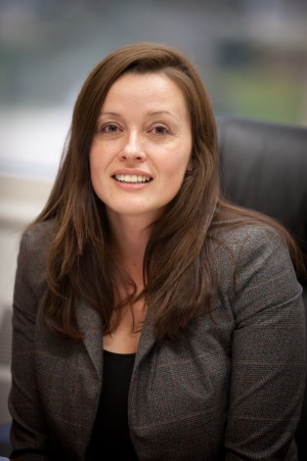
Research at Trent University – Faculty
Arun Moorthy
Assistant Professor
CRAFTS Lab: www.crafts-lab.ca
arunmoorthy@trentu.ca
Dr. Moorthy leads the Computational Research Applied to Forensic Technology and Sciences (CRAFTS) Lab–a multidisciplinary research group working on measurement and data interpretation challenges in the forensic sciences. Specific projects include:
Data-driven decision-making with the ForeST© Database
Computational tools for interpreting ambient ionization mass spectra

Slide 48
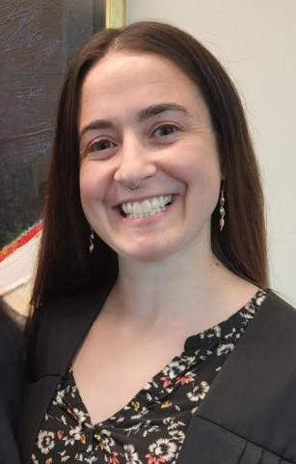
Research at Trent University – Faculty
Amy Scott
Associate Professor (cross-appointed with Anthropology)
Trent FAB Lab: LINK
amyscott@trentu.ca
Dr. Scott's research interests include bioarchaeology and understanding human health in 18th century Atlantic Canada. She is also a Forensic Anthropology consultant for the Government of Manitoba and local law enforcement agencies. Past research projects have focused on death and dying, paleopathology, and the ethics of working with human remains.
Dr. Scott is also the Director of the Trent University Bioarchaeology Field School, in partnership with Parks Canada.

Slide 49
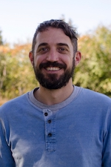
Research at Trent University – Faculty
Aaron Shafer
Full Professor
WAG Lab: http://www.aaronshafer.ca
aaronshafer@trentu.ca
Dr. Shafer is interested in applying genomic methods to conservation, wildlife management, and legal issues. His interests also involve using molecular tools to study evolution of wild animals, and degradation of biomolecules in a forensics context.

Slide 50
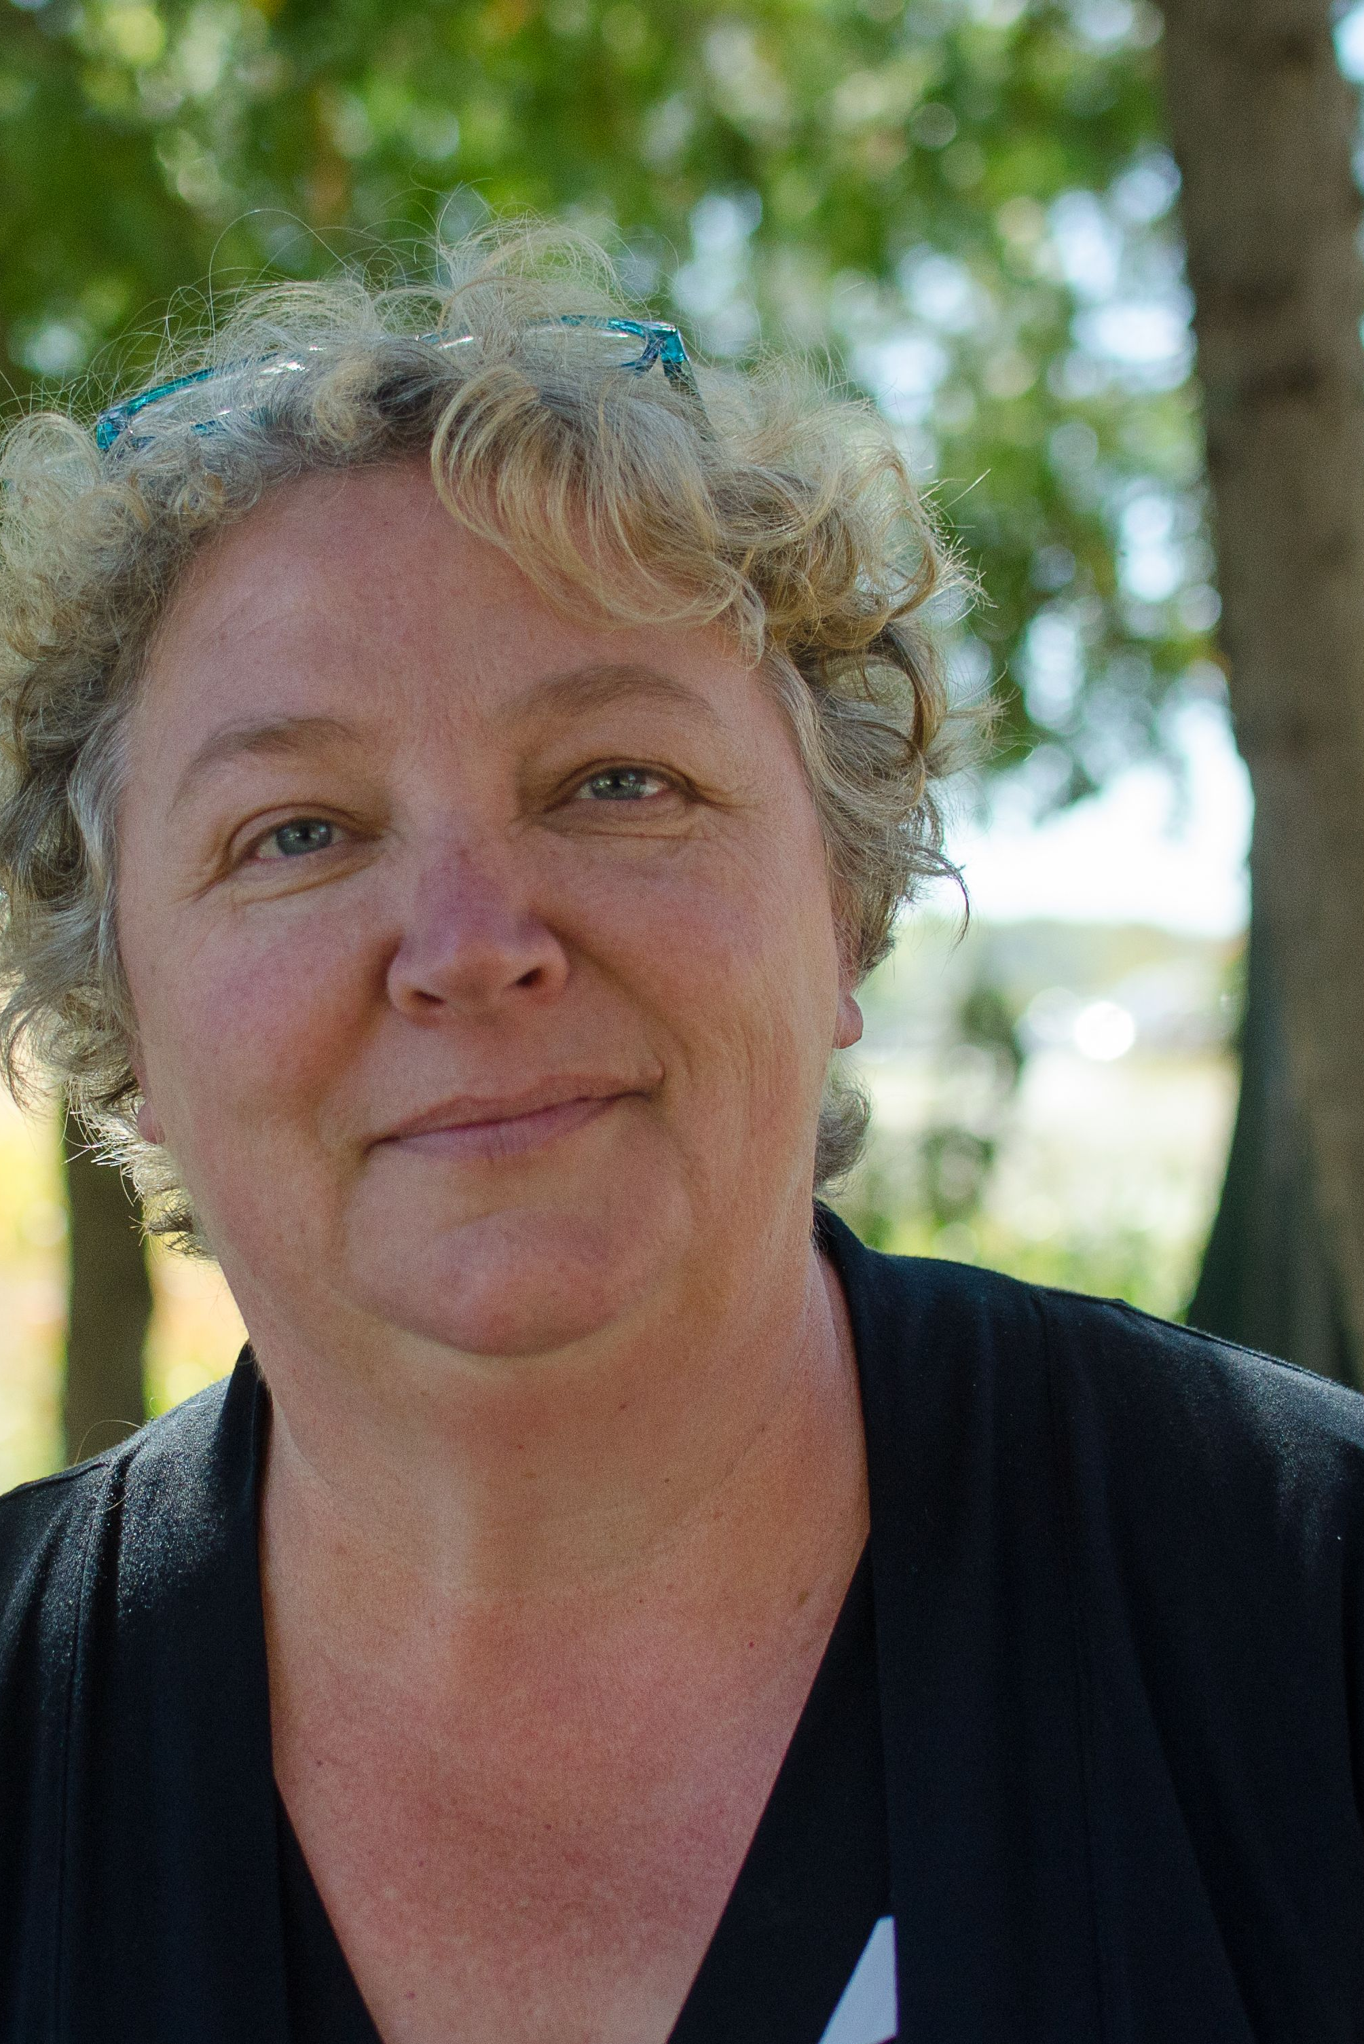
Research at Trent University – Faculty
Rhonda Smith
Associate Professor
rhondasmith@trentu.ca
Professor Smith conducts research into alternate ways scientific expert evidence is presented in criminal courts, judicial use of statistical evidence in criminal courts, and communication of law to scientists.

Slide 51
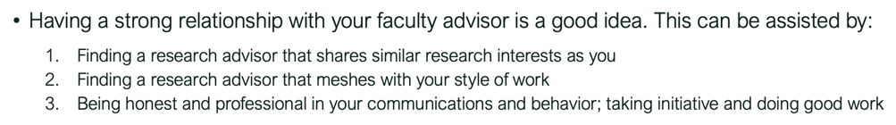
Approaching a faculty advisor
Do your work first!
  Read up on the potential advisor’s field and their recent work
  Think of potential (genuine) questions that would help you better understand their field
  Think about what you’d like from a research experience in their lab
  Think about what you can contribute to a lab given your ability
Send a professional and courteous email introducing yourself and stating your interest in learning about opportunities in their lab. Include your Curriculum Vitae (CV) and unofficial transcripts. Offer to meet them at their office during their scheduled office hours.

Slide 52
Approaching a faculty advisor
Every professor will have a different process for how many students they admit in their lab and how they sift through applicants, so be patient before you follow up with them
If the professor responds and invites you to meet them, try your best to GO TO THE MEETING! This is an informal interview, a way to get to know if your style of work meshes well.
A meeting doesn’t guarantee a thesis placement, summer job, but it helps you (and the professor) figure out options

Slide 53
On informational interviews
You may want to contact multiple professors just to see who has the opportunities that best align with your interests, but make sure you still
DO YOUR WORK FIRST
Do not expect each professor to give you a lecture about their research work
Go in with questions: research, lab culture, expectations, etc.
Listen to the answers: an informational interview is a way for you to learn

Slide 54
Working in a research lab
Be mindful of the fact that there are other people in the lab; try to take initiative and be independent without doing things that interrupt others’ on-going research.
For example, if you are working in the CRAFTS Lab and you think you could benefit from some specific software on our shared server.
  You SHOULD write up a short report that explains what the software is, why you need it, how much it costs, how it will benefit the lab, etc.—this is taking initiative.
  You SHOULD NOT install the software without asking—this is being inconsiderate.

Slide 55

Things to ponder (leading to 4th year)
I’ve put together a list of statements for you to think about over the next several months that I hope will help you decide your path for 4th year FRSC courses
Be honest; take note of your answers; see how your answers change over time
NOTE: This is nothing more than an exercise! I provide no warrantees!

Slide 56
I am willing to read many scientific publications.
strongly disagree
mildly disagree
mildly agree
agree
strongly agree
disagree
neutral
IP, CBR, Thesis
Traditional course work

Slide 57
I am willing to spend significant time writing proposals, reports and papers.
strongly disagree
mildly disagree
mildly agree
agree
strongly agree
disagree
neutral
IP, CBR, Thesis
Traditional course work

Slide 58
I prefer variety over singular activities.
strongly disagree
mildly disagree
mildly agree
agree
strongly agree
disagree
neutral
IP, CBR, Thesis
Traditional course work

Slide 59
I prefer predictability over uncertainty.
strongly disagree
mildly disagree
mildly agree
agree
strongly agree
disagree
neutral
IP, CBR, Thesis
Traditional course work

Slide 60
Efficiency is very important to me.
strongly disagree
mildly disagree
mildly agree
agree
strongly agree
disagree
neutral
IP, CBR, Thesis
Traditional course work

Slide 61
I like working with others.
strongly disagree
mildly disagree
mildly agree
agree
strongly agree
disagree
neutral
IP, CBR, Thesis
Traditional course work

Slide 62
I am comfortable being wrong.
strongly disagree
mildly disagree
mildly agree
agree
strongly agree
disagree
neutral
CBR, Thesis
IP, Traditional course work

Slide 63
There are professors on campus that do research I am interest in.
strongly disagree
mildly disagree
mildly agree
agree
strongly agree
disagree
neutral
Thesis
IP, CBR, Traditional course work

Slide 64
ETHICS AND RESPONSIBILITIES

Slide 65
Ethical considerations in Forensic Science
Ethics: a branch of philosophy concerned with individual conduct within a social structure
  Examines rationality for moral judgements, and attempts to determine what is morally right and wrong, what is just or unjust
The words ethics and morality are often used interchangeably in common parlance, but ethics are often “codified” by the social constructs that follow them (e.g., professional societies, universities, etc.)
  Ethical considerations, in theory, should be more-or-less agreed upon, by a society
  Ethical considerations should evolve with time and experience

Slide 66
Ethics as a professional forensic scientist
Almost all professional organizations use a code of conduct or code of ethics to provide guidance to their members and set expectations for their customers
Broadly, two models for “codes”:
  General Models: Often used by large umbrella organizations and societies with voluntary membership. E.g., Code of Conduct of the Canadian Society of Forensic Science (CSFS)
  Specific Models: Often used by specific organizations and organization units with employees. E.g., Code of Conduct of the Royal Canadian Mounted Police (RCMP)

Slide 67
CSFS Rules of Professional Conduct
Members of the Canadian Society of Forensic Science,
 | with respect to their responsibilities to the C.S.F.S., shall:
1 | comply with the By-laws of the Society;
2 | report to the Board, any violation of these “Rules of Professional Conduct” by another member of the Society;
3 | accept that their membership in the Society demonstrates an active interest in forensic science however, this membership does not by itself mean that they have the necessary qualifications to practice in their forensic science discipline nor does it mean that they are competent in their forensic science discipline;

Slide 68
CSFS Rules of Professional Conduct
Members of the Canadian Society of Forensic Science,
 | with respect to their responsibilities to their client, employer or to the court, shall:
4 | treat all information from an agency or client with the appropriate confidentiality;
5 | make all reasonable efforts to treat items of potential evidential value with the care and control necessary to ensure their integrity;
6 | take reasonable steps to ensure that all items in a case receive appropriate technical analysis;
7 | a. utilise methods, techniques, standards and controls, provided that they exist, that they are generally accepted and that they are current and; b. utilise methods and techniques with standards and controls to conduct examinations and analysis such that they could be reproduced by another qualified and competent person;
8 | make full and complete disclosure as required by law of the findings to the submitting agency or client;

Slide 69
CSFS Rules of Professional Conduct
Members of the Canadian Society of Forensic Science,
 | with respect to their responsibilities to their client, employer or to the court, shall:
9 | make and keep work notes on all items received, the examinations done, the results obtained and the findings and conclusions made in a timely fashion;
10 | render opinions and conclusions strictly in accordance with the results and findings in the case and only to the extent justified by those results and findings;
11 | make all efforts to testify in a clear, straightforward manner and refuse to extend themselves beyond their field of expertise or level of competence;
12 | not exaggerate, embellish or otherwise misrepresent qualifications when testifying;
13 | be impartial and independent in their analysis, reporting and testimony;

Slide 70
CSFS Rules of Professional Conduct
Members of the Canadian Society of Forensic Science,
 | with respect to their responsibilities to the profession of forensic science, shall:
14 | carry out their duties in a professional manner and strive to be worthy of the confidence of the public;
15 | regard and respect their peers with the same standards that they hold for themselves;
16 | a. set a reasonable fee for services if it is appropriate to do so, taking care not to set unreasonably high fees for services, not to charge fees for services not done or services that are unnecessary, while being able to reduce or waive fees; b. not, under any circumstances, render services on a contingency basis; and
17 | strive to maintain and improve their skills and knowledge and to keep current with advances and standards in their discipline.

Slide 71
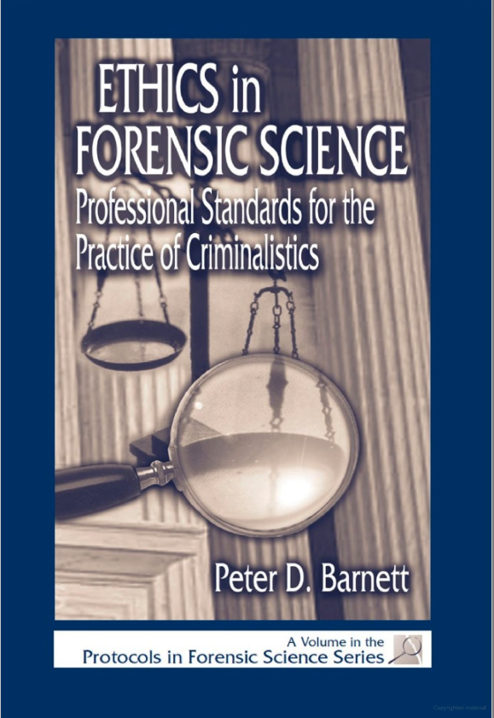
Applied ethics in professional practice
“It is easy to read a document titled Code of Ethics or Standards of Professional Practice, nod wisely, and think I agree with all of that and cannot imagine a situation in which there would be a problem with following the practices specified… the proper course of action is not always obvious, codes of ethics do not necessarily cover all contingencies, and not all professional standards are necessarily appropriate.”
(Barnett, 2001, p.7)

Slide 72
Example 1: Selective Evidence
Scenario: You are a consulting forensic scientist hired by the defense to review a report of analysis provided by law enforcement agency. You identify a mistake in the original analysis and provide this finding to the defense. But you also realize there is additional evidence that had not been analyzed by law enforcement OR sent to you by the defense for further examination.

Slide 73
Example 1: Selective Evidence
Ethical consideration: You—hired by the defense—only looked at the analyses that were sent to you. It is possible that analysis of the new evidence would provide new insights. What is your obligation?

Slide 74
Example 1: Selective Evidence
Applicable ethical codes from CSFS:
 | with respect to their responsibilities to their client, employer or to the court, shall:
6 | take reasonable steps to ensure that all items in a case receive appropriate technical analysis;
10 | render opinions and conclusions strictly in accordance with the results and findings in the case and only to the extent justified by those results and findings;

Slide 75
Example 1: Selective Evidence
Resolution: I can tell my employer, the defense, that there is additional evidence that has not been evaluated. It is up to my employer and the crown attorney’s office to decide whether such evaluations are necessary—I should avoid commenting on hypothetical analyses and only report findings that I knows are true.

Slide 76
Example 2: Rumored incompetence
Scenario: A consulting forensic scientist, Jeff, is retained by the crown attorney’s office to work on a major case in which the local laboratory does not have the expertise. Jeff is currently the subject of allegations that, if true, cast doubt on his competence or credibility.

Slide 77
Example 2: Rumored incompetence
Ethical consideration: If you were a forensic scientist working at the local laboratory, should you inform the crown attorney’s office about the allegations against Jeff? Should you inform the defense? What is your obligation.

Slide 78
Example 2: Rumored incompetence
Applicable ethical codes from CSFS:
 | with respect to their responsibilities to their client, employer or to the court, shall:
 | none
 | with respect to their responsibilities to the profession of forensic science, shall:
14 | carry out their duties in a professional manner and strive to be worthy of the confidence of the public;

Slide 79
Example 2: Rumored incompetence
Resolution: Unclear. Likely depends on what the allegations are against Jeff, how I came to be aware of the allegations, etc. To me, this is an ethical scenario where there is no obvious path-forward.

Slide 80
Some example “Codes of Ethics”
https://www.csfs.ca/become-a-member/code-of-conduct/
https://www.acfi.ca/our-commitment/code-of-professional-ethics-and-conduct/
https://www.abft.org/code-of-ethics/
https://www.wildlifeforensicscience.org/mission/ethical-guidelines/
https://www.csofs.org/about-us/governance/code-of-conduct/

Slide 81
Ethics as a researcher
The goal of research activity is to extend knowledge and understanding through disciplined inquiry and systematic investigation
“Research is a step into the unknown.” TCPS2-2022 (p.13)
Because research is exploring ideas that are not yet understood, there are often risks to participants; risks can be trivial or profound
Because research is so diverse, there is no-single “code of ethics” document; there are some institutional mechanisms to encourage research is conducted ethically, and guidelines for responsible researchers to follow

Slide 82
Research Ethics Board
One of the main mechanisms in place to encourage ethical research are research ethics boards
Research ethics board (REB): A multidisciplinary committee that reviews all research proposals involving human participants to ensure the projects meet the highest ethical standards and that safeguards are implemented to protect participants and/or communities.
At Trent, the REB is composed of faculty, graduate students and community members

Slide 83
Research Ethics Board
Every institutions REB may have slightly different protocols and responsibilities. At Trent, the REB is expected to (1-3):
Conduct ethics reviews of proposals from members of Trent University, and others who conduct research involving human participants at Trent, to determine conformance with the whole of the Tri-Council Policy Statement: “Ethical Conduct for Research Involving Human Subjects”, within the context of the University’s responsibility to ensure that research meets high scientific and scholarly standards;
Delegate course-related, non-funded, minimal risk research to the relevant department, school or graduate program ethics review body for review and approval; and oversee that review process;
Terminate any research that it considers to be threatening or causing distress to the participants, deviates from the approved protocol, or has not been approved by the appropriate body;

Slide 84
Research Ethics Board
Every institutions REB may have slightly different protocols and responsibilities. At Trent, the REB is expected to (4-7):
Ensure that departments, schools, and graduate programs are familiar with, and adhere to the Trent University Senate Policy for Research Involving Human Participants;
Act as an advisory body for the University, educating the community on ethics in research and providing guidance on the ethics review process;
Report at least once a year to Senate on its activities, including a list of protocols reviewed and approved; and
Ensure that departments advise students about the relevant aspects of ethics in research and the paramount need to treat participants ethically and respectfully.

Slide 85
Research Ethics Guidance Documents
The Canadian Interagency Advisory Panel on Research Ethics has provided a policy guideline for researchers conducting research in Canada and Canadians doing research abroad: Tri-Council Policy Statement (TCPS)
If you are considering doing research involving humans (including surveys), you must complete TCPS training prior to starting your research
TCPS Highlights: Defines the core principles that shape the the policy. Covers topics including: the process of acquiring consent for research, fairness and equity considerations, privacy and confidentiality, and considerations for working with first nations, inuit and metis peoples of Canada.

Slide 86
Research Ethics Guidance Documents
The U.S. National Academies has a guidance document titled “On Being a Scientist: A guide to conduct in research” from 2009
This document does explore several important but “grey” topics faced by active scientist: ensuring laboratory safety, sharing of research results, authorship and allocation of credit / intellectual property

Slide 87
Research Ethics Guidance Documents
Links to documents:
Trent Research Ethics Board
TCPS 2 (2022) (Canada, Tri-council Policy Statement)
On being a scientist (2009) (US National Academy of Science)
On being a scientist (2026) (US National Academy of Science)
Link to Training (get a certificate): https://tcps2core.ca/welcome

Slide 88
Good luck with content quizzes 5a and 5b!
(Due November 5th at 11:59 PM)

