Slide 1
Aspect-based sentiment analysis for informed shopping
- Asma Narmawala (202318025) - Ananya Adarsh (202318027)
- Preyali Dave (202318028)

Slide 2

Problem Statement
When buying a product online, customers face disparities between the information presented and the actual product.
Navigating through the vast amounts of information and reviews can feel overwhelming, leaving consumers uncertain about the accuracy of the details they come across.
This inconsistency complicates the process of determining the best option for their needs when making online purchasing decisions.

Slide 3
Our goal is to assist consumers in making informed decisions about purchasing the right product.

Slide 4
Methodology
Data collection
Pre-Processing
Extracting
aspects
Output
Fine tuning our trained model on reviews dataset
Model training on labelled dataset

Slide 5
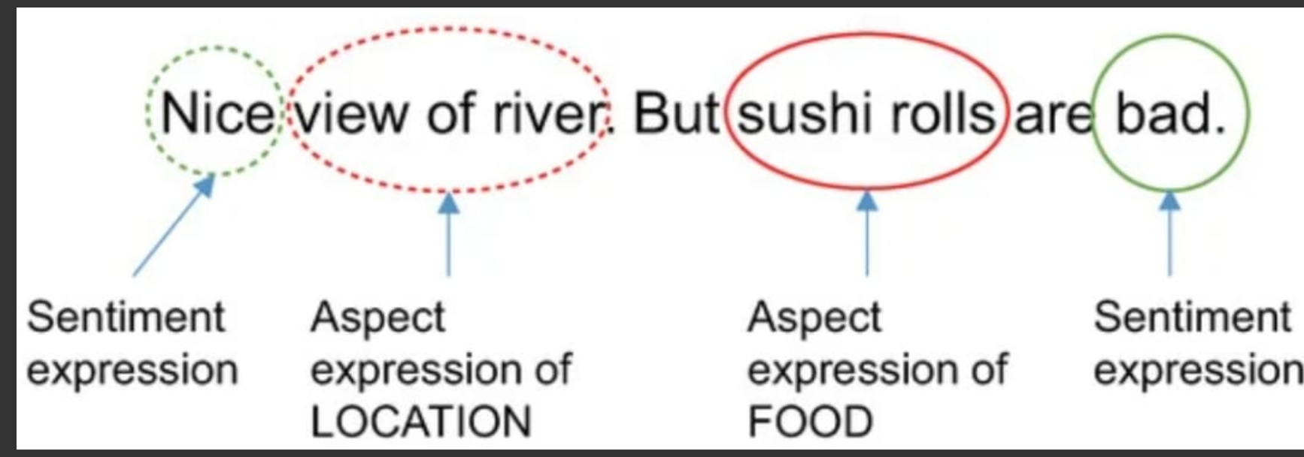

Aspect-based sentiment analysis
Aspect-based sentiment analysis is utilized to analyze text data, such as customer reviews, by considering specific aspects or attributes of a product, service, or entity.
Unlike the general sentiment analysis, which provides an overall sentiment score for a piece of text, aspect-based sentiment analysis aims to extract sentiment towards individual aspects mentioned within the text.

Slide 6
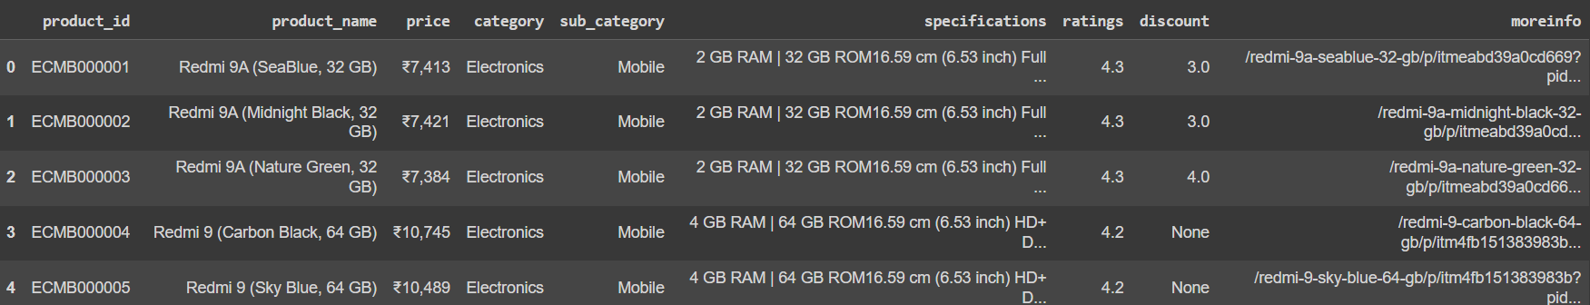
Data
We have data in the following format
We have 53,493 rows and 9 columns

Slide 7
Data pre-Processing
Following things were taken care of in the pre-processing step:
URL Removal
Emoji Handling
Tokenization and Stop words Removal
Stemming and Lemmatization

Slide 8
Aspect Extraction:
We analyze customer reviews to identify the most frequently mentioned topics or "aspects."
This helps us in understanding customer preferences, concerns, or common subjects in reviews
We focus on these key aspects for our further analysis.

Slide 9
Model training and fine tuning
We used an already labeled dataset for sentiment analysis and trained an SVM (Support Vector Machine) on that dataset.
The trained model is then used to predict sentiments on a test set, and its performance is evaluated using precision, recall, and F1-score metrics, providing insights into the model's accuracy in sentiment classification.
We use this trained SVM model on our reviews dataset to obtain polarity scores for each of the aspect.

Slide 10


Output
We prompt the user to enter a product name and an aspect for that product and based on the obtained polarity for each aspect for each product in the previous step we provide user with the following output

Slide 11


