Slide 1
Object- Oriented Programming (CS201)

Slide 2

JAVA
C
1970
C++
1979
JAVA
1991
http://java.sun.com/
C#
2000

Slide 3
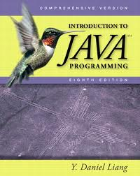
Text Book

Slide 4
TIOBE Programming Community Index for December 2011 http://www.tiobe.com
Position Dec 2011 | Position Dec 2010 | Programming Language | Ratings Dec 2011
1 | 1 | Java | 17.561%
2 | 2 | C | 17.057%
3 | 3 | C++ | 8.252%
4 | 5 | C# | 8.205%
5 | 8 | Objective-C | 6.805%
6 | 4 | PHP | 6.001%
7 | 7 | (Visual) Basic | 4.757%
8 | 6 | Python | 3.492%
9 | 9 | Perl | 2.472%
10 | 12 | JavaScript | 2.199%
11 | 11 | Ruby | 1.494%
12 | 10 | Delphi/Object Pascal | 1.245%
13 | 13 | Lisp | 1.175%
14 | 23 | PL/SQL | 0.803%
15 | 14 | Transact-SQL | 0.746%
16 | 16 | Pascal | 0.734%
17 | 18 | Ada | 0.632%
18 | 35 | Logo | 0.619%
19 | 17 | Assembly | 0.563%
20 | 25 | ABAP | 0.560%

Slide 5
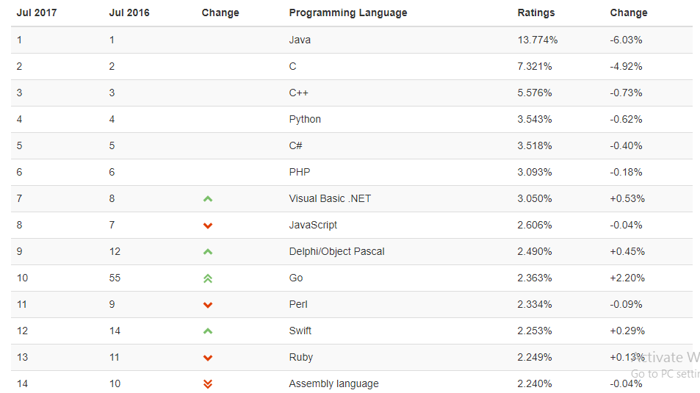

Slide 6
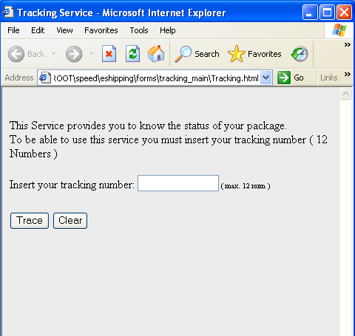
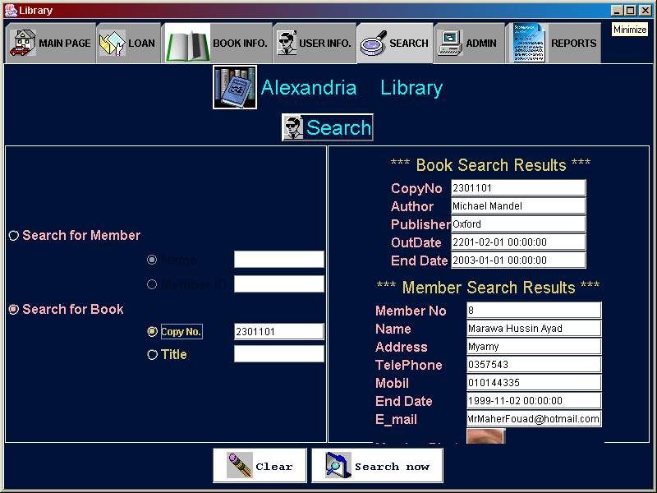

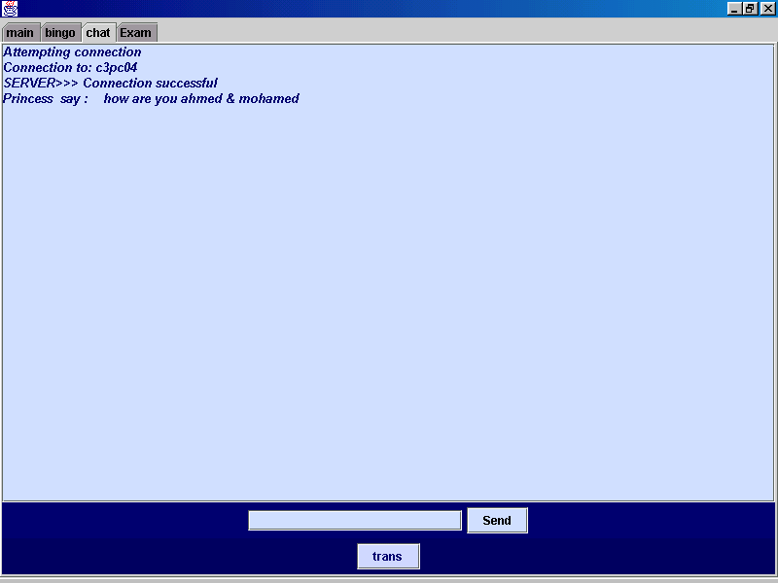

What can JAVA Do???
Web Application
Desktop Application
Mobile Application
Network Application

Slide 7
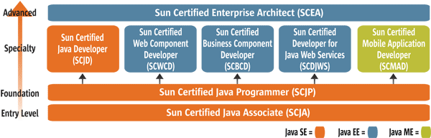
Editions
Java Card for smartcards
Java Platform, Micro Edition (Java ME) — targeting environments with limited resources.
Java Platform, Standard Edition (Java SE) — targeting workstation environments.
Java Platform, Enterprise Edition (Java EE) — targeting large distributed enterprise or Internet environments.
Java SE version history
JDK 1.0 (January 23, 1996)
JDK 1.1 (February 19, 1997)
J2SE 1.2 (December 8, 1998)
J2SE 1.3 (May 8, 2000)
J2SE 1.4 (February 6, 2002)
J2SE 5.0 (September 30, 2004)
Java SE 6 (December 11, 2006)
Java SE 7 (July 2011)
Notes:
Java SE 7 (Expected 2009)

Slide 8
Advantages of JAVA
Java is simple.
Java is object-oriented.
Java is platform-independent.
Java embraces Distributed computing.
Java is secure.
Java is reliable.
Java is multithreaded.
Automatic memory management
Java is free!
Disadvantages of JAVA
Slower
memory-consuming
Single-pattern language (Every thing is an object)
statically typed language
Easy to decompile (need java obfuscator)
Notes:
Advantages of JAVA JAVA offers a number of advantages to developers. Java is simple: Java was designed to be easy to use and is therefore easy to write, compile, debug, and learn than other programming languages. The reason that why Java is much simpler than C++ is because Java uses automatic memory allocation and garbage collection where else C++ requires the programmer to allocate memory and to collect garbage. Java is object-oriented: Java is object-oriented because programming in Java is centered on creating objects, manipulating objects, and making objects work together. This allows you to create modular programs and reusable code. Java is platform-independent: One of the most significant advantages of Java is its ability to move easily from one computer system to another.
The ability to run the same program on many different systems is crucial to World Wide Web software, and Java succeeds at this by being platform-independent at both the source and binary levels. Java is distributed: Distributed computing involves several computers on a network working together. Java is designed to make distributed computing easy with the networking capability that is inherently integrated into it.
Writing network programs in Java is like sending and receiving data to and from a file. For example, the diagram below shows three programs running on three different systems, communicating with each other to perform a joint task. Java is interpreted: An interpreter is needed in order to run Java programs. The programs are compiled into Java Virtual Machine code called bytecode.
The bytecode is machine independent and is able to run on any machine that has a Java interpreter. With Java, the program need only be compiled once, and the bytecode generated by the Java compiler can run on any platform. Java is secure: Java is one of the first programming languages to consider security as part of its design. The Java language, compiler, interpreter, and runtime environment were each developed with security in mind. Java is robust: Robust means reliable and no programming language can really assure reliability. Java puts a lot of emphasis on early checking for possible errors, as Java compilers are able to detect many problems that would first show up during execution time in other languages. Java is multithreaded: Multithreaded is the capability for a program to perform several tasks simultaneously within a program. In Java, multithreaded programming has been smoothly integrated into it, while in other languages, operating system-specific procedures have to be called in order to enable multithreading. Multithreading is a necessity in visual and network programming. Disadvantages of JAVA Performance: Java can be perceived as significantly slower and more memory-consuming than natively compiled languages such as C or C++. Look and feel: The default look and feel of GUI applications written in Java using the Swing toolkit is very different from native applications. It is possible to specify a different look and feel through the pluggable look and feel system of Swing. Single-paradigm language: Java is predominantly a single-paradigm language. However, with the addition of static imports in Java 5.0 the procedural paradigm is better accommodated than in earlier versions of Java.
http://en.wikipedia.org/wiki/Type_system#Static_typing

Slide 9
Object- Oriented Programming (CS201)
Lecture 1

Slide 10
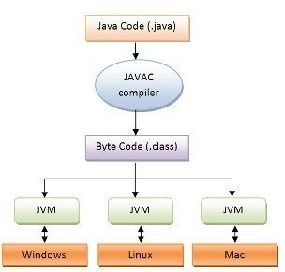
Java Basic Information
Source code is first written in plain text files ending with the .java extension.
JAVA source files are compiled into .class files by the java compiler.
The .class file contains bytecodes which is the machine language of the Java Virtual Machine(Java VM).
The JVM runs your application by running the .class file.
Through the Java VM, the same application is capable of running on multiple platforms.
MyProgram.java
MyProgram.class
class MyProgram
{
……..
}
…………
………
……….
Notes:
C#
.class=intermediate language file .exe
JVM=Common Language Runtime (CRM)
classes has .cs extention
Java is both compiled and interpreted. At first, the Java source code (in .java files) is compiled into the so-called Bytecode (.class files). The Bytecode is a pre-compiled, platform independent version of your program. The .class files can be used on any operating system. When the Java application is started, the Bytecode is interpreted by the Java Virtual Mashine. Because the Bytecode is pre-compiled, Java does not have the disadvantages of classical interpreted languages, like BASIC. Read more: http://wiki.answers.com/Q/Is_java_interpreted#ixzz1HgWHbMTb
A bytecode program may be executed by parsing and directly executing the instructions, one at a time. This kind of bytecode interpreter is very portable. Some systems, called dynamic translators, or "just-in-time" (JIT) compilers, translate bytecode into machine language as necessary at runtime: this makes the virtual machine unportable, but doesn't lose the portability of the bytecode itself. For example, Java and Smalltalk code is typically stored in bytecoded format, which is typically then JIT compiled to translate the bytecode to machine code before execution. This introduces a delay before a program is run, when bytecode is compiled to native machine code, but improves execution speed considerably compared to direct interpretation of the source code—normally by several measures.

Slide 11
your first application!
To write, compile & run your first program, you'll need:
The Java SE Development Kit 7 (JDK 7).
A text editor.
1-JDK 7
http://java.sun.com/javase/downloads/index.jsp
JDK 7 : Java SE 7
Java SE 7 Documentation
2-A Text Editor
http://www.textpad.com
TextPad
Alternative :NetBeans IDE http://netbeans.org/

Slide 12
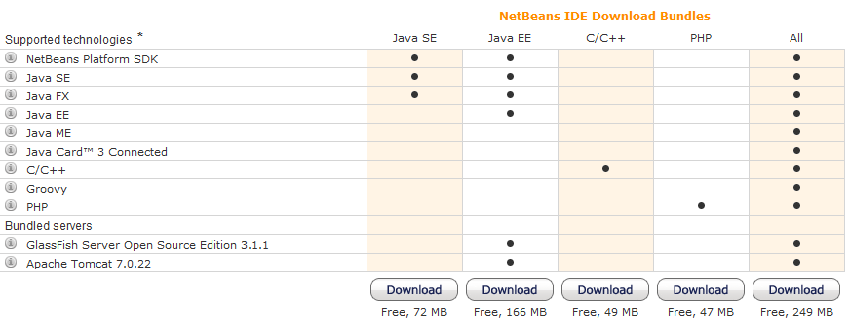


Installing NetBeans
http://netbeans.org/downloads/index.html
JDK7 & NetBeans Bundle
JDK 7u3 with NetBeans 7.1
http://www.oracle.com/technetwork/java/javase/downloads/jdk-7-netbeans-download-432126.html

Slide 13
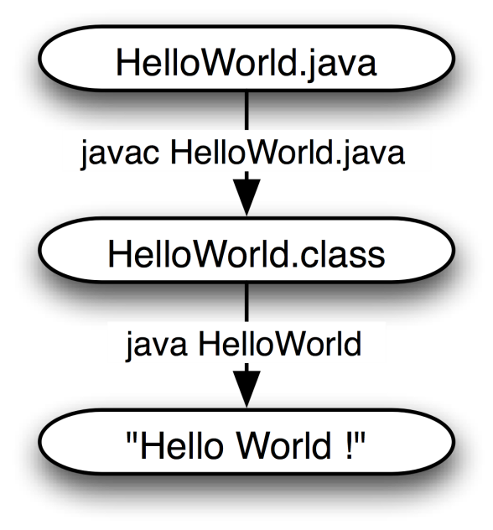

Creating Your First Application
Create a source file
Compile the source file into a .class file :The Java programming language compiler (javac) takes your source file and translates its text into bytecodes.
(. class files are produced only if there are no compilation errors)
Run the program The Java application launcher tool (java) uses the Java virtual machine to run your application.
javac
java
Notes:
Your first application, HelloWorldApp, will simply display the greeting "Hello world!". To create this program, you
Create a source file A source file contains code, written in the Java programming language, that you and other programmers can understand. You can use any text editor to create and edit source files.
Compile the source file into a .class file The Java programming language compiler (javac) takes your source file and translates its text into instructions that the Java virtual machine can understand. The instructions contained within this file are known as bytecodes.
Run the program The Java application launcher tool (java) uses the Java virtual machine to run your application.
will:

Slide 14
A Simple Java Program
Keyword
Identifier for Class name
// this program prints “Hello World” to screen
public class HelloWorld
{
public static void main(String[] args)
{
System.out.println("Hello World!");
}
}
Comment
Modifier
Main method declaration
Statement Calling the method for printing to screen
HelloWorld.java
Notes:
package cs243;

Slide 15
compiler error
A problem in the structure of a program that causes the compiler to fail and prevent
the creation of the .class file.
1 public class Hello {
2 pooblic static void main(String[] args) {
3 System.owt.println("Hello, world!")
4 }
5 }
compiler output:
Hello.java:2: <identifier> expected
pooblic static void main(String[] args) {
^
Hello.java:5: ';' expected
}
^
2 errors

Slide 16
The main method
The main method is called automatically when the class is executed
The main method signature is
public static void main (String [] args)
The argument of main method must be an array of string ,however it can take any name
The main must be public ,void and static

