Slide 1
Employee Attrition Analysis

Slide 2
Introduction
A company which was established a few years back is facing around a 15% attrition rate for a couple of years.
And it's majorly affecting the company in many aspects.
In order to understand why employees are leaving the company and reduce the attrition rate in company has approached an HR analytics consultancy for analyzing the data they have.

Slide 3
Employee Attrition Dataset Summary
Employee Attrition Dataset Summary
Demographics: Age, Gender, Marital Status.
Job Details: Role, Department, Job Level, Tenure.
Compensation: Monthly Income, Salary Hike, Stock Options.
Experience: Total Working Years, Companies Worked, Training.
Satisfaction: Environment and Job Satisfaction, Work-Life Balance, Job Involvement.
Performance: Performance Rating, Attrition Status.
This dataset provides insights into the factors influencing employee attrition, including demographics, job satisfaction, compensation, and work-life balance.

Slide 4
Main KPIs
Employee Count
Attrition Count
Attrition Rate
Active Employees
Average Age

Slide 5
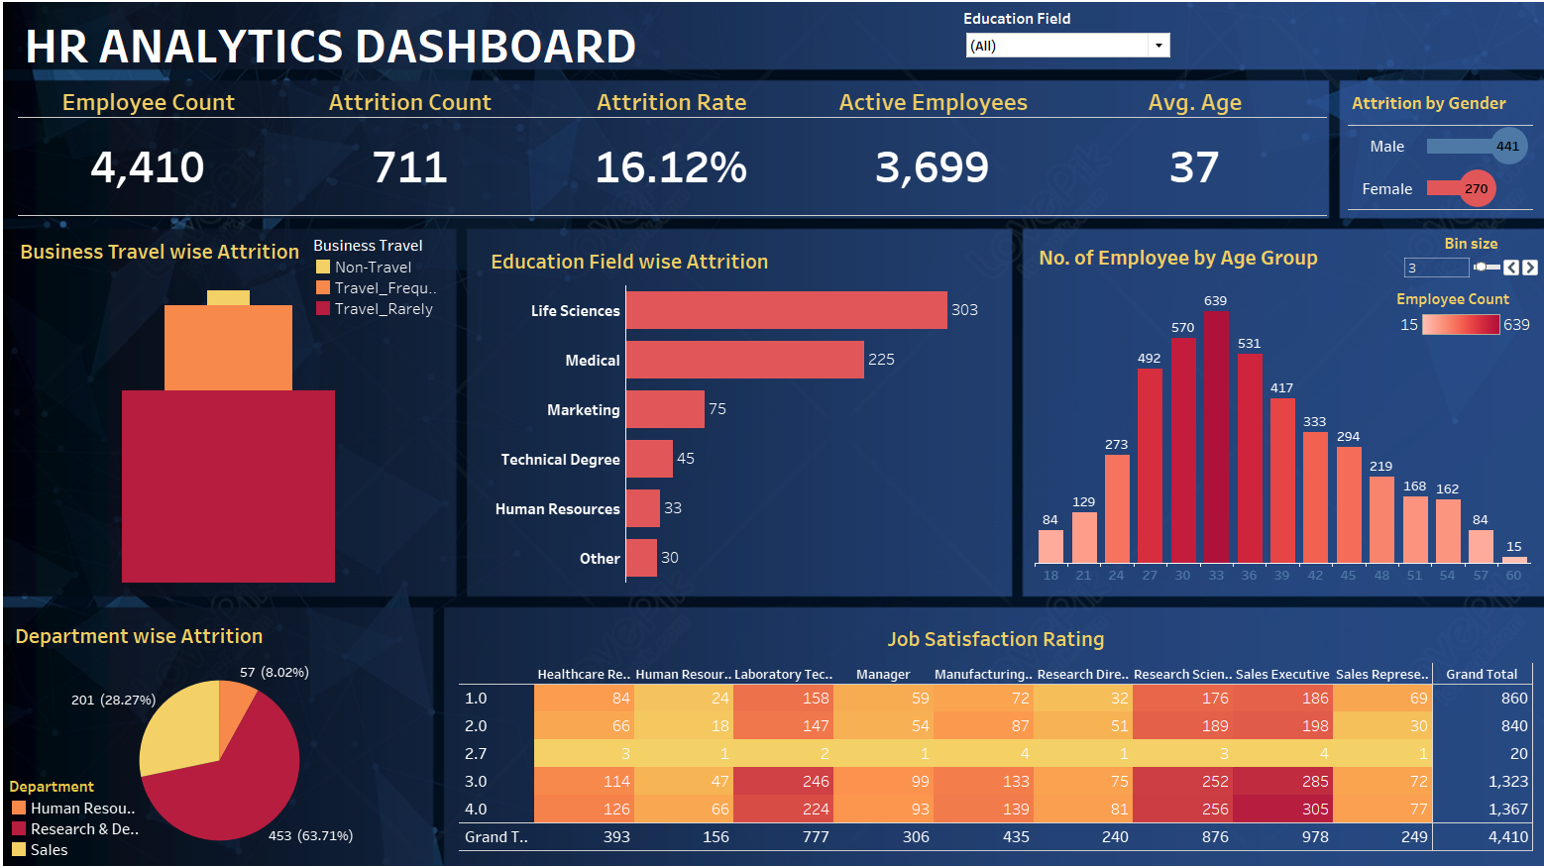
Employee Attrition Analysis Dashboard

Slide 6
Thank You

