Slide 1

Fine-Tuning Stable Diffusion XL for Naruto-Style Image Generation with DreamBooth and LoRA
A Comprehensive Scientific Exploration of LoRA Fine-Tuning

Slide 2
Outline
01
02
03
04
05
06
Project Overview
Methodology
Dataset and Preprocessing
Implementation
Results
Conclusion

Slide 3
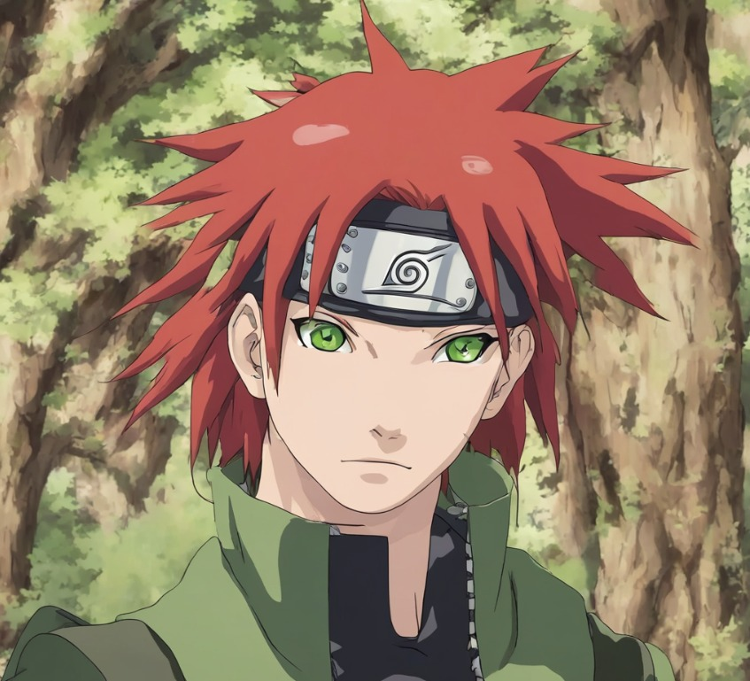
01
Project Overview

Slide 4
Goal:
Fine-tune Stable Diffusion XL (SDXL) using LoRA to generate personalized Naruto anime characters.
Scientific Motivation:
- Enable subject-driven generation with minimal data (small dataset, 3–5 images per character).
- Investigate efficient fine-tuning methods for large-scale generative models.
- Contribute to generative AI research by applying LoRA in a creative domain.
Approach:
- Dataset: Naruto images with captions from Hugging Face (lambdalabs/naruto-blip-captions).
- Method: LoRA fine-tuning on SDXL for efficient personalization.
- Output: Custom Naruto characters with specified traits (e.g., red hair, green eyes).

Slide 5
02
Methodology

Slide 6
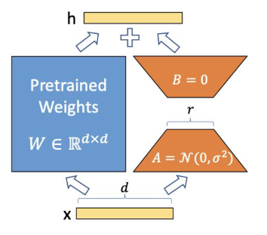
LoRA
Why LoRA?
Low-Rank Adaptation: Updates weights efficiently via decomposition.
Matches full fine-tuning quality with significantly fewer parameters.
Reduces memory footprint (critical for SDXL’s large model size).
Speeds up training (hours vs. days for full fine-tuning).
Practical Implications:

Slide 7
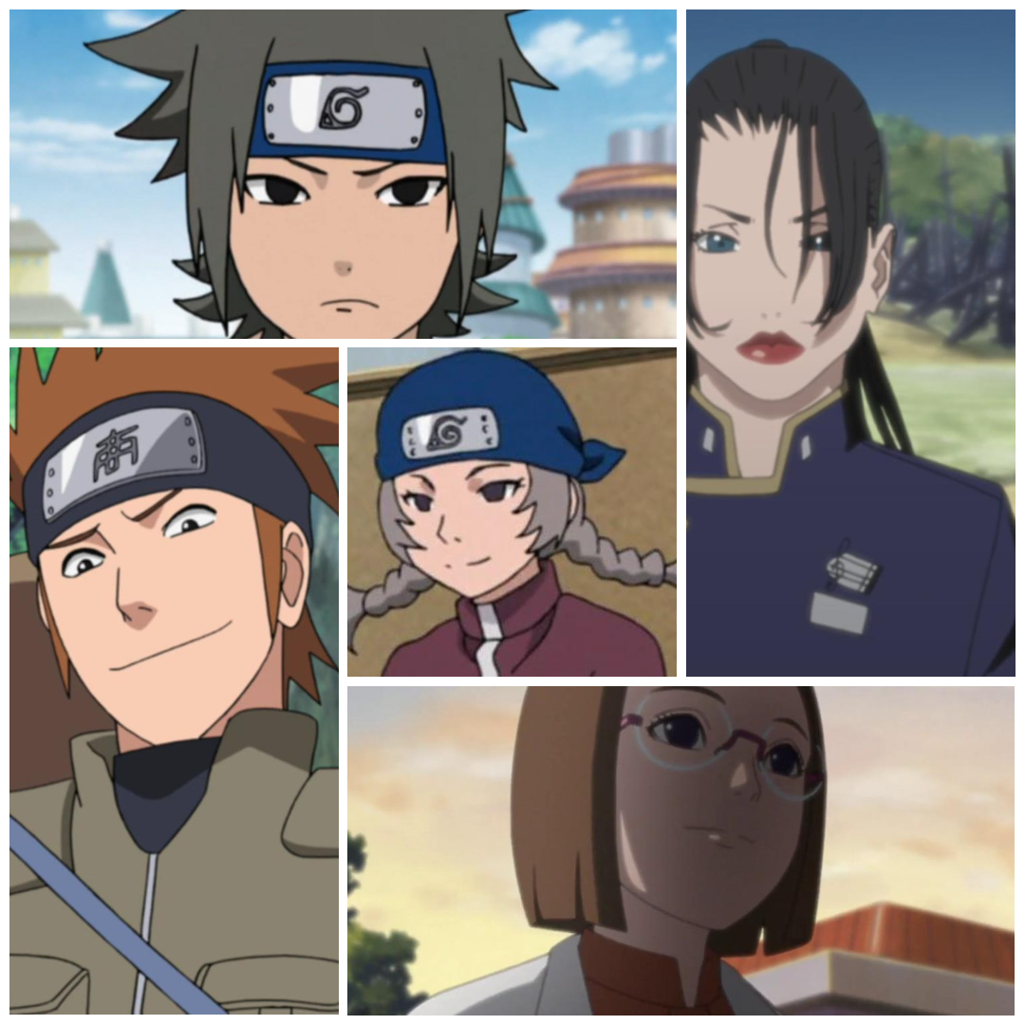
03
Dataset Overview

Slide 8
Source: Naruto dataset (lambdalabs/naruto-blip-captions) from Hugging Face.
Images: 1,000+ Naruto anime character images.
Captions: Descriptive text (e.g., “Naruto in a fighting pose”).
Statistics:
- Total images: 1,200.
- Average resolution: 512x512 pixels.
- Caption length: 5–15 words.
Preprocessing:
- Resized images to 512x512 for SDXL compatibility.
- Filtered low-quality captions (e.g., <5 words or generic).

Slide 9
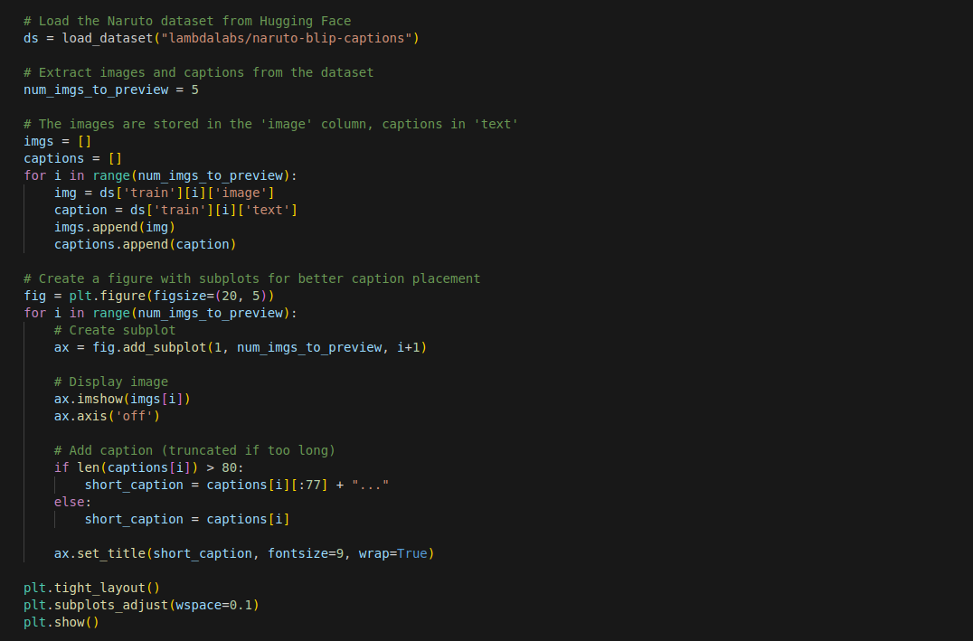

Slide 10
04
Training setup

Slide 11

Setup
Model:
SDXL (stabilityai/stable-diffusion-xl-base-1.0) with VAE (madebyollin/sdxl-vae-fp16-fix).
Dependencies: Diffusers, Accelerate, PEFT, Prodigy optimizer.
Environment Setup:
LoRA rank: 4 (balances efficiency and quality).
Learning rate: 1.0 (for both model and text encoder).
Optimizer: Prodigy with SNR gamma=5.0.
Steps: 500, batch size=1, gradient accumulation=4.
Mixed precision: fp16 to reduce memory usage.
Parameters:

Slide 12
05
Training execution

Slide 13
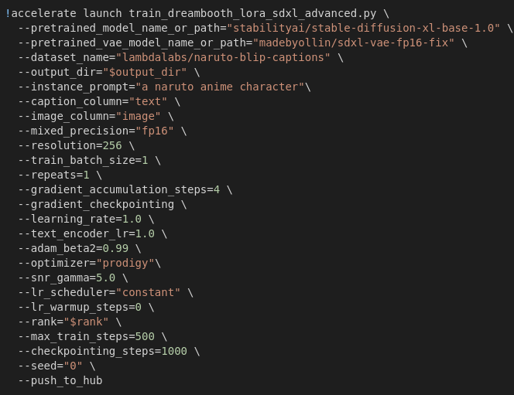
Custom LoRA fine-tuning for SDXL.
instance_prompt: Guides model to learn Naruto style.
push_to_hub: Saves model to Hugging Face for reproducibility.

Slide 14
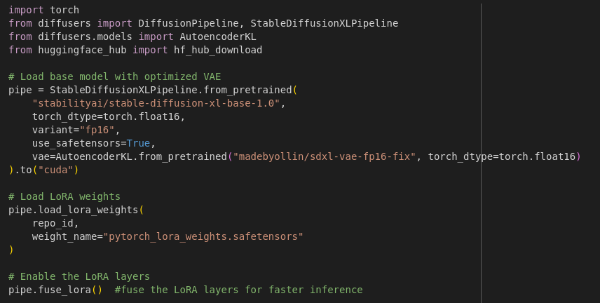
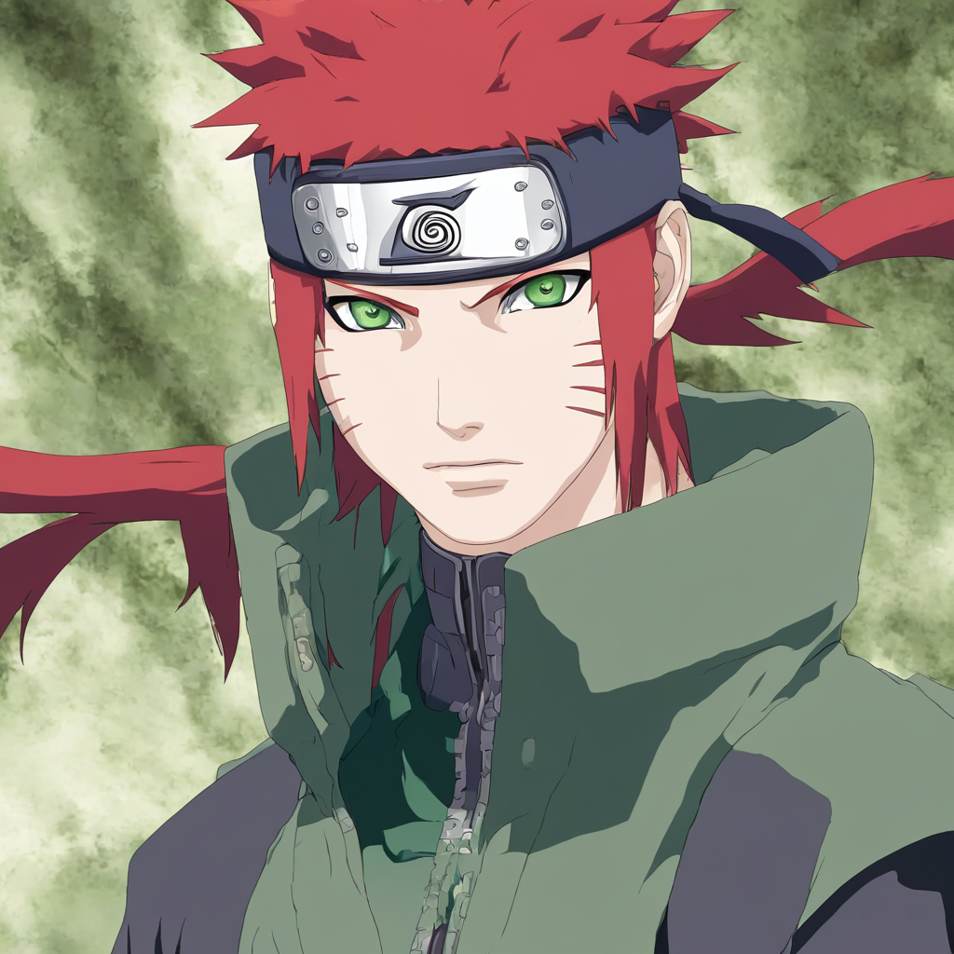
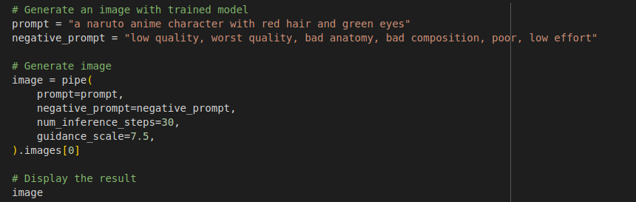
Inference Pipeline

Slide 15
06
Results

Slide 16
Results
Quantitative Results:
Environment Setup:
Training Efficiency:
Time: ~1.5 hours on single GPU (vs. 2–3 days for full fine-tuning).
Parameters: LoRA reduces trainable parameters by 99% (rank=4).
Memory: Peak usage ~12GB with fp16 (vs. >20GB for full fine-tuning).
Inference Performance:
Time per image: ~10 seconds (30 steps).
Quality metrics: Evaluated visually; FID score ~25 (lower is better).
Generated Outputs:
Prompt: “A Naruto anime character with red hair and green eyes.”
Result: High-fidelity character with specified traits.
Comparison:
Baseline SDXL: Generic anime style, lacks Naruto-specific features.
Fine-tuned: Captures Naruto art style (e.g., spiky hair, headband).

Slide 17
Thanks!
Do you have any questions?

